Slide 1
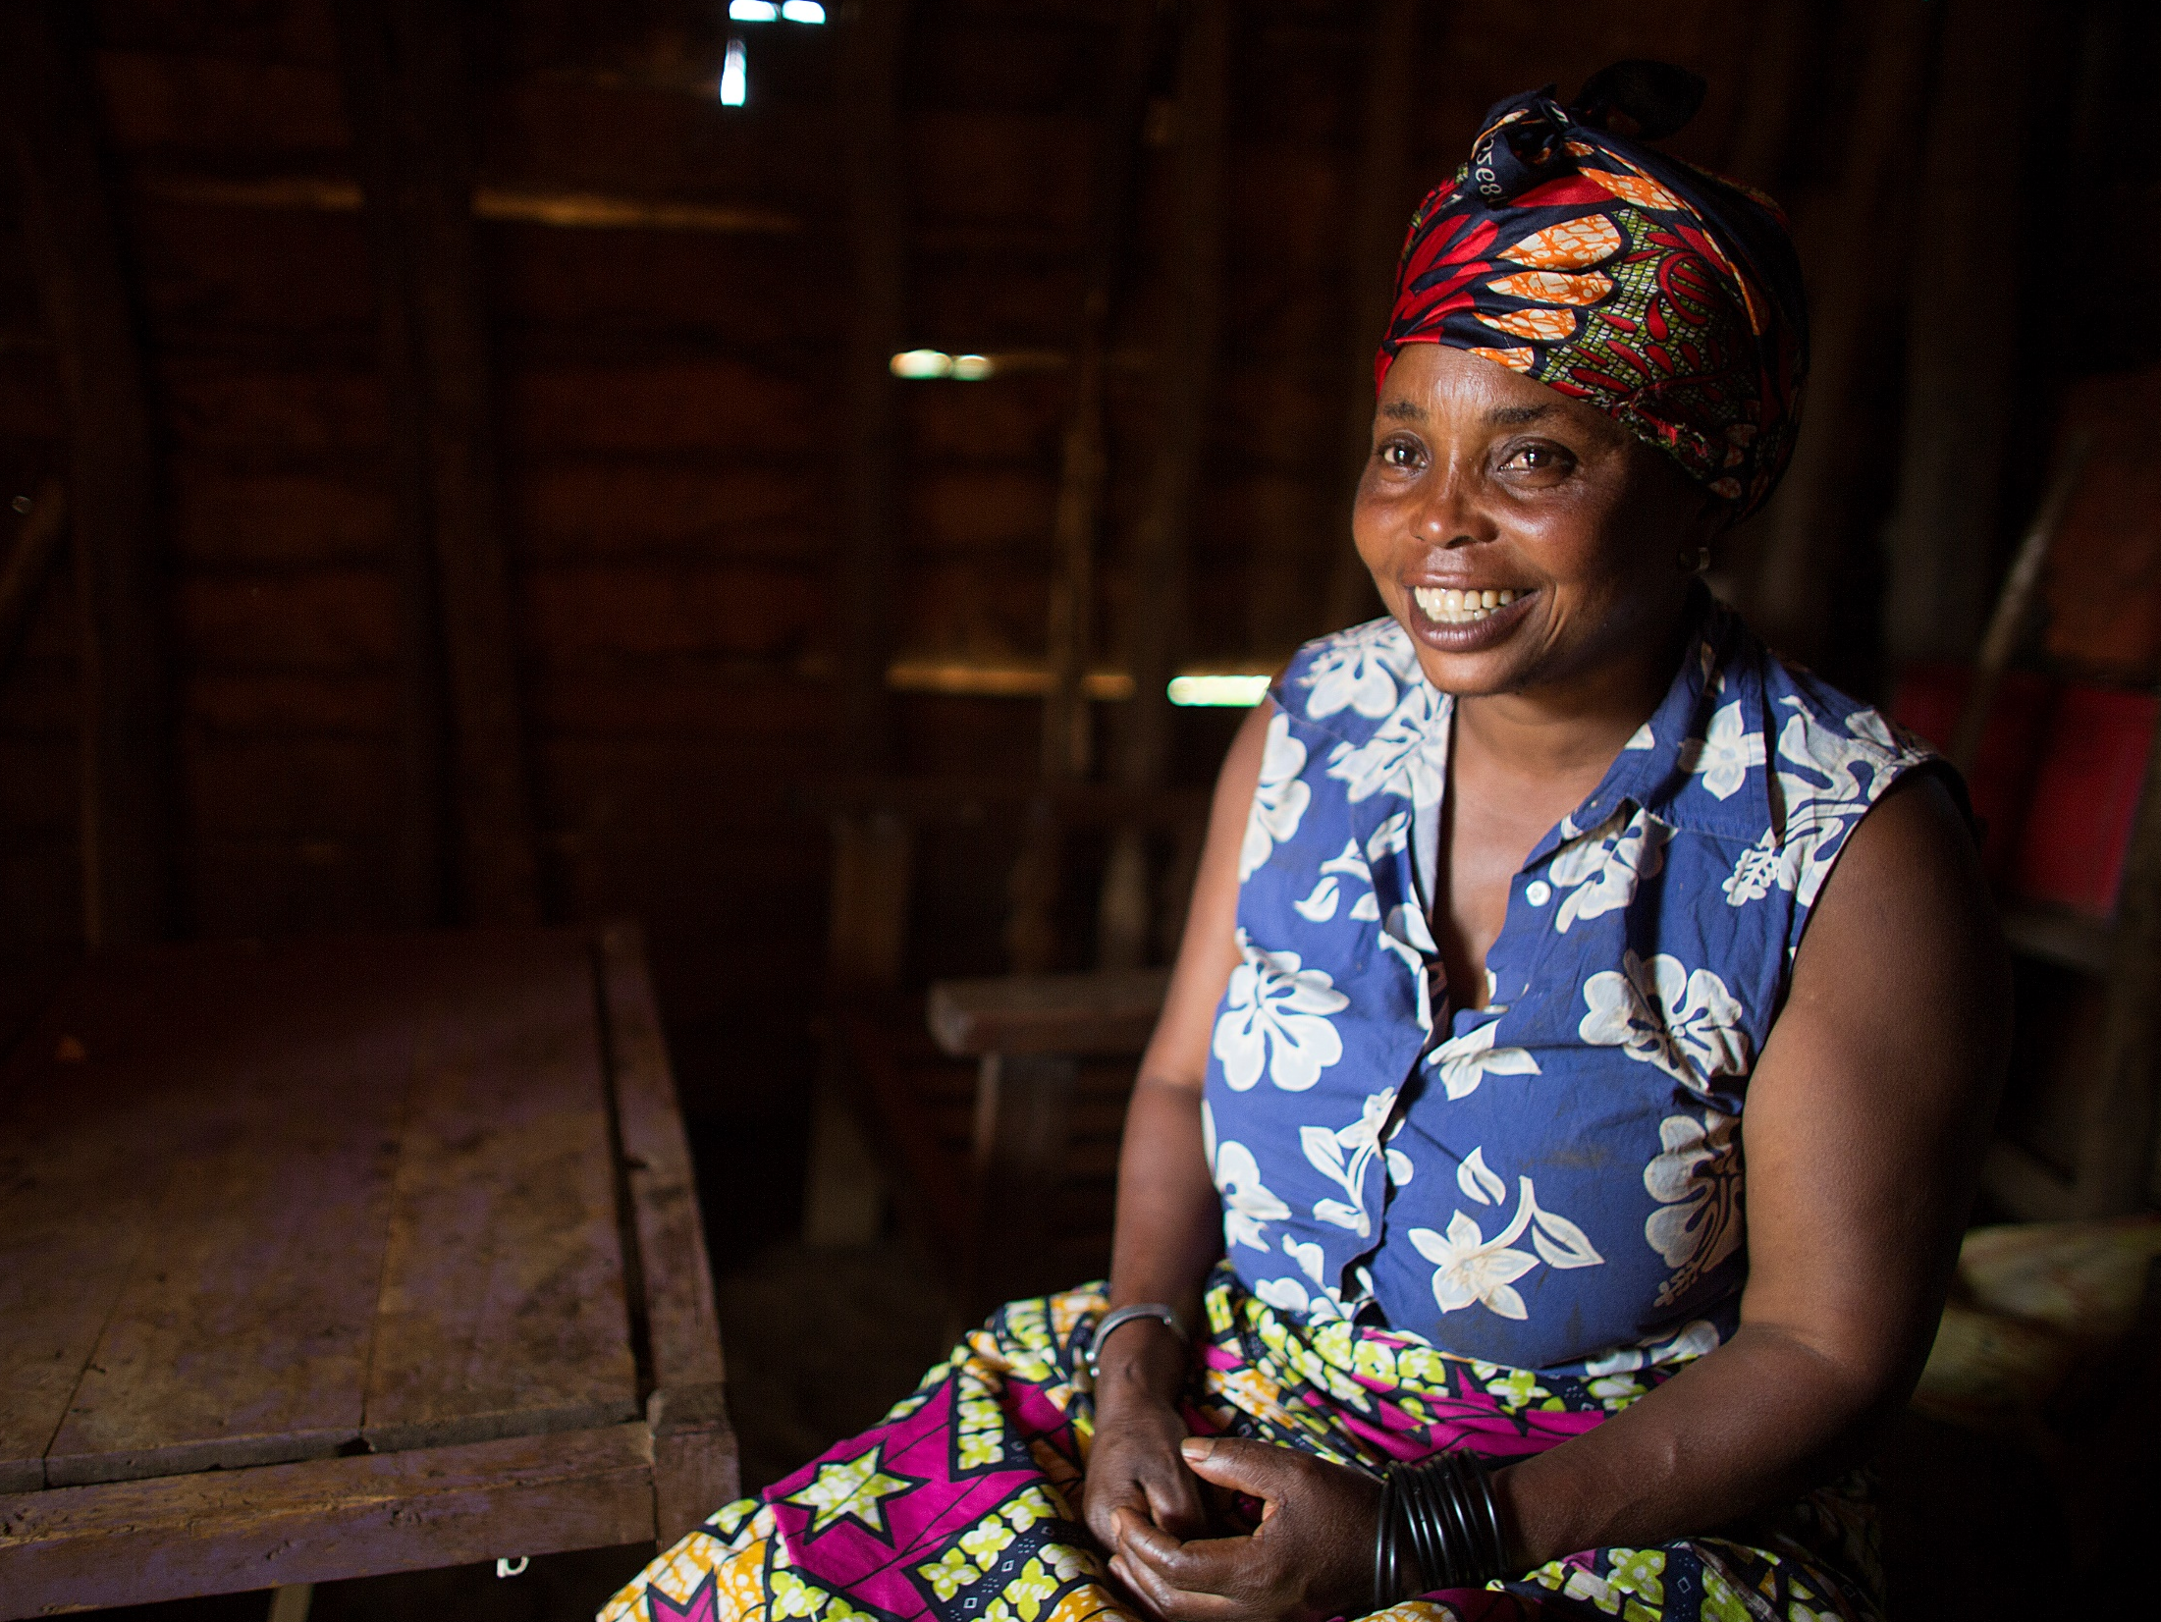



WEE BOX BIG CHANGE 2020
This year, your £1 = £2. Give before 20th May and all public donations to our WEE BOX BIG CHANGE appeal will be doubled by the UK government.
Notes:
Hello, my name is xxxxx and I’m a volunteer for the charity SCIAF. Today I’m going to talk to you about SCIAF’s work and show you some examples of how your generous donations have helped families around the world.

Slide 2



SCIAF
Day in the life – Christina
Notes:
This is Christina. She lives with her family in the Democratic Republic of Congo, in Africa.

Slide 3

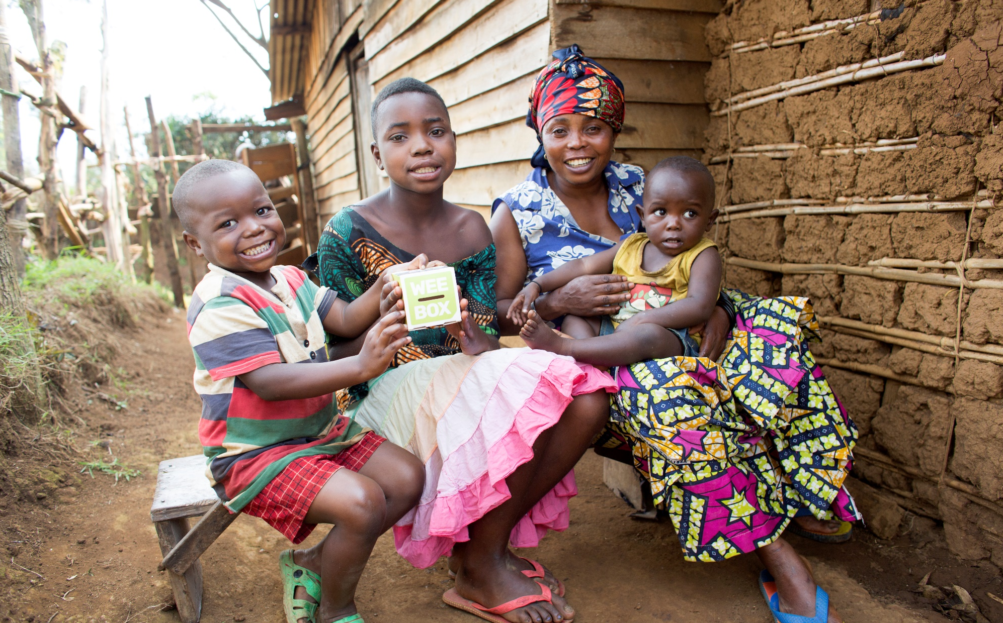
WEE BOX, BIG CHANGE 2020
Christina
Sylvia
Daniel
Jude
Notes:
Christina’s mum Sylvia is featured on the WEE BOX this year.
Christina lives with her mum and two nephews - Jude and Daniel. Jude is 4 years old and Daniel is 18 months old.
Her nephews are the sons of her older sister, Charlene.

Slide 4
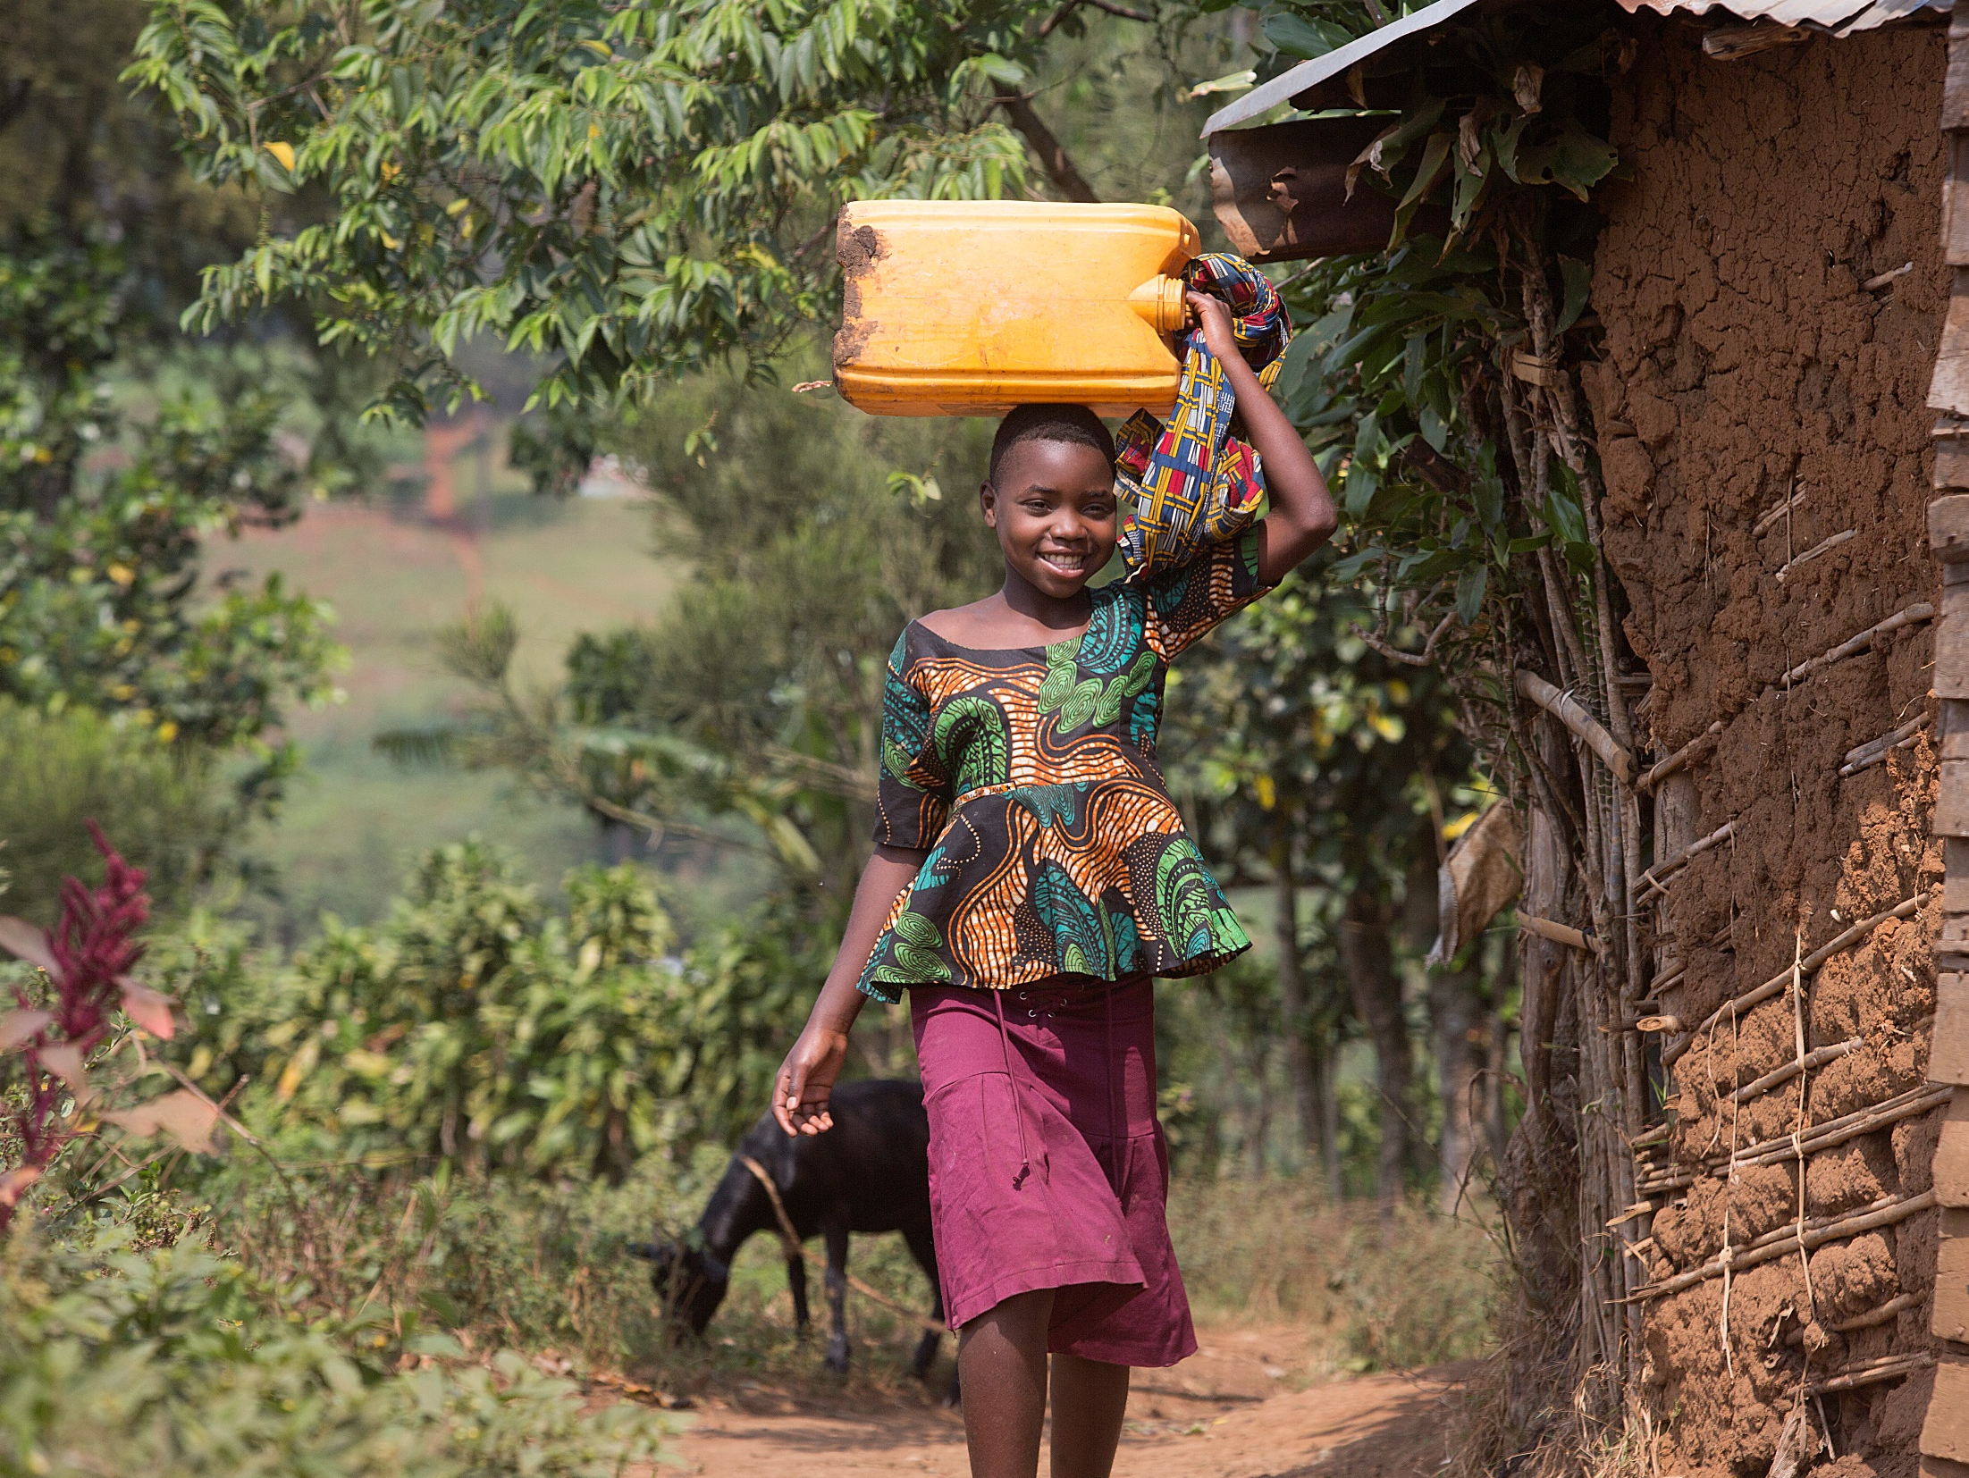
Notes:
Christina wakes up at 6am. She goes to collect water for the family.

Slide 5
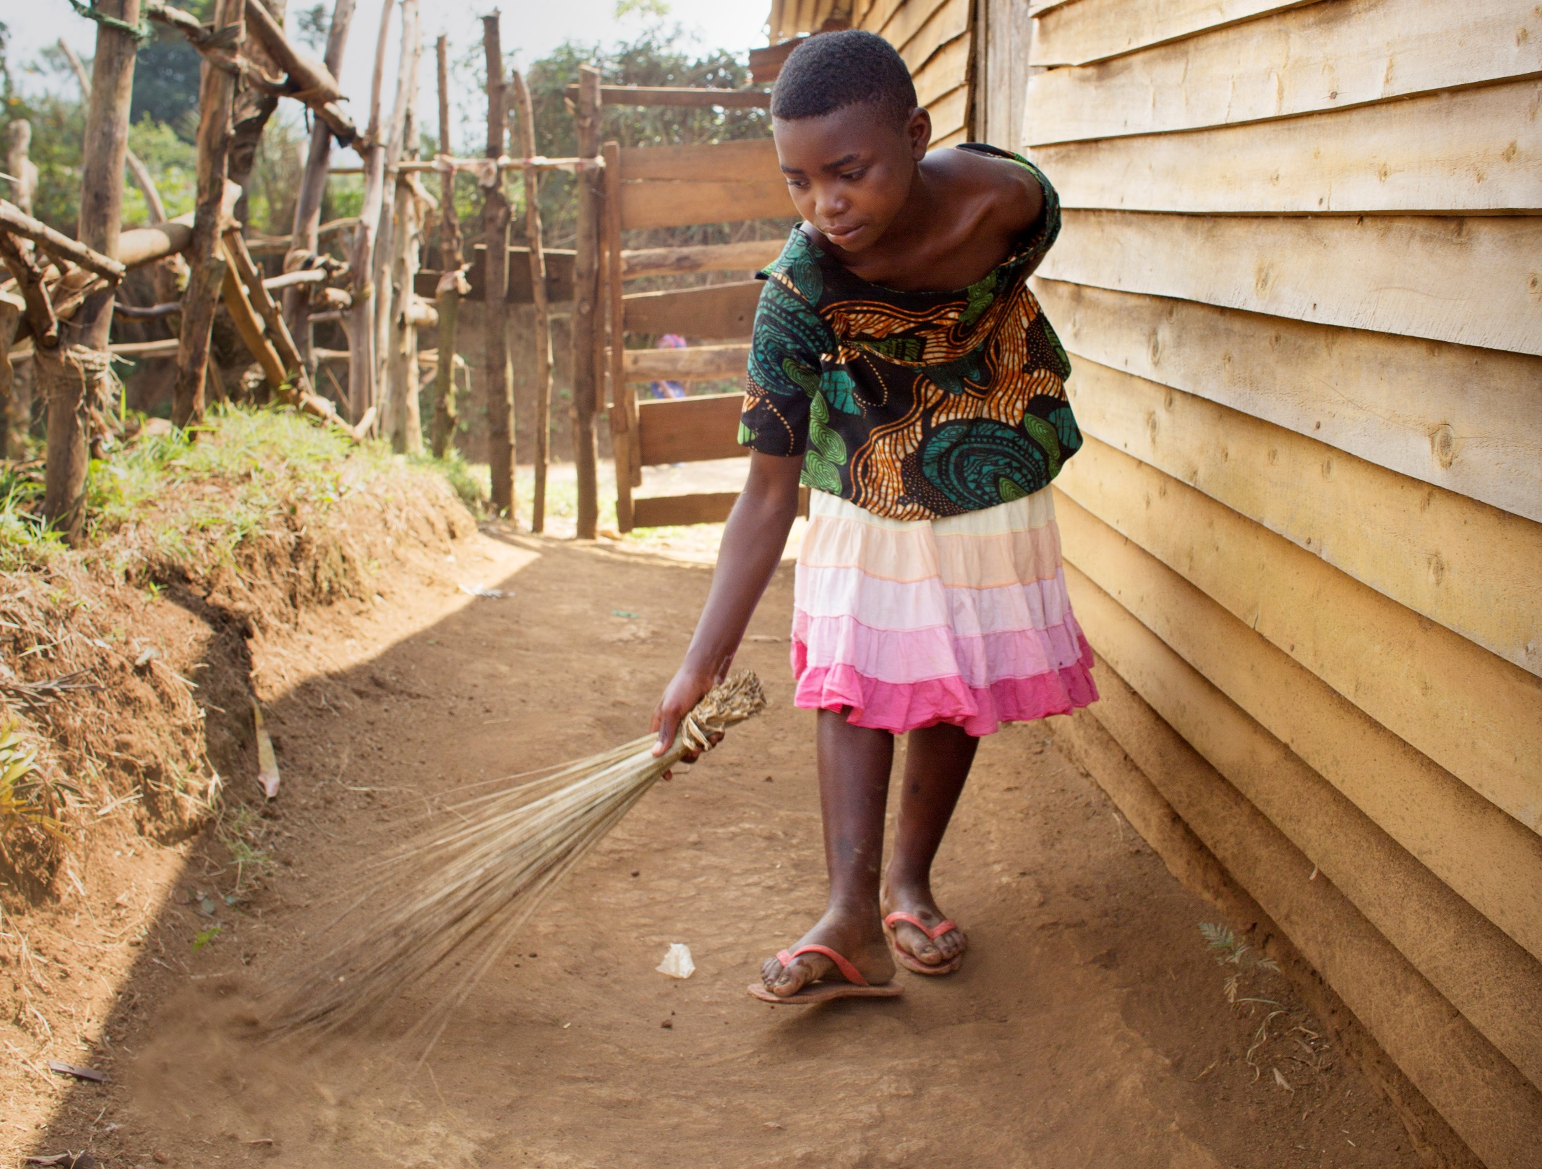
Notes:
Christina also helps her mum in the morning by sweeping up the house.

Slide 6
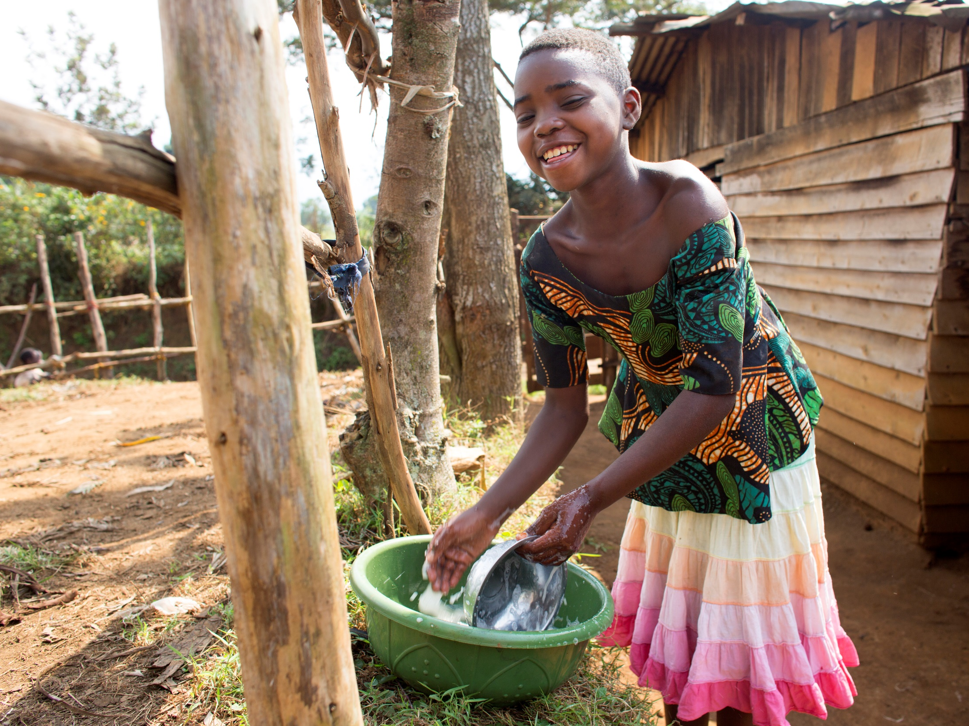
Notes:
Then she washes the dishes.

Slide 7
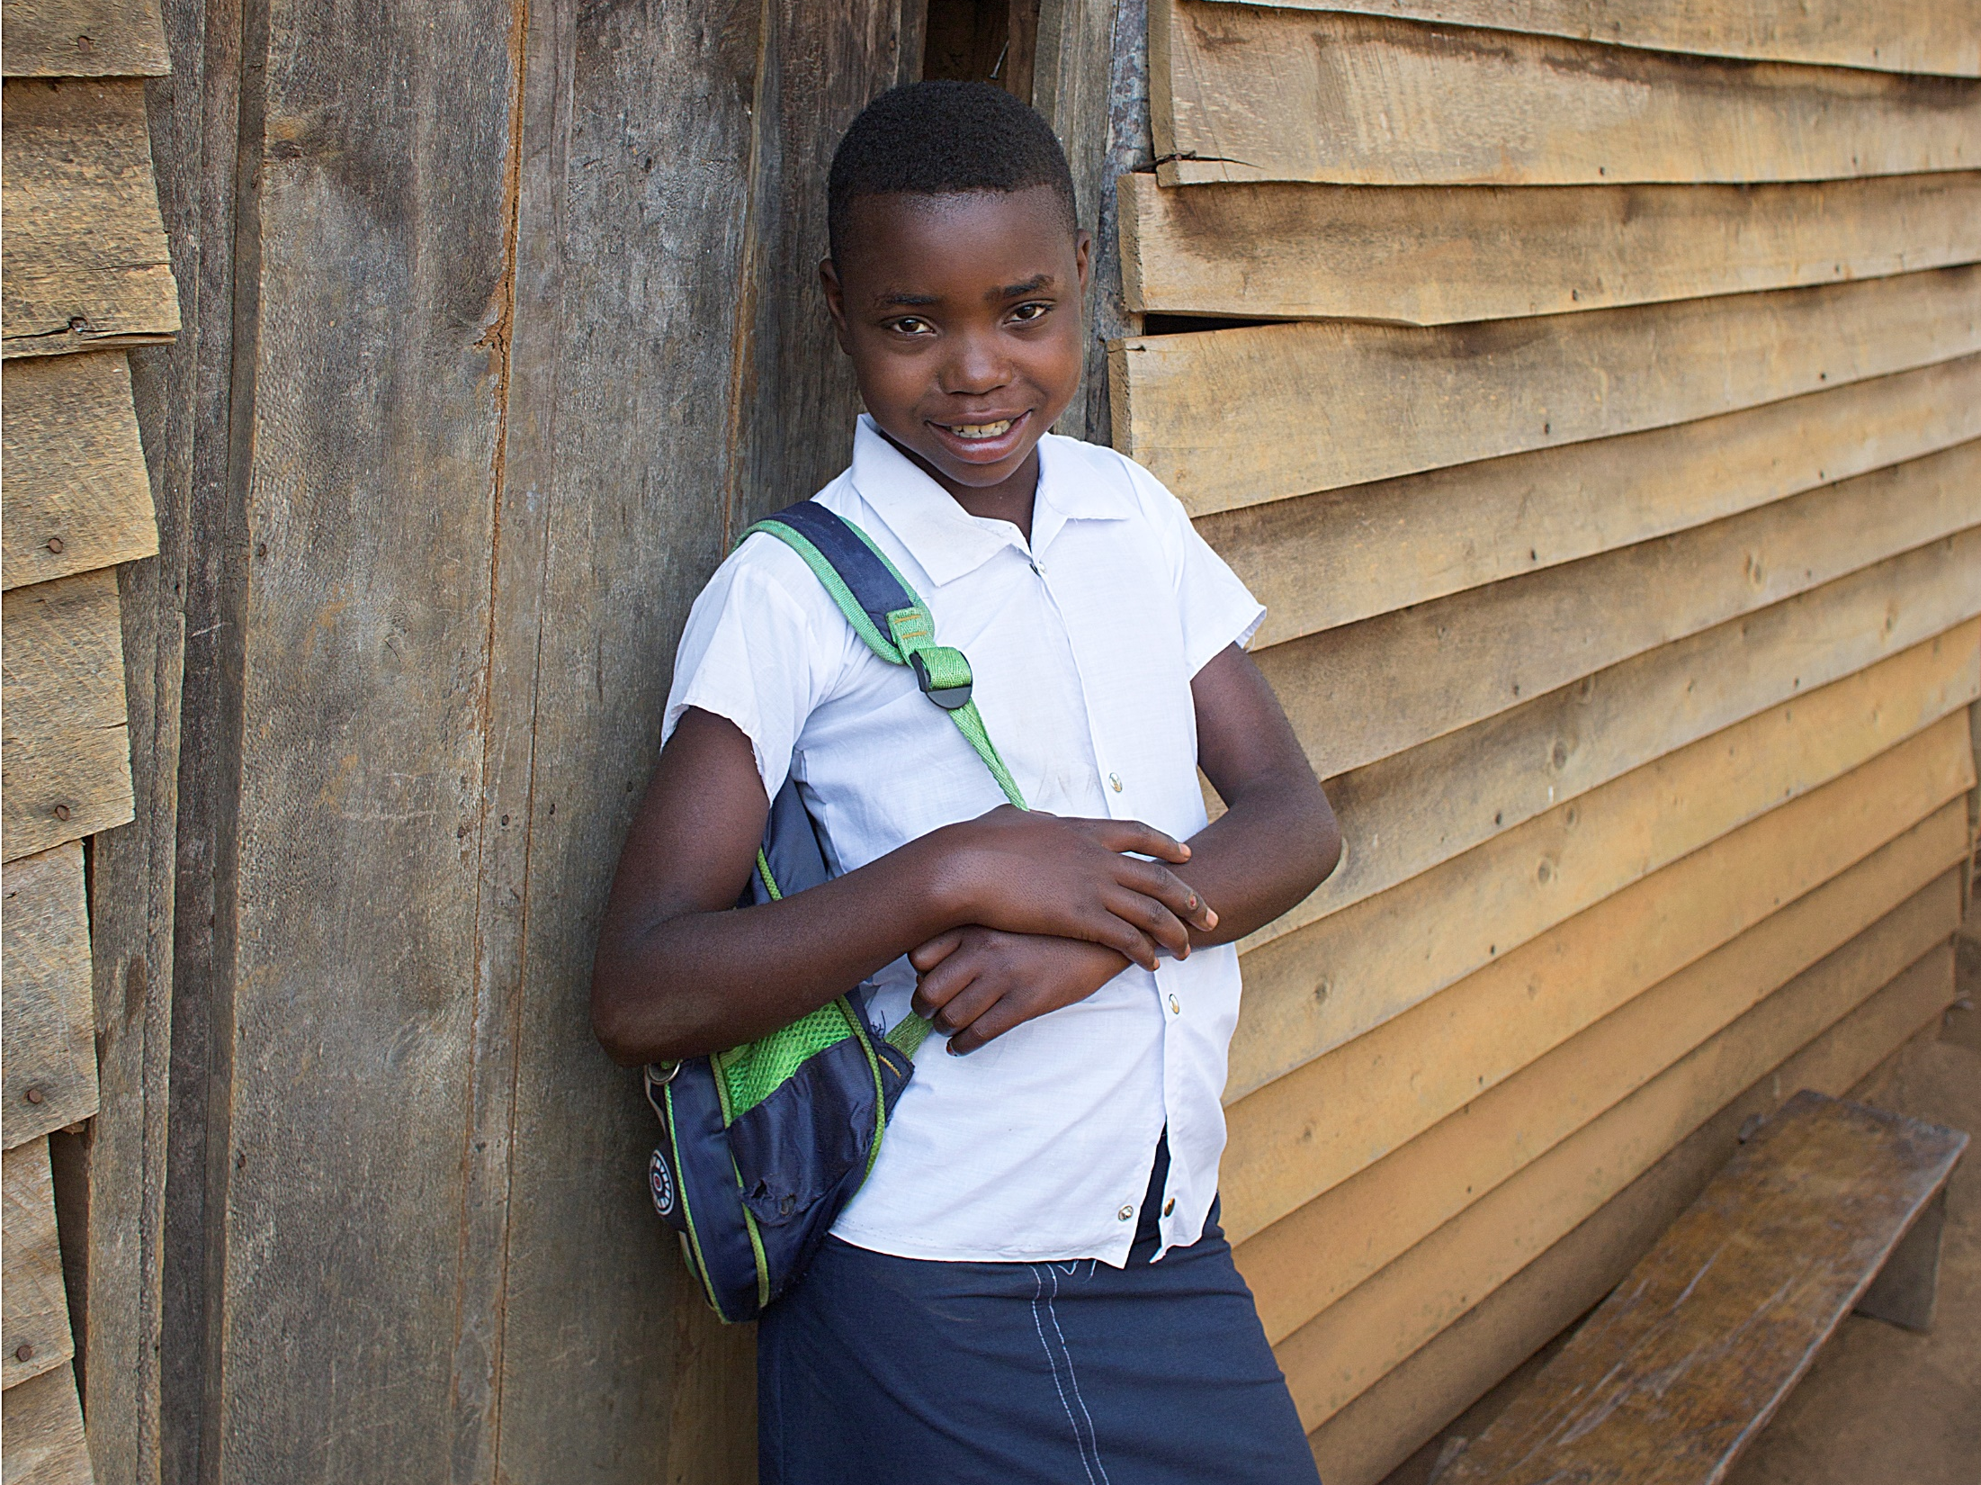
Notes:
Christina then takes a shower and gets dressed for school.

Slide 8
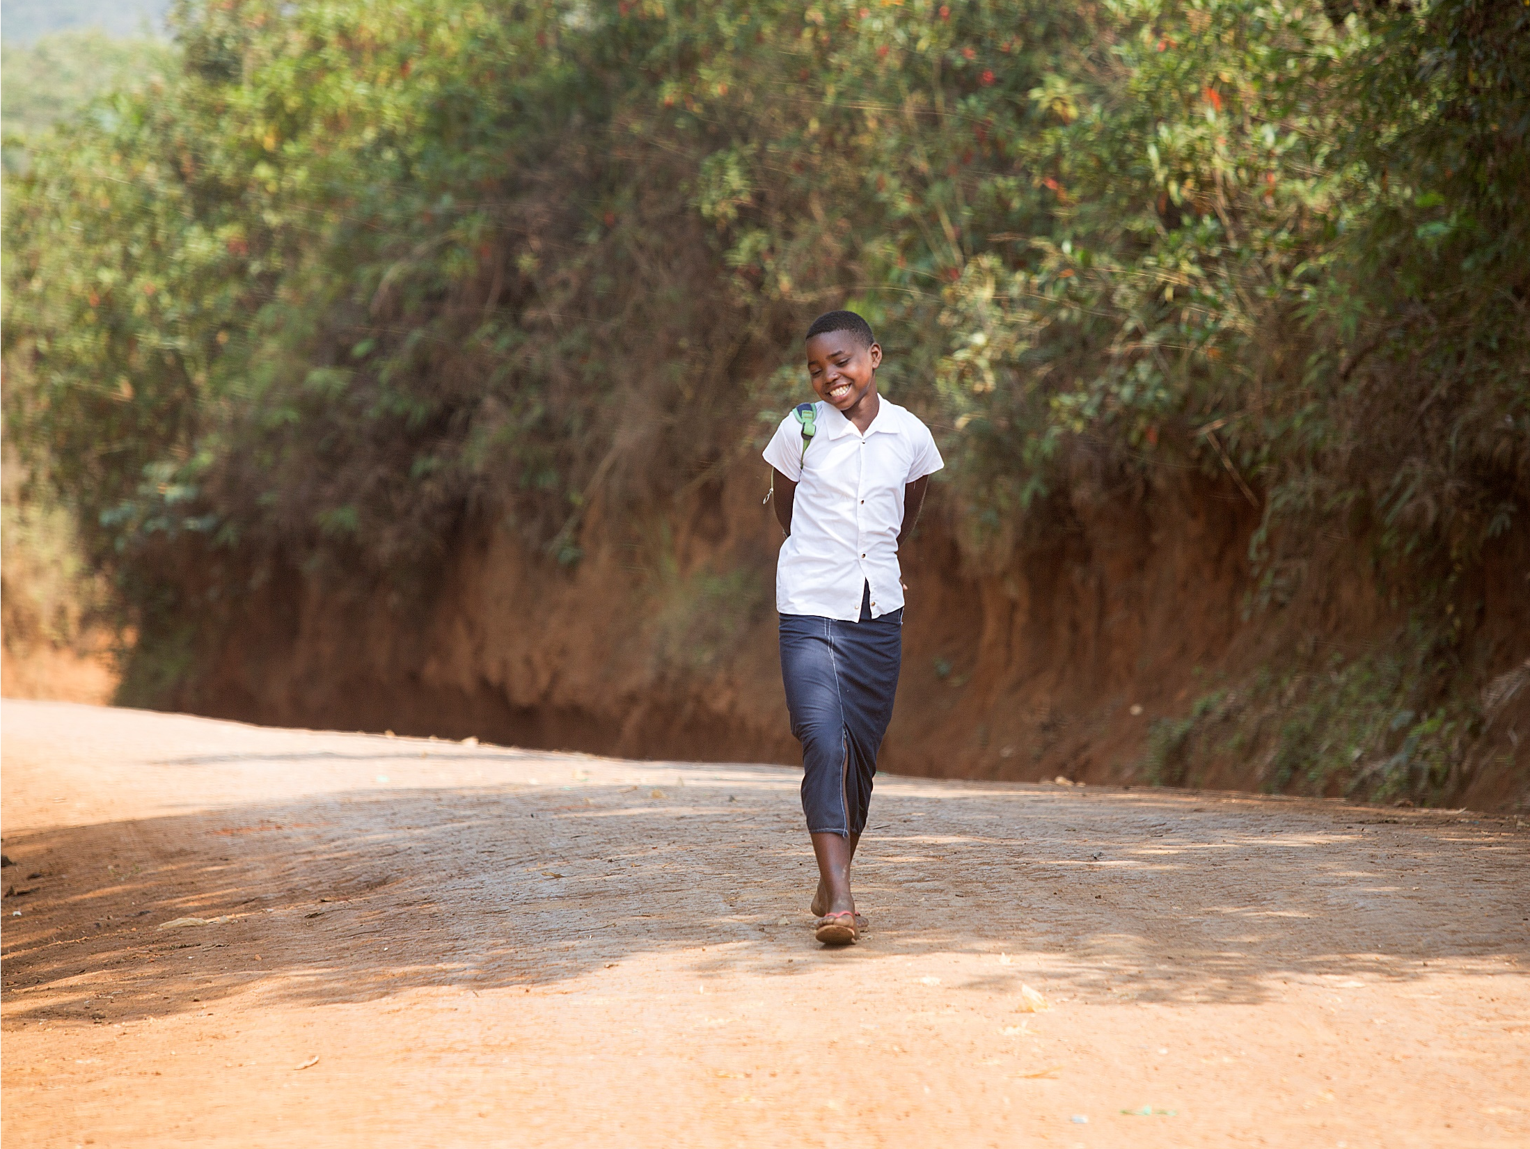
Notes:
Christina walks for one hour to get to school.

Slide 9
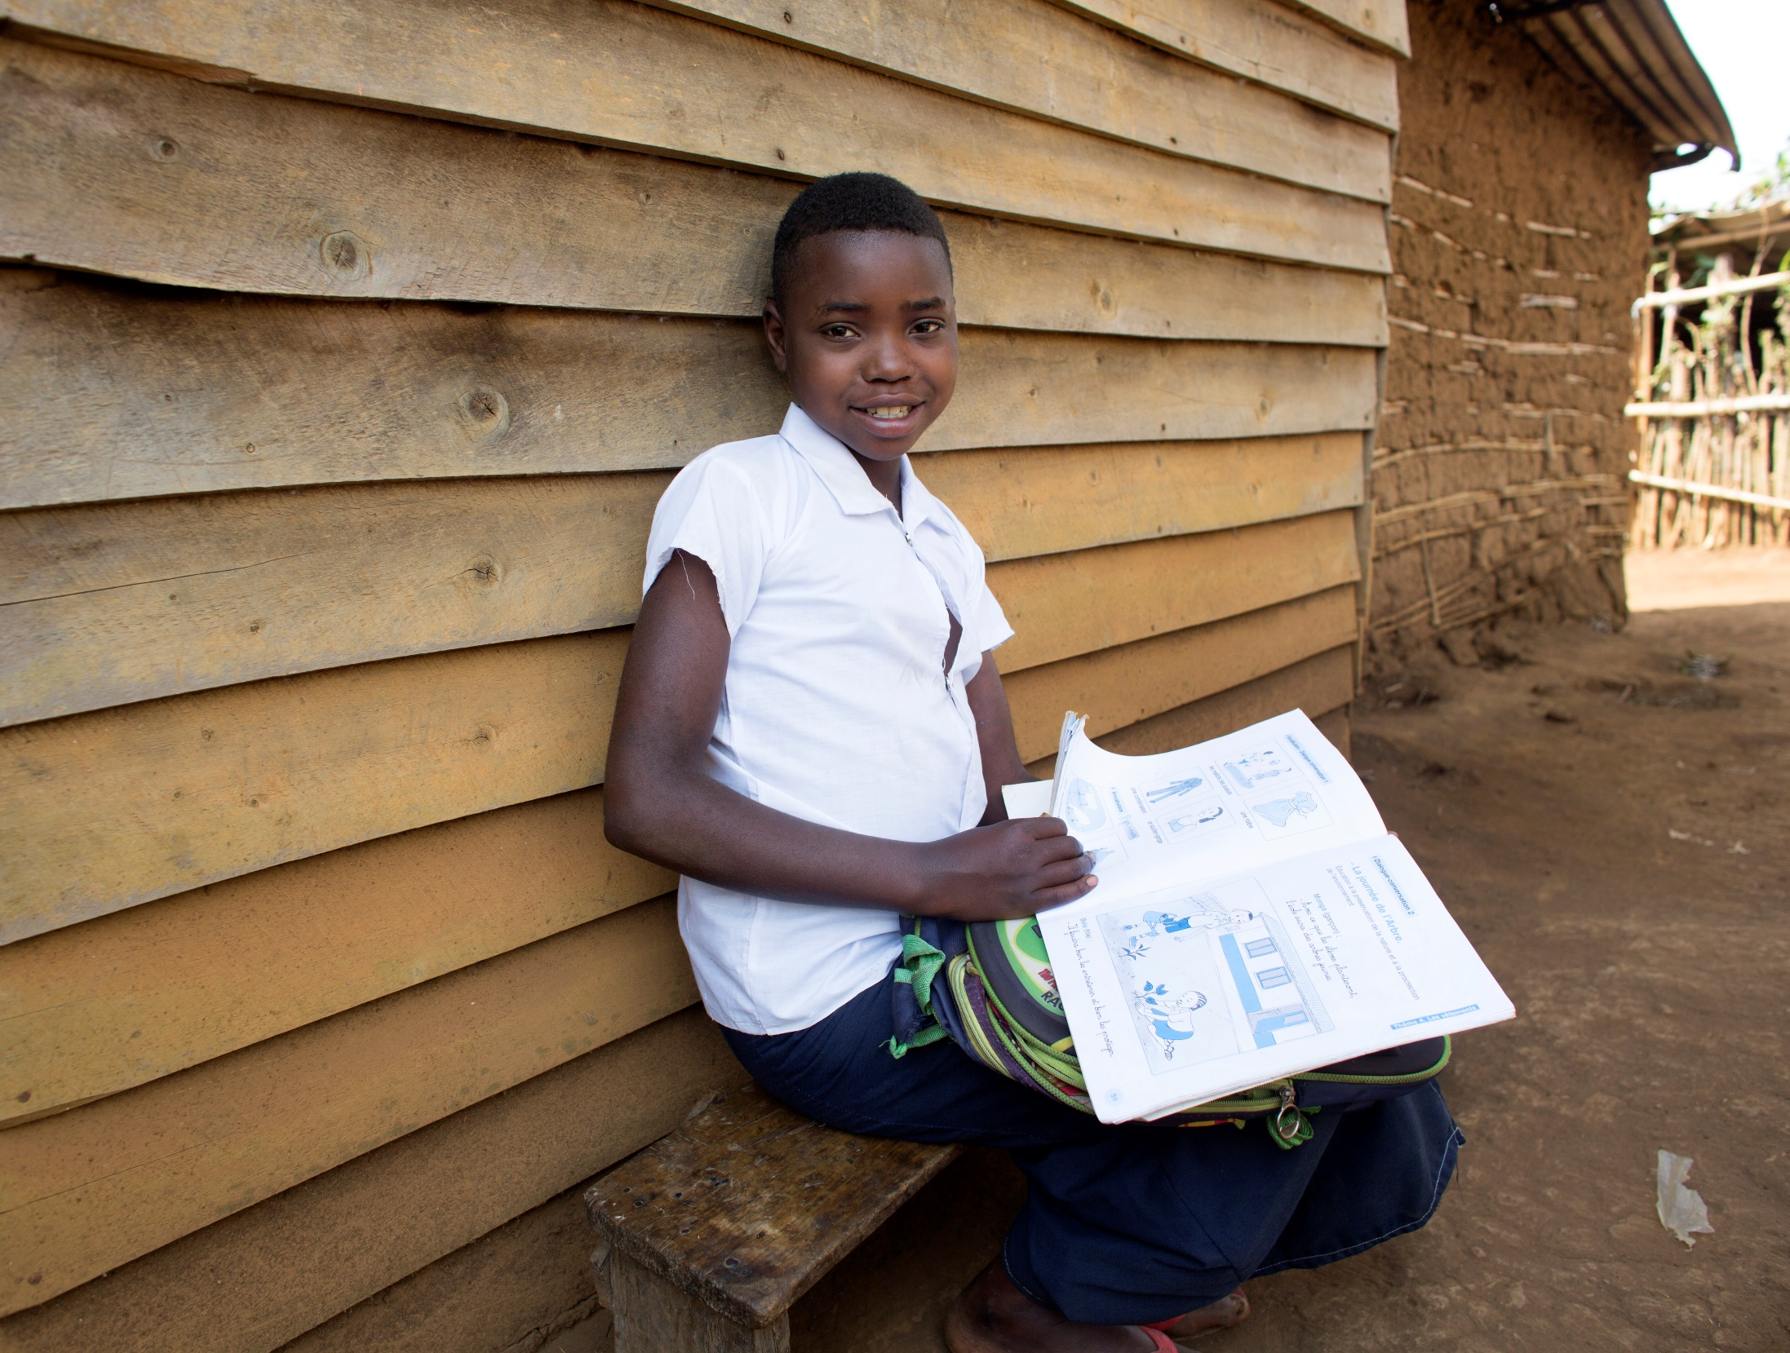
Notes:
She studies French, mathematics, grammar, music, handwriting and sciences. But her favourites subjects to study are geography and history.

Slide 10
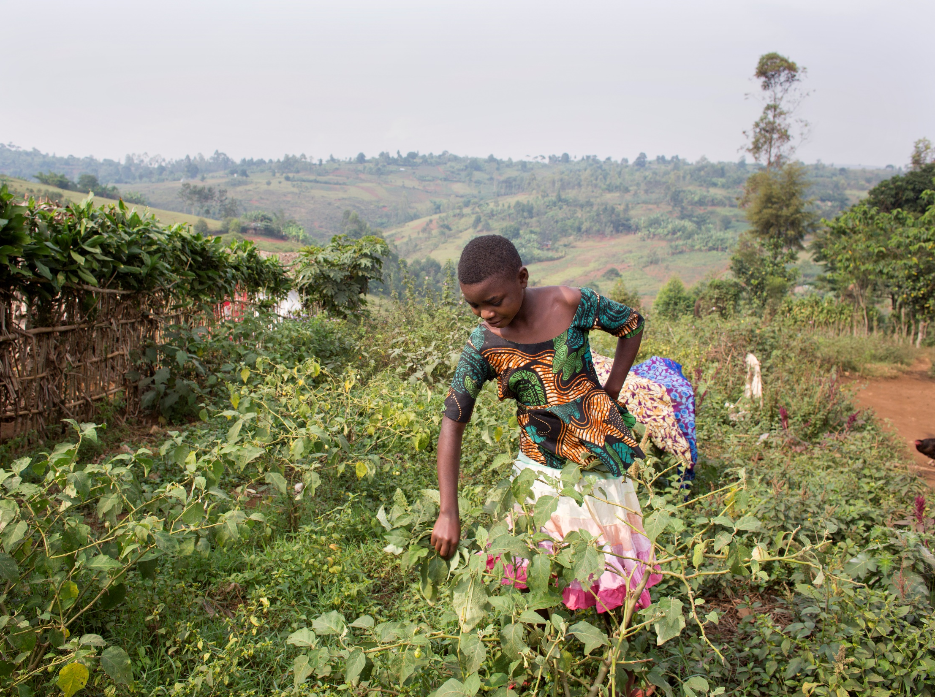
Notes:
After she returns from school, Christina helps her mum by bringing manure to the field and picking vegetables.

Slide 11
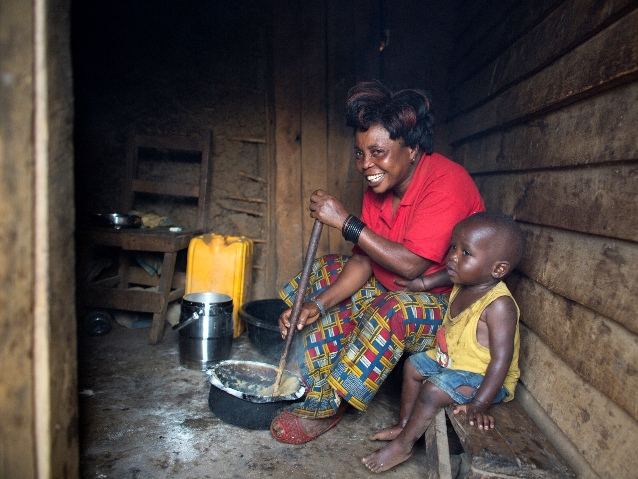
Notes:
Her mum cooks dinner for the family.

Slide 12
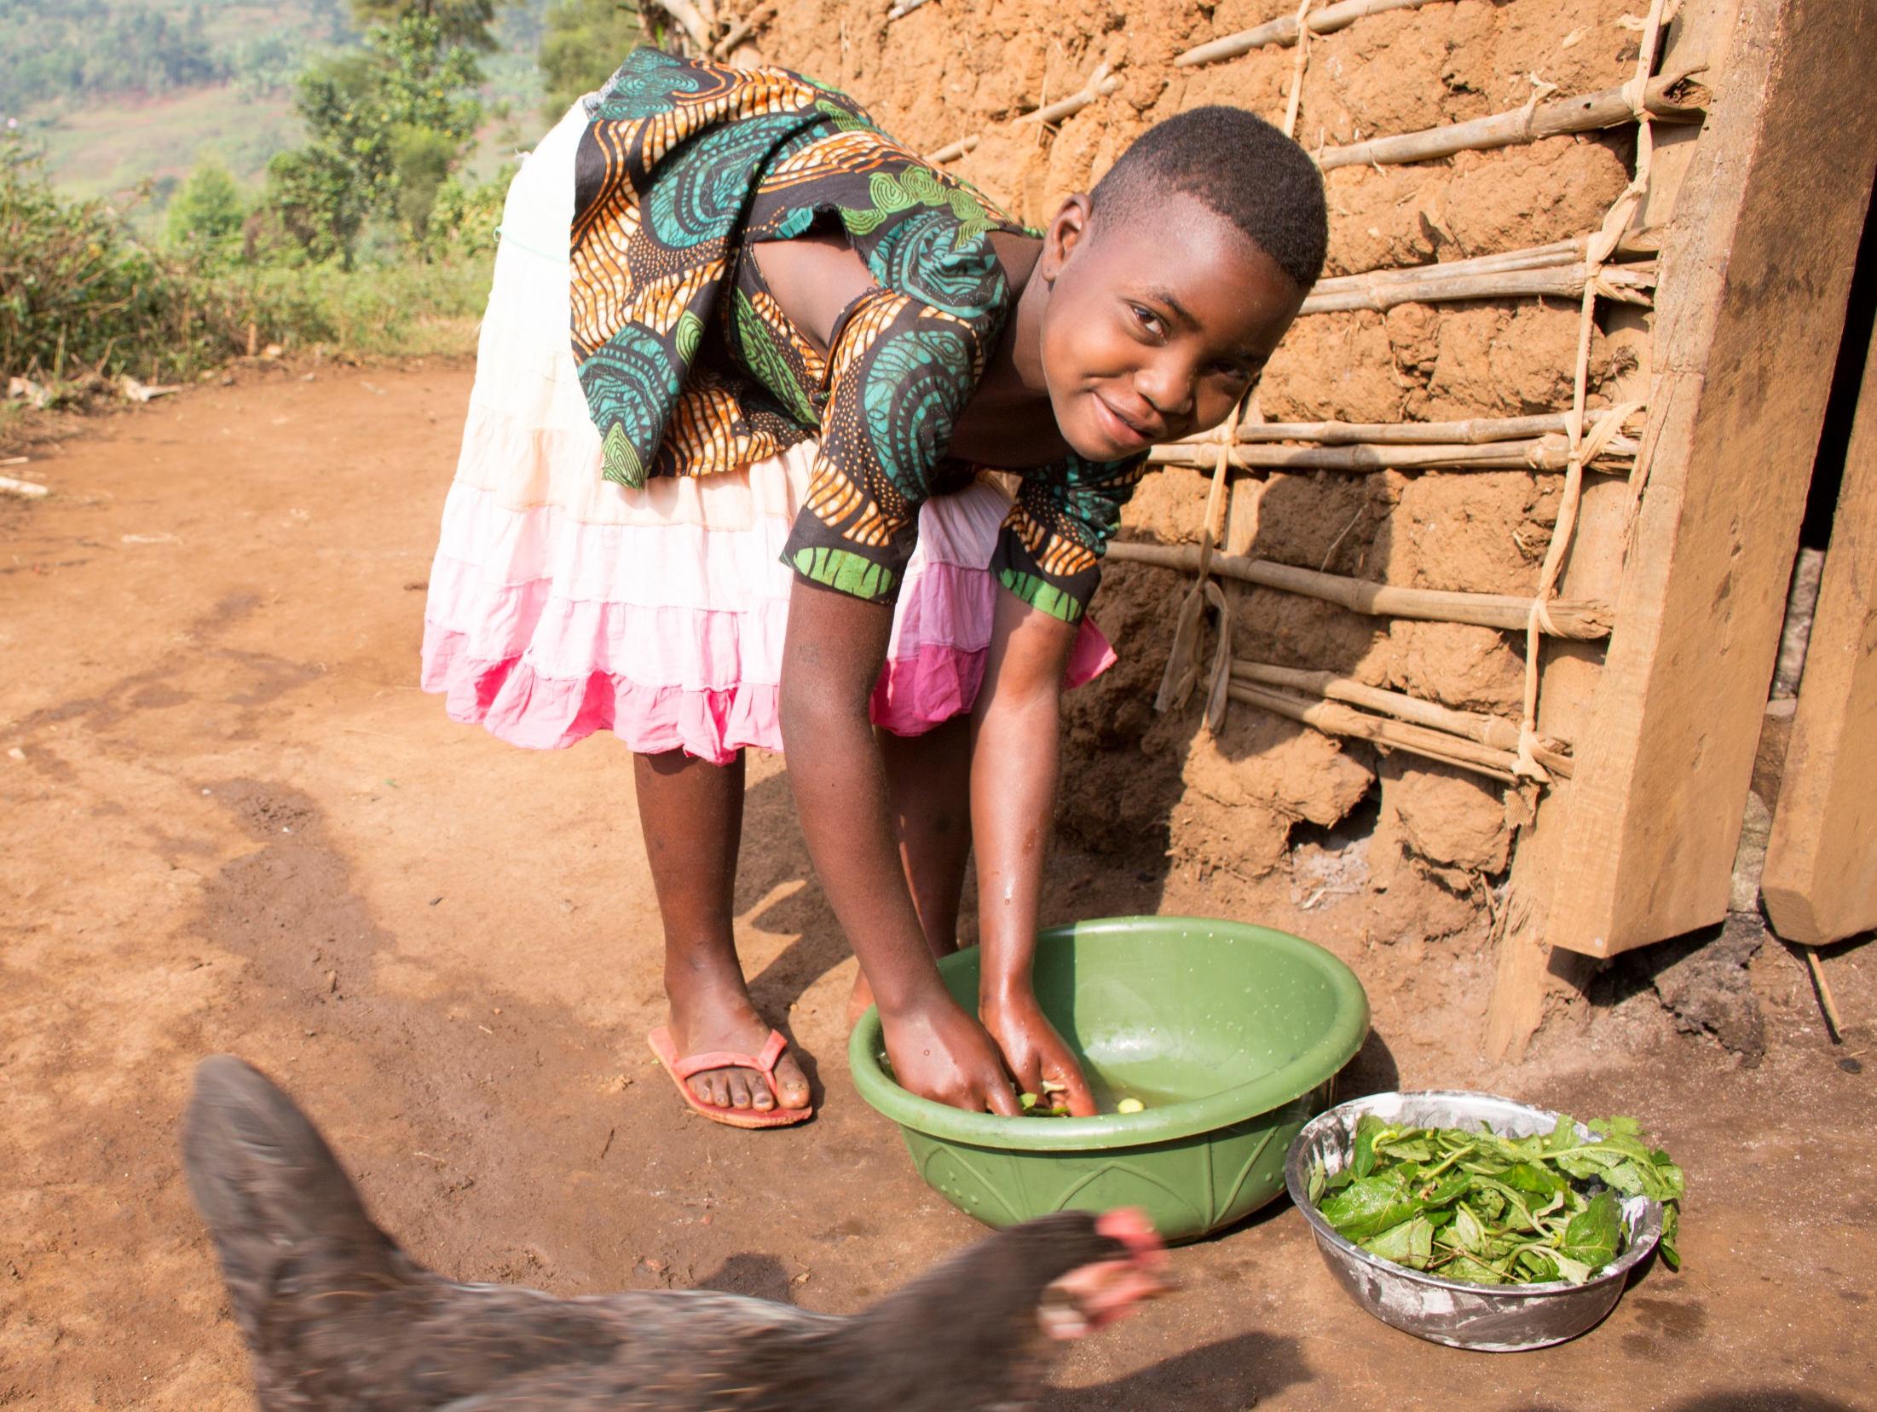
Notes:
Christina helps to prepare dinner. The family eat different vegetables like amaranth, cabbage, aubergine and cassava, plus bread.

Slide 13
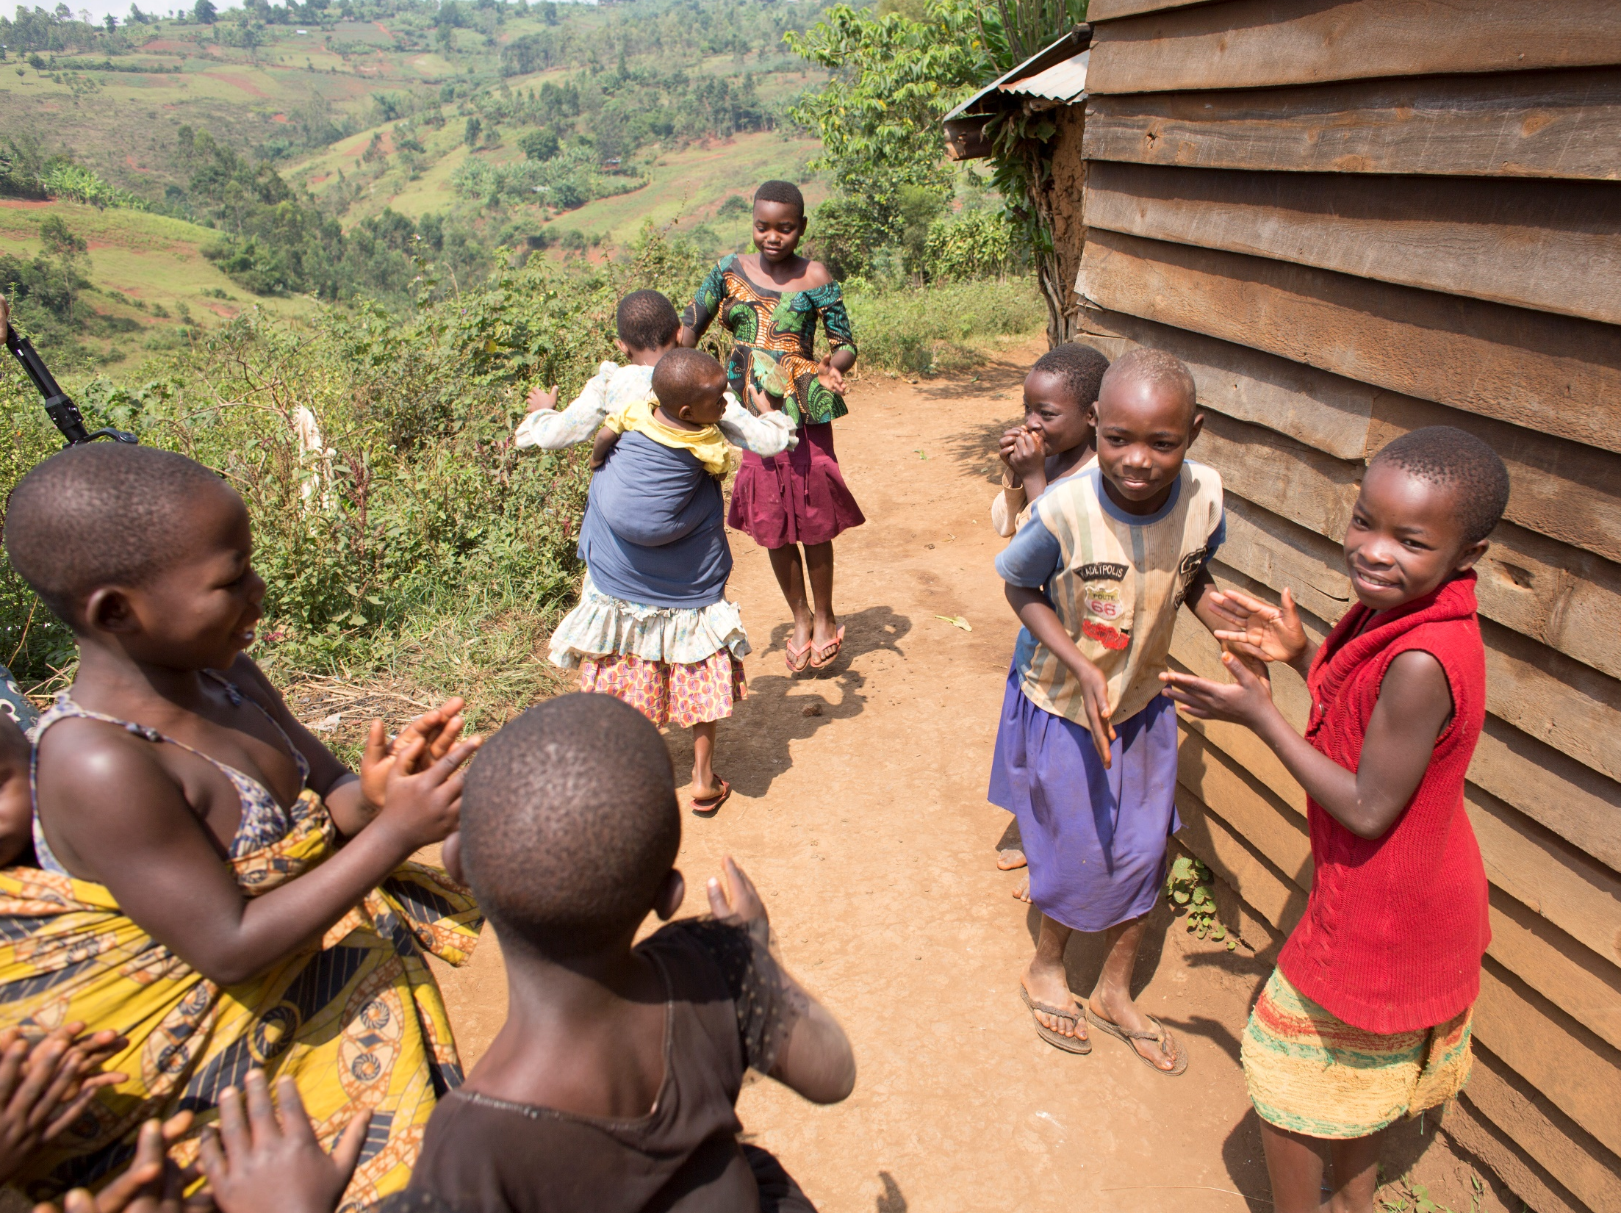
Notes:
Christina’s friends live close by and they play a game called Kange.
She goes to bed at 8pm

Slide 14
Notes:
When she grows up, Christina wants to be a doctor so she can cure peoples illness.

Slide 15

Thank you
We want a world without poverty, where the poorest can survive and thrive.
SCIAF
7 West Nile Street, Glasgow, G1 2PR
0141 354 5555
www.sciaf.org.uk
schools@sciaf.org.uk
Names changed to protect identities.
Photos: Angela Catlin, DR Congo 2019
Notes:
Thank you for supporting SCIAF. We couldn’t do our work supporting families like Christina’s without your help!

