Slide 1


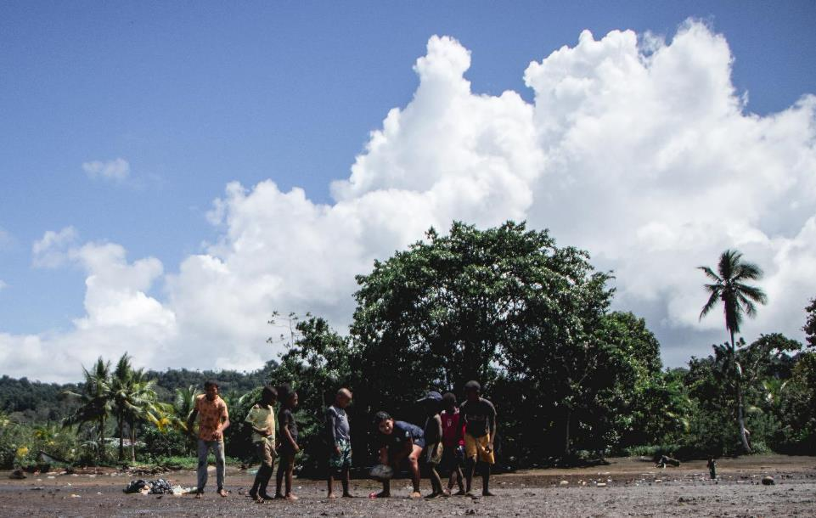


Advent 2022
1st December
2nd December
3rd December
4th December
5th December
6th December
7th December
8th December
9th December
10th December
11th December
12th December
13th December
14th December
15th December
16th December
17th December
18th December
19th December
20th December
Rugby training on the
Pacific Coast, Colombia

Slide 2
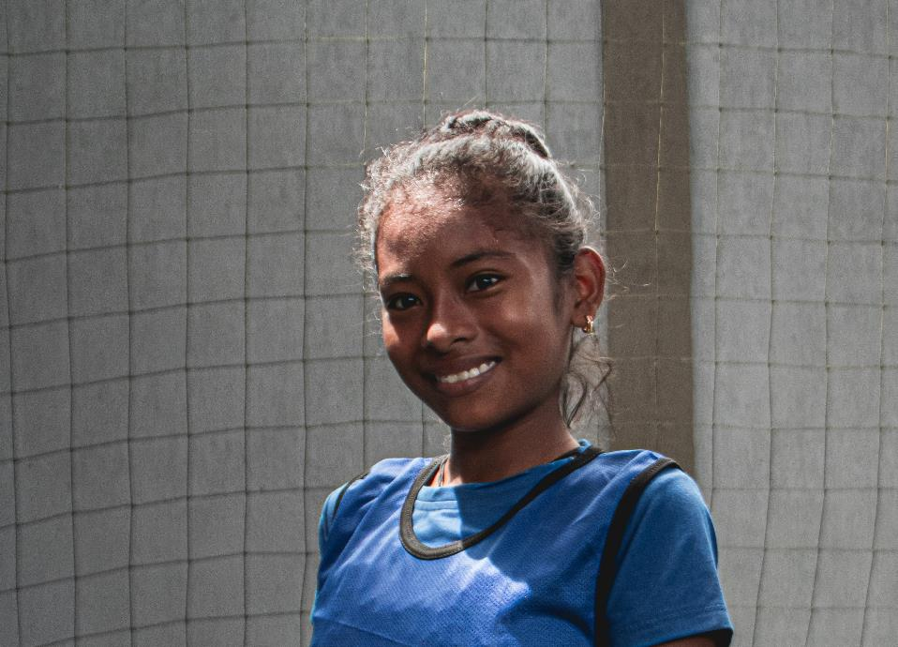
Advent 2022
21st December
“For a Child has been born for us, a son given to us; authority rests upon his shoulders; and he is named Wonderful Counsellor, Mighty God, Everlasting Father, Prince of Peace.”
Isaiah 9:6
22nd December
23rd December
24th December
Mariana, Colombia

Slide 3
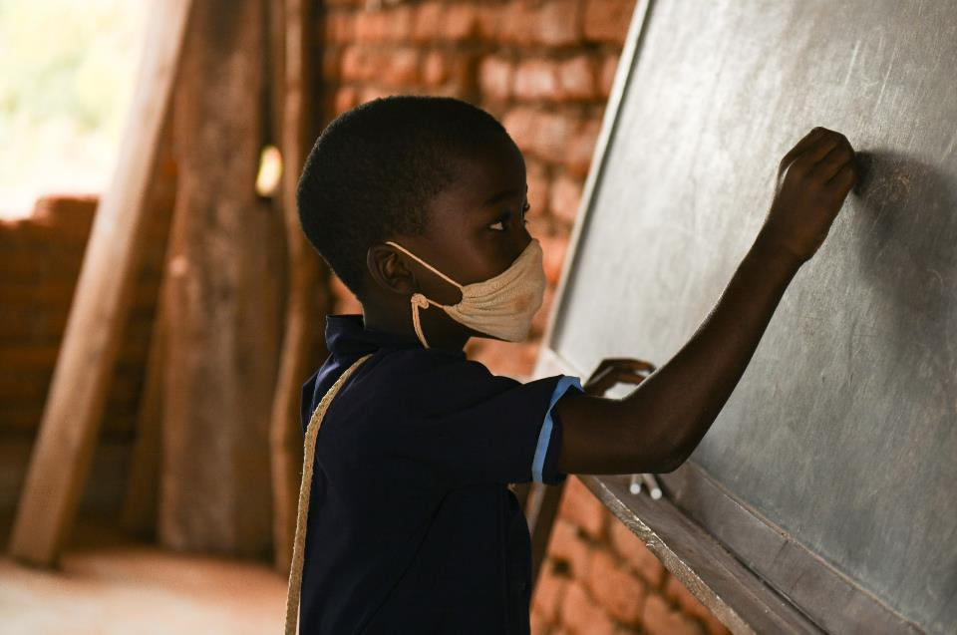

1st December
Father God,
We thank you for the gift of a child born to us and for us.
Your Son Jesus, Immanuel, God is with us!
A gift of grace given because you love us.
Help us this Advent to prepare our hearts to accept this gift and to share it with others.
Amen
Calendar
Grade one pupil, Malawi

Slide 4
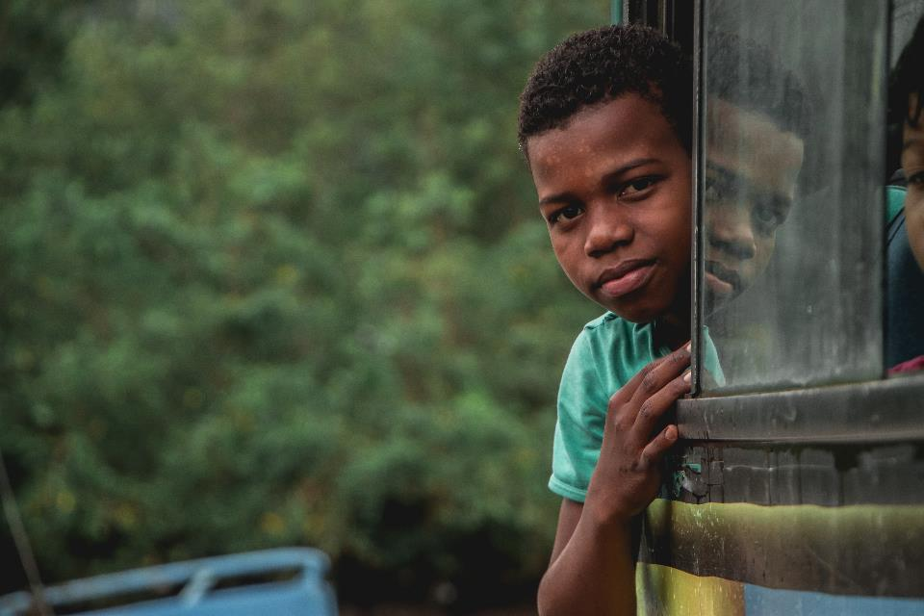
2nd December
God of Love,
As I prepare to celebrate the birth of your son, Jesus, open my heart to the needs of others.
Help me to respond with love and compassion to the cries of my sisters and brothers around the world, and to the cries of the earth itself.
Amen
Calendar
Rugby for Peace, Colombia

Slide 5
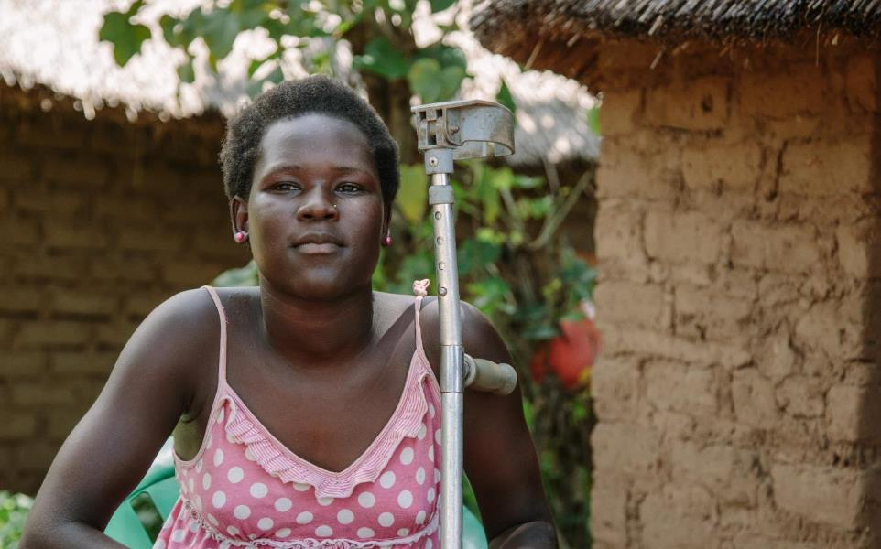

3rd December
SCIAF are supporting young people like Vaida, who are living with disabilities in South Sudan .
Dear Lord,
This Advent open my heart to the needs of others.
Help me to respond with love, compassion and action.
Amen
Vaida, South Sudan
Calendar
UN International Day of Persons with Disabilities

Slide 6
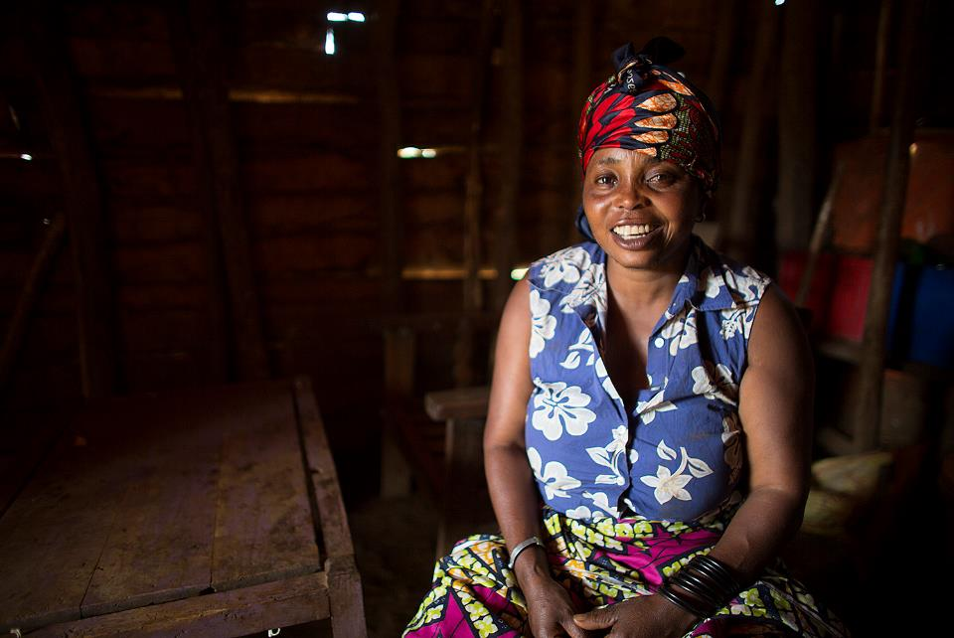
4th December
Heavenly Father,
You are with me always.
Help me this Advent to trust you more
as I prepare my heart for your coming.
In the face of doubt and uncertainty,
give me your peace and remind me
that all things are possible with you.
In Jesus’ name.
Amen.
Calendar
Sylvia, DR Congo

Slide 7
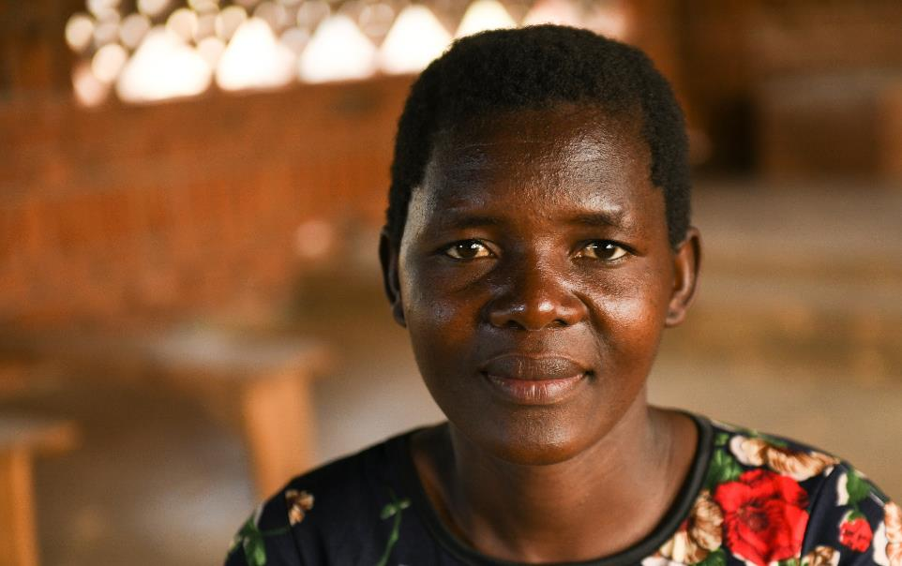
5th December
Teleza, Malawi
Heavenly Father,
Holy is your name throughout all generations.
Your mercy is sufficient for all.
Help me Lord to serve you with humility and praise your name always.
Amen
Calendar

Slide 8

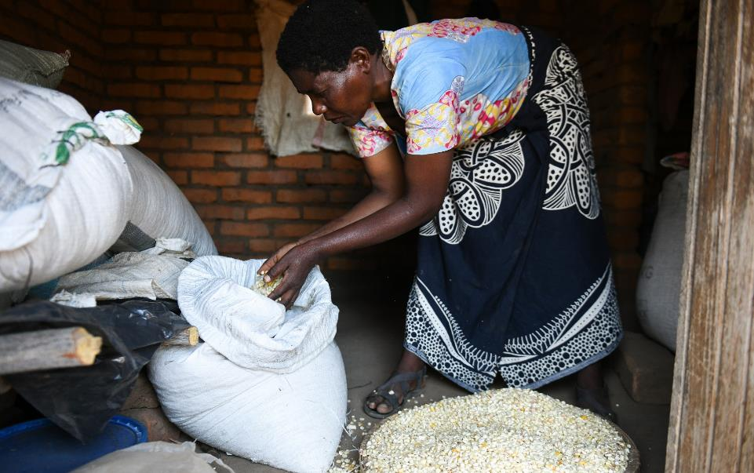

6th December
“To care for the world in which we live means to care for ourselves.”
Pope Francis
Calendar
Malita, Malawi

Slide 9
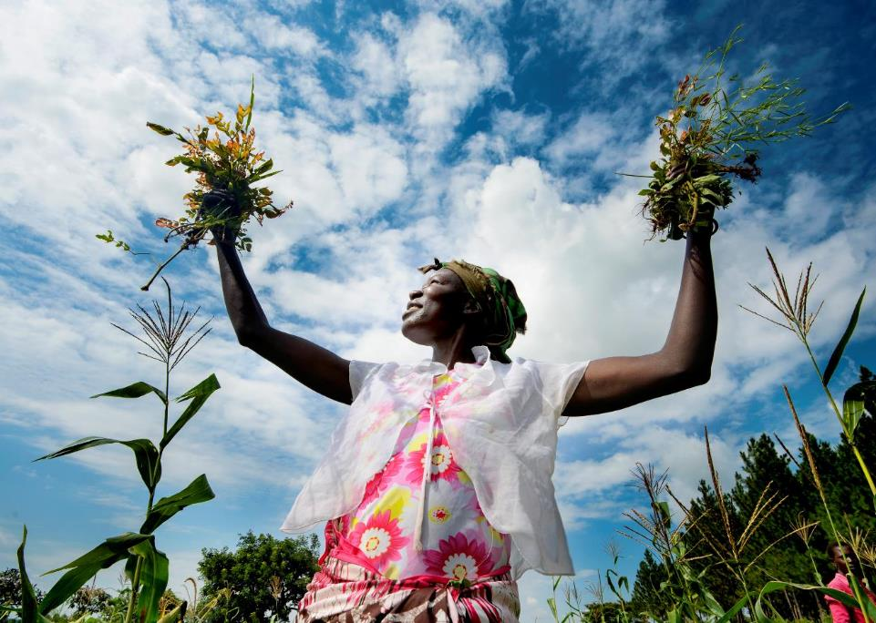

7th December
Aciro, Uganda
“Advent is the time to welcome the Lord who comes to meet us, the time to look ahead, and to prepare ourselves for Christ’s return.”
Pope Francis
Calendar

Slide 10

8th December
Feast of The Immaculate Conception of the Blessed Virgin Mary
The angel said to her, “Do not be afraid, Mary, for you have found favour with God. And now, you will conceive in your womb and bear a son, and you will name him Jesus. He will be great, and will be called the Son of the Most High, and the Lord God will give to him the throne of his ancestor David. He will reign over the house of Jacob forever, and of his kingdom there will be no end.
Luke 1:30-33
Loving God,
As we wait for the birth of Jesus at Christmas, we give thanks for the wonderful gift of new life.
We pray for all parents around the world and for their children,
that they will be healthy, happy and love one another.
Amen
Calendar

Slide 11
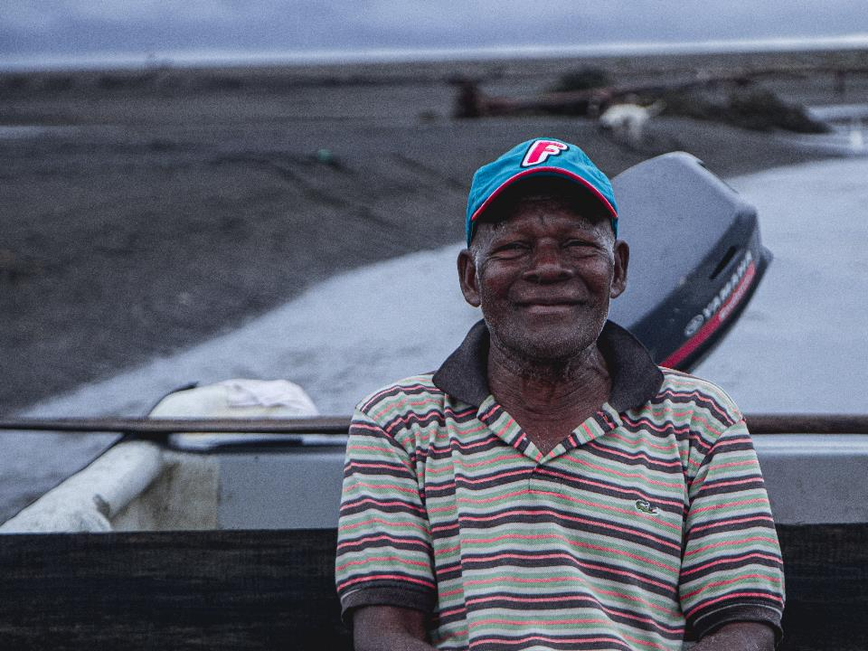
9th December
All-powerful God,
We remember Our Lady and St Joseph
who became refugees in order to protect Jesus.
We pray for all those seeking refuge
due to the impacts of climate change.
Protect them and provide for them
we pray in Jesus’ name.
Amen
Calendar
Isidro, Colombia

Slide 12
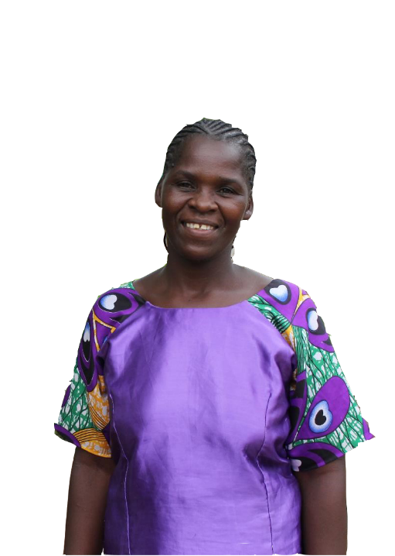
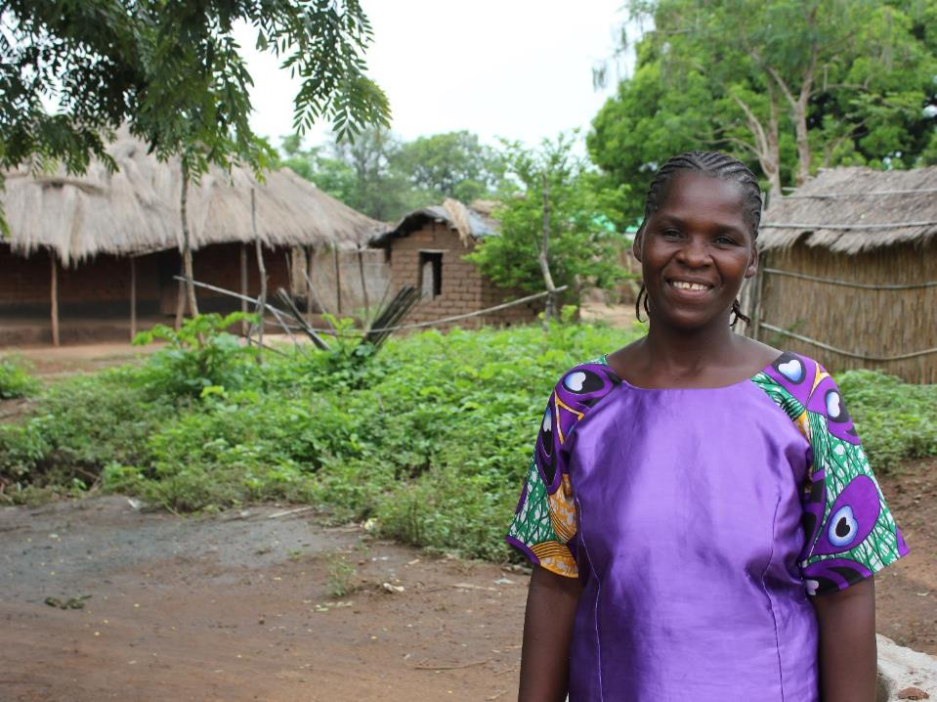
10th December
Human Rights Day
God of light, shine forth,
show us how
to bring hope to others.
God of mercy, help us
to comfort your people
and share in their joy.
God of hope, make us an Advent people,
preparing the way for life
in all its fullness.
Amen.
Calendar
Lucy, Malawi

Slide 13
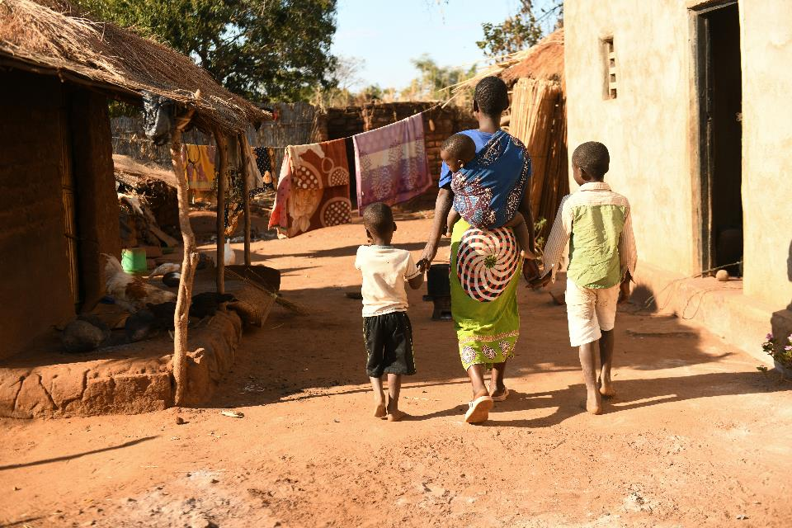
11th December
‘Speak up for those who cannot speak for themselves, for the rights of all who are destitute.
Speak up and judge fairly; defend the rights of the poor and needy.’​
Proverbs 31:8-9
Tamala and her
family, Malawi
Calendar

Slide 14
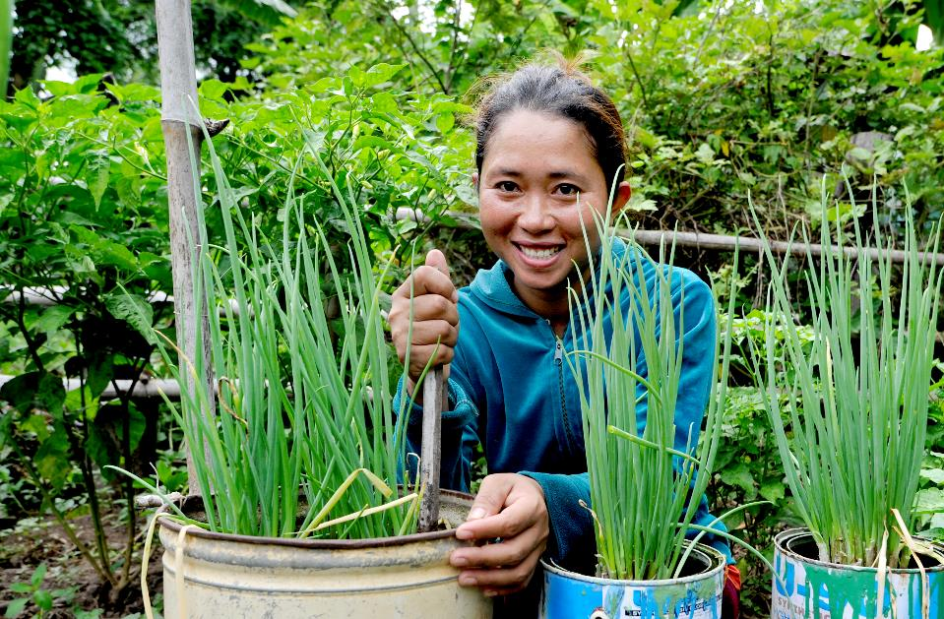
12th December
Growing vegetables in Cambodia
Lord God,
Inspire us to build a just world, free of poverty and hunger.
May our hearts be open to our neighbours, near and far.
May we recognise the goodness and beauty
that you have sown in each of us.
Amen
Calendar

Slide 15
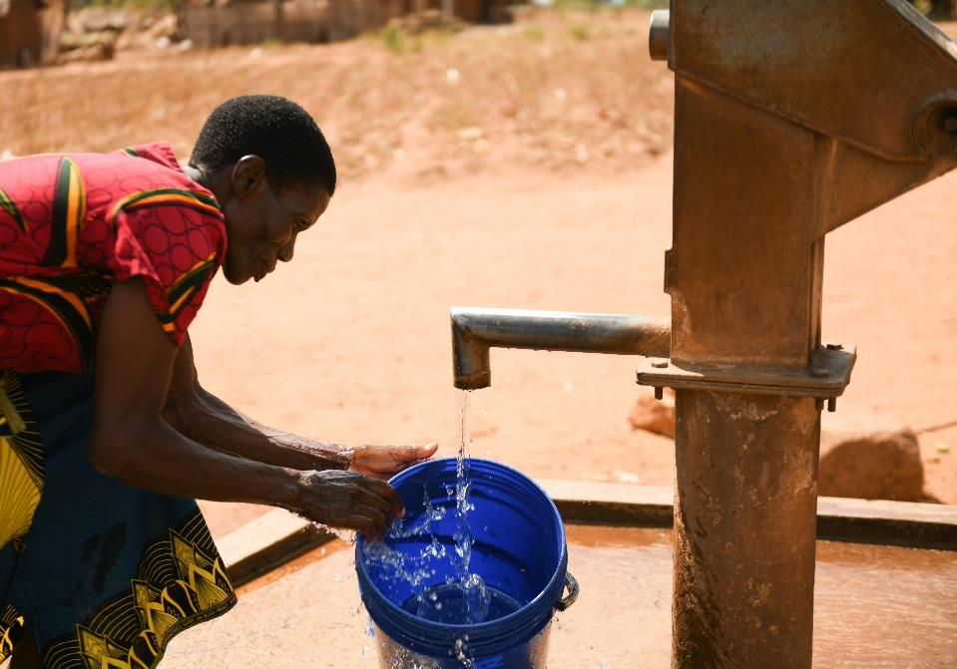
13th December
Lord God,
This Advent we pray for everyone feeling the effects of climate change.
May you inspire in us action to protect the earth and all of your creation.
Amen
Calendar
Lickness, Malawi

Slide 16
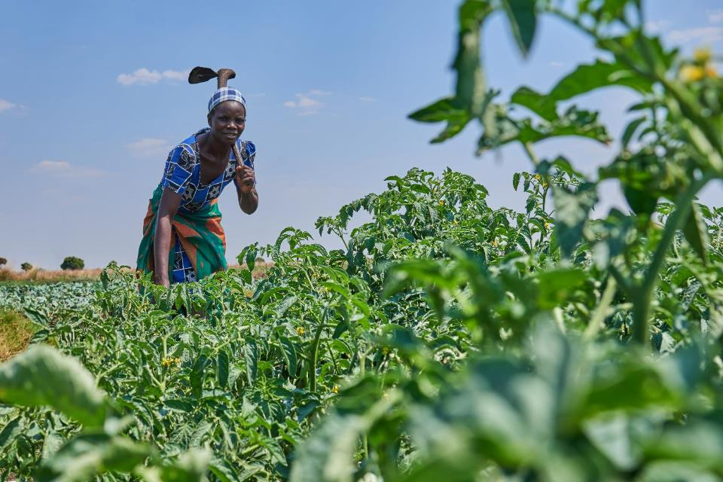
14th December
Farming in
Zambia
Generous God,
We thank you for all the good
things that you have given us.
Help us this Advent to follow the example of Jesus, to care for
others and treat everyone with respect and kindness.
Amen
Calendar

Slide 17
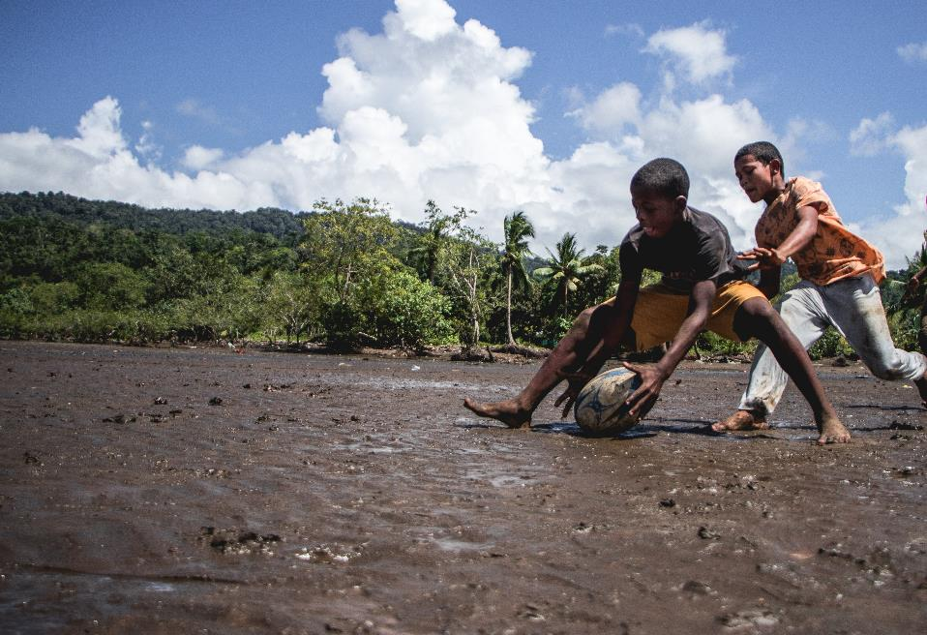
15th December
Rugby training
in Colombia
God of life,
We give thanks for all those people in our lives who are kind to us.
Help us in turn to be kind to others, in preparation for the coming of your Son Jesus.
Amen
“Advent is a time to recognize the emptiness needs to be filled in our lives, a time to smooth the rough edges of pride, and to make room for Jesus who comes.”
Pope Francis
Calendar

Slide 18
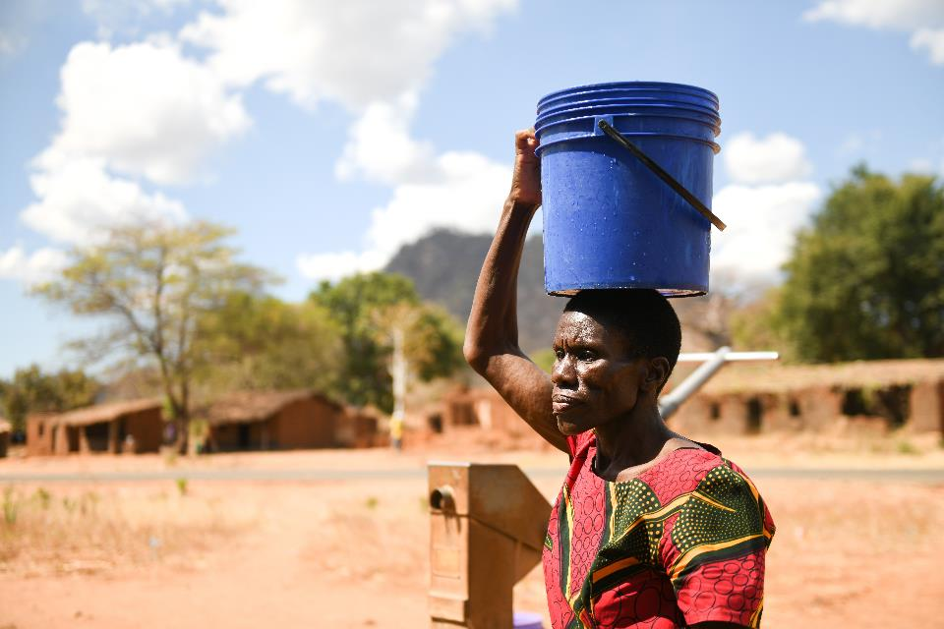
16th December
God of Love,
Your son, Jesus, is your greatest gift to us.
He is a sign of your love.
Help us walk in that love during the weeks of Advent, as we wait and prepare for his coming.
We pray in the name of Jesus, our Saviour.
Amen.
Calendar
Lickness, Malawi

Slide 19
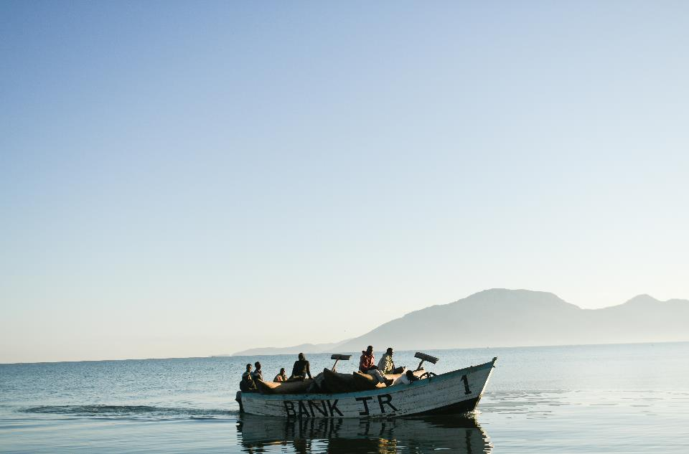
17th December
Loving God,
Thank you for the beauty of your creation and for all the good things you graciously give us.
We pray for more understanding of each other and to know that we are all one in Christ.
Give us the strength and wisdom to work together and bring about positive change for those
who are suffering.
Amen.
Fishing on Lake Malawi
Calendar

Slide 20


18th December
Jhonathan, Colombia
“The word Advent
means coming. The Lord is coming. This is the root of our hope: the certainty that God's consolation comes to us amidst the troubles of the world. Not a consolation of words, but of His presence among us.”
Pope Francis
Calendar

Slide 21
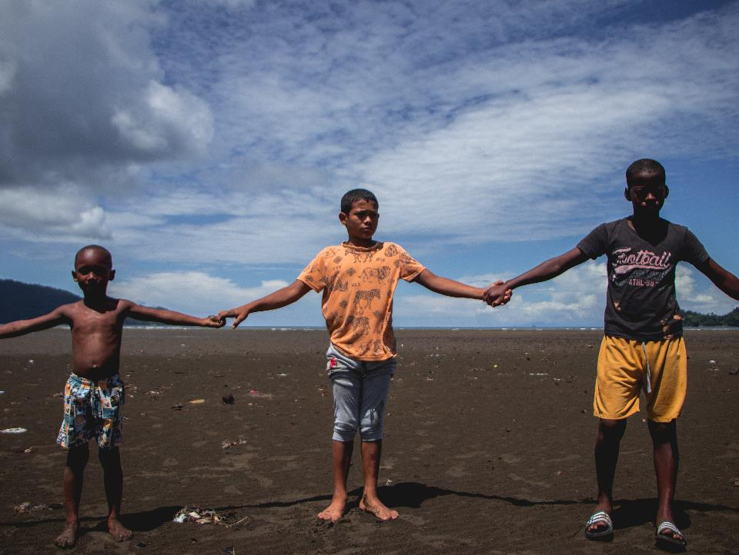
19th December
Rugby for Peace
Colombia
Loving Father.
Thank you for Jesus and thank you for loving me. Help prepare my
heart for your service, and help me to serve willingly. I pray for those that will have little this Christmas. In particular, I pray for the work of SCIAF and their partners. That they experience your peace and provision. I pray this in the name of Jesus.
Amen
Calendar

Slide 22
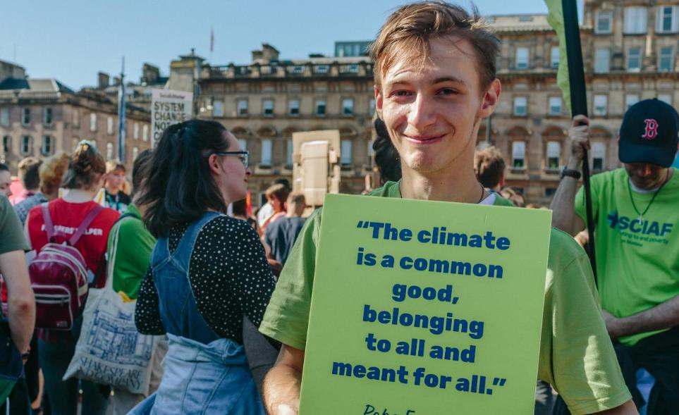
20th December
Climate march,
Scotland
May the God of hope fill you with all joy and peace in your faith, so that in the power of the Holy Spirit you may be rich in hope.
Romans 15:13
International
Human
Solidarity
Day
Calendar

Slide 23
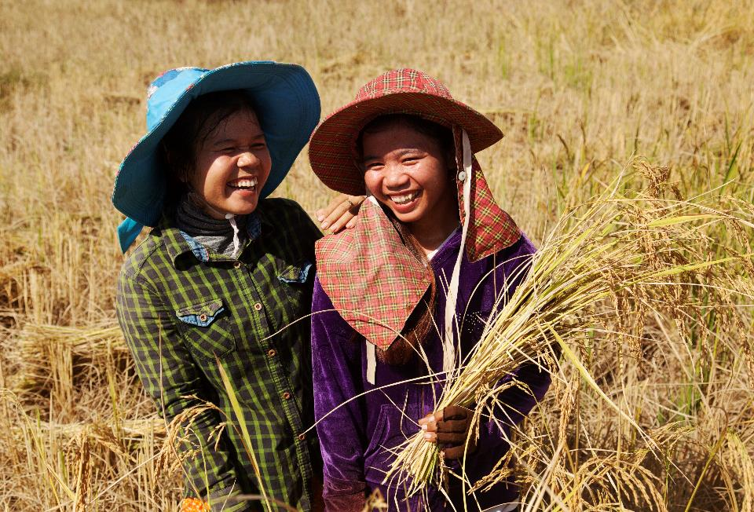
21st December
Farming in Cambodia
Loving God,
Fill our hearts
with compassion
for the earth and
all its people.
Lead us to be
good neighbours
to all who
are in need.
Amen
Calendar

Slide 24
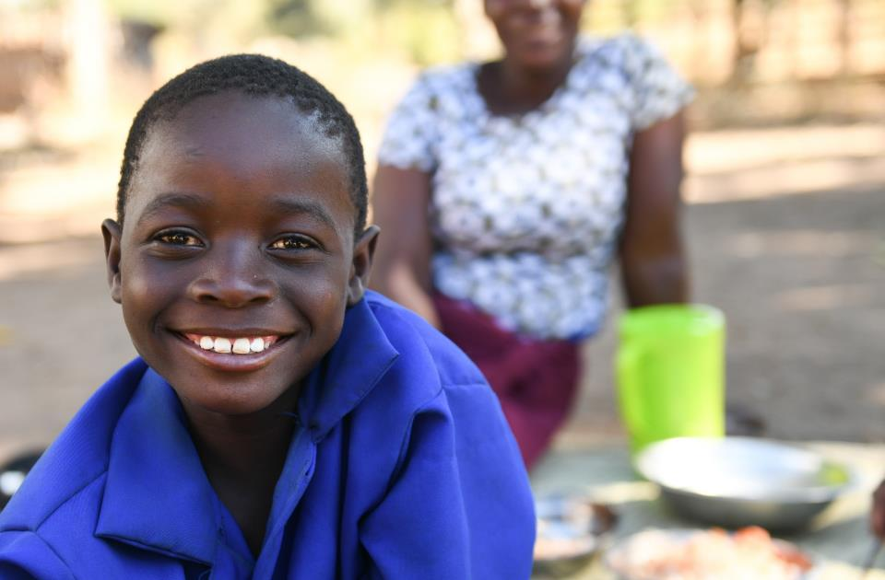
22nd December
Gentle God,
We pray for those
who work for justice
all over the world.
As we support the
work of SCIAF, let
us never lose hope
of building a just and green world.
Amen
Odeka, Malawi
Calendar

Slide 25
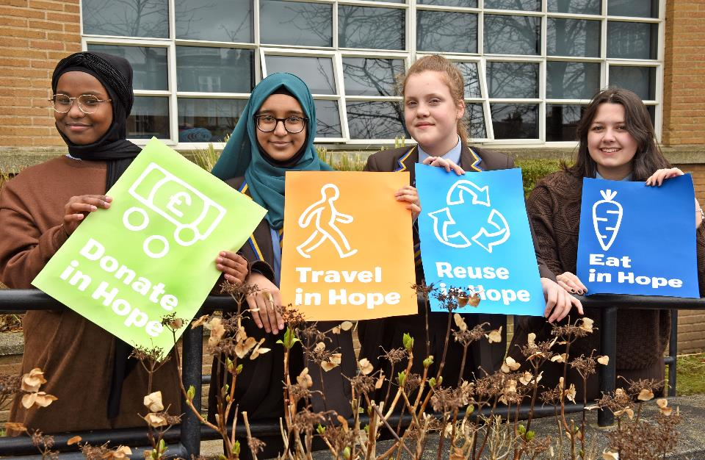
23rd December
Notre Dame High School
Glasgow
“Each of you should use whatever gift you have received to serve others, as faithful stewards of God’s grace in its various forms.”
1 Peter 4:10
Calendar

Slide 26
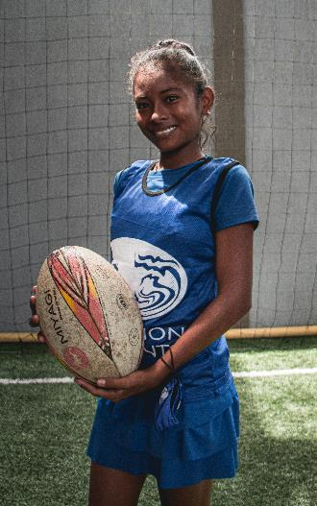
24th December
Christmas is nearly here!
We look forward to tomorrow’s joyful celebration as we welcome Jesus, the light of the world, once again.
Mariana,
Rugby for Peace,
Colombia
“To give light to those who live in darkness and the shadow dark as death, and to guide our feet into the way of peace.”
Luke 1:79
Thank
you
Calendar

Slide 27
Thank you
A just world, free of poverty, where we flourish and live
in harmony with each other and all creation.
Scottish Catholic International Aid Fund
SCIAF is the official relief and development agency of the Catholic Church in Scotland
and a proud member of the Caritas family. 7 West Nile Street, Glasgow G1 2PR.
Tel: 0141 354 5555. Scottish Charity No: SC012302. Company No: SC197327.
sciaf@sciaf.org.uk

