Slide 1



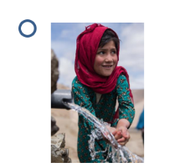


Christmas Real Gifts 2022
How to play: Find a pair of Real Gifts pictures by turning over two cards at a time. If you don’t find a pair turn the cards back over. Try to remember where each picture was to make a pair on your next turn.
To turn a card over click on the Real Gift icon
If they’re not a match click on this button to turn
the cards back over
If they’re a match click on the image to read about
this Real Gift.
Use this button to get back to the Game board
Start game

Slide 2

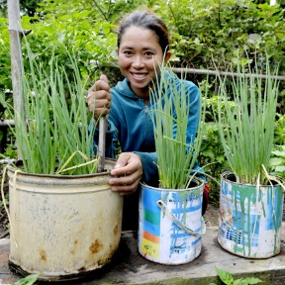
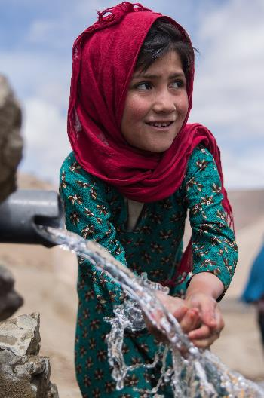
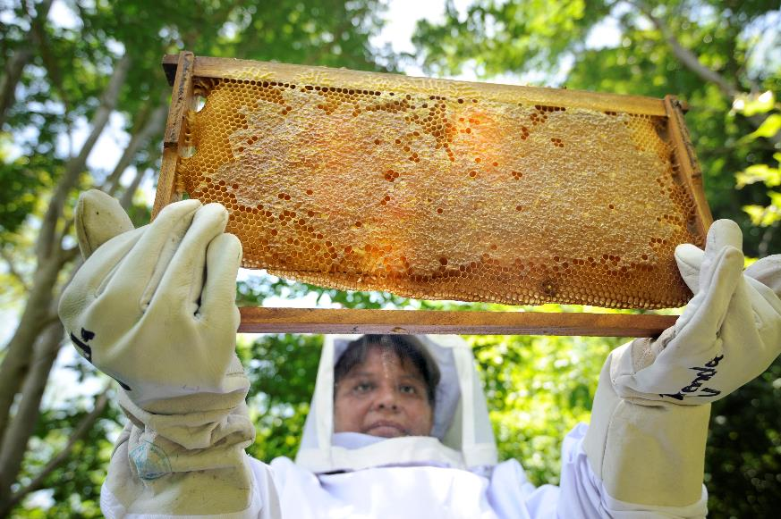
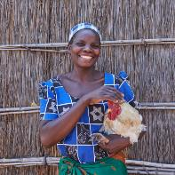
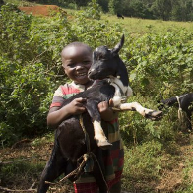
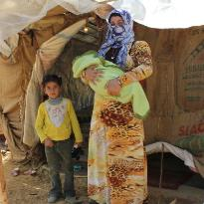
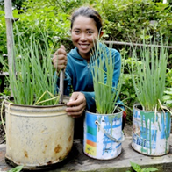
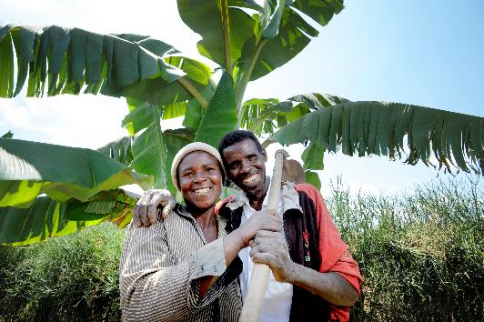
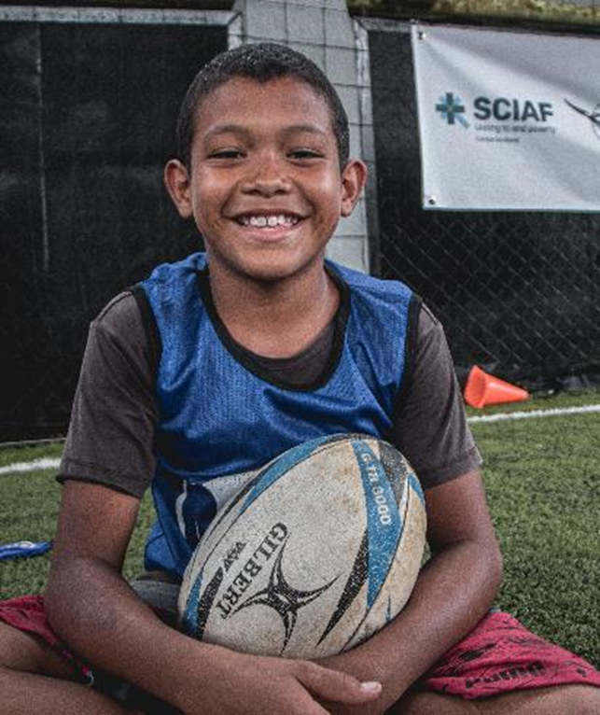

Slide 3

Beekeeping Kit £117
This Real Gift provides beekeeping equipment which whole communities can use in shared forest spaces.
Bees help to keep the forest healthy by pollinating flowering plants.

Slide 4
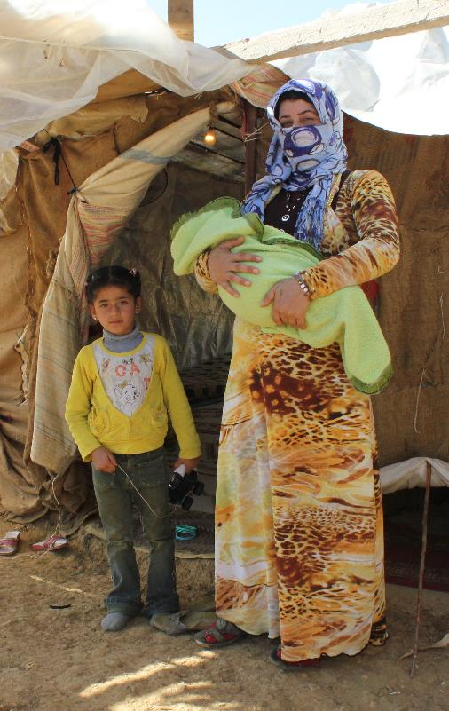
Shelter for a family £32
War and natural disasters, like hurricanes, earthquakes and floods, often leave families homeless.
This Real Gift will help a family have shelter until a permanent home can be found.

Slide 5
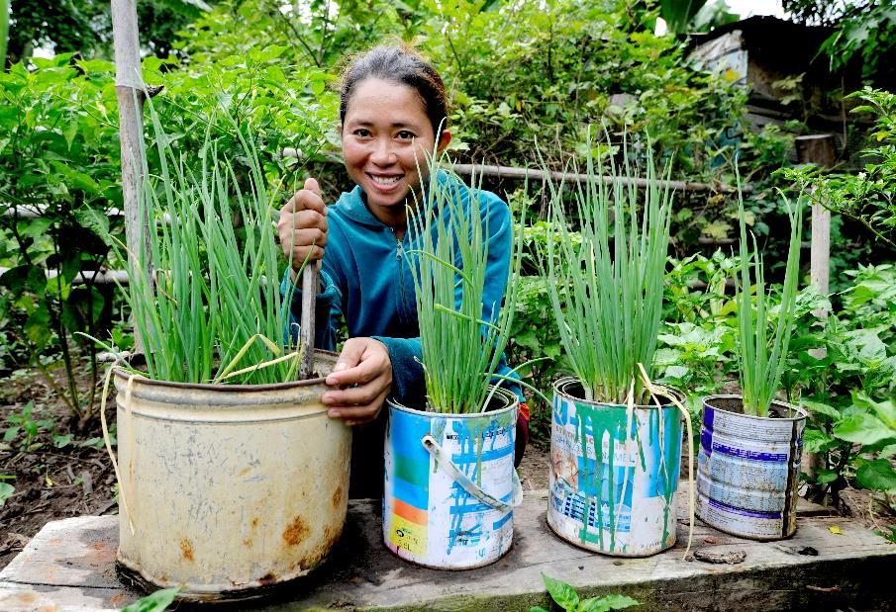
Vegetable garden £25
This gift gives people the seeds and training they need to grow their own vegetables in a small garden at home.
Families are able to eat nutritious, chemical free food they’ve grown themselves.

Slide 6
Emergency water £37
This real gift provides emergency clean water.
Water is a precious resource.
We need water to drink and wash ourselves. And, to grow and cook food.
During emergencies like
droughts water is one
of the most basic needs.

Slide 7

Rugby for Peace £15
This gift provides uniforms and training kits for young rugby players in Colombia.
Sport teaches us how to work together. We also learn about the importance of honesty and how to play fairly.

Slide 8
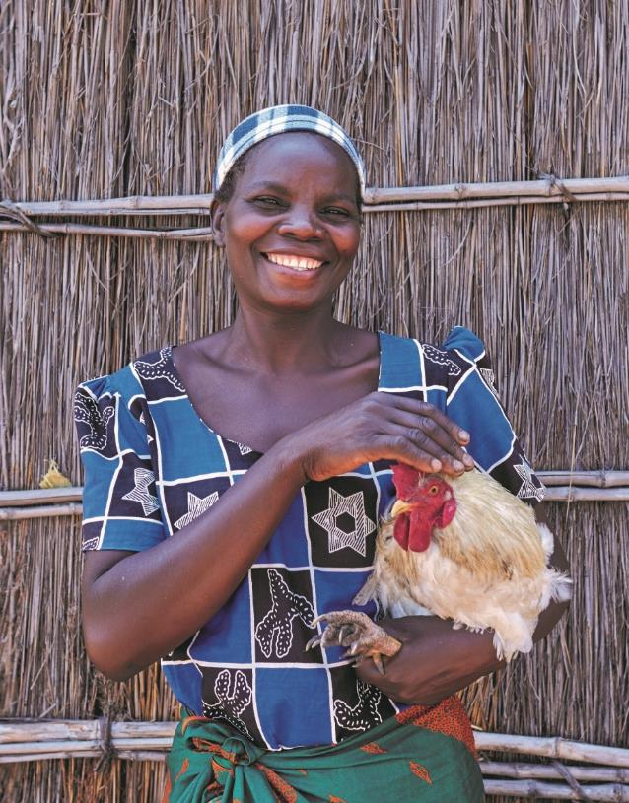
Chickens £14
The gift of chickens will give a family a nutritious supply of eggs to help keep their children happy and healthy.
When the chickens breed, the family can sell the chicks to earn money for other essentials like vegetables, so the family have a healthier diet.

Slide 9

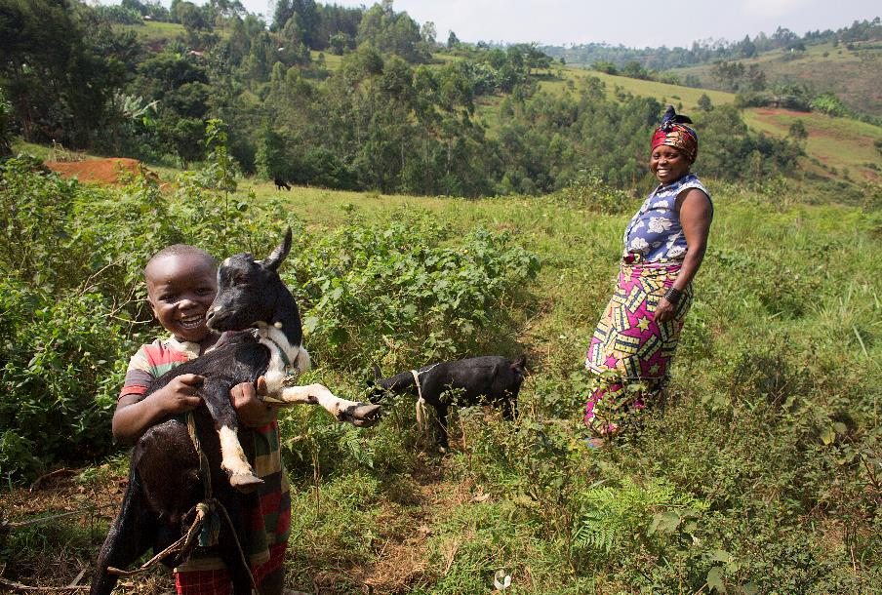
Goat £32
This Real Gift will give a goat to a family living in poverty.
A goat can give the family as many as
12 pints of fresh milk a week!

Slide 10
Farming training, tools and seeds £250
Seeds, training and basic tools are essential for farming families to be able to grow enough food.
“After I got involved in the SCIAF project, I learnt about farming and how to eat a balanced meal. We now grow vegetables and take them to the market to sell them. I now have school materials for the children too.”
- Claire Kayitesi, Rwanda

