Slide 1



Christmas Real Gifts 2022
Buy ethical
Real Gifts this Christmas and transform lives
in the world’s poorest places.

Slide 2

What are Real Gifts?
Real Gifts are a brilliant way to give a gift that makes a real difference in the world.
When you buy a Real Gift for a loved one, you’re providing something vital to our sisters and brothers in need and you’ll receive a beautiful card to send on.

Slide 3
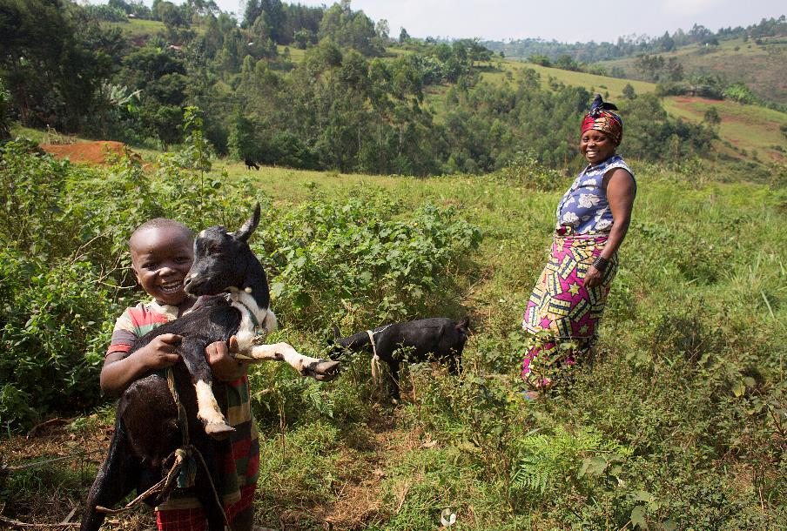

Goat £32
This Real Gift will give a goat to a family living in poverty.
A goat can give the family as many as
12 pints of fresh milk a week!
Notes:
A goat can give a family as many as 12 pints of fresh milk a week. Goats milk is high in fat and has lots of vitamins so it helps to keep families healthy.
Families can also sell any extra milk to buy food and other essentials. They can make some money by breeding and selling their kid goats. Their droppings make great organic fertiliser too!
Our partners work with families and local vets to make sure the goats are looked after to a high standard.

Slide 4
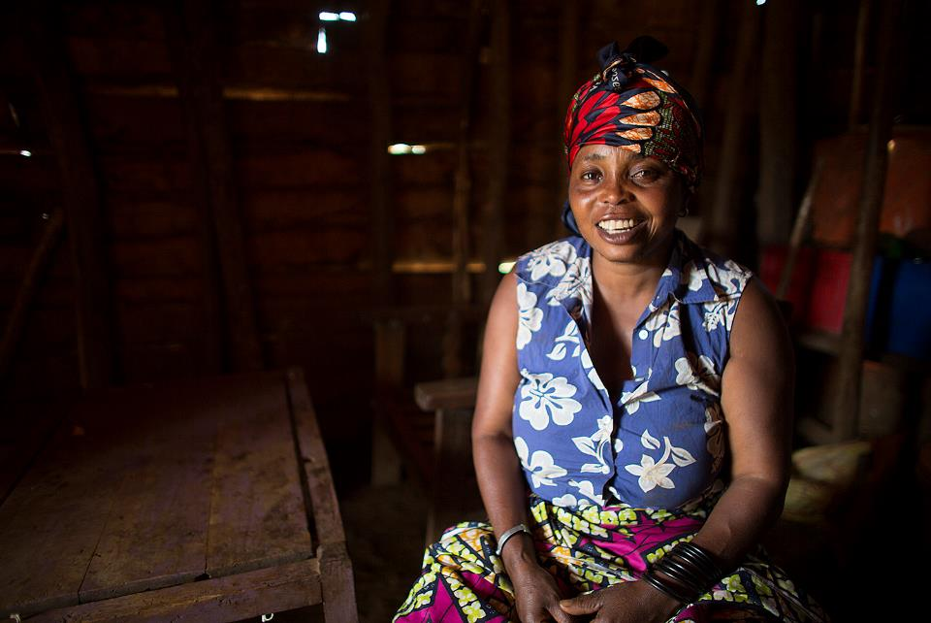
Goat £32
“With your help we started learning new farming techniques. We now grow vegetables and sell them in the market.
I was also given a goat, and used my profits from the vegetable garden to buy another. I will sell their offspring when they’re older.
With the money I can educate my child, buy what I need and also save.”
- Sylvia, DR Congo

Slide 5

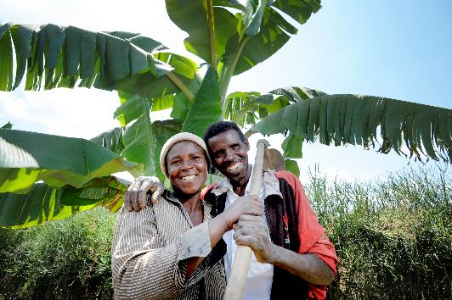
Farming training, tools and seeds £250
Seeds, training and basic tools are essential for farming families to be able to grow enough food.
“After I got involved in the SCIAF project, I learnt about farming and how to eat a balanced meal. We now grow vegetables and take them to the market to sell them. I now have school materials for the children too.”
- Claire Kayitesi, Rwanda
Notes:
Basic equipment like watering cans, spades and hoes are essential so farmers in the worlds poorest places are better able to work their land. Globally 2.37 billion people are going hungry - that’s about 3 people out of every 10 around the world. The largest proportion of people going hungry live in Africa, Asia and Latin America.

Slide 6
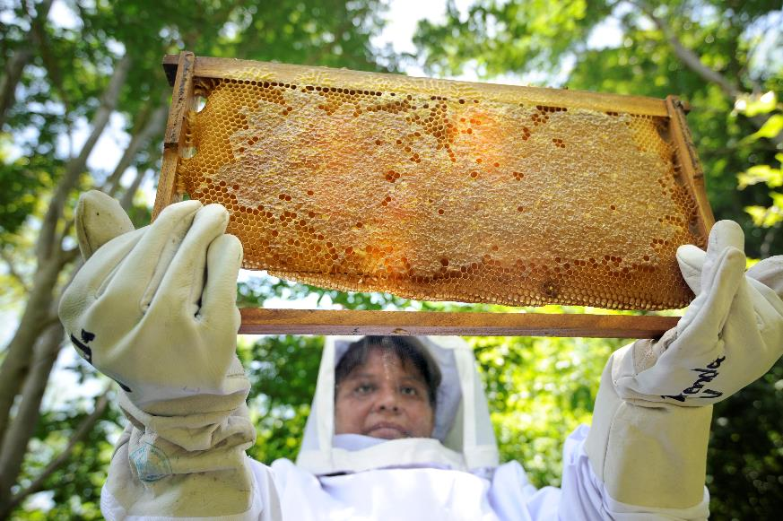
Beekeeping Kit £117
This Real Gift provides beekeeping equipment which whole communities can use in shared forest spaces.
Bees help to keep the forest healthy by pollinating flowering plants.
Notes:
Bees need to produce 20-30 lb of honey for their hive to survive an average winter, but the bees are capable of collecting much more. One hive can produce 60 lb or more in a good season.

Slide 7
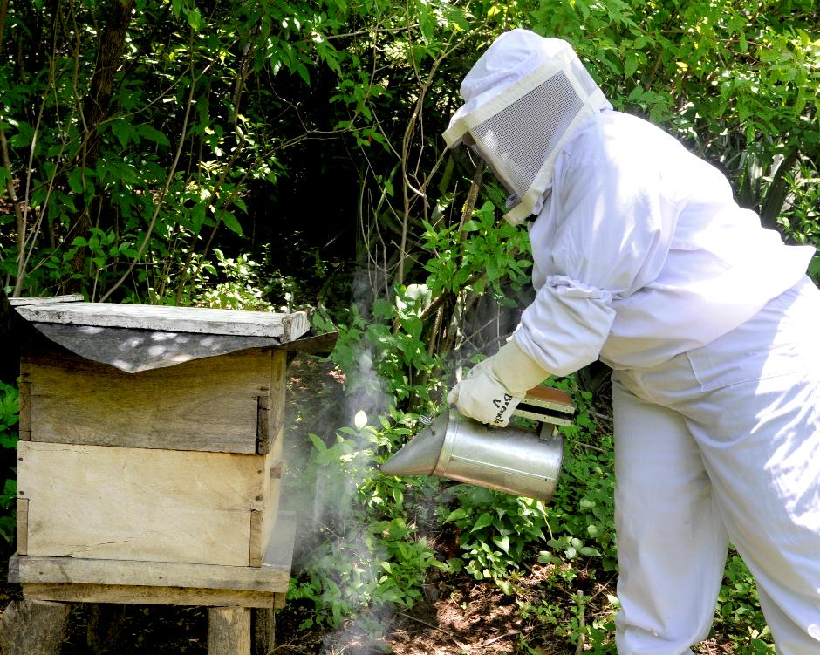
Beekeeping Kit £117
Bees also produce honey which can be eaten or sold to benefit the community.

Slide 8

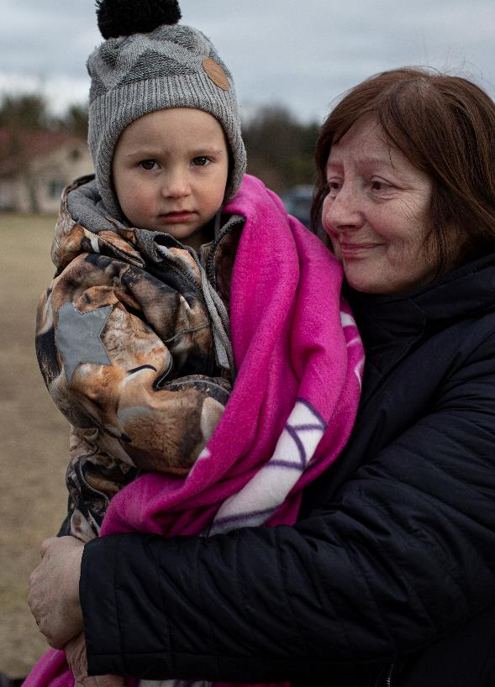
Emergency Response £50
Emergency Response Real Gift
Families caught up in humanitarian crises, whether natural disasters or conflict, need urgent help.
Thanks to this gift, you are standing with people in their hour of need.
Last year we helped over 34,000 people
with emergency relief
Notes:
In 2021 SCIAF responded to 67 emergencies in 18 countries. We helped 34,602 people with emergency relief.

Slide 9
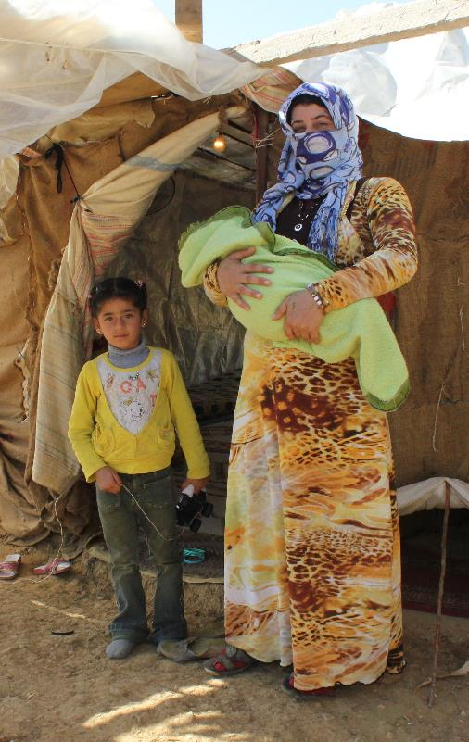
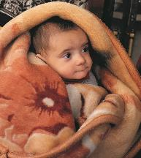
Shelter for a family £32
Warm blankets £18
War and natural disasters, like hurricanes, earthquakes and floods, often leave families homeless.
This Real Gift will help a family have shelter until a permanent home can be found.
Warm blankets are essential for families living in temporary shelters

Slide 10
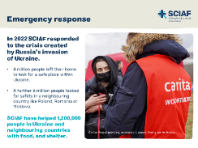
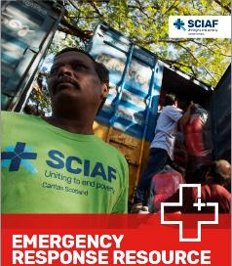
Emergency Response
When disaster strikes we are there to provide emergency food, shelter, water and access to healthcare.
And, we will be there long after others have left.
Find our more in SCIAF’s
Emergency Response Resource
for Primary and Secondary Schools
Notes:
Emergency Response Resource for schools (sciaf.org.uk)

Slide 11
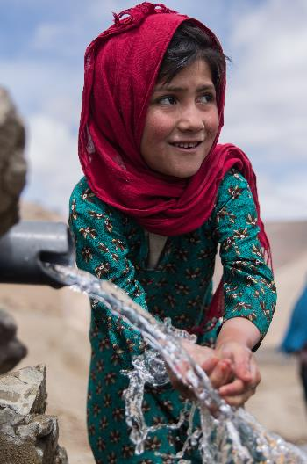

Emergency water £37
This real gift provides emergency clean water.
Water is a precious resource.
We need water to drink and wash ourselves. And, to grow and cook food.
During emergencies like
droughts water is one
of the most basic needs.
Find out more in SCIAF’s Resource for Primary Schools
Water Is Life
Notes:
In an emergency like a drought, conflict or other disaster, clean water is the first and most basic need
This gift could provide an emergency water supply for five families for a year.
Water is life (sciaf.org.uk)

Slide 12
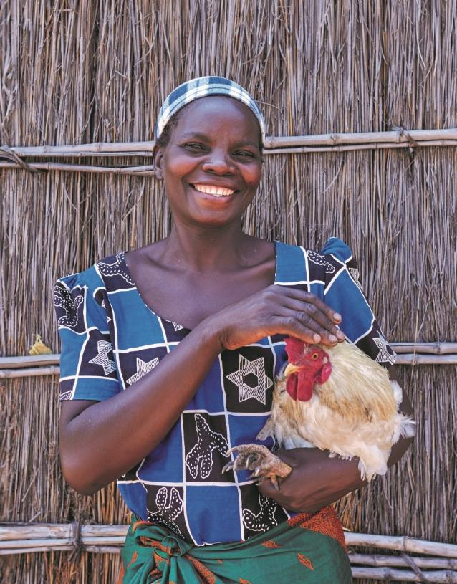
Chickens £14
The gift of chickens will give a family a nutritious supply of eggs to help keep their children happy and healthy.
When the chickens breed, the family can sell the chicks to earn money for other essentials like vegetables, so the family have a healthier diet.
Notes:
Although chickens are relatively easy to keep, our partners work with families to make sure they have the knowledge and skills to look after their chickens to a high standard. Last year supporters bought over 1,300 Real Gifts of chickens! It’s one of our most popular Real Gifts every year.

Slide 13
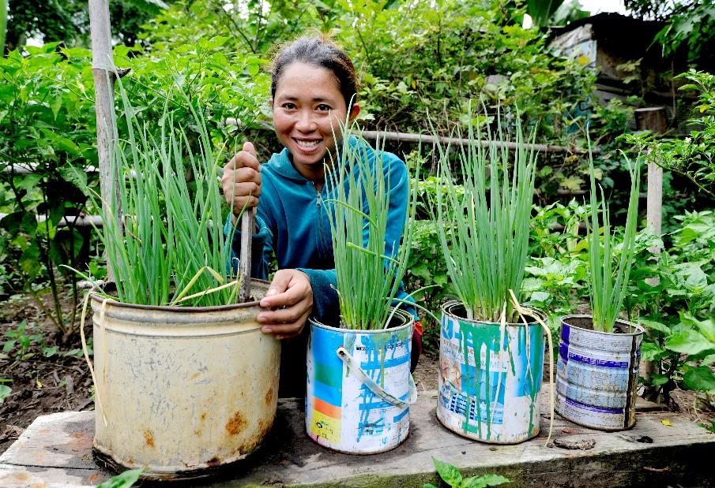
Vegetable garden £25
This gift gives people the seeds and training they need to grow their own vegetables in a small garden at home.
Families are able to eat nutritious, chemical free food they’ve grown themselves.
Notes:
Vegetables like sweet potato, carrot, onion, cabbage and varieties of cucumbers and spinach are common in vegetable gardens in Africa and Asia.

Slide 14
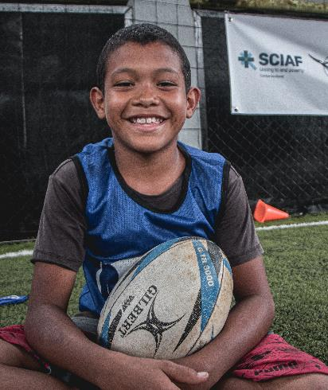
Rugby for Peace £15
This gift provides uniforms and training kits for young rugby players in Colombia.
Sport teaches us how to work together. We also learn about the importance of honesty and how to play fairly.

Slide 15
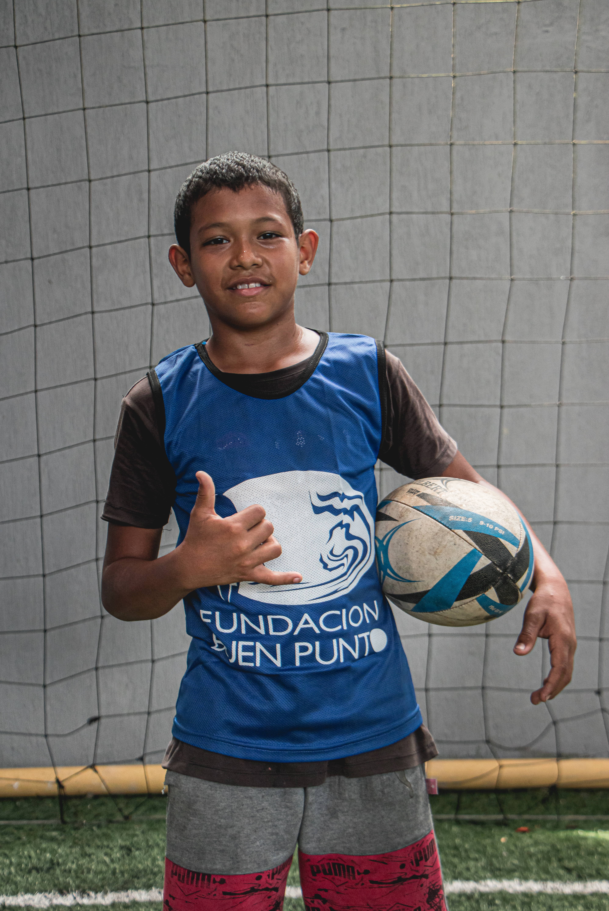
Rugby for Peace £15
Jhonathan and his teammates have had a difficult start in life.
But, things are starting to change, one pass at a time.
“In sport, as in life, competing for the result is important but playing well and fairly is even more important.”
- Pope Francis

Slide 16

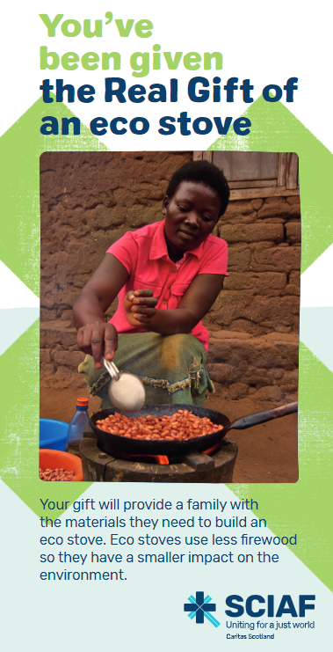
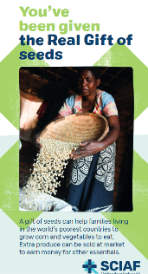

Real Gift of seeds £4
Real Gift of an eco stove £6
Bookmarks would make great stocking fillers this Christmas!

Slide 17
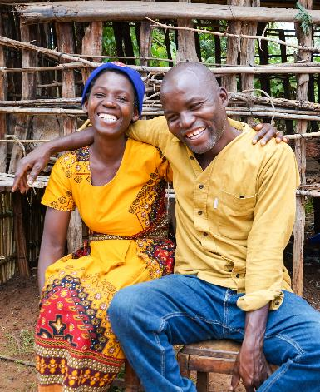

Real Gifts
Make a donation in someone's name this Christmas.
£2
£1
£1
£5
Notes:
Thanks to this gift you are providing families and communities in the world’s poorest places with the support and tools they need to build resilient and bright futures.

Slide 18
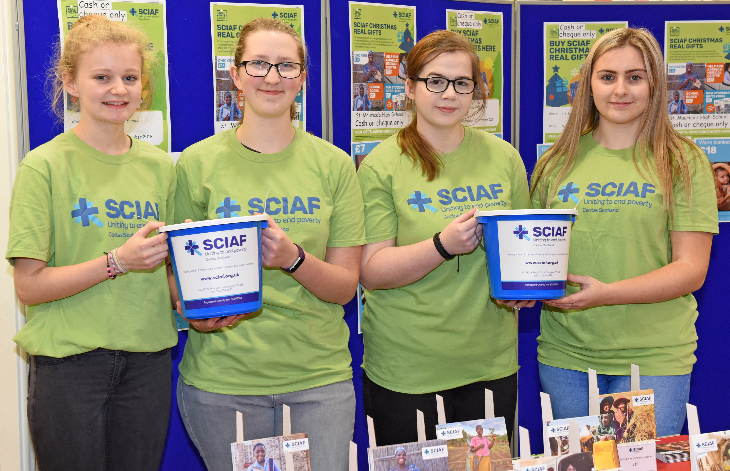
Sell Real Gifts
Our Sale or Return packs help you to set up a stall in your school or parish.
Sell Real Gifts, raise money for SCIAF and make a real difference in the world.
Get
involved today!
Notes:
sciaf.org.uk/get-involved

Slide 19
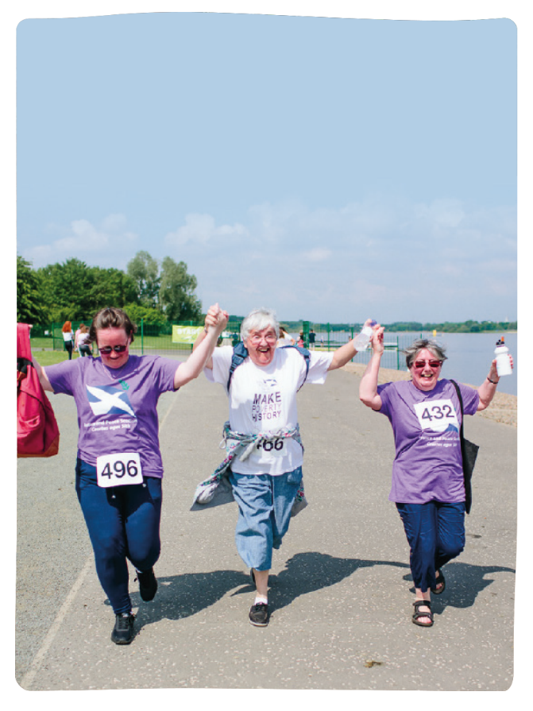


Get involved today!
There are so many ways to get involved with our work, and reach out with love and compassion to those who are less fortunate than ourselves.
Get involved today!
sciaf.org.uk/get-involved

Slide 20
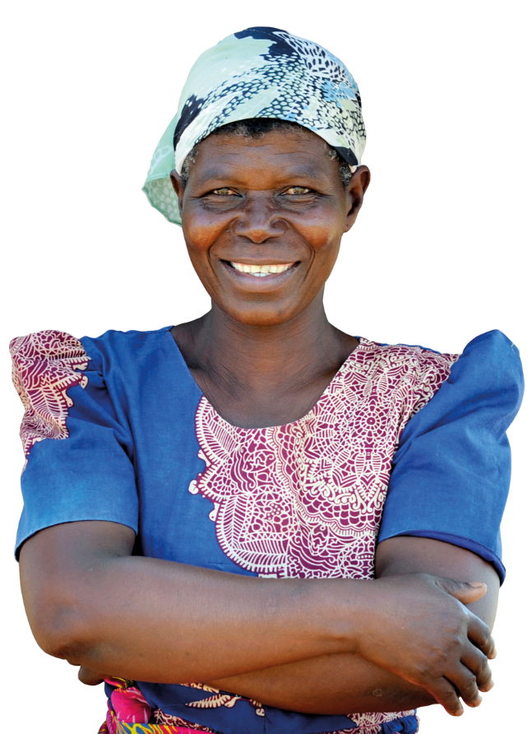
Let us pray
Loving Father,
We thank you for the gift of Jesus,
given freely to us from your gracious hands.
We thank you for the many gifts that we benefit from.
Gifts of food, water, warmth, an education and more.
Help us to be grateful for what we have,
and to help others when we can.
Help us to see our sisters and brothers through your eyes.
In Jesus name,
Amen

Slide 21
Thank you
A just world, free of poverty, where we flourish and live
in harmony with each other and all creation.
Scottish Catholic International Aid Fund
SCIAF is the official relief and development agency of the Catholic Church in Scotland
and a proud member of the Caritas family. 7 West Nile Street, Glasgow G1 2PR.
Tel: 0141 354 5555. Scottish Charity No: SC012302. Company No: SC197327.
sciaf@sciaf.org.uk

