Slide 1
To play the
climate emergency game start in
slide show mode,
then click here

Slide 2


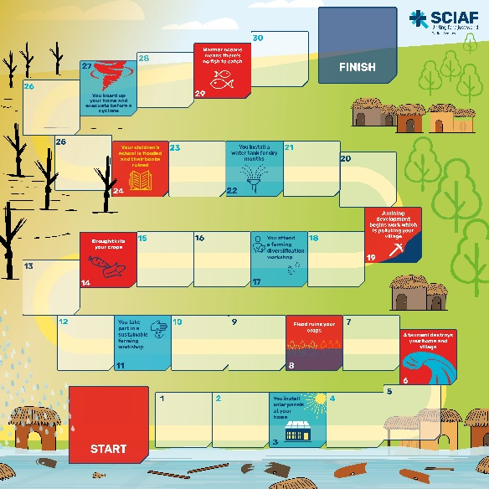

Climate Emergency
Travel around the board
from start to finish…
but you might encounter some obstacles
along the way.
How to play
Start game
This game introduces you to
the people for whom the
obstacles featured are not
simply a game, but a
real-life climate emergency
Notes:
Lets get started…

Slide 3
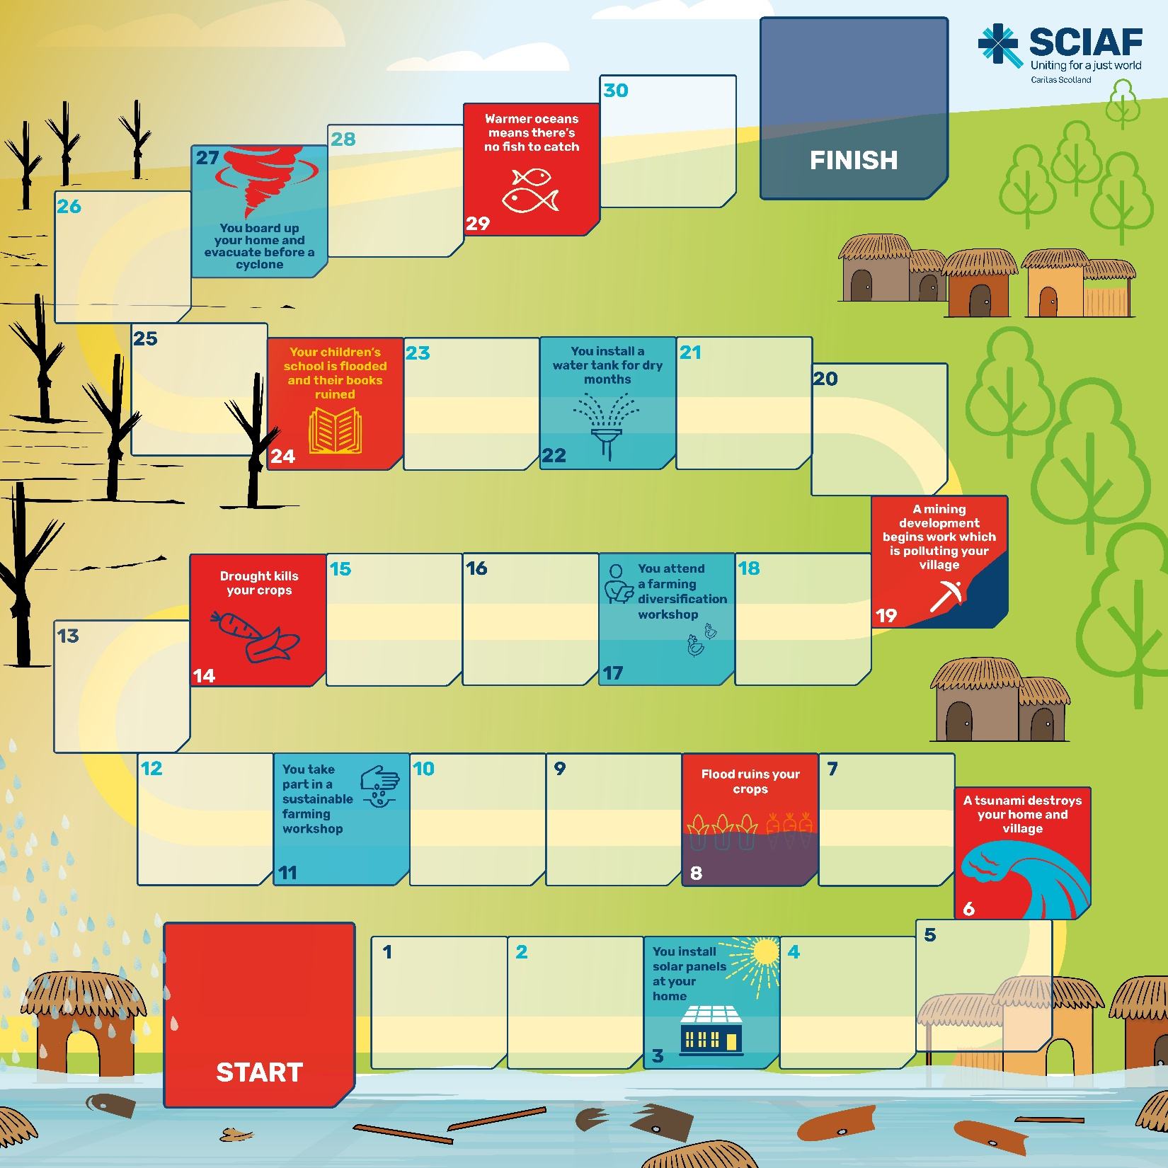
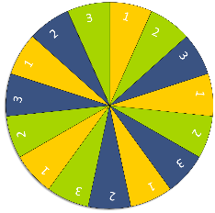

How to play
Spin

Slide 4


Click on the wheel to spin
Click to stop
3
1
2
2
1
3
3
1
2
2
1
3
Go to board
3
1
2

Slide 5
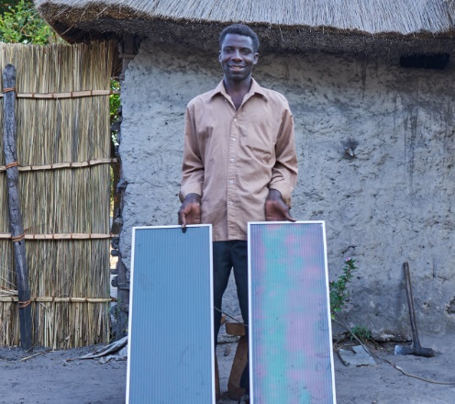
You install solar panels at your home
Solar panels allow you to power a small electric radio.
Move forward one space.
Every hour the sun beams more energy onto Earth than it needs to satisfy global energy needs for an entire year.
Harnessing the power of the sun can provide people with a clean, renewable source of energy in some of the world’s poorest countries.
Read the real-life story
Spin again
Go to board

Slide 6
Each year Zambia receives around
2,800 hours of sunshine.
David Munyindeyi and his family live in Zambia. They grow the food they eat on a small piece of land.
With help from SCIAF’s partners, David received training on organic farming to help increase his harvest.
With the money he’s earned from selling surplus produce at market he bought solar panels which power an electric light in the family home.
Spin again
Go to board

Slide 7

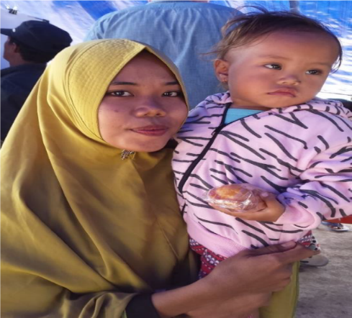
A tsunami destroys your
home and village
Your home is destroyed. The village hospital, school and shops are damaged. Miss a turn.
Rising sea levels significantly increase the destructive force of a tsunami.
Read the
real-life story
Spin again
Go to board

Slide 8

A recent tsunami in Indonesia killed over 2,000 people and significantly damaged, or destroyed, over 67,000 homes.
Indi and her 2-year-old daughter suffered devastating
losses in the tsunami. Their home was washed away and several members of their family drowned.
“…everyone ran to the rice fields, but water started coming out from the soil. We made a row, hand in hand, and suddenly a muddy wave as high as a coconut
tree hit us all. We were carried away. I saw people
drowning in the mud.”
Through our partners Caritas Indonesia, SCIAF were able to get essential supplies to those most in need.
Spin again
Go to board

Slide 9
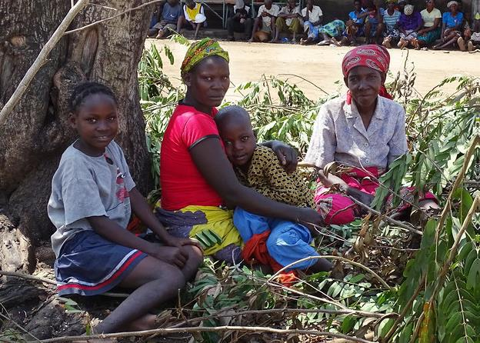
Flood ruins your crops
Flood ruins your food crops and your farming tools are washed away. You’ve nothing to eat, and no produce to sell at market to earn money. Miss a turn.
Floods are more likely as weather patterns become more erratic. Extreme flooding can be triggered by intense rain and longer rainy seasons.
Read the real-life story
Spin again
Go to board

Slide 10
Severe flooding in Mozambique in 2019 was devastating to people already living in poverty.
Rita lives in Mozambique with her children.
The family lost their home and possessions in the flood.
“Our house is gone, it is destroyed. Our clothes are gone, everything is gone. The rain was so heavy…water just filled our houses.
Through our partners Caritas Mozambique, SCIAF helped to get emergency food, cooking utensils, hygiene kits and basic materials to build a temporary shelter to house those most in need.
“Our homes are
now like rivers.”
Rita (centre) with her son Ivo, daughter Antonia (left), and their neighbour (right).
Spin again
Go to board

Slide 11
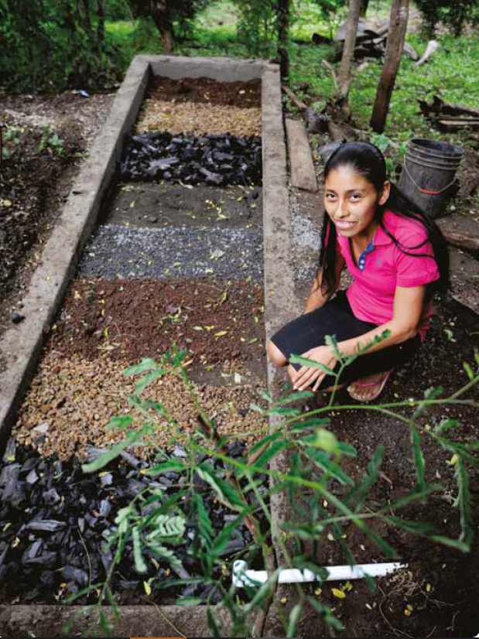
You take part in a
sustainable farming workshop
You learn techniques to make your own organic fertiliser, meaning you can grow more diverse crops. Move forward one space.
SCIAF and its partners implemented two sustainable farming programmes in El Salvador and Nicaragua.
The projects helped to improve the resilience of vulnerable
small-scale farmers to climate change.
Read the
real-life story
Spin again
Go to board

Slide 12
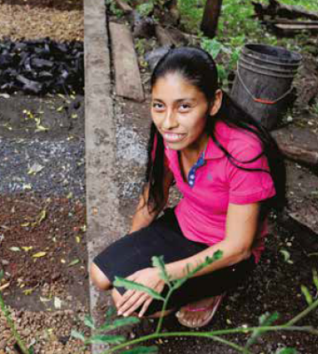
The sustainable farming project trained farmers to make two different kinds of organic fertiliser, which are able to feed plants and nourish the earth at the same time:
Solid fertiliser: Micro-organisms decompose organic waste to produce a material known as bokashi (organic fertiliser).
Bio-fermented fertiliser: Naturally occurring
micro-organisms are
obtained by fermentation
and the decomposition of organic waste to produce a liquid fertiliser.
3,343 people learned about sustainable farming through the project
Spin again
Go to board

Slide 13
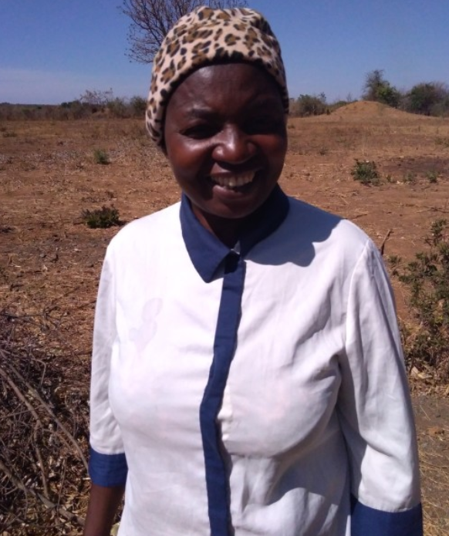
Drought kills your crops
With no food crops you’ve nothing to eat, and no produce to sell at market to earn a living. Miss a turn.
Rising global temperatures and erratic weather make prolonged dry spells a reality for millions of people.
For communities who survive by farming, changes in weather patterns and an increase in droughts only makes life more difficult.
As well as killing food crops, drought creates a scarcity of water and usually inflates the price of food to buy. It is devastating for people already living in poverty.
Read the
real-life story
Spin again
Go to board

Slide 14
Zambia is on the frontline of the climate crisis – a crisis that is beyond the country’s control, and which is having a devastating impact on its people.
SCIAF’s Kumena Project works with
communities to improve their resilience to the extreme changes in the weather.
1,000 farming families are participating in the project
“I have grown enough food for my family. Even with little rain, we will not go hungry this year.”
Kahumbu has learned how to farm organically, producing crops in harmony with the land. For her family – her five children and six grandchildren – the training has provided some certainty for the future. And, this year, has resulted in her harvesting maize, beans, ground nuts, lentils and vegetables.
Spin again
Go to board

Slide 15
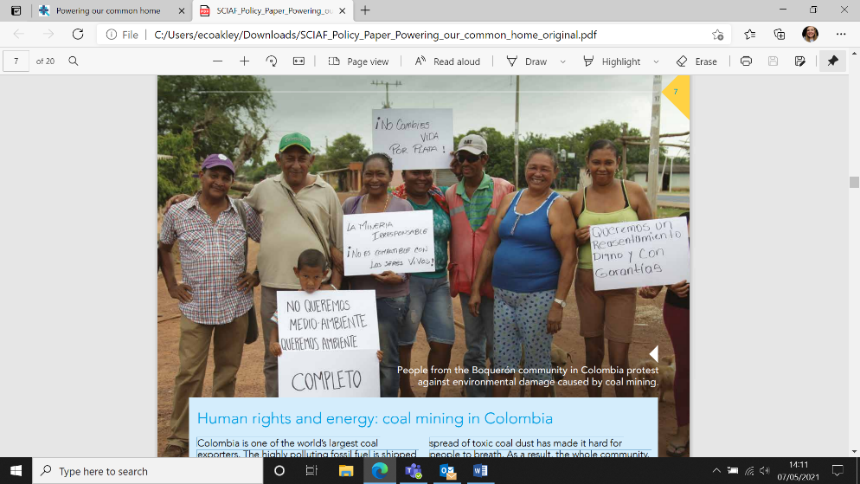
A mining development begins work which is polluting your village
The air and water supply in your village is polluted and making your family ill. Miss a turn.
Colombia is rich in natural resources like oil, gold, copper and silver. It’s one of the world’s largest coal exporters.
Illegal mining developments have resulted in large-scale deforestation, air pollution and water contamination.
It has caused environmental damage, put communities' health at serious risk and forced others to leave their homes.
Read the
real-life story
Spin again
Go to board

Slide 16
SCIAF, through our partner in Colombia, Tierra Digna, are supporting the communities who have been harmed by coal mining developments through campaigning and advocating for justice.
For the people of Boquerón (pictured) the arrival of
coal mining has been
devastating; polluting the village’s water supply, and spreading
toxic coal dust.
As a result, the whole community, which has traditionally relied on the local river for farming and fishing, has had to abandon their village.
Spin again
Go to board

Slide 17
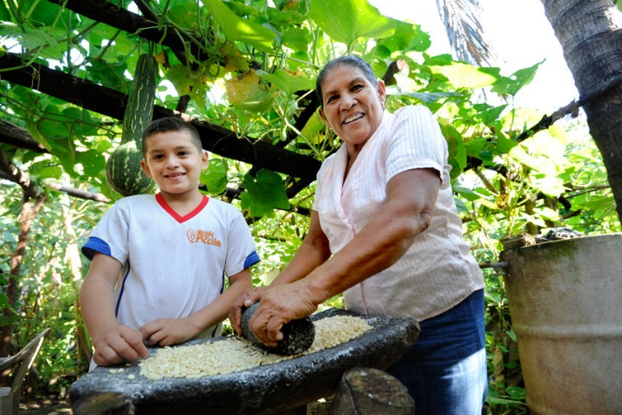
You attend a farming diversification workshop
You learn techniques to use on your farm to help mitigate
the devastating effects of climate change.
Move forward one space.
SCIAF and its partners have implemented farming diversification projects in El Salvador and Nicaragua.
The projects help to improve the resilience of vulnerable small-scale farmers to climate change.
Read the real-life story
Spin again
Go to board

Slide 18
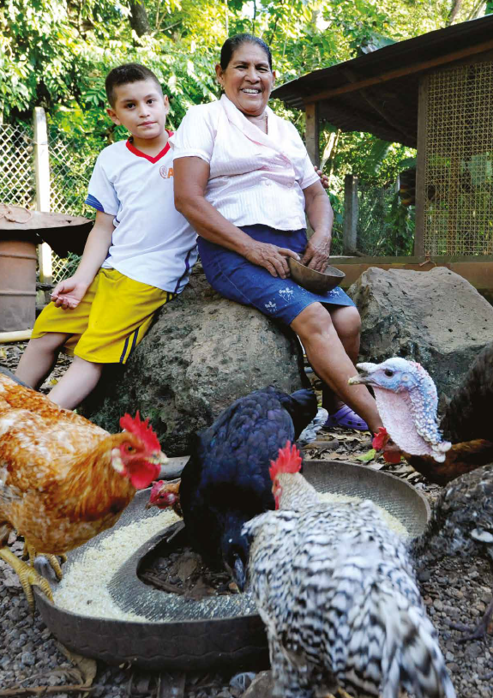
The Agroecology projects work in harmony with the land, helping farmers to improve their resilience to climate change. The project provides training on –
Crop diversification: Crop diversification takes advantage of the space available for planting different types of crops so that the farmer has food to eat and produce to sell at different times of the year. Organic barrier crops are also used to help protect plants and soil from wind and water.
Energy parcels: By planting fast-growing trees families get firewood and charcoal without the need for future deforestation.
Homemade chicken feed: The homemade feed is cheaper to produce and provides a balanced feed for chickens, keeping them healthier and producing good quality eggs and meat for families.
Tina, and her grandson, in El Salvador
Tina took part in the project and she now grows a variety of organic fruit and vegetables for the family to eat and has organic feed for her chickens.
Spin again
Go to board

Slide 19
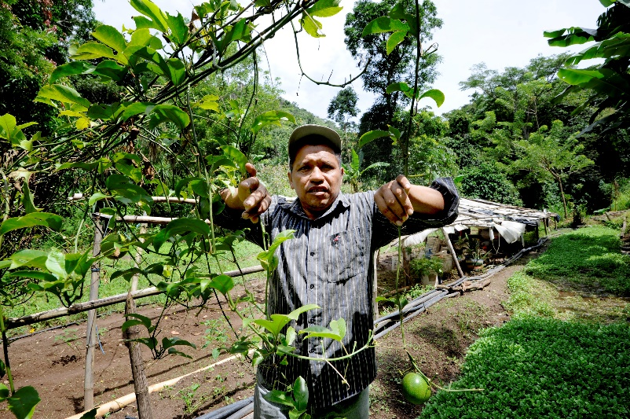
You install a water tank
for dry months
Your water tank will mean you can plant and water your crops in the dry season. Move forward one space.
Water is a precious commodity and increasingly erratic weather patterns make it more difficult for small-scale farmers who rely on the regular rainfall for planting and harvesting.
By 2025 half of the world’s population will be living in an area where water is scarce.
Spin again
Go to board
Read the real-life story

Slide 20
SCIAF and its partners have implemented Agroecology projects in El Salvador and Nicaragua. The projects work in harmony with the land and help to improve the resilience of small-scale farmers to climate change.
One increasingly important element of the project is to help farmers improve their water conservation for dry months. The project provides training on:
Bio-filters: Water used in showers and sinks in homes in rural areas is wasted because it is contaminated by cleaning products. The bio-filter is able to decontaminate this water and make it useful for watering kitchen vegetable gardens, plants and trees all year round.
Drip irrigation: An easy to manage system with quick installation. It increases resilience to climate change as it helps mitigate irregular rainfall and is used to water plants during the dry season. Drip irrigation allows water to drip directly to the roots of the plants and minimises wasted water.
Spin again
Go to board

Slide 21
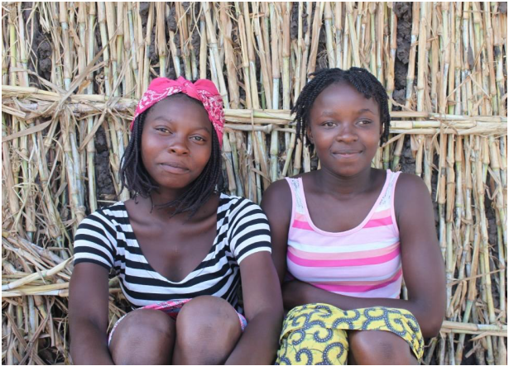
Your children's school is flooded and their books ruined
Your children are missing the vital education that would help them develop the skills and knowledge they need to live life to the full.
Miss a turn.
Climate change is affecting the poorest not only in their livelihoods but in their schooling too.
Every year, millions of children miss out on an education because of natural disasters.
Read the
real-life story
Spin again
Go to board

Slide 22
More than half a billion children live in extremely high flood occurrence zones, and nearly 160 million live in high or extremely high drought severity zones.
Linda and Maria are both
16 years old. They are best friends and classmates at secondary school in Mozambique.
A flood destroyed both of the
girls’ homes and their school. They lost all their possessions including their school books and uniforms which need to be replaced before they can
return to school.
“The school opened again last week but we can’t afford to go back yet.”
Linda
“Our parents have asked us to be patient. Any money we have has to be first used for trying to repair the house and other things. We really want to go back to school but we realise that home has to come first.” Maria
Spin again
Go to board
Notes:
In the past 5 years supporters here in Scotland have donated over £50,000 to provide young people with the Real Gift of school books.
School books 4928 sold, with income value of £50,403

Slide 23
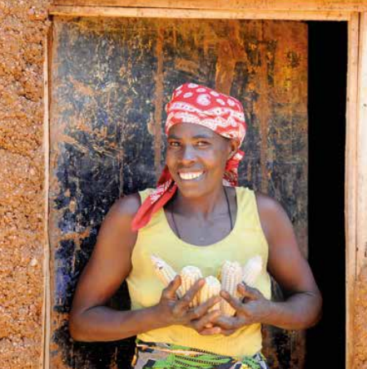
You board up your home and evacuate before a cyclone
Your village has an early warning system in place giving you valuable time to get to safety and protect your home and possessions. Move forward one space.
As well as the destructive force of a cyclone, heavy rainfall and polluted water associated with cyclones are likely hazards.
Read the real-life story
Spin again
Go to board

Slide 24
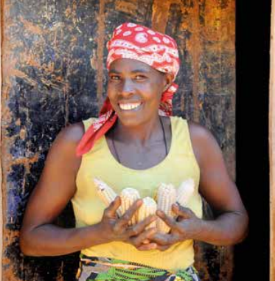
For people living in areas most vulnerable to extreme weather, early warning systems and evacuation drills help them to prepare and mitigate the risks they live with. It can equip communities with the skills, knowledge and materials they need to stand the best chance of surviving the next
environmental emergency.
As part of a programme to support farmers in Rwanda, SCIAF partners trained communities in disaster risk reduction to identify, asses and reduce the risks they face caused by environmental emergencies.
Nyirakanani Collette, Rwanda
The project supported people in six villages. They set up community action groups which helped families to develop strategies to be better prepared in the future.
Spin again
Go to board

Slide 25
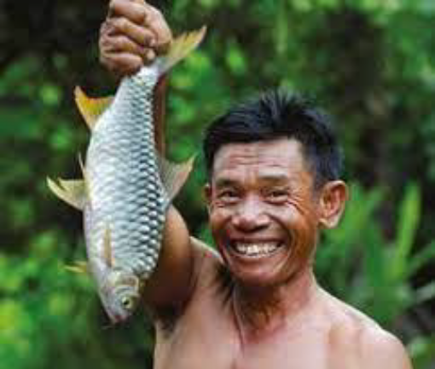
Warmer oceans means there’s no fish to catch and eat
You rely on the local river for fishing, to feed your family and sell your catch at market. Miss a turn.
The earth’s oceans are getting hotter and the average temperature is increasing every year because of human-caused global warming. Warmer waters can make it harder for fish to find food or reproduce. This has a huge impact on the people who rely on fishing for their livelihoods.
Read the
real-life story
Spin again
Go to board

Slide 26
Working with our partners in Cambodia we’re helping communities to adapt they way they farm and fish to better cope with climate change.
We’re helping them to protect their rivers and set up community fish farms.
We’re also helping them use sustainable and organic methods of growing rice and vegetables to increase their harvest. These methods are cost-effective for the
farmers and use no machinery, less water, organic
fertilizer and less seeds.
Lang’s family took part in the project
“My family’s situation is better than before. Most of our money now comes from fishing and farming. I now have enough money to help my youngest son to go to university.”
Lang
Spin again
Go to board

Slide 27



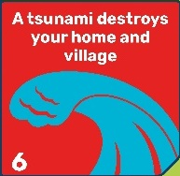

How to play
Spin
Spin the wheel to see how many moves to take…
…make your way around the board from start to finish by clicking on the pawn to move one space at a time…
…you may find some obstacles along the way, caused by the climate emergency. But, you can also progress forward by taking action to protect the earth.
Go to board
Spin again
Move forward one space
Miss a turn
When you land on an action square like this…
…click on it to read about the people who are already feeling the real-life effects of climate change.
Then spin again and make your
next move…good luck!
Read the real-life story

