Slide 1
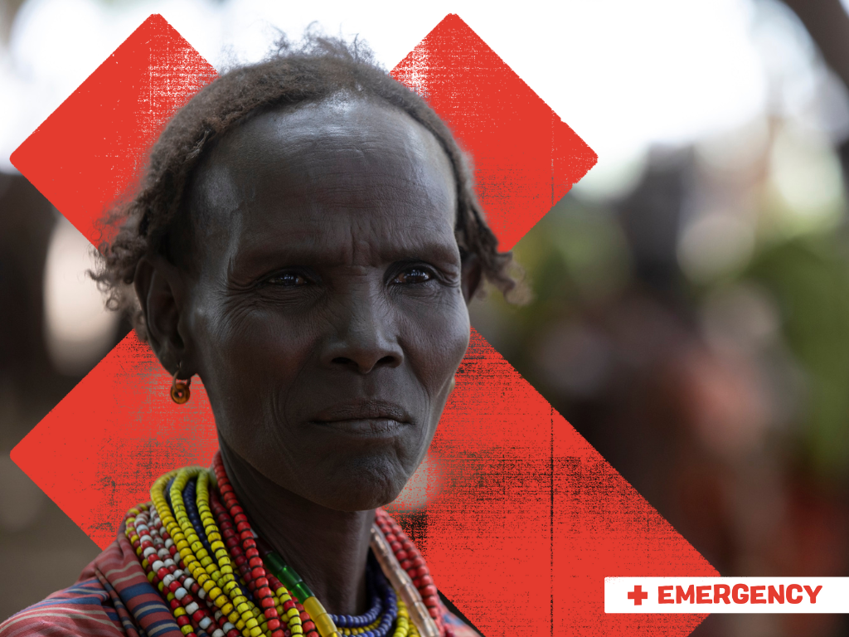

Emergency
Appeal
Summer 2023
Ayoyo, Ethiopia

Slide 2
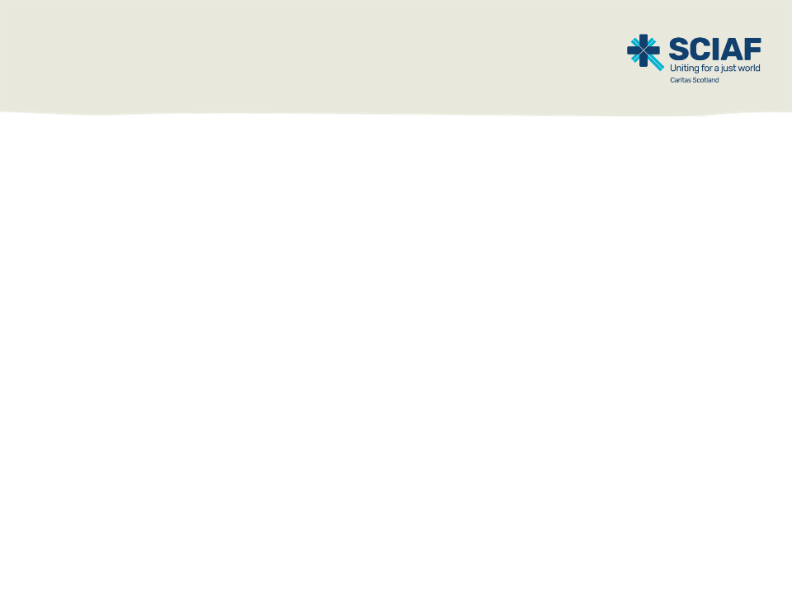
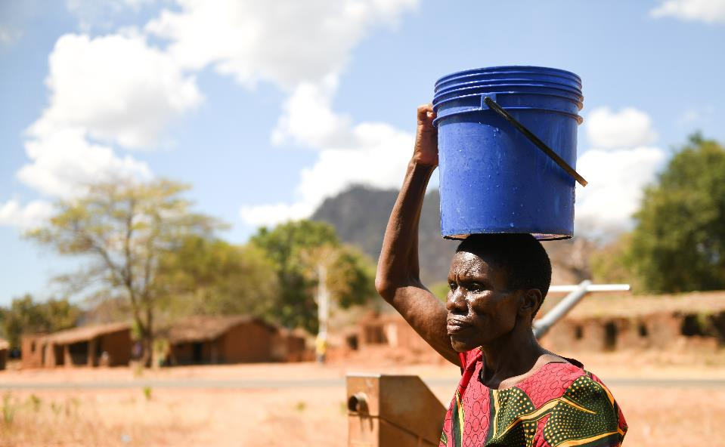
Introduction
The world exists for us all, yet millions of men, women and children are deprived of the things they need to survive.
But it doesn’t have to be this way.
Lonnex, Malawi

Slide 3
Introduction
Our vision is a just world, free of poverty, where we flourish and live in harmony with each other and all creation.
Compelled by Christ’s love, we work with those in the world’s poorest places to end poverty, protect our common home, and help people recover from disaster.
We inspire loving action in the Scottish Catholic community to sustain our work.

Slide 4




Together
we reach out in love
We work across Africa, Asia, Latin America, the Middle East and Europe. In 2022…
We helped over
1 million
people to have
a brighter future
We supported
30
emergency responses in 16 countries
We spent over
£8 million
on 101 projects,
in 26 countries

Slide 5
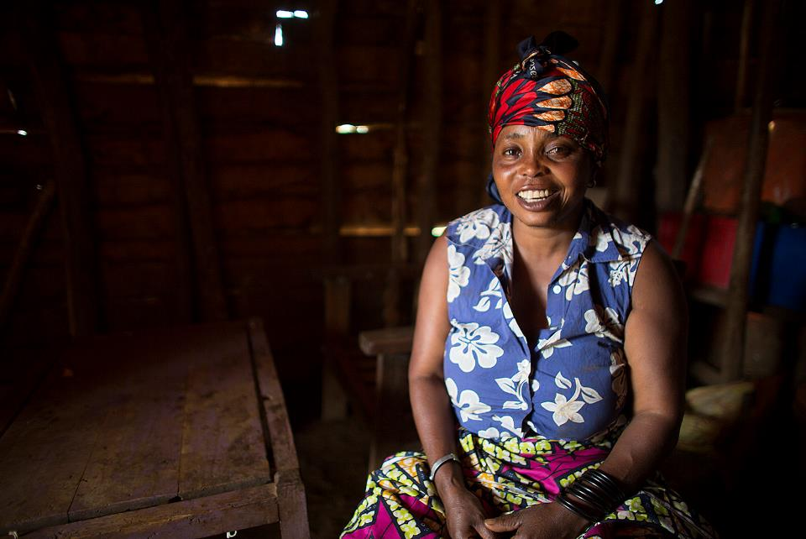
Our work
We’re present in the most difficult places. We work with people in the hardest circumstances, so they can overcome their daily struggles and dismantle the structures that
keep them poor.
Sylvia, DRC

Slide 6
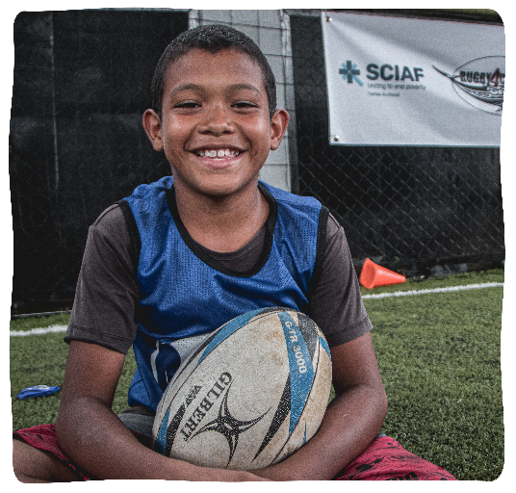


The Caritas family
We are part of the Caritas network, the second largest humanitarian network in the world, with members in over
160 countries.
Jhonathan,
Colombia

Slide 7
What we do
We help people provide for themselves and their families, supporting them to start businesses and learn new skills, creating hope for the future.
We stand side by side with communities to build peace and promote justice, so they have power over their own lives.
We advocate for change at the national
and international level to tackle the
deeper issues which keep people poor.

Slide 8

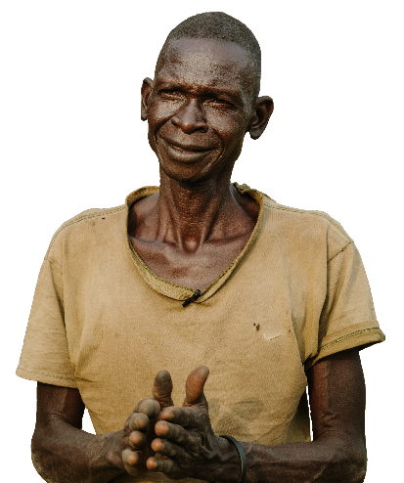





Our focus: hunger
Conflict, climate change and COVID-19 have left millions facing the worst hunger crisis in decades.
How we help:
1.
Immediate
access to
life-saving food and financial support
2.
Access to seeds, tools and training to grow food that’s resistant to a changing climate
3.
Provide the support needed to increase income, save money and provide a secure future
Justin,
South Sudan

Slide 9
Emergency appeal: Ethiopia
We work with our local partners and the Ethiopian Catholic Church.
As an important part of the local community, the Church is well placed to provide both long-term support to families, and emergency humanitarian assistance, including food, shelter and other essentials.

Slide 10
Emergency appeal: Ethiopia
Ethiopia is experiencing the worst drought in its recent history.
Millions of people are on the brink of famine.
Rivers have dried up, crops have withered and died, livestock have perished.

Slide 11
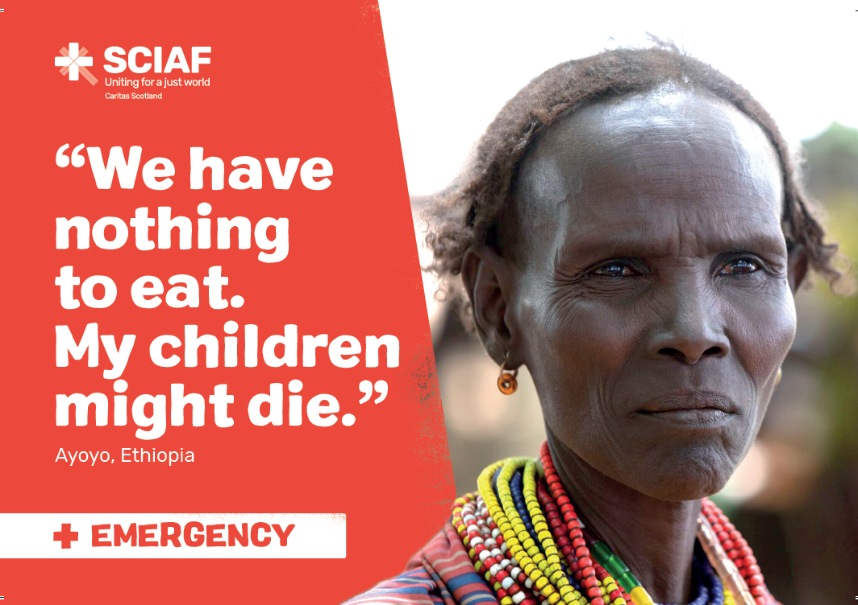
Notes:
Ayoyo used to farm for food and run a small business. However, because of the drought, this is now impossible. Everything around her has died. She said,
“The drought has destroyed all our crops and left us very hungry – we have nothing to eat. Before he died my husband supported me, but now I don’t have any support. I used to have ten goats and five cows, but the drought has killed all my livestock. There is nothing left. Without SCIAF my children might have died.”
With her livelihood destroyed, Ayoyo is only able to support her family through vital emergency relief.

Slide 12
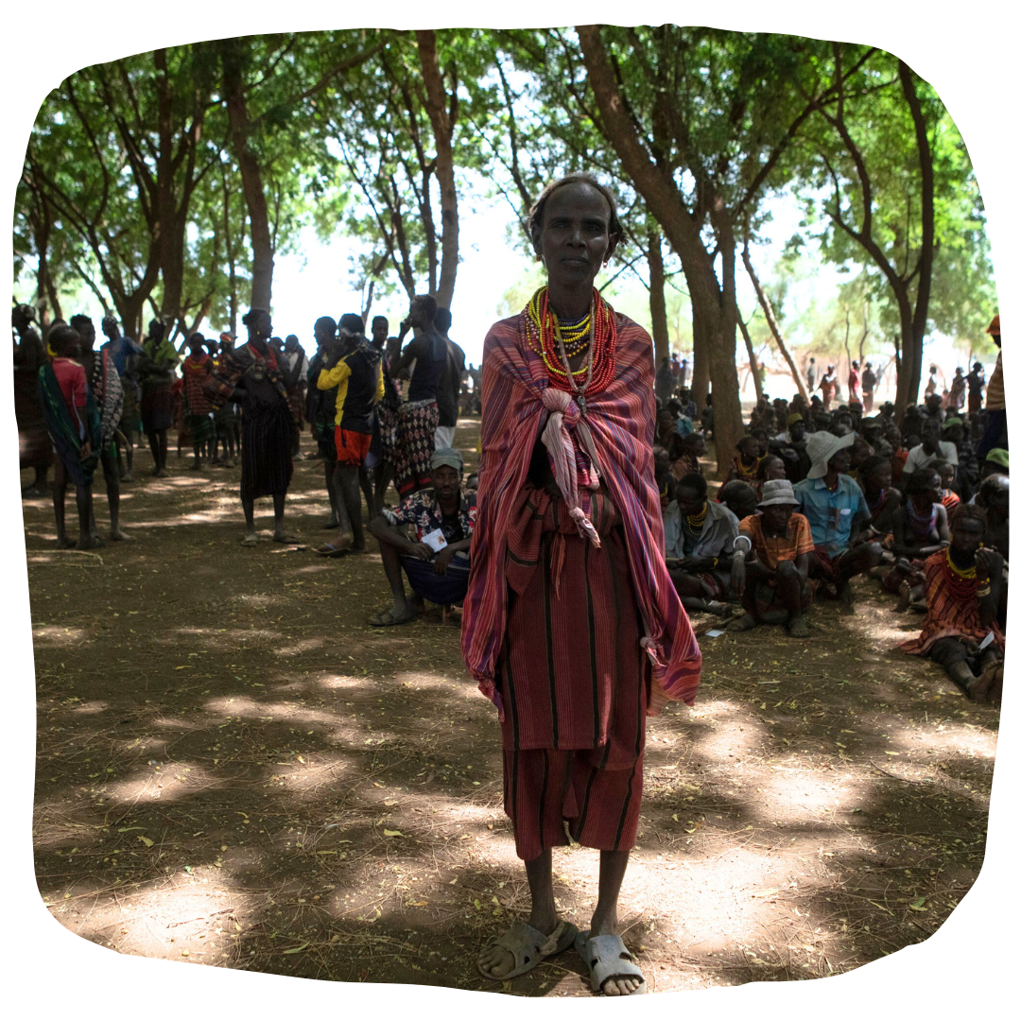

Donate today
Ayoyo, Ethiopia
You can depend on SCIAF to get your donations straight to the people who need it.
Please donate today
SCIAF.org.uk/donate
Notes:
We are in difficult financial times, but if you wish to make a donation to this appeal, then please email getinvolved@sciaf.org.uk or visit the website.
Thank you once again for your support of SCIAF and the life-changing work that continues to empower and enable our sisters and brothers to help themselves out of the poverty they find themselves in.

Slide 13
Prayer
Loving Father, we thank you that the Church here in Scotland is providing long-term support to millions of families in Ethiopia.
Thank you that in times of emergency, SCIAF can respond.
We pray that SCIAF partners in Ethiopia will continue their life giving support, and that with our help, they will continue to help the millions of people without access to sufficient food and water.
We pray for their safety. We ask you for your peace.
Through Jesus Christ, our Lord.
Amen.

Slide 14
Thank you
A just world, free of poverty, where we flourish and live
in harmony with each other and all creation.
Scottish Catholic International Aid Fund
SCIAF is the official relief and development agency of the Catholic Church in Scotland
and a proud member of the Caritas family. 7 West Nile Street, Glasgow G1 2PR.
Tel: 0141 354 5555. Scottish Charity No: SC012302. Company No: SC197327.
sciaf@sciaf.org.uk

