Slide 1
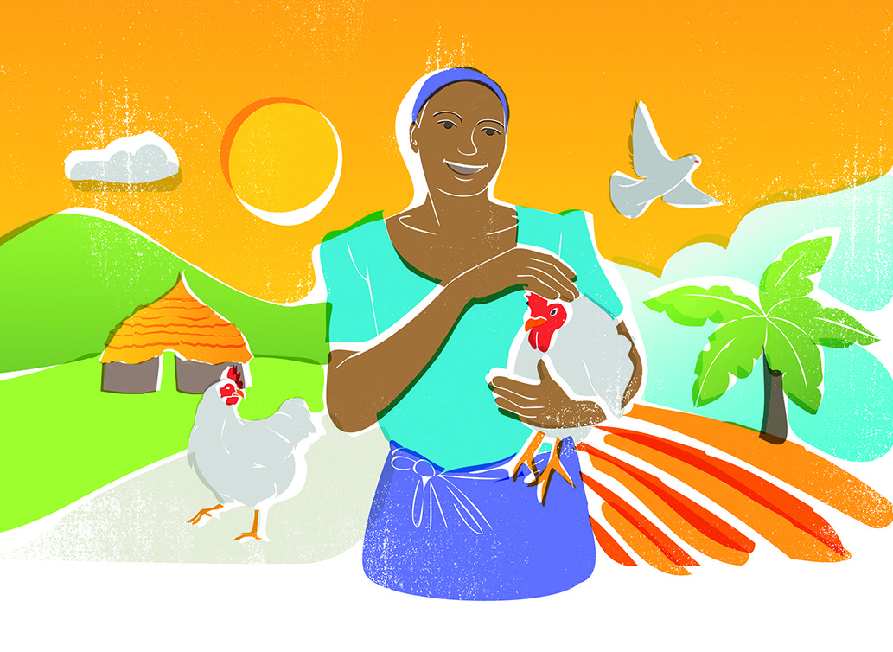


GIFTS THAT
KEEP ON GIVING

Slide 2




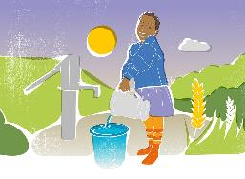

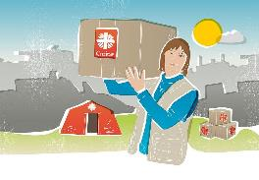
REAL GIFTS
ARE THE REAL DEAL
Real Gifts make a world of difference. Unique and impactful, they’re the gift that keeps on giving.
FARMING GIFTS
EDUCATION GIFTS
WATER GIFTS
EMERGENCY GIFTS

Slide 3
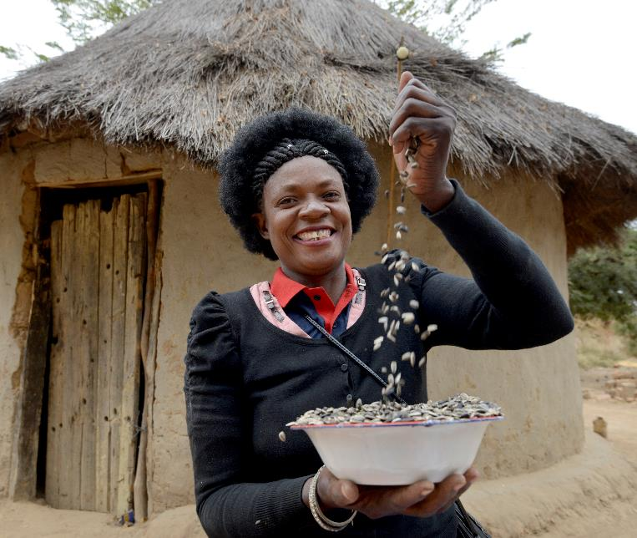

SUPER
SEEDS
Your gift of seeds can help people in the poorest parts of the world grow more food, eat a more varied diet, and improve their health and quality of life.
These super seeds are the start of a more sustainable future.
£4

Slide 4
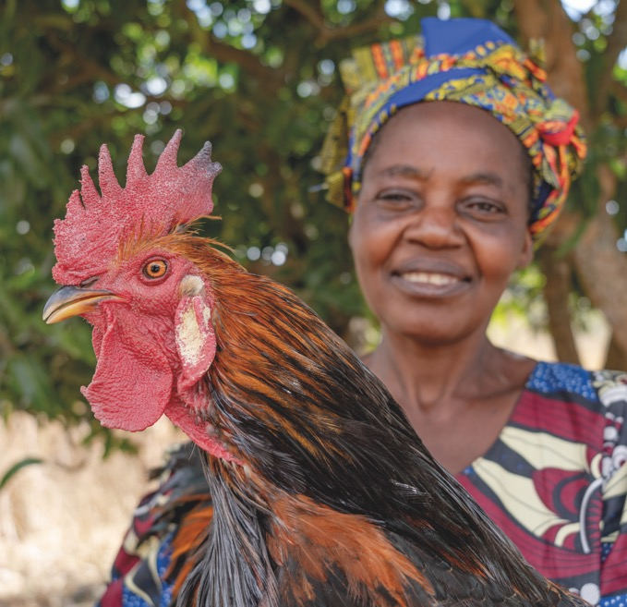
£15
CHEEKY
CHICKS
Your simple gift of chickens can bring hope to families in need, providing them with a sustainable source of nutrition from eggs and extra money through the sale of chicks.
Although chickens are relatively easy to keep, our partners work with families to make sure they have the knowledge and skills to look after their chickens to a high standard.

Slide 5
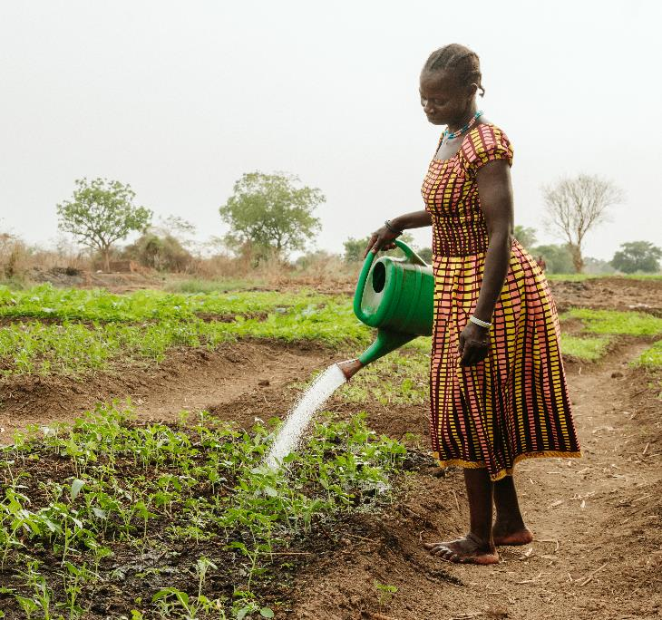
A MIGHTY
WATERING
CAN
Water is life! In areas where water is scarce, a watering can isn’t just a simple tool, it’s a lifeline for crops – and the families that rely on them.
From sprinkle to sprout, watering cans help families grow more food and eat healthier diets.
£6

Slide 6
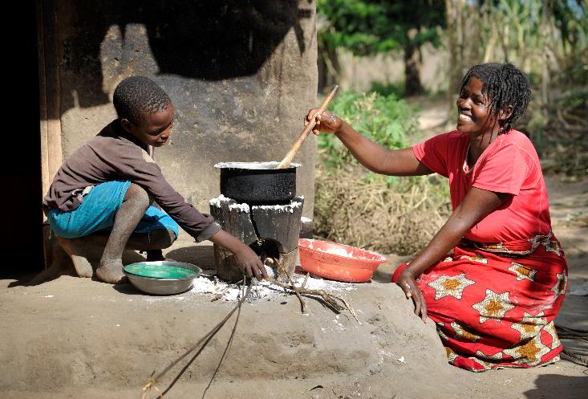
A LITTLE
GREEN STOVE
This gift helps tackle the climate emergency not only by cutting back on firewood, but by reducing smoke pollution and burning fuel more efficiently too.
Eco stoves are good for both people and planet!
£9

Slide 7
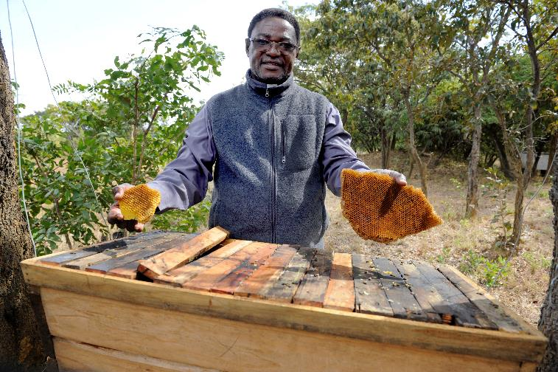
BEE-KEEPING
EQUIPMENT
£12
Bee-keeping equipment not only helps protect vital bee populations, but also offers a viable source of income for families.
Plus, who doesn’t love fresh, delicious honey?
One bee-hive can produce more than 60lb of fresh honey in a good season.

Slide 8
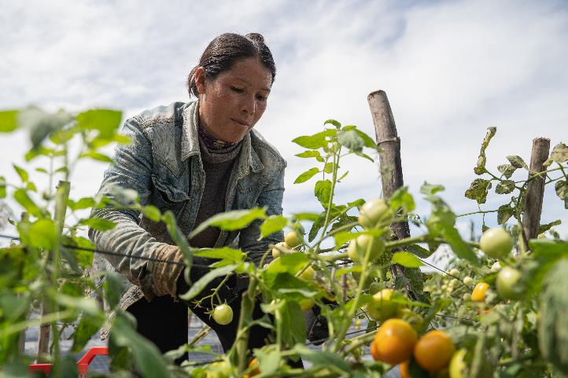
A VITAL VEGGIE GARDEN
Your gift of a vegetable garden helps families to grow fresh and healthy vegetables, and herbs on their own small plot of land.
This not only provides people with healthy food options like sweet potato, carrot, onion, cabbage, cucumbers and spinach but also allows them to sell their produce in local markets for additional income, promoting self-sustainability.
Watch life grow!
£25

Slide 9
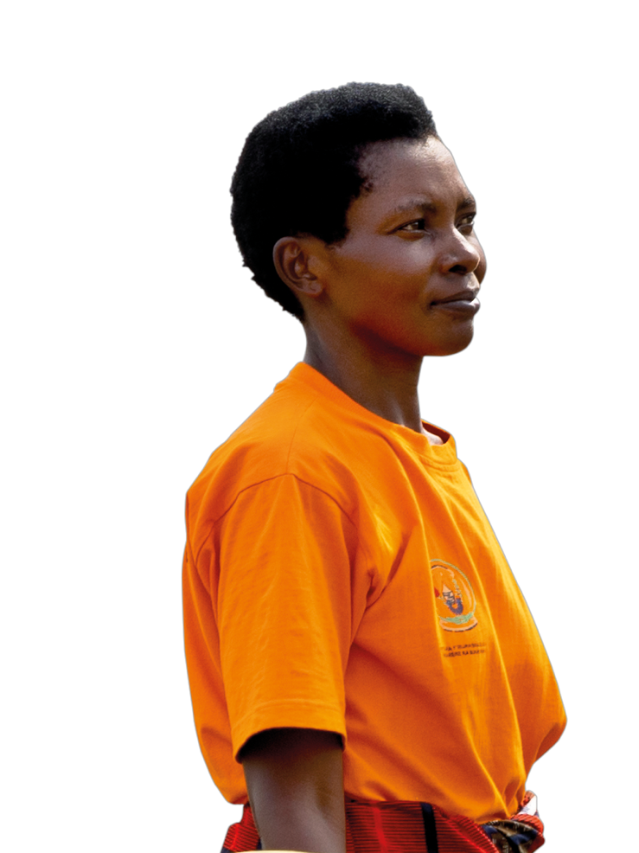

“We used to struggle to even buy porridge to eat. Now we eat three times a day without any problems, and have the freedom to eat whatever we want. We grow our own crops and enjoy the fruits of our labour. We can afford whatever we need from the market.”
- Julien, Rwanda

Slide 10
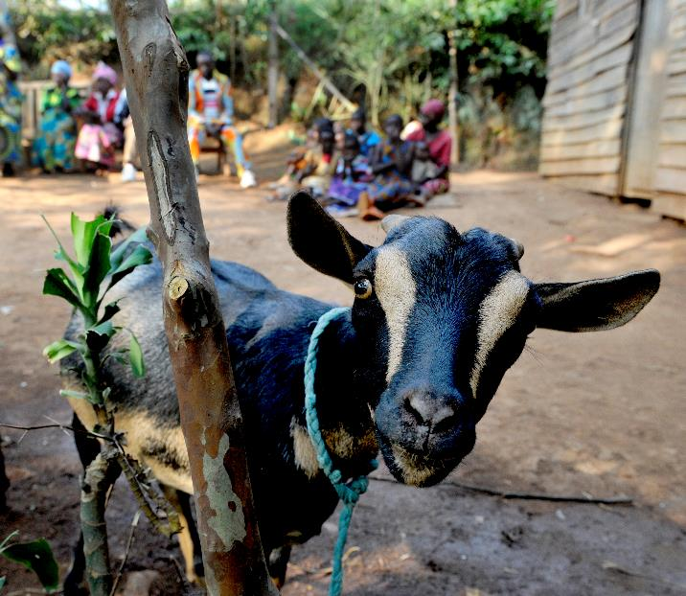
GOATS
Goats not only provide vitamin rich milk to drink – they can also be bred, and sold for profit. And the best part? Their droppings make for excellent organic fertiliser, helping fields flourish!
Our partners work with families and local vets to make sure the goats are looked after to a high standard.
£35

Slide 11
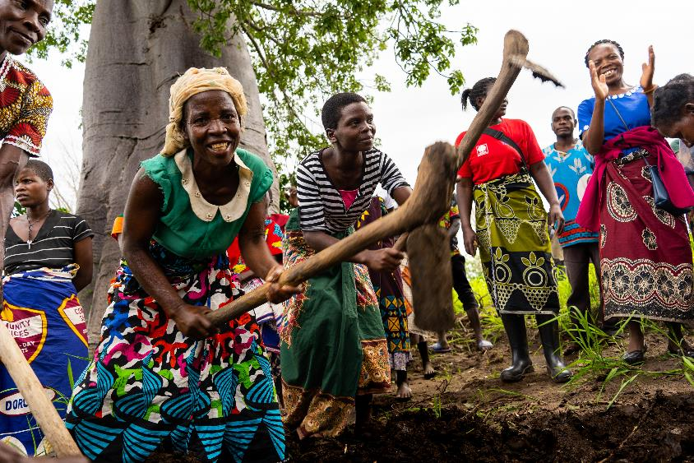
A SPADE
MADE TO LAST
£8
With the gift of a farming tool, like a spade, you can help farmers plant and harvest, saving them time and energy.
Spades cultivate real change from the ground up, helping make a lasting impact on livelihoods and wellbeing.

Slide 12
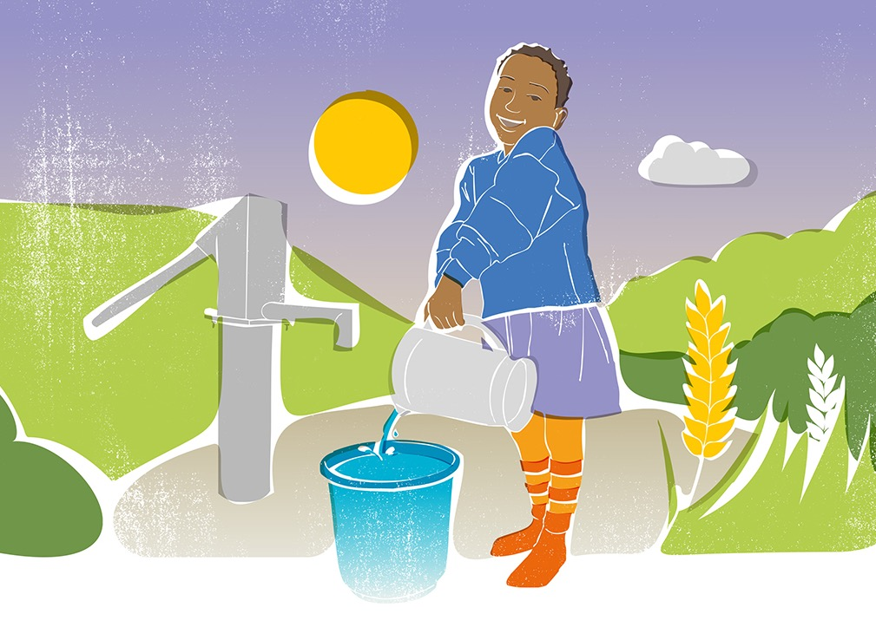
GIFTS THAT
KEEP ON GIVING

Slide 13

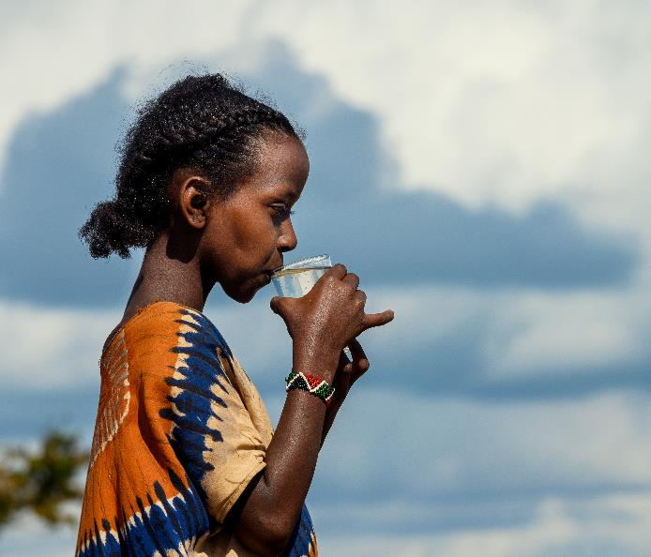
FABULOUS
FILTERS
£37
Access to clean water is a fundamental right, yet millions of people around the world still don’t have it.
Your gift of a water filter ensures families can access clean water. Not only does it protect them from diseases, but it also brings a healthier, brighter future!

Slide 14

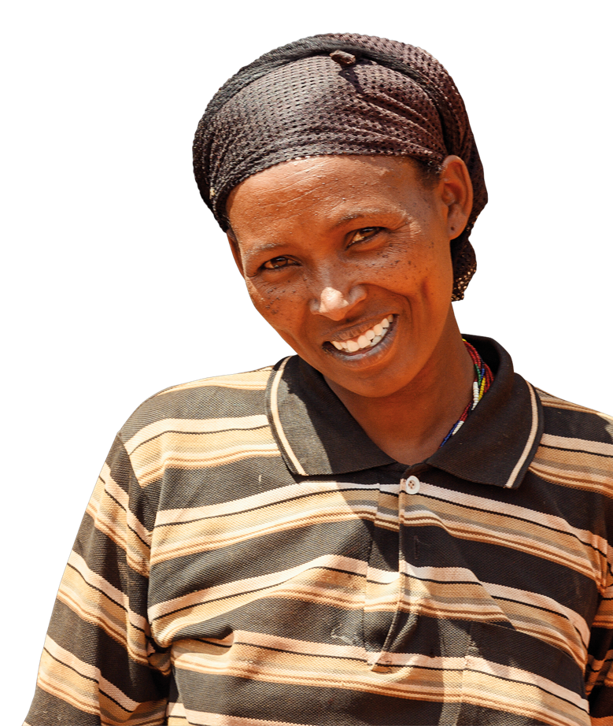
“We have a much closer source of water and we can clean it without burning any precious fuel. My children are no longer sick, they can attend school every day.”
- Bokayo, Ethiopia

Slide 15
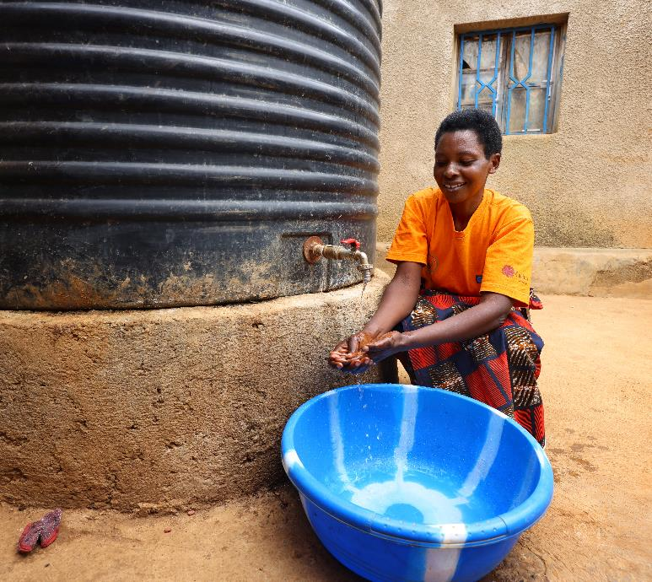
BUCKETS
OF FUN
This seemingly simple gift has the power to make a significant difference in someone’s life by helping them to wash their hands and clothes.
A wash bucket helps uphold dignity in some of the worlds poorest places.
It’s not ‘just’ a bucket.
£4

Slide 16
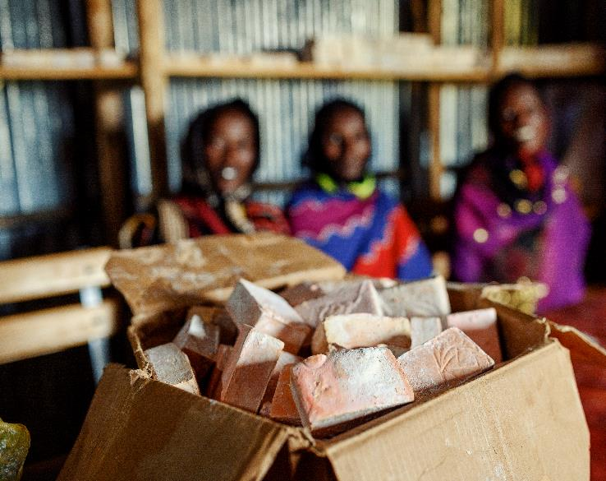
SOAP
A bar of soap: so simple yet
life-changing.
For people living in the world’s poorest places, soap can mean the difference between life and
death, helping stave off infection and keeping children safe.
A gift of soap helps families
live healthy and dignified lives.
£5

Slide 17

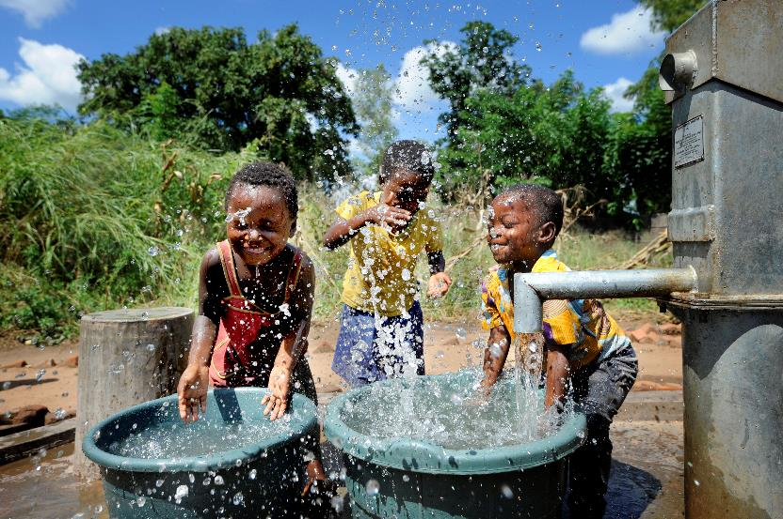
WATER FOR A
VILLAGE
Water is life.
But around the world, families without clean water are trapped in a deadly cycle of poverty, poor health and premature death.

Slide 18
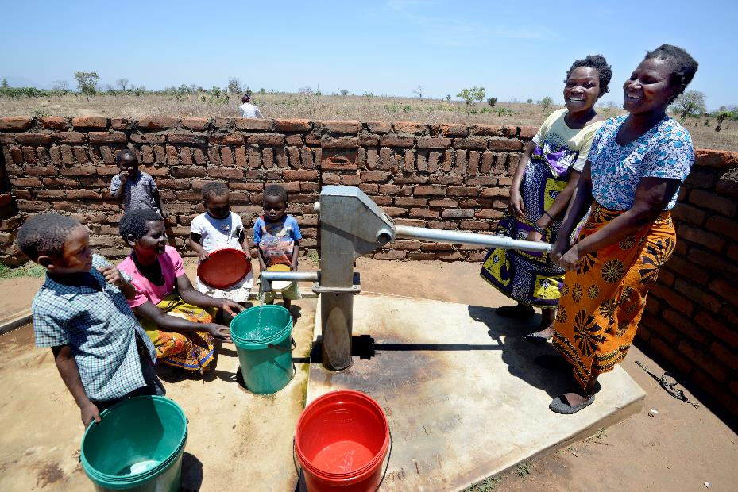
WATER FOR A
VILLAGE
771 million people don’t have access to clean water.
That’s 1 in 10 people.
This gift will improve access to water for people in the poorest parts of the world.

Slide 19
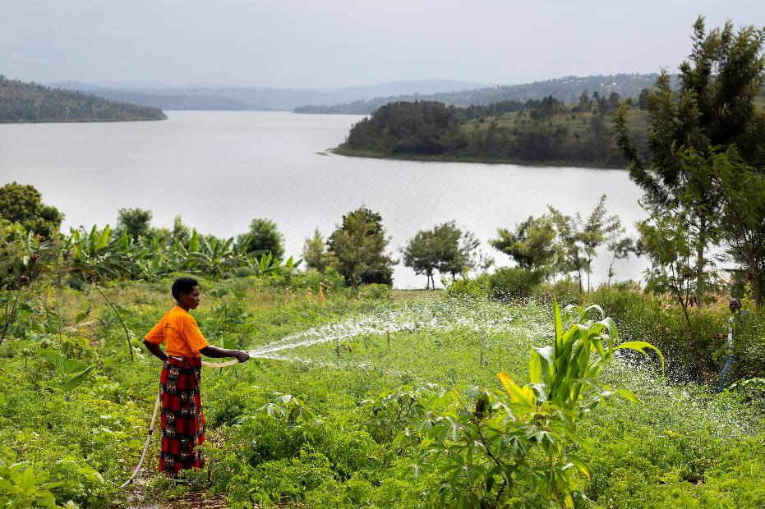
WATER FOR A
VILLAGE
This gift can provide community water sources such as wells and lakes, installing irrigation systems to help crops grow.

Slide 20
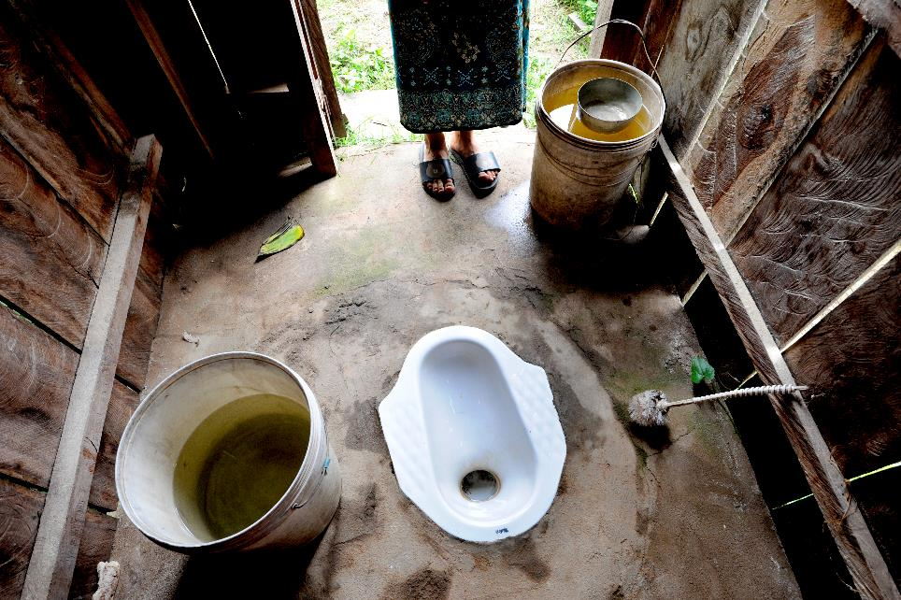
WATER FOR A
VILLAGE
Or, it can build hygiene facilities such as handwashing stations and proper toilets.

Slide 21

GIFTS THAT
KEEP ON GIVING

Slide 22

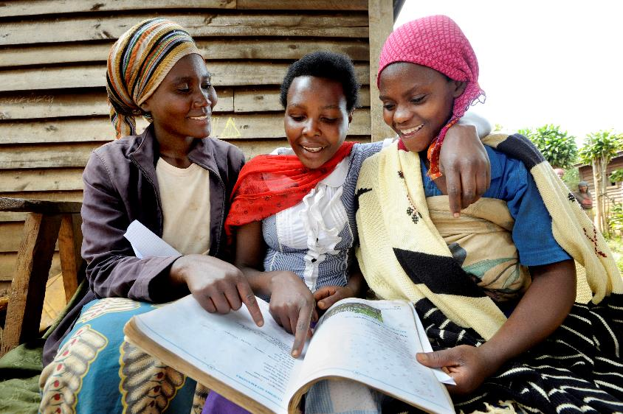
LITERACY
£17
Education is a precious gift, opening up possibilities for a better future!
Your gift provides the opportunity to learn how to read and write - unlocking new stories and new possibilities!

Slide 23

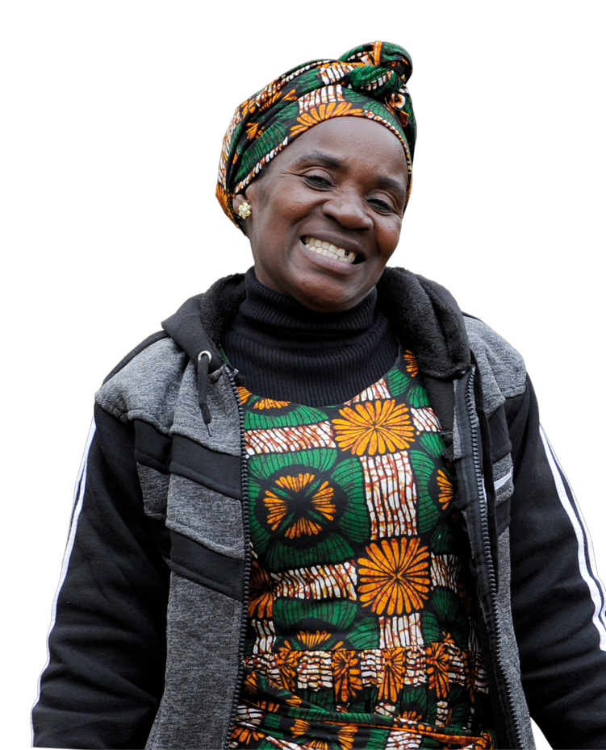
“Caritas came and taught me how to read and write. I couldn’t sign my name before, it was tough. But now I teach literacy to other women.”
- Emeldah, Zambia

Slide 24
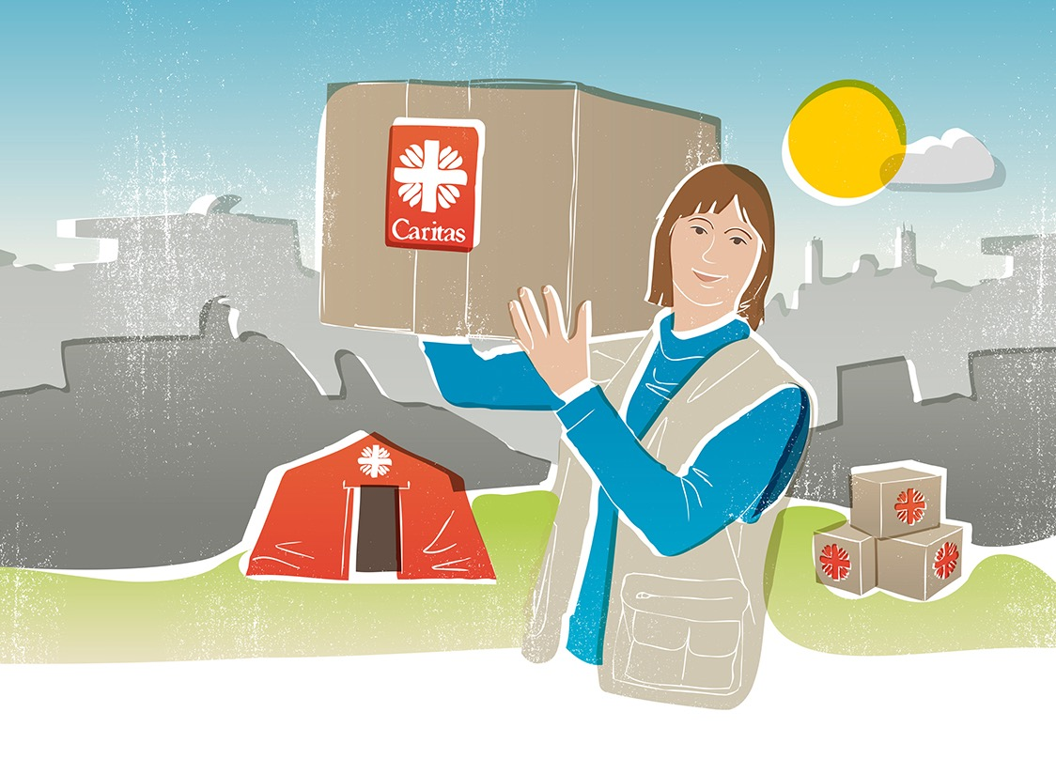
GIFTS THAT
KEEP ON GIVING

Slide 25

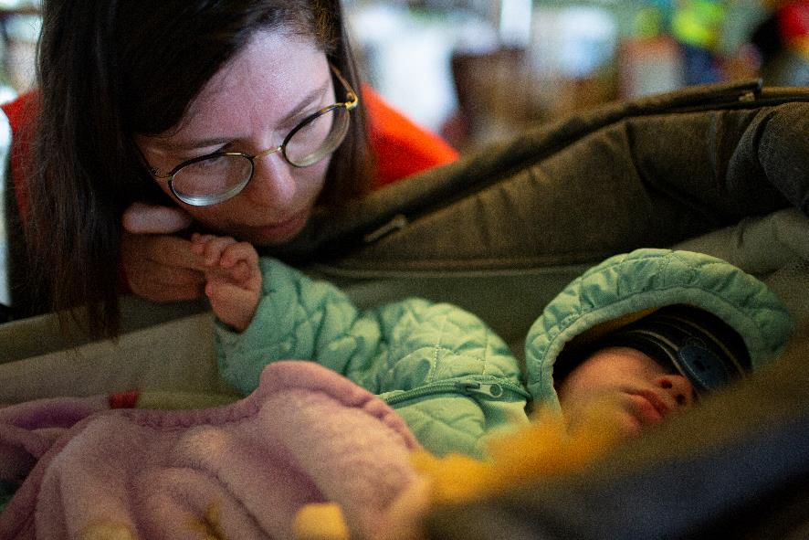
COMFORT BLANKETS
£18
On cold nights, a simple blanket can mean the
difference between life and death for the most
vulnerable – the elderly, children, and infants.
Your gift of warmth can bring comfort and
security to families living in temporary shelters.

Slide 26
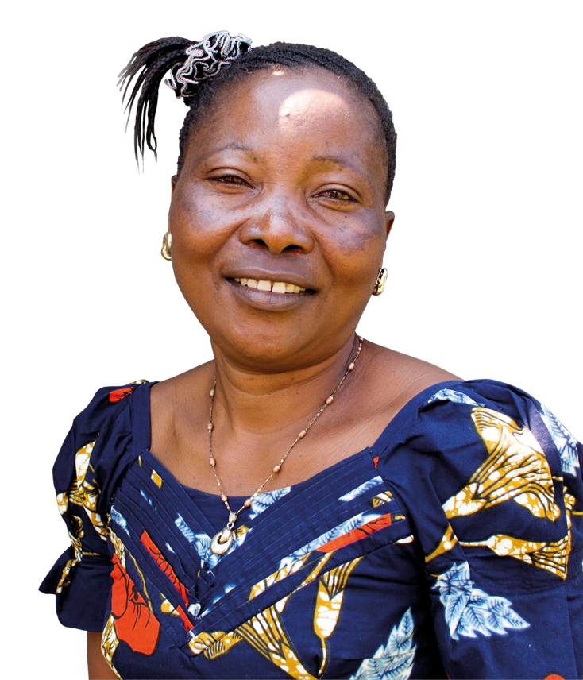
Heavenly Father
We lift up our hearts in gratitude,
for the blessings we've received from You.
We offer these Real Gifts,
as a sign of love for our global family.
May they be a beacon of hope,
for those who need it most.
May they bring nourishment,
joy, and brighter futures.
May our fundraising efforts echo
Your call to love and serve.
And, may we always work to create
a more just and kinder world for all.
Amen

Slide 27

“Participating in the women’s group and listening to stories of what has happened to others, gives me strength.”
- Joan, DR Congo

Slide 28
JOIN US NOW
TO BUILD A JUST WORLD, FREE OF POVERTY.
Thanks to you, we support people to lift themselves
out of poverty, work to protect our common home,
and help people recover from disaster.
Scottish Catholic International Aid Fund
SCIAF is the official relief and development agency of the Catholic Church in Scotland
and a proud member of the Caritas family. 7 West Nile Street, Glasgow G1 2PR.
Tel: 0141 354 5555. Scottish Charity No: SC012302. Company No: SC197327.
sciaf@sciaf.org.uk

