Slide 1

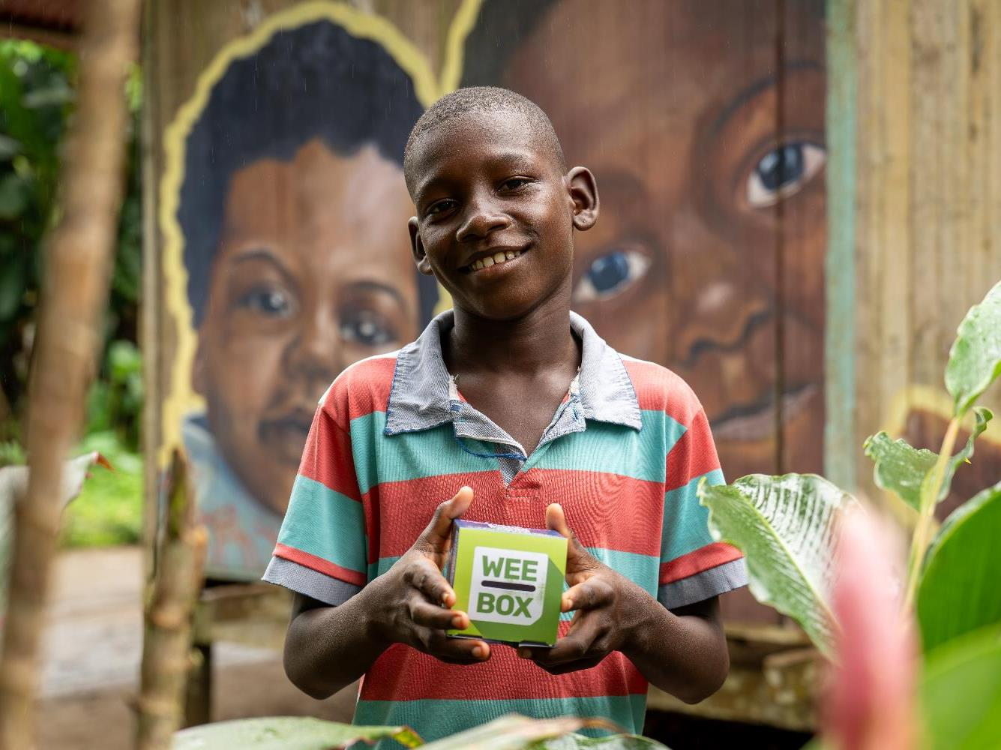


WEE BOX 2025
PRIMARY
ASSEMBLY
Notes:
Teacher/Reader notes:
This PowerPoint looks at the impact of conflict on people in Colombia and how the Church, through SCIAF, are helping. Conflict can be a difficult subject for people of any age. Some people may have experienced displacement, war and conflict themselves. So, check in on your pupils and look after yourself.
At SCIAF, we believe it is important to balance discussion about war and conflict with hope and optimism.
Read aloud script:
Our school are supporting SCIAF’s WEE BOX appeal this year.
SCIAF are one of the official charities of the Bishops Conference of Scotland.
This year they mark 60 years of serving the poor and vulnerable around the world.

Slide 2




WHAT WE DO
We work across Africa, Asia, Latin America, the Middle East and Europe.
Every year
we help over
1 million
people to have
a brighter future
We support people during emergencies
Together, we reach out as Pilgrims of Hope in this special Jubilee Year.
Notes:
Read aloud script:
Evey year, through SCIAF help over 1 million people to recover from disaster and to have a brighter future.
This year is a special Jubilee year for the Catholic Church, where we are invited to be pilgrims of hope showing care for others and living out our faith.

Slide 3

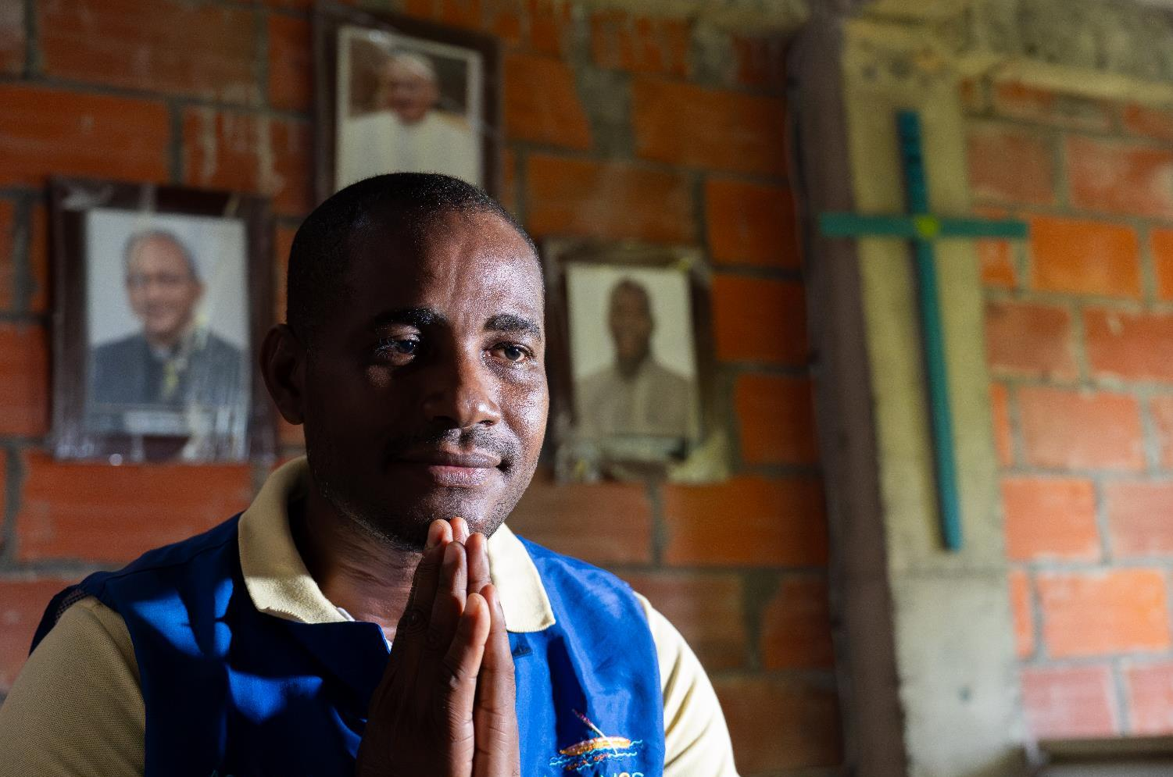
JUBILEE 2025
Notes:
Read aloud script:
One way we can do this is through supporting SCIAF this Lent.

Slide 4

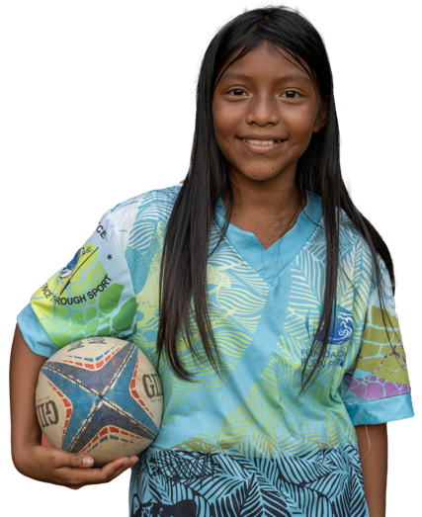
WHAT WE DO
DEVELOPMENT EDUCATION
ADVOCACY
HUNGER
WATER
PEACE & JUSTICE
EMERGENCIES
Marilin, Colombia
Notes:
Read aloud script:
SCIAF work here in Scotland educating people in schools and parishes about global issues and campaigning for a more just world.
SCIAF’s work around the world focuses on helping people grow enough food to eat, get clean water to drink and helping to make communities safe for everyone.
They also respond to global emergencies like floods and droughts and provide aid for refugees during conflicts.

Slide 5
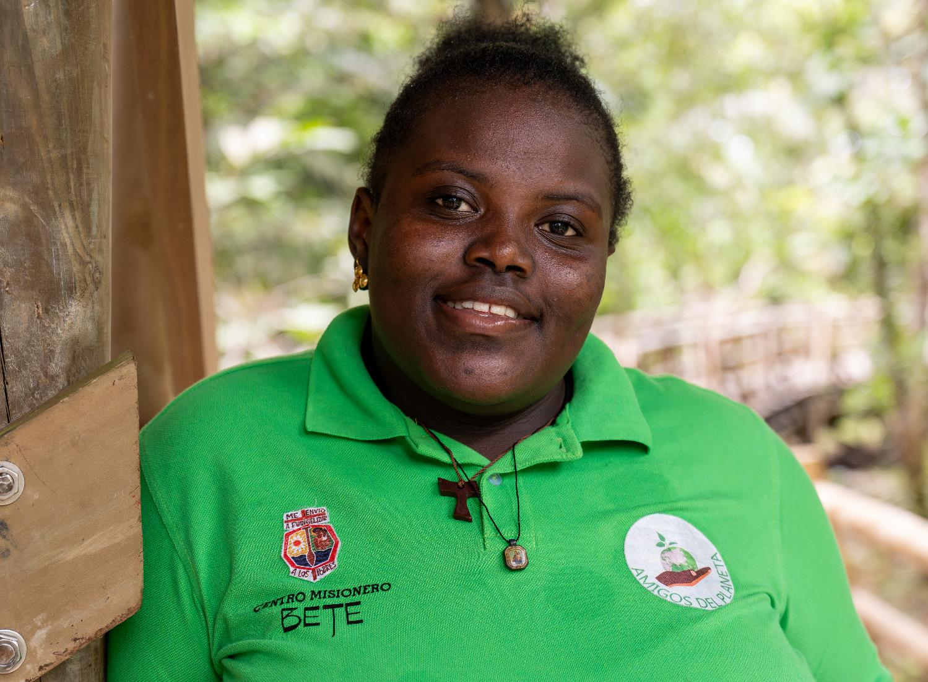

COLOMBIA
Notes:
Read aloud script:
Every year schools and parishes across Scotland donate to the WEE BOX appeal at Lent.
This year’s WEE BOX focuses on SCIAF’s work in Colombia.
Colombia is the fourth largest country in South America. It has natural resources like oil, gold, silver, emeralds, platinum, and coal. However, the society in Colombia is very unequal, with big differences between rich areas and poorer communities.

Slide 6
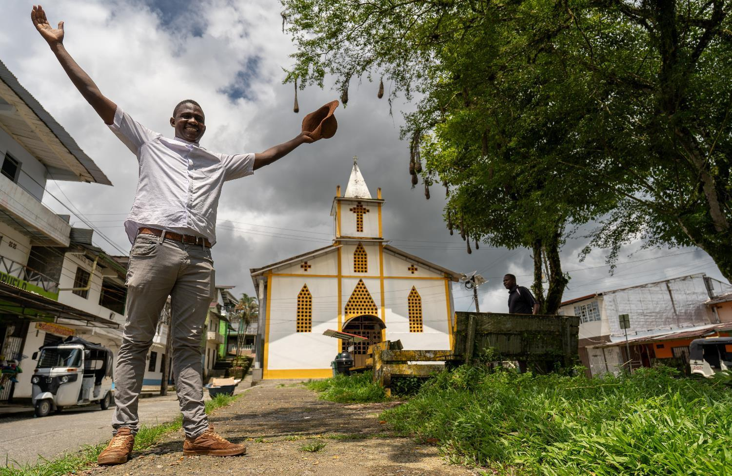
COLOMBIA
The Catholic Church in Colombia serves over 47 million Colombians, in 65 Dioceses.
Fr Daniel
Notes:
Read aloud script:
SCIAF work through local partners including the local Catholic Church in Colombia.
The Catholic Church in Colombia serves over 47 million Colombians - over 93% of the population -
in 65 Dioceses.
This is Fr Daniel, he is a parish priest in Chocó (Cho-KOH), one of the poorest parts of Colombia.

Slide 7
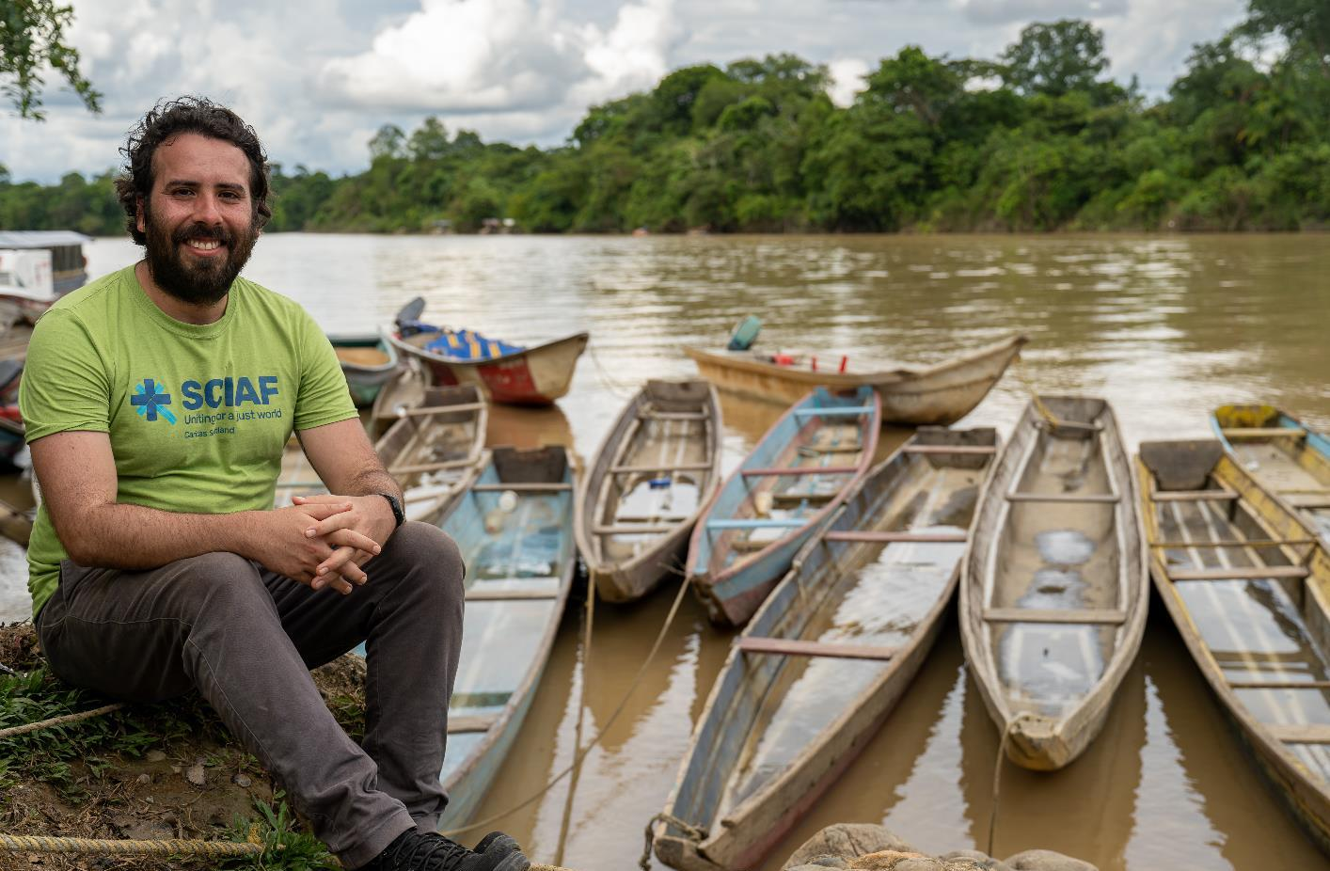
COLOMBIA
Rodrigo
Notes:
Read aloud script:
Even though Colombia is a beautiful country with amazing rivers and forests, many people face violence because of dangerous gangs.
For those living along the River Atrato (Ah-TRAH-toh) in northwest Colombia, the river is a vital part of their lives.

Slide 8

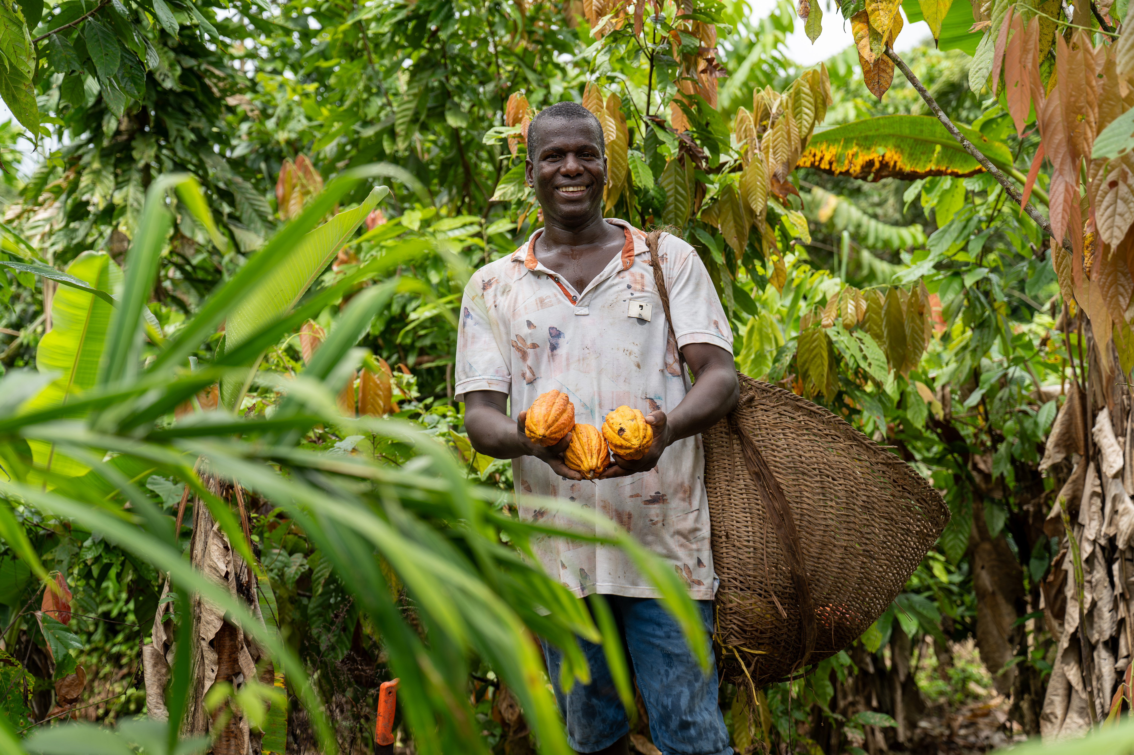
COLOMBIA
Arcadio
Notes:
Read aloud script:
This is Arcadio (Ahr-CAH-dee-oh). He grows cocoa in a very rural area in Colombia.
He takes his cocoa by boat to sell to communities along the River Atrato (Ah-TRAH-toh).

Slide 9
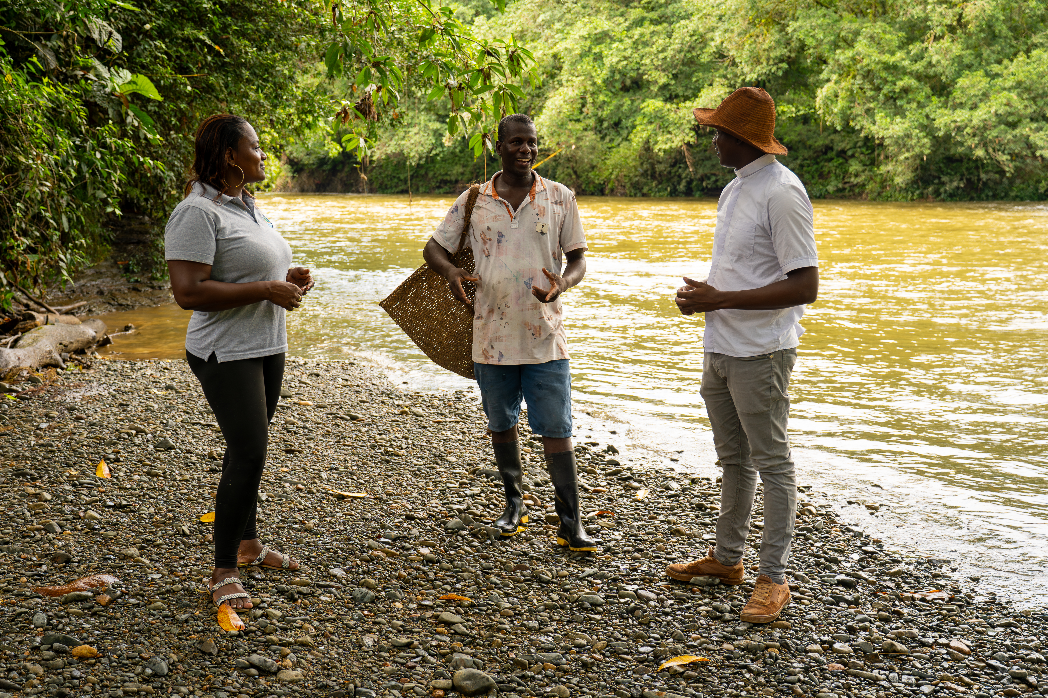
COLOMBIA
Arcadio and Fr Daniel
Notes:
Read aloud script:
Many communities who live along the river depend on it every day.
Fr Daniel travels by boat to meet people living along the river.

Slide 10
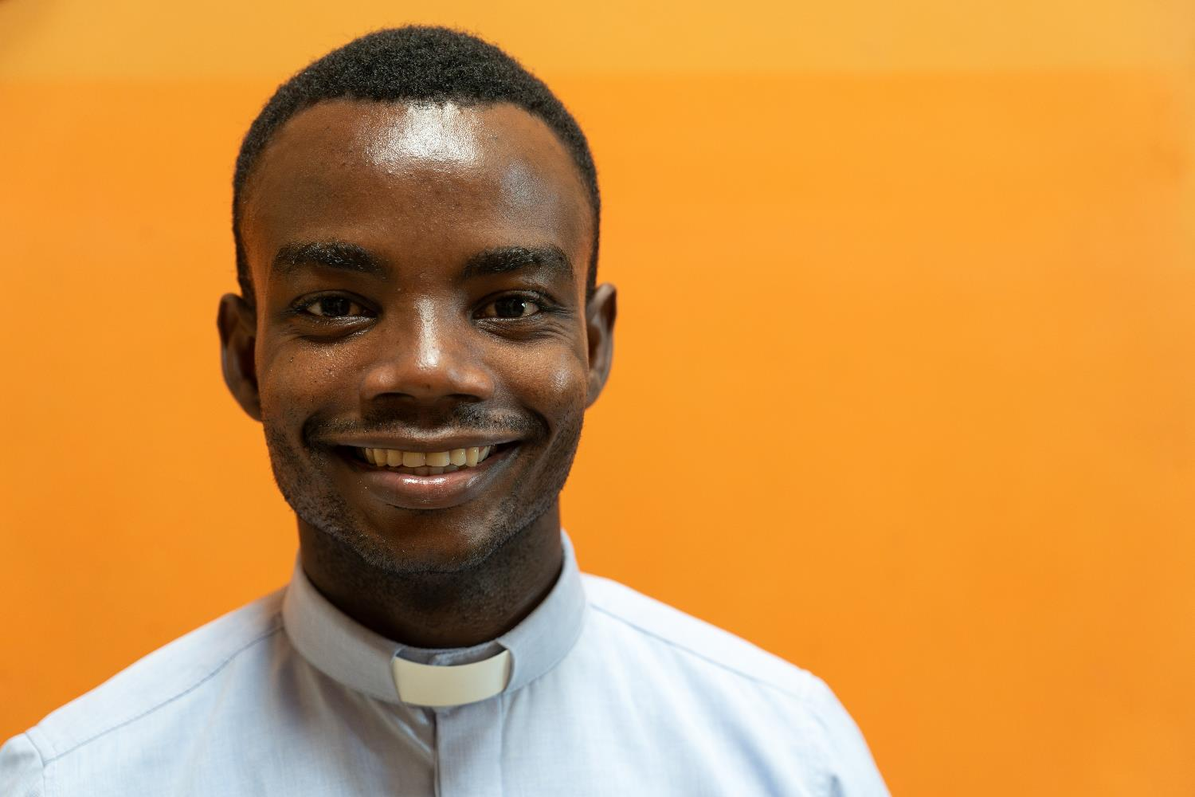
COLOMBIA
Fr John runs a youth group where young people put faith into action.
Fr John
Notes:
Read aloud script:
This is Father John.
He works with young people along the River Atrato (Ah-TRAH-toh) .
The young parishioners come together each week to talk about their faith.
They also put faith into action by campaigning on river pollution and arranging litter picking.

Slide 11
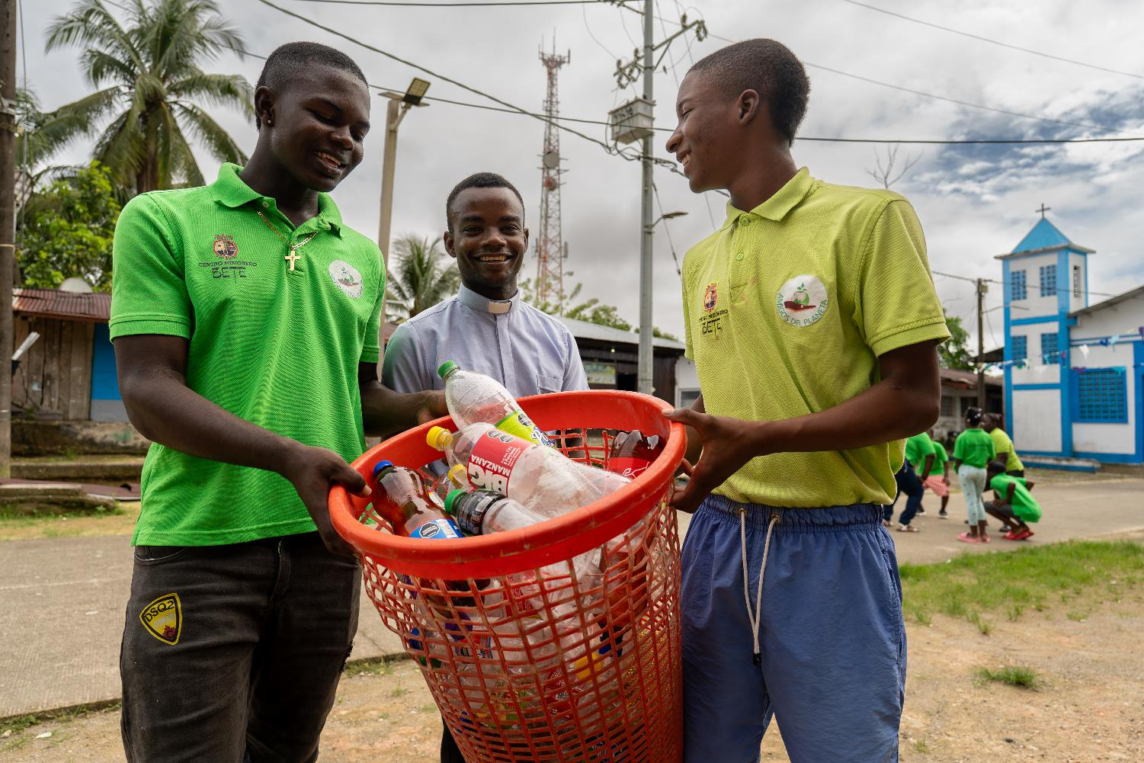
COLOMBIA
The Young Friends of the Planet –
“Amigos Del Planeta”
Fr John
Notes:
Read aloud script:
The group have named themselves The Young Friends of the Planet – or “Amigos Del Planeta” (Ah-mee-gohs Del Plah-neh-tah)

Slide 12
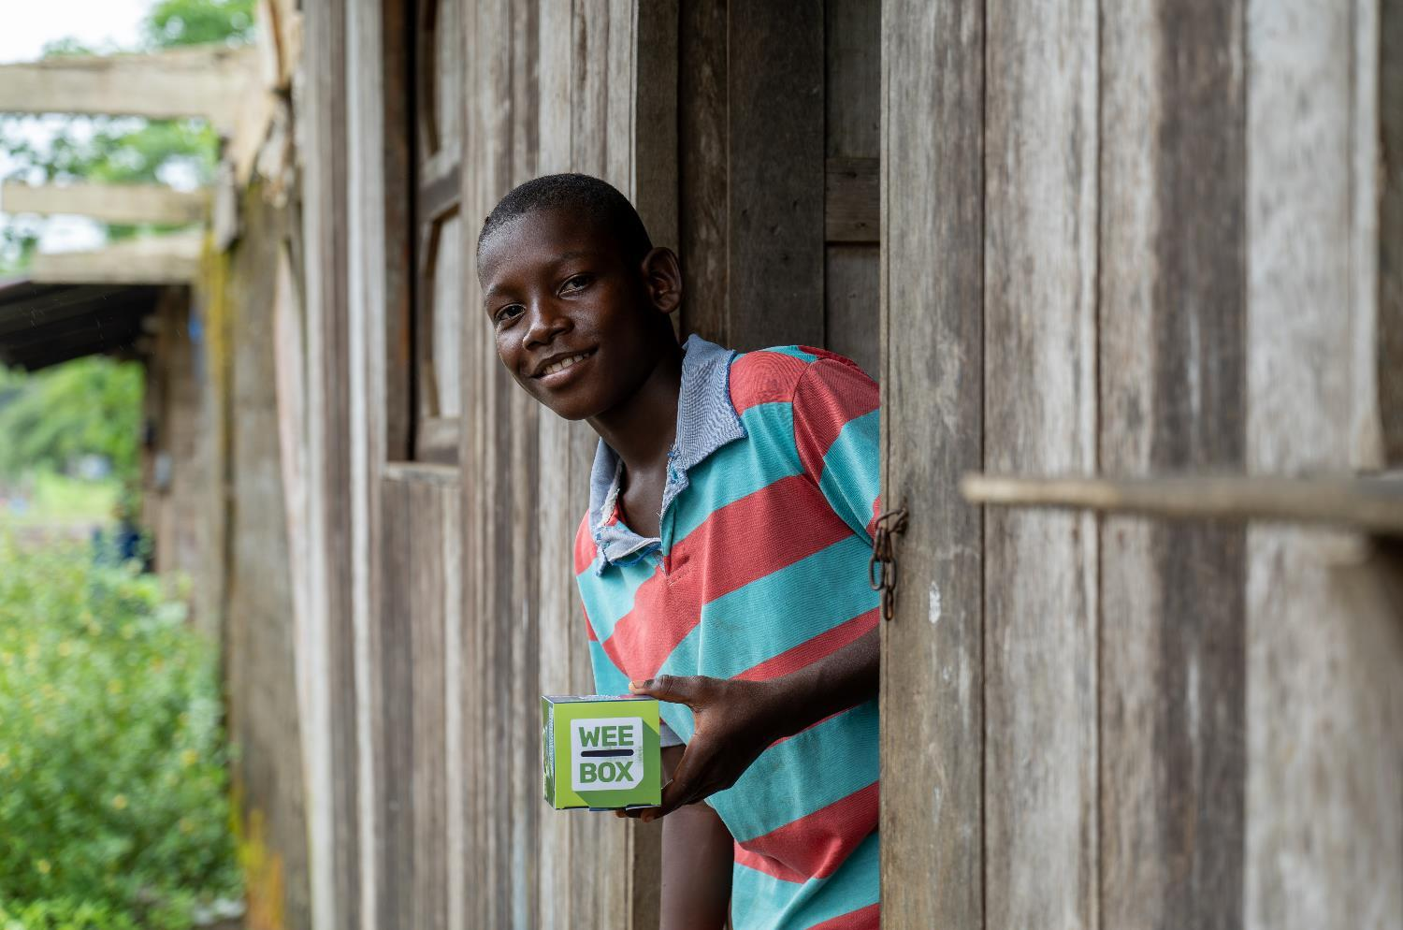
WEE BOX 2025
Notes:
Read aloud script:
This year’s WEE BOX appeal focuses on SCIAF’s work with the poorest communities in and around Chocó (Cho-KOH) and the River Atrato (Ah-TRAH-toh) .

Slide 13
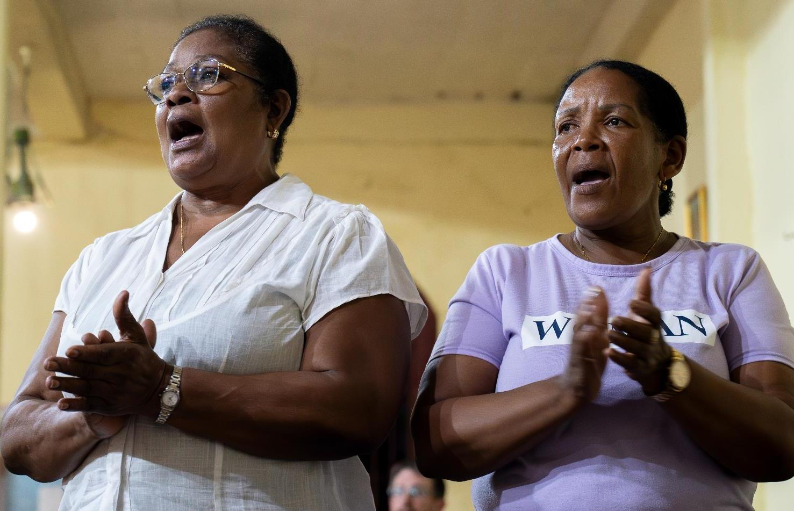
WEE BOX 2025
Parishioners in Colombia
Notes:
Read aloud script:
The River Atrato can be a very dangerous place.

Slide 14
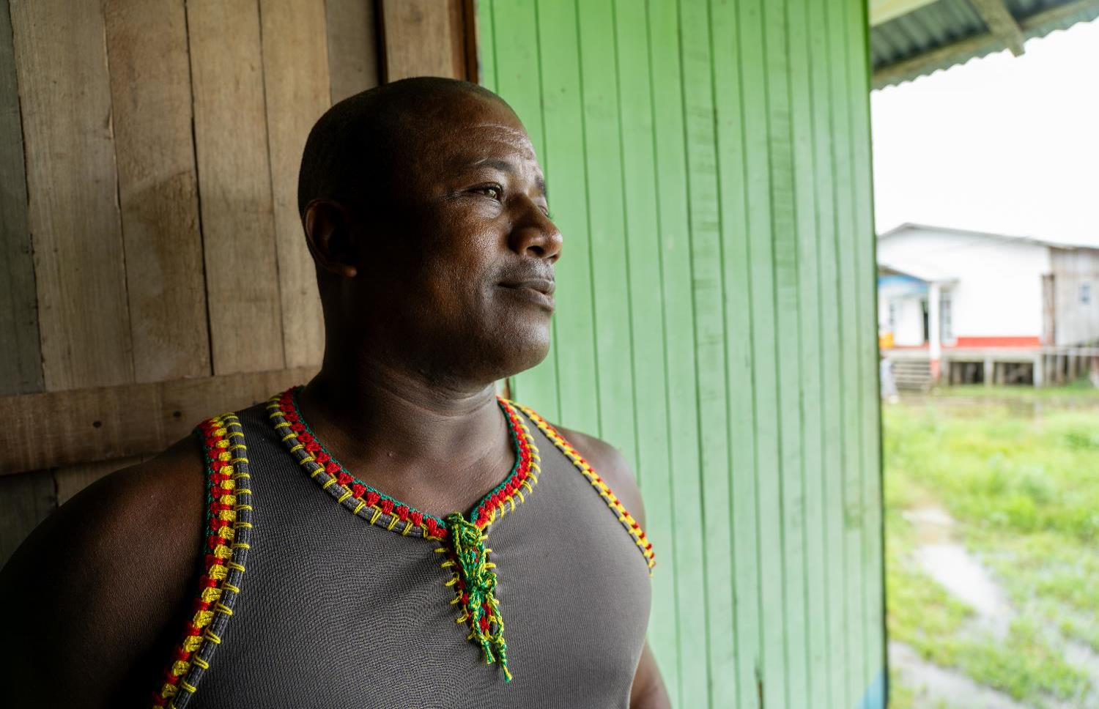
WEE BOX 2025
Enrique and his family were forced to leave their home.
Enrique
Notes:
Read aloud script:
This is Enrique (En-REE-kay).
Enrique and his family were forced to leave their home when their town was taken over by an armed gang.
They wanted the land so they could transport illegal drugs and illegally mined gold through the area.

Slide 15
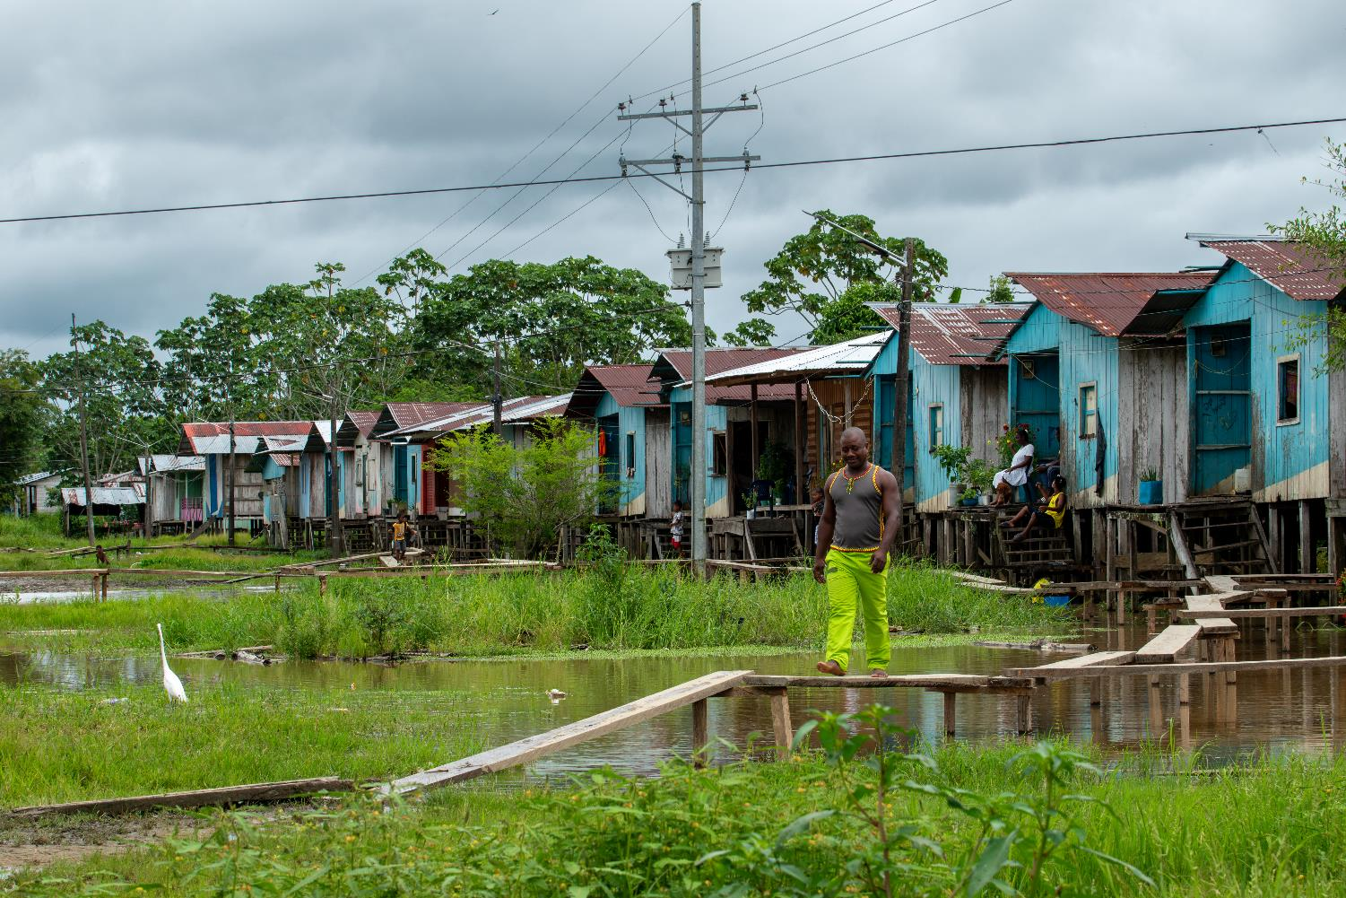
WEE BOX 2025
Enrique and his family had nowhere to go.
“When you’re displaced you have to move out quickly, and leave everything behind.”
Enrique
Enrique
Notes:
Read aloud script:
Enrique and his family had nowhere to go.
Enrique told SCIAF that “when you’re displaced you have to move out quickly and leave everything behind.”

Slide 16
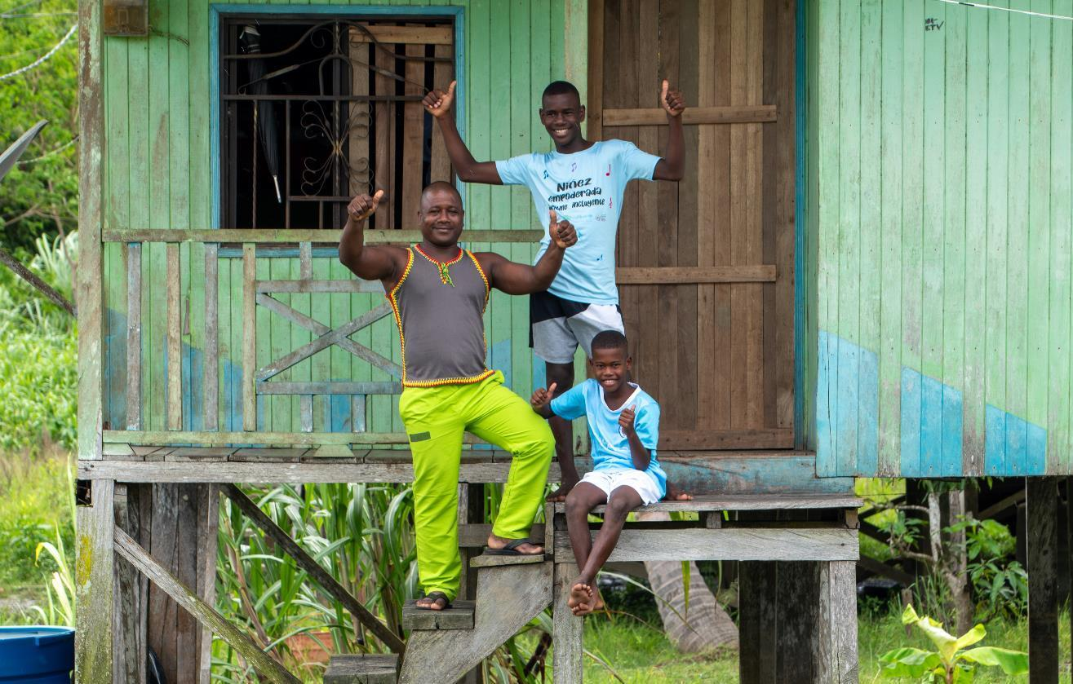
WEE BOX 2025
Enrique and family
“For those that finally returned to their homes, the state did not help – the Church, however, has helped us return with all their might.
Their presence has helped guard us from the armed groups that still operate here.”
Enrique
Enrique
Notes:
Read aloud script:
SCIAF’s Church partners in Colombia have helped people like Enrique’s family return to their homes, while keeping them safe.
Enrique told SCIAF “for those that finally returned to their homes, the state did not help – the Church, however, has helped us return with all their might. Their presence has helped guard us from the armed groups that still operate here.”

Slide 17
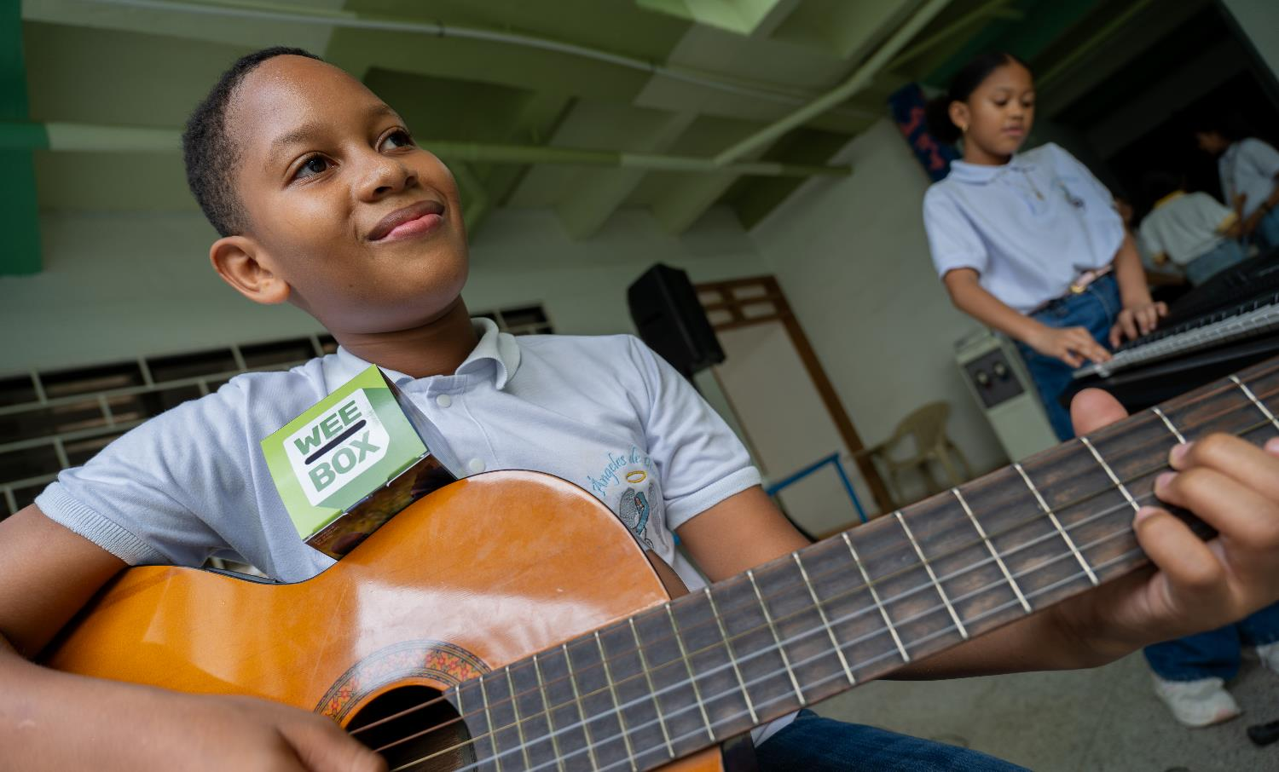
WEE BOX 2025
Safe place to play project
Notes:
Read aloud script:
The conflict has forced families from their homes all along the River Atrato, often separating families who have nowhere to go.
SCIAF offer safe places for children to play, to engage with music, art and sports activities.

Slide 18
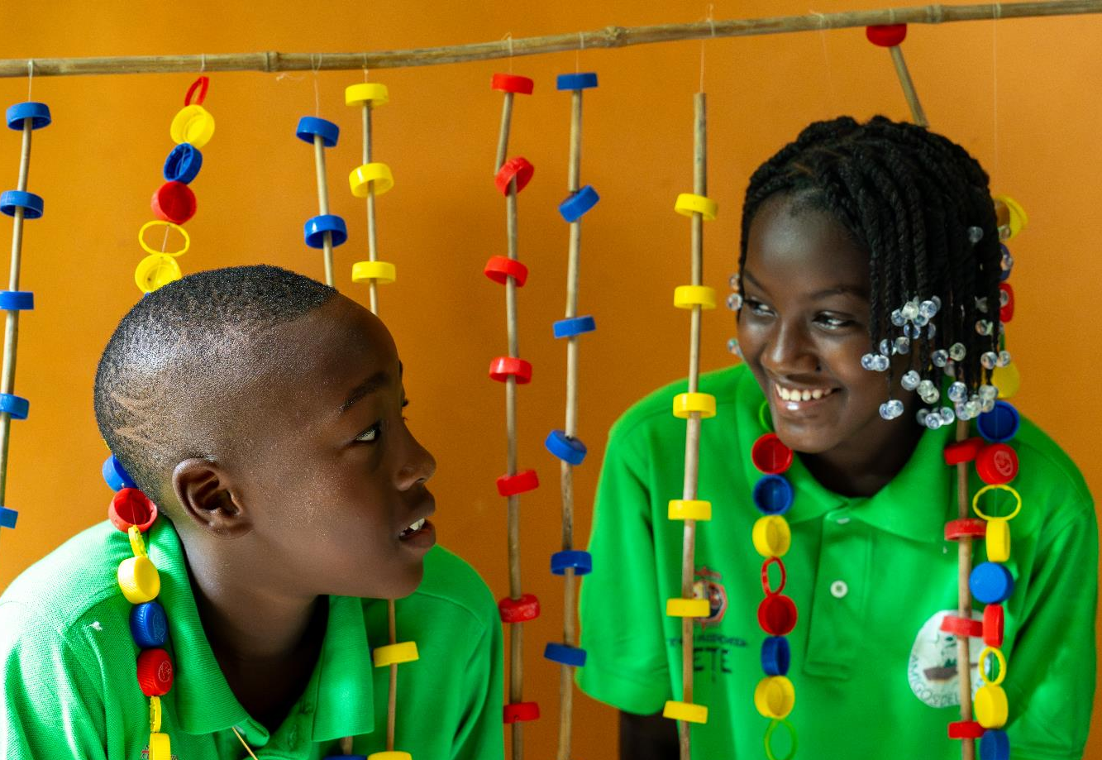
WEE BOX 2025
Notes:
Read aloud script:
SCIAF help people in Colombia, and around the world to have a brighter future.

Slide 19

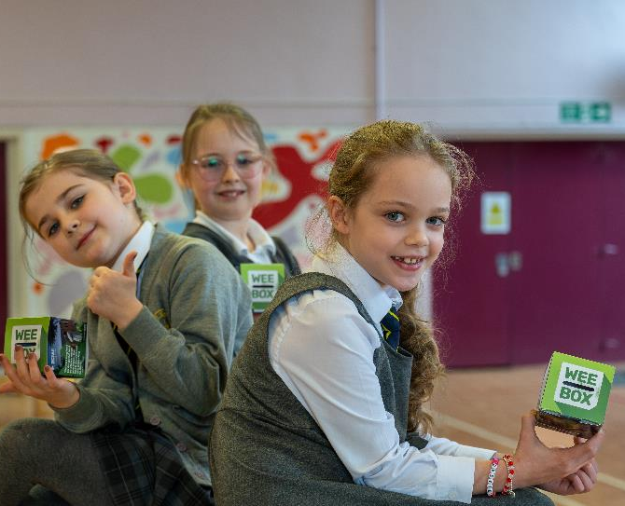
WEE BOX 2025
WE’RE USING
OUR
WEE BOX
TO
MAKE A
BIG CHANGE
Notes:
Reader notes:
Use this slide to tell the audience how your school are supporting SCIAF this Lent and ask them to join in your efforts to learn, pray and act for global justice.
Read aloud script:
This Lent our school are supporting SCIAF.

Slide 20
WEE BOX 2025
God of Peace and Justice
As we journey through Lent,
help us to be mindful of those
with whom we share God’s Creation,
our common home.
May our praying, fasting and giving,
help us to draw ever closer to You,
and inspire us to find new ways
to bring dignity, joy, peace and justice to others,
especially this year to the people of Colombia.
Amen
Notes:
Reader notes:
Say this prayer together.

Slide 21

WEE BOX 2025
A JUST WORLD, FREE OF POVERTY, WHERE WE FLOURISH AND LIVE
IN HARMONY WITH EACH OTHER AND ALL CREATION.
Scottish Catholic International Aid Fund
SCIAF is the official relief and development agency of the Catholic Church in Scotland
and a proud member of the Caritas family. 7 West Nile Street, Glasgow G1 2PR.
Tel: 0141 354 5555. Scottish Charity No: SC012302. Company No: SC197327.
sciaf@sciaf.org.uk
Notes:
Thank you.

