Slide 1





BIG LENT WALK SCOTLAND TO VATICAN CITY
RESOURCE

Slide 2



BECOME PILGRIMS OF HOPE
Over Lent, become a Pilgrim of Hope in marking
the Jubilee Year by walking a virtual route from
Scotland to Vatican City. The target is 2,000
miles, so join together as a school or class and
get going!
During this Jubilee, Pope Francis asks us
“to discover hope in the signs of the times
that the Lord gives us.” So, along the way, this
resource can help you look out for ‘signs of hope’
and learn about our European Saints and Blessed
Servants of God. Plus give ideas for putting faith
into action by fundraising for our sisters and
brothers in the world's poorest places.

Slide 3
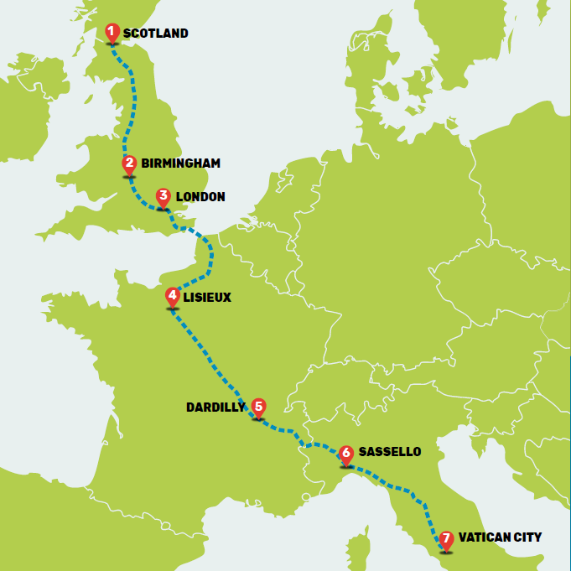
THE JOURNEY
Following this route over the 6 weeks of Lent, you will encounter 7 Saints and Blessed Servants of God.
This resource is to be used for your classes to teach them and show Signs of Hope along with the Schools Fundraising Pack digital resource.
Please do use the last 2 entries earlier or after the Easter school holidays depending on how quickly you complete the challenge.

Slide 4
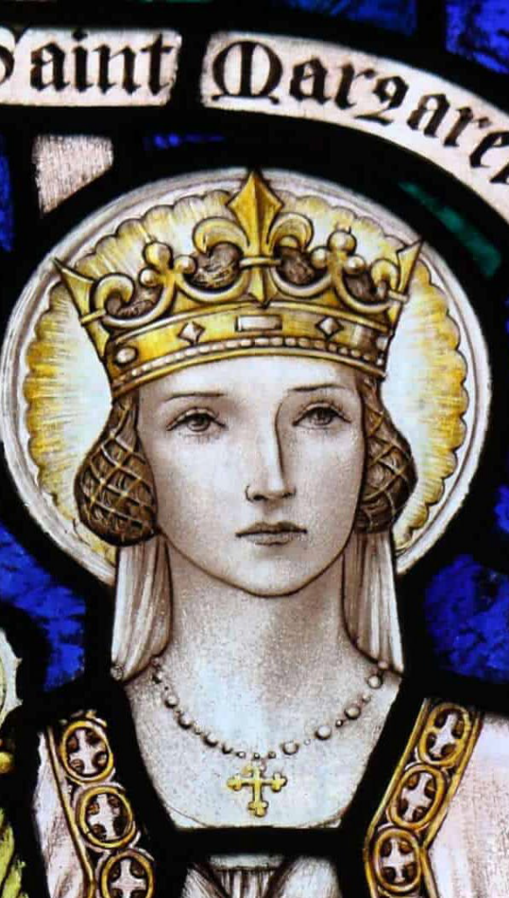
THE BEGINNING – ASH WEDNESDAY
ST MARGARET OF SCOTLAND
Notes:
As you begin this Lenten journey, as a Pilgrim
of Hope, we want to reflect on the impact that
Scotland, and you all, have on the world.
One of SCIAF’s Patron Saints is St Margaret of
Scotland. Born nearly 1000 years ago, Margaret
became Queen of Scotland in 1070.
Despite being a Queen, Margaret was a humble,
loving and generous woman, taking in the
homeless and feeding orphans. Legend says
she would sit on a stone outside Dunfermline
Castle for people in trouble to find her. Poor
people were also able to enter the castle where
the King and Queen would feed them!
She was declared a saint in 1250 by Pope
Innocent IV and buried in Dunfermline
Cathedral. Margaret will always be remembered
for her generous, kind spirit – and this spirit
is very much alive in the supporters of SCIAF
today.
As we take these steps and come together on
this Big Lent Walk, we say,
“Saint Margaret, Queen of Scotland,
pray for us.”
SIGNS OF HOPE
The St Margaret’s Pilgrimage in Dunfermline began in 2015 after a break of 41 years.
Today, hundreds of pilgrims participate in the procession and the Thanksgiving Mass.

Slide 5
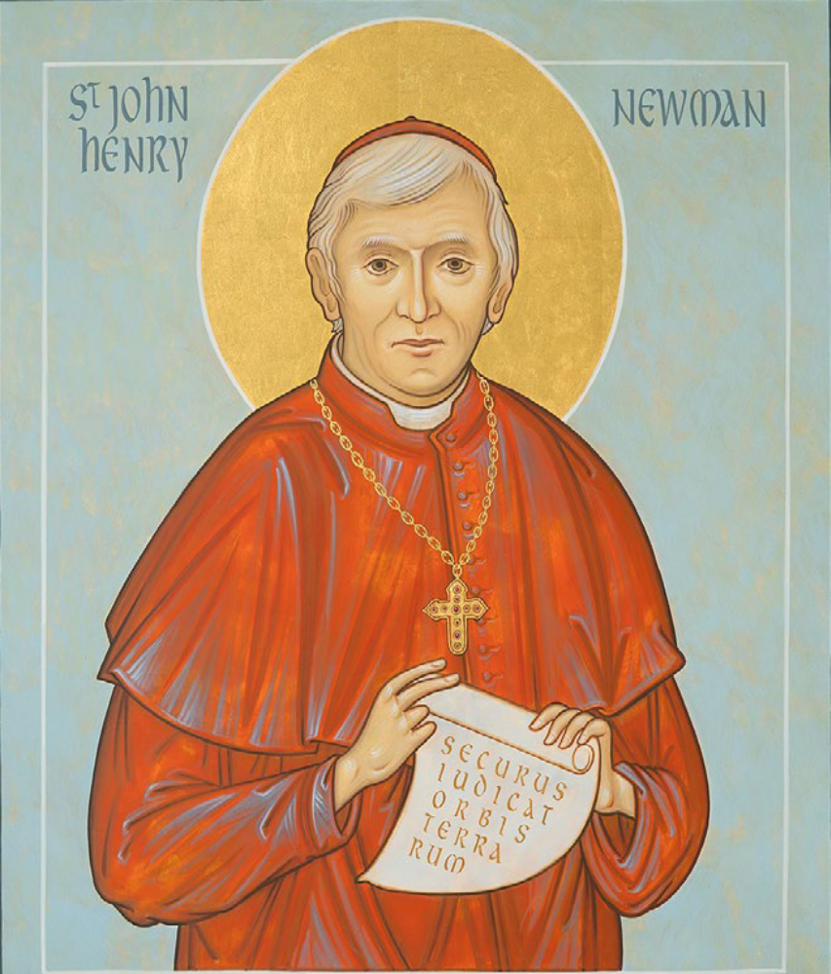
FIRST STOP – BIRMINGHAM (340 MILES)
ST JOHN HENRY NEWMAN
Notes:
As you begin the first steps of your journey
through Europe, you will walk through
Birmingham, once home of St John Henry
Newman.
St John Henry Newman (1801–1890) started
his life as an Anglican priest but later became
a Catholic and was made a Cardinal. His strong
belief in the Catholic Church was central to his
life, and he often visited Saint Peter's Basilica
as a sign of his faith.
On 11 August 1890, ten years after becoming
a Cardinal, John Henry Newman died in
Birmingham. He left behind an inspiring example
that still touches people all over the world.
His journey from being an Anglican to a
Catholic and his work with the Oratorians have
had a lasting effect on the Catholic Church.
Oratorians are communities of priests and lay
brothers who don’t take religious vows but
focus on prayer, helping others, and supporting
people’s spiritual growth.
His life is still an example for those looking for
truth, faith, and spiritual direction. Beatified
in 2010 by Pope Benedict XVI, he was made a
saint by Pope Francis in 2019.
SIGNS OF HOPE
Today, the Roman Catholic Archdiocese of Birmingham is one of the principal Diocese in
England and Wales, covering an area similar in size to the Diocese of Galloway. It is home to
217 parishes and 240 schools, serving 450,000 Catholics. St John Henry Newman’s legacy
lives on in the Birmingham Oratory, founded by Newman in 1848, now housing the Cardinal
Newman Museum.
PRAYER
Dear Lord,
Shine through me,
and be so in me that every soul I come in
contact with
may feel Your presence in my soul.
Let me thus praise You in the way You love
best,
by shining on those around me.
Amen
St John Henry Newman

Slide 6
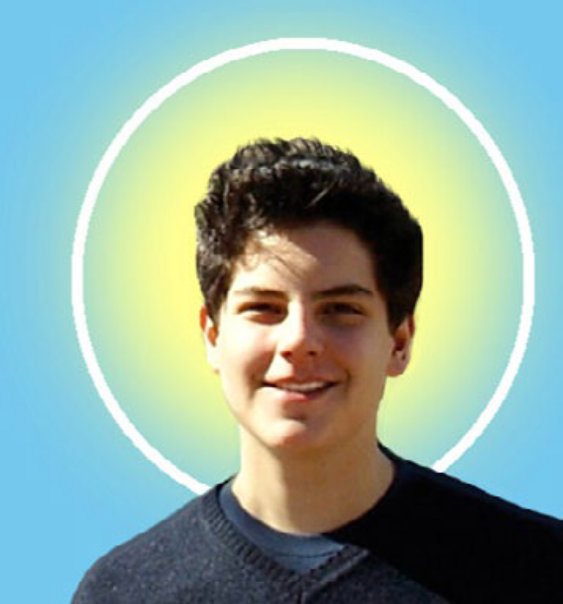
SECOND STOP – LONDON (600 MILES)
BLESSED CARLO ACUTIS
Notes:
Carlo Acutis (1991–2006), who was born in
London, had a deep love for God, even though
his parents weren’t very religious. His mother
admitted that before Carlo came along, she
only went to Mass for special occasions like
her First Communion, Confirmation, and
wedding.
But from a young age, Carlo had a strong faith
and loved praying the rosary. After making his
First Communion, he started going to Mass as
often as he could at the church near his school.
Carlo’s devotion to the Eucharist also helped
his mother grow in her faith.
Carlo’s example of faith, even as a child,
inspired many adults to become baptised and
join the Church. He was also a loyal and kind
friend, standing up for classmates who were
bullied, especially the vulnerable and those
with additional needs.
At the age of 15, Carlo was diagnosed with
leukaemia. Before passing away in Italy
in 2006, he offered his suffering for Pope
Benedict XVI and the Church.
Beatified in 2020, recognising his holy life,
he will be canonized as a Saint during the
Church’s Jubilee of Teenagers in April 2025.
SIGNS OF HOPE
Blessed Carlo Acutis is a sign of the immense goodness present in our world today.
His joyful embrace of technology is a tangible sign of hope in a society often distracted
by the superficial aspects of the internet. He has shown us that faith can thrive in the digital
world that is a powerful instrument for glorifying God, Evangelisation and connection.
PRAYER
O God our Father,
We thank you for giving us Carlo,
a model of life for young people,
and a message of love for all.
You made him fall in love with your son Jesus,
making the Eucharist his “highway to heaven.”
You gave him Mary as a beloved mother,
and you made him, through the Rosary,
a cantor of her tenderness.
Receive his prayer for us.
Look above all upon the poor, whom he loved
and assisted.
Grant me too, through his intercession,
the grace that I need.
And make our joy full, raising Carlo among
the saints of your Church,
so that his smile shines again for us
to the glory of your name.
Amen

Slide 7
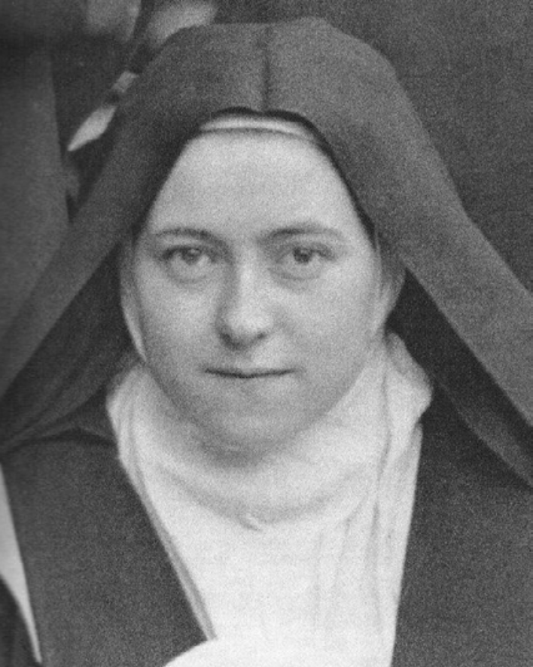
THIRD STOP – LISIEUX, FRANCE (960 MILES)
ST THÉRÈSE OF LISIEUX
Notes:
Three weeks into your Big Lent Walk and you will
be passing through France. As a group you will
have covered nearly 1,000 miles and are halfway
through the challenge! Our focus this week is on
St Thérèse of Lisieux.
Saint Thérèse (1873–1897) was one of nine
children born to Louis and Zelie Martin, who
were made saints in 2015. She was born in
Alençon, France, but sadly, four of her siblings
died as babies. The remaining five children, all
girls, became nuns. When Thérèse was just four
years old, her mother passed away, and the
family moved to Lisieux.
In 1887, during a trip to Italy with her father,
Thérèse met Pope Leo XIII. She bravely asked
him if she could join the Carmelite nuns at just
15 years old. The Pope told her, “Go…go… You will
enter if God wills it!”
Saint Thérèse is the Patron Saint of missionaries,
florists, pilots, and priests. Since her death in
1897, many miracles have been linked to her
prayers, fulfilling her promise: “I shall spend my
Heaven in doing good upon earth.”
Thérèse had a profound devotion to the infant
Jesus, and this formed the basis of her
‘Little Way’, a spiritual path of doing small,
ordinary things with great love and trust in God.
Beatified in 1923 by Pope Pius XI, she was
declared a saint in 1925 and given the name
St. Thérèse of the Child Jesus and of the Holy
Face. In 1997, 100 years after her death, Pope St.
John Paul II named her a Doctor of the Church,
a special title given to saints whose teachings
help guide the Church.
“Everything is a grace, everything is
the direct effect of our Father's love –
difficulties, contradictions, humiliations,
all the soul's miseries, her burdens, her
needs – everything, because through them,
she learns humility, realises her weakness.
Everything is a grace because everything is
God's gift. Whatever be the character of life
or its unexpected events – to the heart that
loves, all is well.” St Thérèse Of Lisieux
SIGNS OF HOPE
St. Thérèse is a beacon of hope: that each person, no matter how ordinary, can transform
the world through acts of love, mercy, and unwavering faith. Her legacy reminds us that
hope is found not in extraordinary circumstances but in embracing God's presence in the
smallest moments of life.

Slide 8
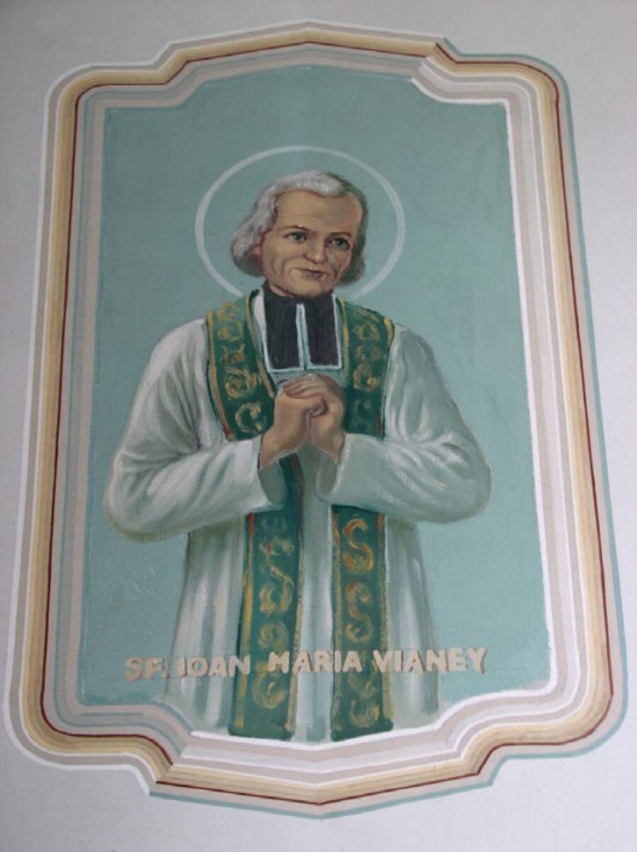
FOURTH STOP – DARDILLY, FRANCE (1300 MILES)
ST JOHN VIANNEY
Notes:
“When the heart is pure and simple it cannot
help loving, because it has discovered the
source of love which is God." St John Vianney
At this point of our Big Lent Walk journey, we are
still travelling through France and our focus is
on St John Vianney.
St John Vianney (1786–1859) grew up in
a Catholic family that often helped the poor.
His family even hosted St Benedict Joseph
Labre (now the Patron Saint of homeless people)
during his pilgrimage to Rome.
In 1790, during the French Revolution, priests
had to hide or risk being executed. Young
John admired their courage and saw them
as heroes. He received his First Communion
lessons in secret from two nuns who had lost
their convents because of the Revolution. At the
age of 13, John made his First Communion and
prepared for his Confirmation in secret.
In 1815, St John Vianney became a priest and
was sent to the small town of Ars as its parish
priest. When he arrived, he saw that many of
the 230 residents had become careless about
religion due to the Revolution’s influence.
Determined to help, he worked for ten years
to renew the town’s faith. His hard work paid
off, with more people coming back to church.
He especially loved teaching children their
catechism and encouraging people to pray the
rosary.
Over time, St John Vianney became known for
his wisdom and holiness, and by 1855, around
20,000 people visited him each year for advice
and guidance.
Declared a saint in 1925 by Pope Pius X, St John
Vianney is now the Patron Saint of priests

Slide 9
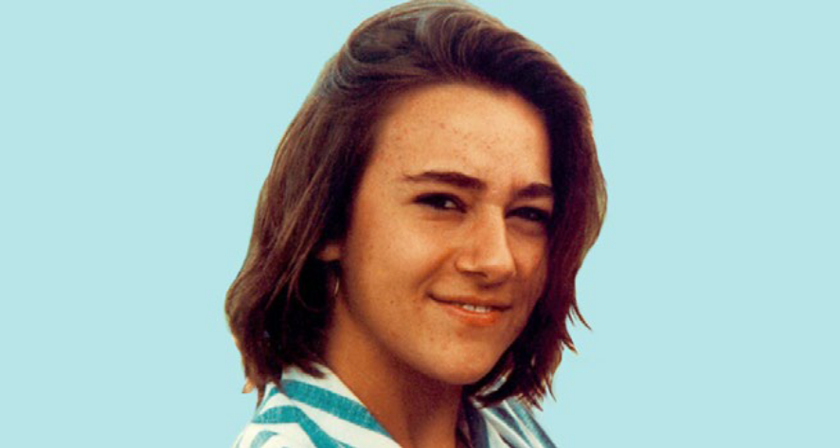
FIFTH STOP – SASSELLO, ITALY (1600 MILES)
BLESSED CHIARA LUCE BADANO
Notes:
As we cross the France-Italy border and near the
end of our Big Lent Walk, we focus on another
Blessed Servant of God.
Chiara “Luce” Badano (1971–1990) was born in
Sassello, Italy. She joined the Focolare Movement
(a Catholic organisation dedicated to living out
Gospel values and fostering unity) at the age of
nine. Her nickname "Luce" means light.
Chiara was known for being calm, joyful, and full
of life. She loved playing tennis and was part of
a youth group. She cared deeply for people who
were vulnerable, rejected, or overlooked by society,
always showing kindness and love to everyone she
met, even as a teenager.
She lived life with a focus on pleasing Jesus, not
worrying about what others thought of her. Chiara
once said, “What matters is to be beautiful inside.”
At 16, Chiara was diagnosed with a painful bone
cancer. Even though she was suffering, she didn’t
lose hope or faith. She spread joy by cheering up
other patients in the hospital and offering her pain
to Jesus. Her trust in God never wavered, and
when asked about her situation, she confidently
said, “God loves me immensely!”
In her final hours, Chiara received her last
confession and the Eucharist, surrounded by her
family and friends in prayer. She died on 7 October
1990, age 18, with her parents at her side. Her last
words were, “Bye, Mum. Be happy, because I am.”
Chiara’s deep love for God and her unshakable
faith transformed her life. She is a powerful
example that, while faith does not take away
suffering, it can bring joy and peace even in the
hardest times.
Beatified by Pope Benedict XVI in 2010, the global
Catholic community hope for the recognition of
miracles through Chiara’s intercession, and pray
for her on the journey to Sainthood.
SIGNS OF HOPE
Blessed Chiara “Luce” Badano’s life is a guide to help us discover hope in the “signs of the
times” the Lord has given us, by recognising His presence in the world today. Her example
calls us to be witnesses of hope in today’s world, recognising the signs of God’s enduring
grace and purpose.
PRAYER
O Father, fount of every good,
We give You thanks for the wonderful
testimony of Blessed Chiara Badano.
Filled with the Holy Spirit, and guided by the
radiant light of Jesus, she believed firmly
in Your infinite love and wished to return it
with all her strength, surrendering herself in
complete trust to Your paternal will.
We humbly beseech You that You may also
grant us the gift to live with You and for You,
and ask You, if it be Your will, for the grace.
Through Our Lord Jesus Christ.
Amen

Slide 10
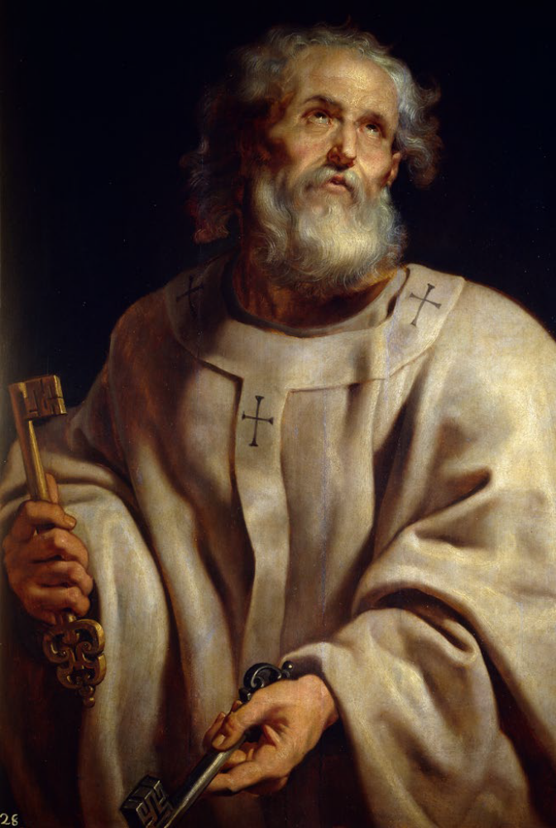
FINAL STOP – VATICAN CITY (2000 MILES)
ST PETER
“And I tell you that you are Peter,
and on this rock I will build my
church, and the gates of hell shall
not prevail against it.”
Matthew 16:18
Notes:
You have made it! Congratulations to you all
and thank you for your efforts this Lent in
fundraising for SCIAF. Your support for our
sisters and brothers is incredible and we hope
that you have enjoyed learning about our
Saints and Blessed Servants of God as you
have journeyed together from Scotland to
Vatican City.
The final focus of our Big Lent Walk is St Peter,
one of the 12 Apostles of Jesus.
St Peter was the first Bishop of Rome – and
his inspiration is a fitting way to reflect on this
journey you have taken through Lent as you
reach Vatican City.
“And I tell you that you are Peter,
and on this rock I will build my
church, and the gates of hell shall
not prevail against it.”
Matthew 16:18
SIGNS OF HOPE
Our Catholic Community in Scotland have made a massive impact on the world.
Through SCIAF and our Caritas network across the world, your love and prayers have
reached our sisters and brothers 60 years now. Your support continues to improve lives
and provide relief to those affected by war and violence. Thank you for all that you do.

Slide 11

BIG LENT WALK 2025
A JUST WORLD, FREE OF POVERTY, WHERE WE FLOURISH AND LIVE
IN HARMONY WITH EACH OTHER AND ALL CREATION.
Scottish Catholic International Aid Fund
SCIAF is the official relief and development agency of the Catholic Church in Scotland
and a proud member of the Caritas family. 7 West Nile Street, Glasgow G1 2PR.
Tel: 0141 354 5555. Scottish Charity No: SC012302. Company No: SC197327.
getinvolved@sciaf.org.uk
Notes:
Thank you.

