Slide 1
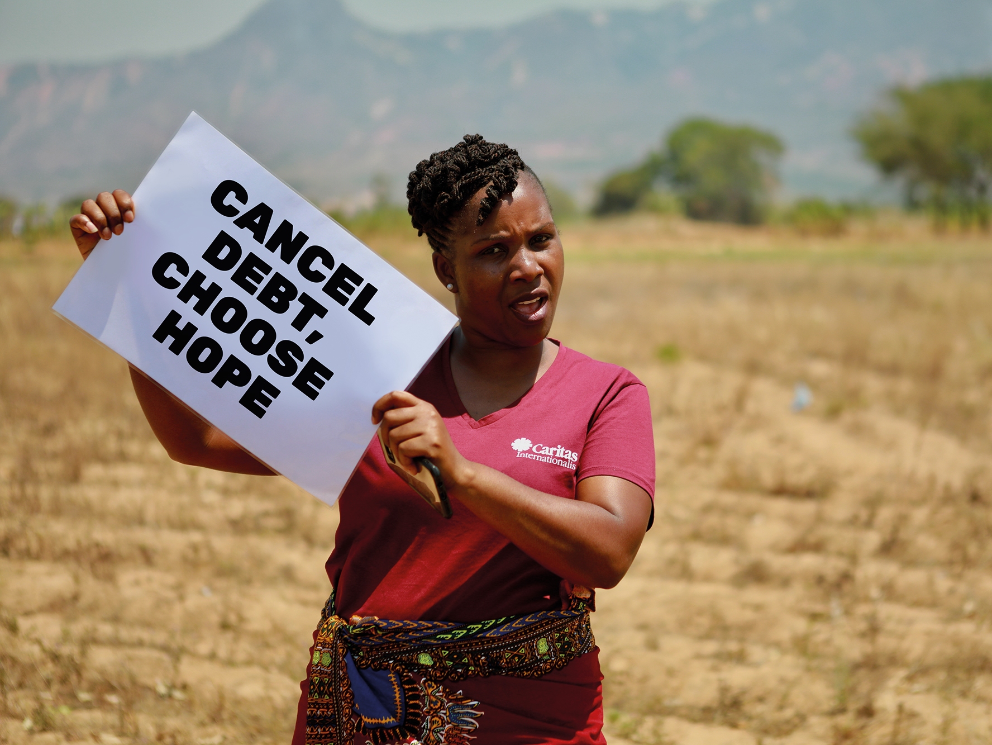

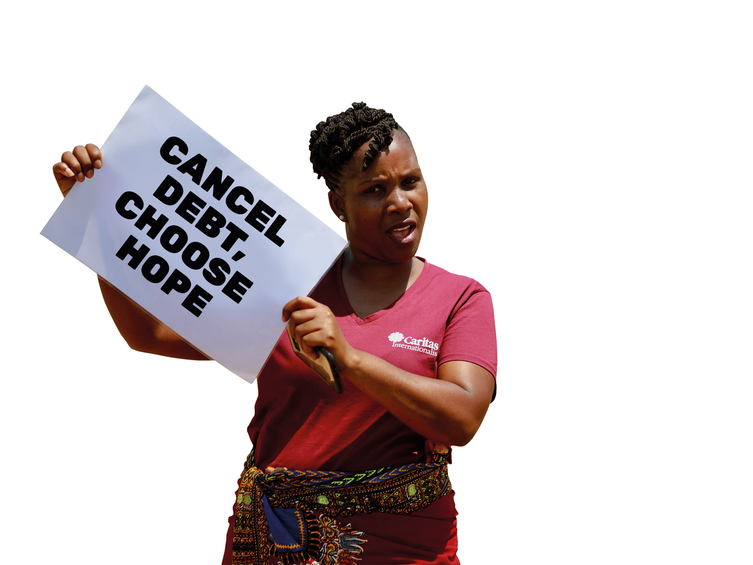


CANCEL DEBT
CAMPAIGN 2025

Slide 2


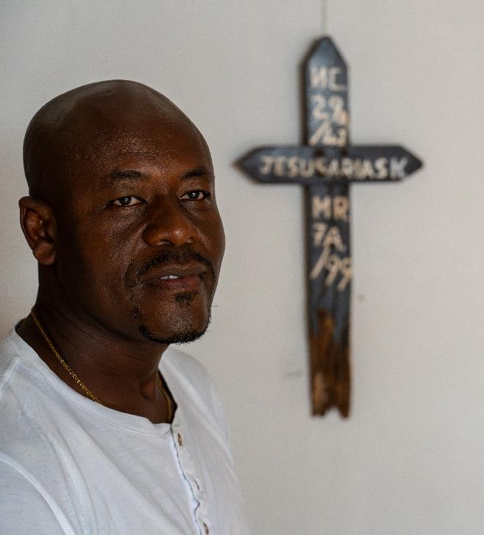
DEBT JUSTICE
In the world’s poorest places, millions of people do not have enough food, water or adequate shelter to live dignified lives.
Yet, despite this deep poverty, the poorest countries are paying back enormous debts to some of the richest groups in the world.
Brother Marcial
Notes:
In the world’s poorest places, millions of people do not have enough food, water or adequate shelter to live dignified lives.
Yet, despite this deep poverty, the poorest countries are paying back enormous debts to some of the richest groups in the world.
We believe this debt money should be spent on improving people’s lives instead of lining the pockets of banks, hedge fund managers and greedy governments.

Slide 3

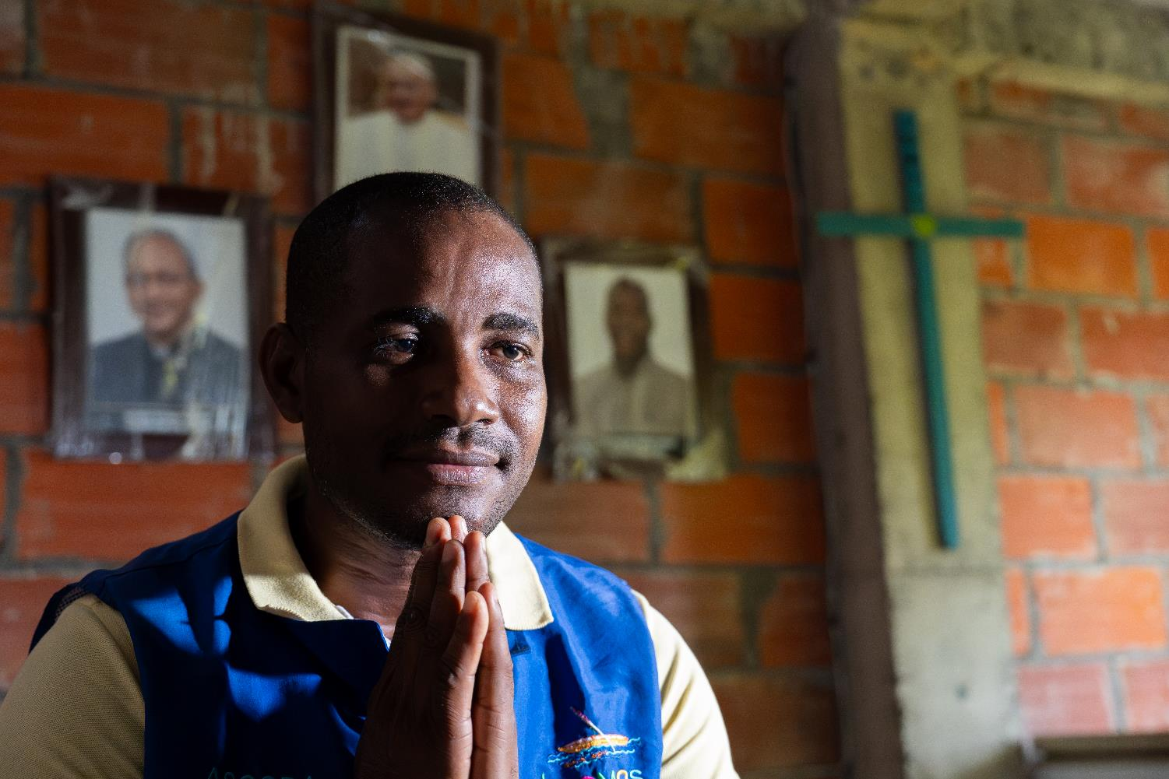
JUBILEE 2025
Notes:
This year is a special Jubilee Year for the Church.
Pope Francis has called on affluent nations around the world to forgive the debts of countries that will never be able to repay them, saying: “More than a question of generosity, this is a matter of justice.”
In this Jubilee year we’re supporting this call to world leaders, asking them to cancel unjust debts and build a permanent system that puts people and planet first.

Slide 4
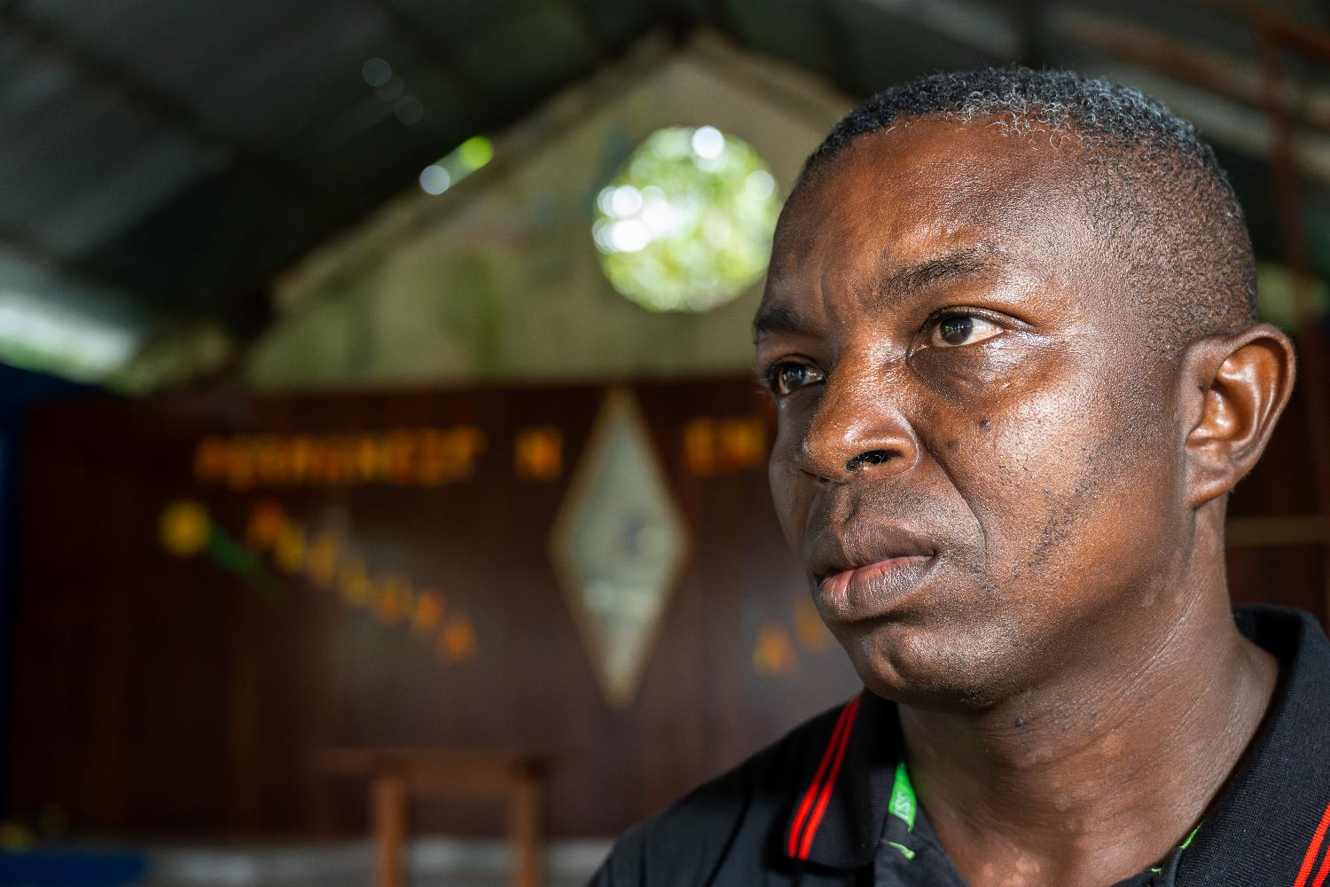
LEVITICUS 25:28
Luis
Notes:
Debt is one way in which people can be trapped, unable to free themselves from the burden laid upon them by their lenders.
But in Leviticus, it is laid out that in the Jubilee Year debts should be released and property returned to its original owner (Leviticus 25:28).
This was a recognition that over time, wealth could become concentrated in the hands of a small minority, and a call for society to be rebalanced every 50 years. Debts were to be cancelled, equality restored and those who had been trapped in poverty would be freed and could have a fresh start.

Slide 5
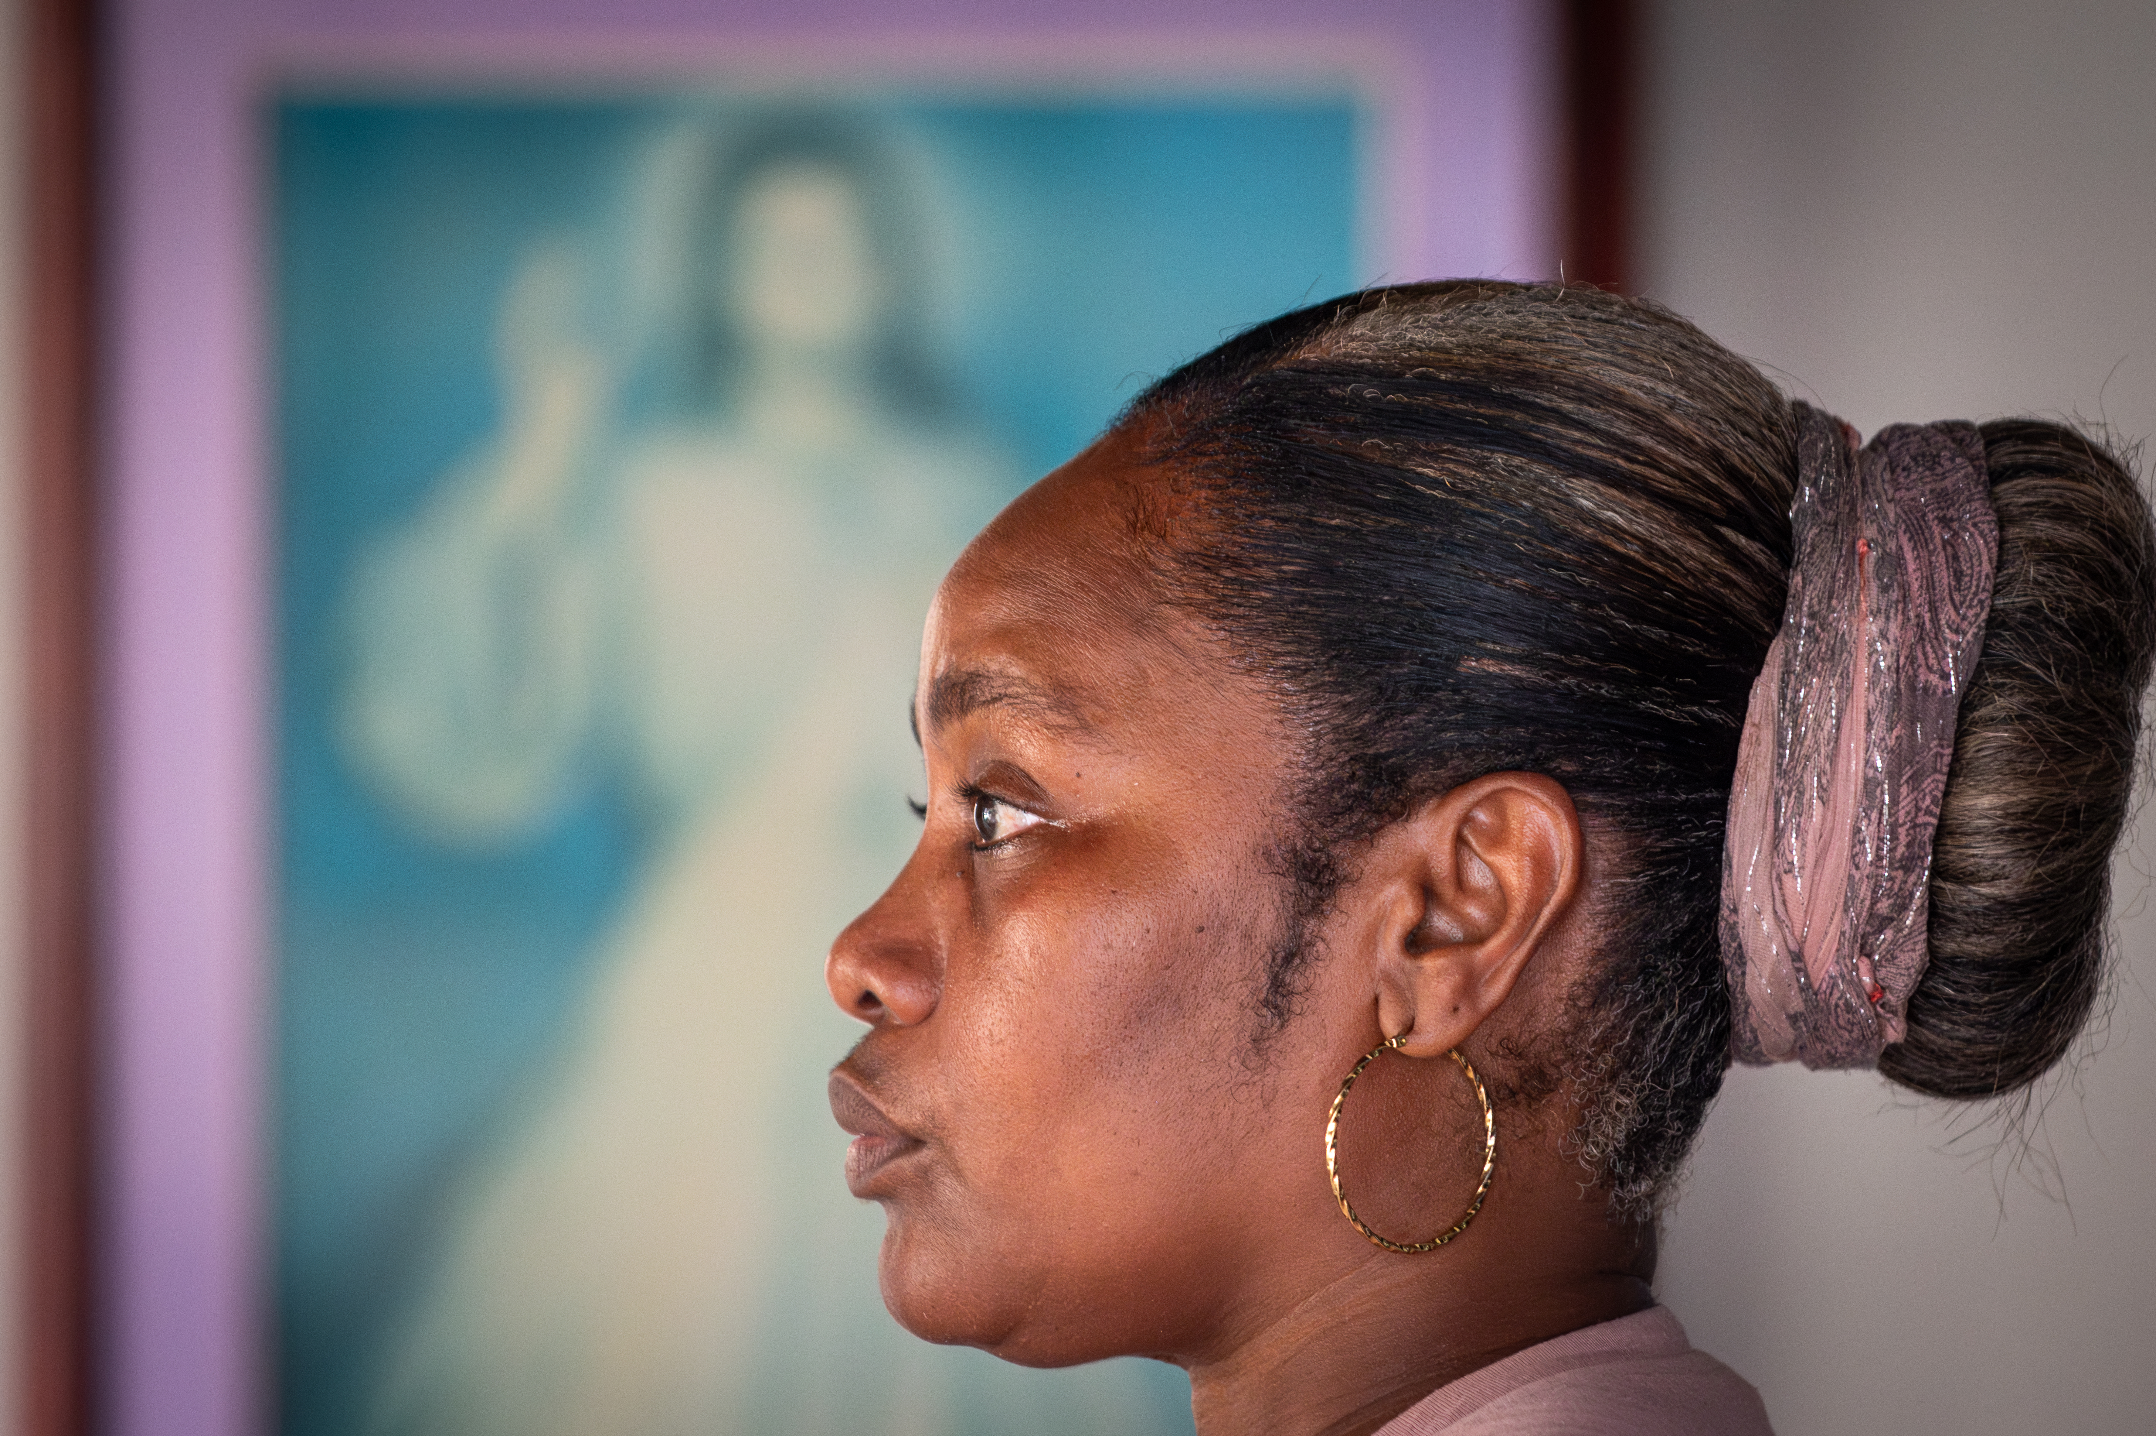
DEBT JUSTICE
About 3.3 billion people now live in countries where debt interest payments are greater than expenditure on health or education.
Notes:
The number of low-income countries in debt crisis has more than doubled since 2015 to over 50.
About 3.3 billion people now live in countries where debt interest payments are greater than expenditure on health or education.

Slide 6
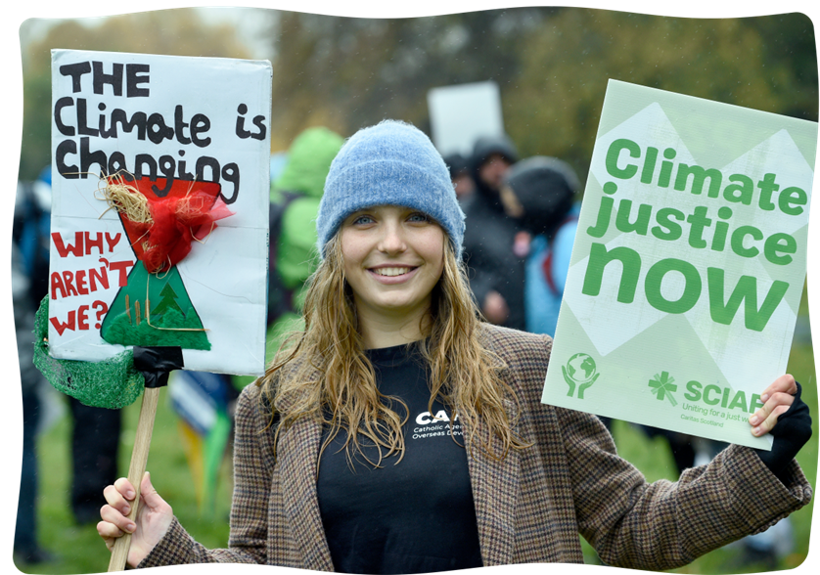
DEBT JUSTICE
It’s time for debt justice
We are called throughout the Jubilee Year to be tangible signs of hope in our world.
We know that our actions can make a difference.
Notes:
We are called throughout the Jubilee Year to be tangible signs of hope in our world. We know that our actions can make a difference.
Many people were inspired by the Jubilee in the year 2000 to come together and call for debt cancellation. As a result of the debt cancelled because of this campaign, Uganda had $1bn (£715m) worth of debt relief and used it to double the number of children able to go to primary school.

Slide 7
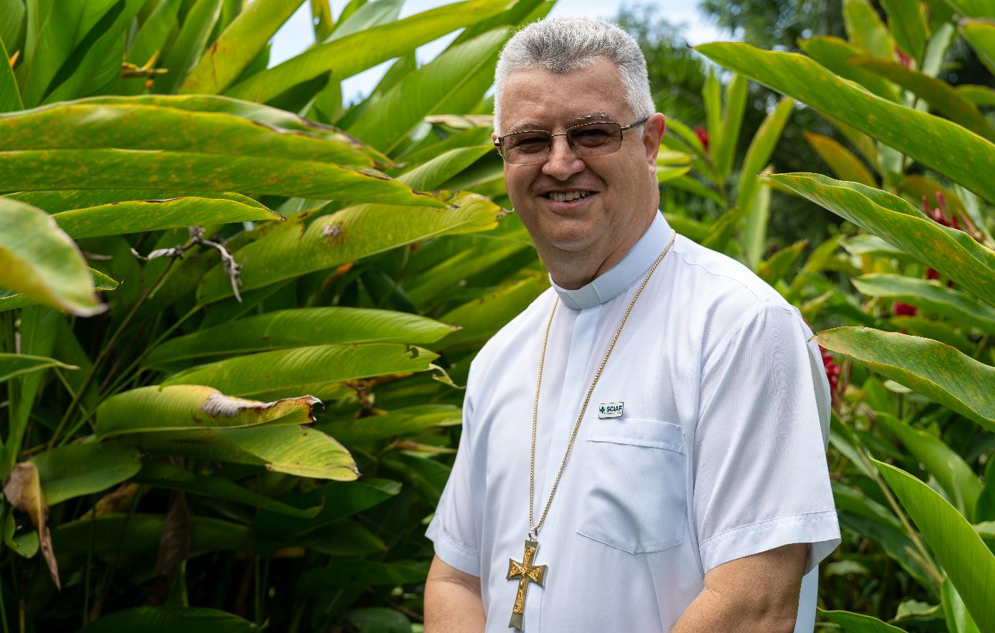
DEBT JUSTICE
“We are all instruments of good. Each of us are living stones in the building of a better world.”
Bishop Carlos, Colombia
Notes:
Raising our voices to call for change can make a difference.
But the same structural causes remain in place.
That is why we need action again now.
“We are all instruments of good. Each of us are living stones in the building of a better world. Bishop Carlos, Colombia

Slide 8


DEBT JUSTICE
“A faith without ​works, a faith that ​doesn’t
get you ​involved, isn’t faith. ​It is words and ​nothing more than ​words.”
Pope Francis
Fausto, River Guardian
Notes:
“A faith without ​works, a faith that ​doesn’t get you ​involved, isn’t faith. ​It is words and ​nothing more than ​words.” Pope Francis
Pope Francis reminds us that real faith isn’t just about what we say or believe; it’s about what we do.
We show our faith through our actions - by helping others, caring for the earth, and standing up for the poor and vulnerable.

Slide 9
CANCEL DEBT
CAMPAIGN 2025
sciaf.org.uk/canceldebt
Notes:
Sign our petition calling on world leaders to cancel unjust debts and build a permanent system that puts people and planet first.
You can sign the petition online and ask for printed copies to put in your school and parish.

