Slide 1

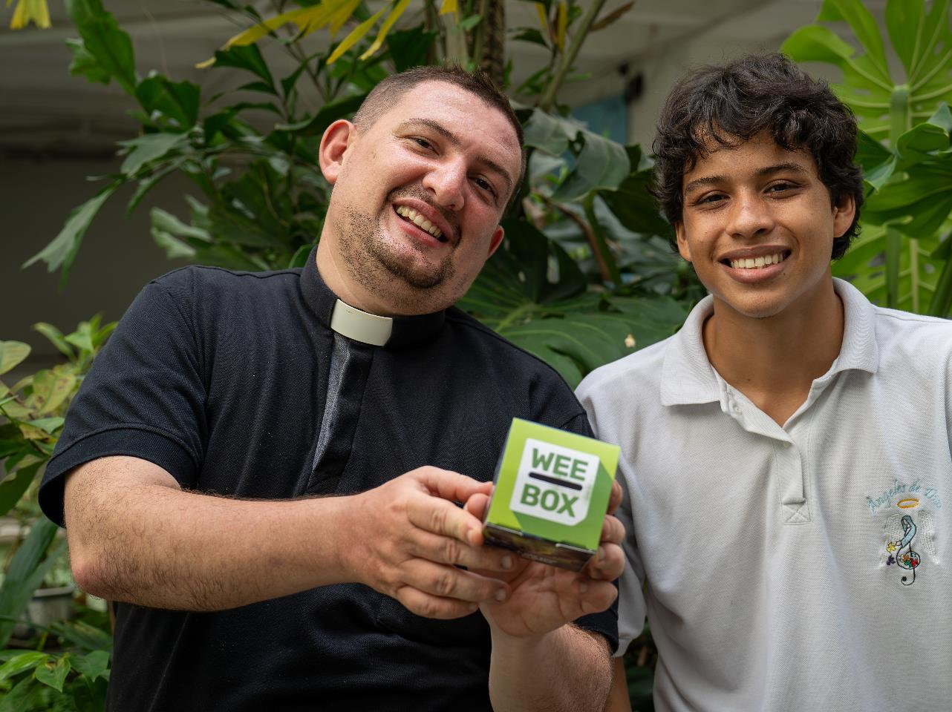


WEE BOX
2025
PARISH
Notes:
Reader notes:
This PowerPoint looks at the impact of conflict on people in Colombia and how the Church, through SCIAF, are helping. Conflict can be a difficult subject for people of any age. Some people may have experienced displacement, war and conflict themselves.
At SCIAF, we believe it is important to balance discussion about war and conflict with hope and optimism.
Read aloud script:
Our pairsh are supporting SCIAF’s WEE BOX appeal this year.
SCIAF are one of the official charities of the Bishops Conference of Scotland.
This year they mark 60 years of serving the poor and vulnerable around the world.

Slide 2




WHAT WE DO
We work across Africa, Asia, Latin America, the Middle East and Europe.
Every year
we help over
1 million
people to have
a brighter future
We support people during emergencies
Together, we reach out as Pilgrims of Hope in this special Jubilee Year.
Notes:
Read aloud script:
Evey year, through long-term development work and emergency response SCIAF help over 1 million people to recover from disaster and to have a brighter future.
This year is a special Jubilee year for the Catholic Church, where we are invited to be pilgrims of hope showing care for others and living out our faith.

Slide 3

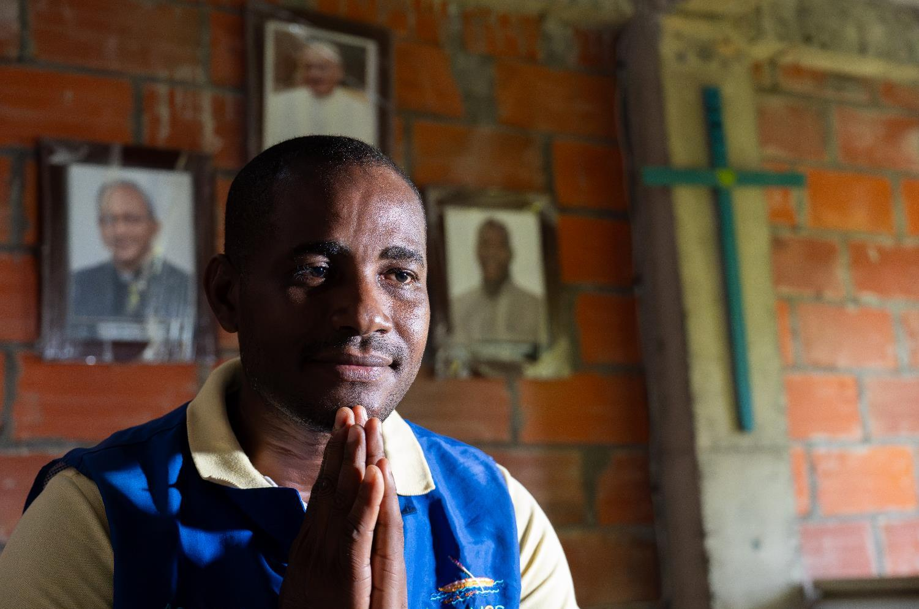
JUBILEE 2025
Notes:
Read aloud script:
One way we can show care for others and live out our faith is through our support of SCIAF.

Slide 4

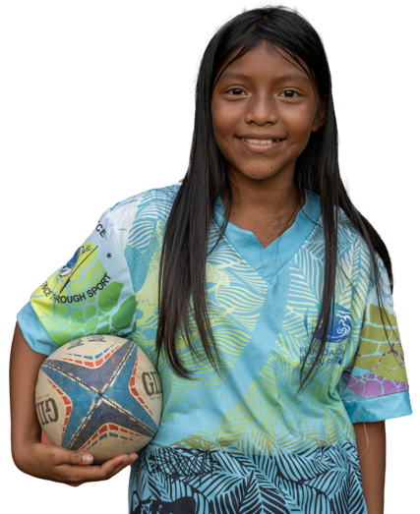
WHAT WE DO
DEVELOPMENT EDUCATION
ADVOCACY
HUNGER
WATER
PEACE & JUSTICE
EMERGENCIES
Marilin, Colombia
Notes:
Read aloud script:
SCIAF work here in Scotland educating people in schools and parishes about global issues.
Their advocacy work tackles the root causes of these issues through campaigning for a more just world.
SCIAF’s work around the world focuses on helping people grow enough food to eat, providing safe clean water to communities and ensuring that women are supported equally. They also respond to global emergencies like floods and droughts and provide aid for refugees and displaced people during conflicts.

Slide 5
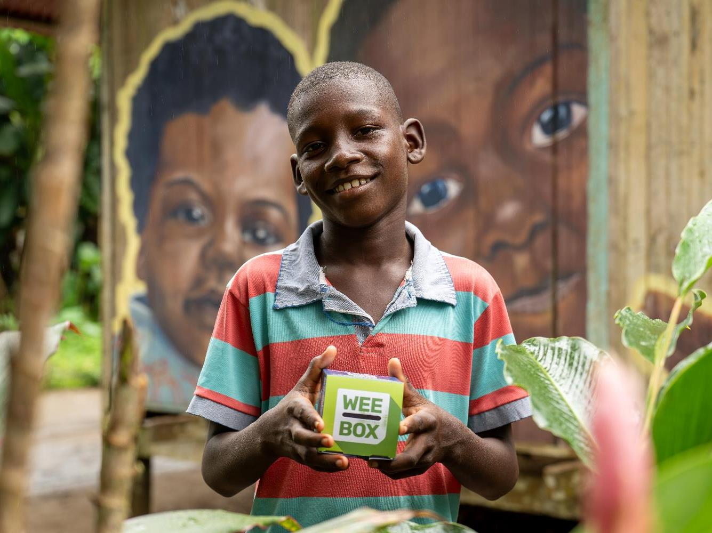

COLOMBIA
Jhoshua
Notes:
Read aloud script:
Every year schools and parishes across Scotland donate to the WEE BOX appeal at Lent.
This year’s WEE BOX focuses on SCIAF’s work in Colombia.
Colombia is the fourth largest country in South America. It has natural resources like oil and is one of the top producers of gold, silver, emeralds, platinum, and coal. However, the society in Colombia is very unequal, with huge disparities between rich areas and poorer communities.
The official language in Colombia is Spanish but there over 60 indigenous language spoken.

Slide 6
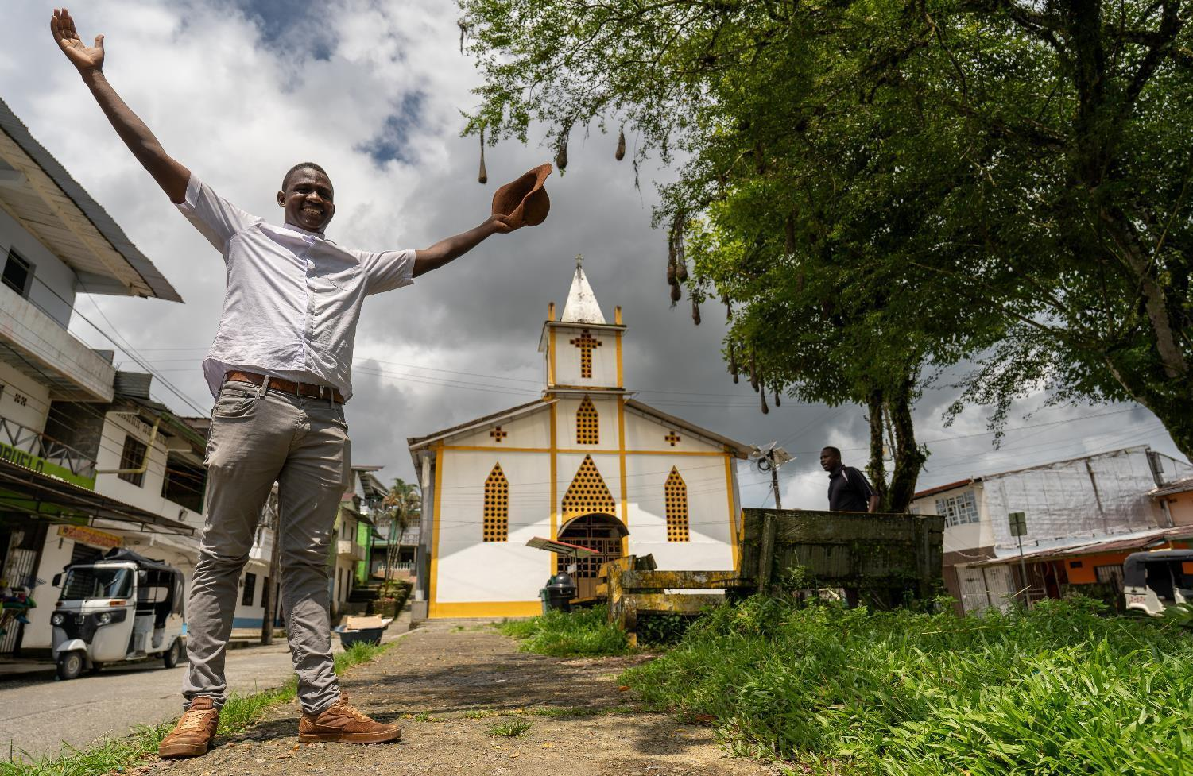
COLOMBIA
The Catholic Church in Colombia serves over 47 million Colombians, in 65 Dioceses.
Fr Daniel
Notes:
Read aloud script:
SCIAF work through local partners including the Church.
The Catholic Church in Colombia serves over 47 million Colombians - over 93% of the population -
in 65 Dioceses.
This is Fr Daniel, he is a parish priest in Chocó (Cho-KOH), one of the poorest parts of Colombia.

Slide 7
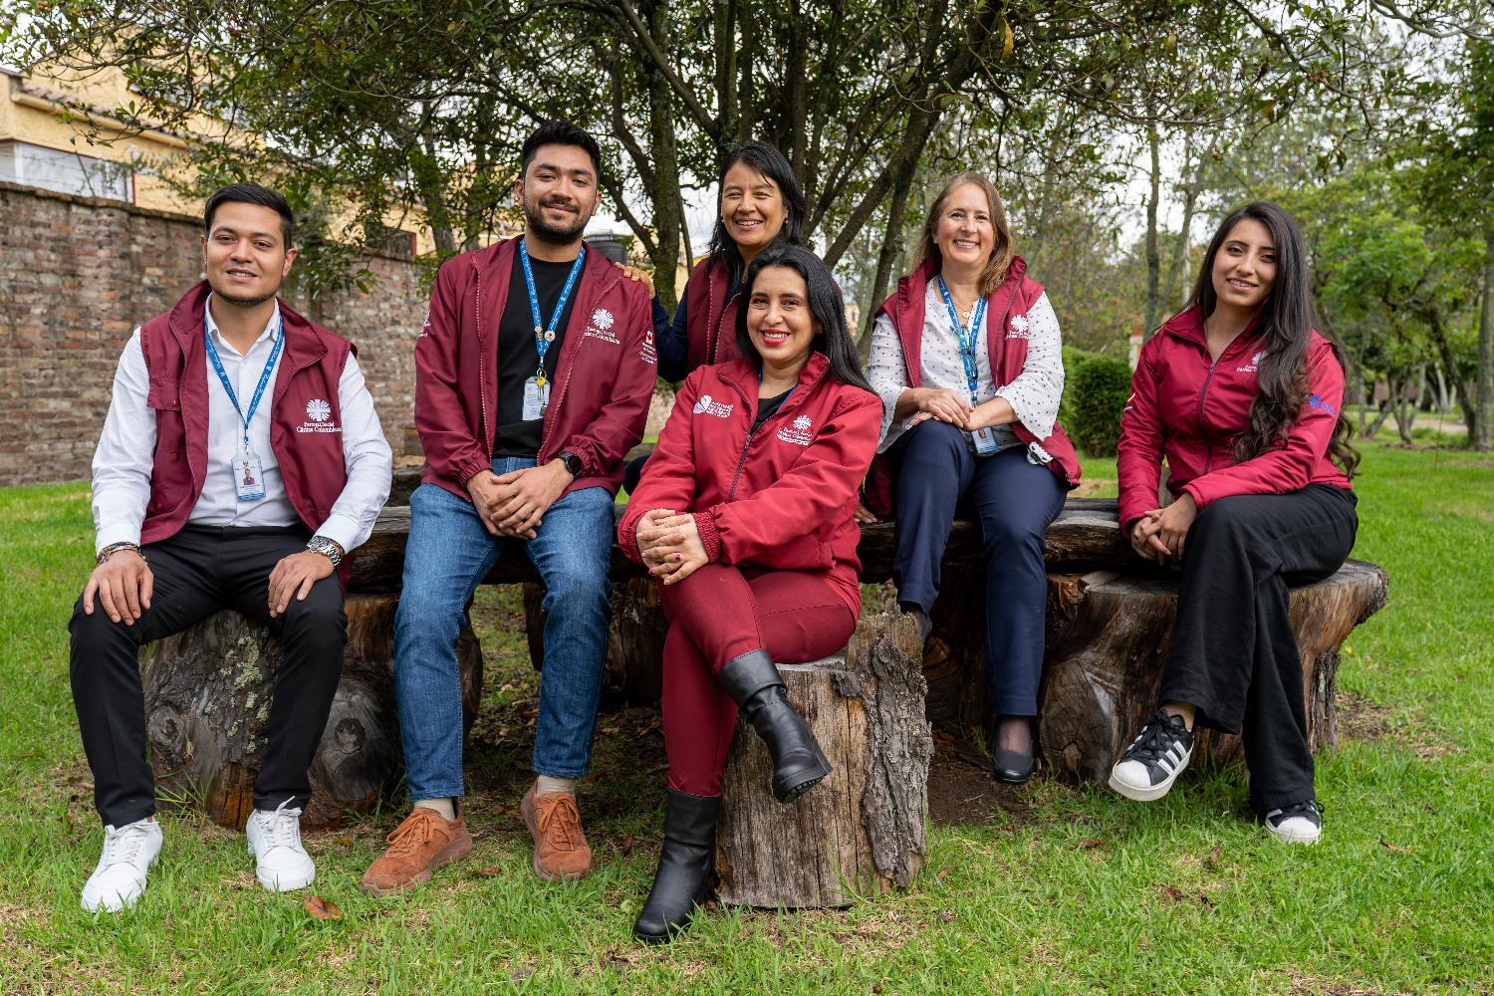
COLOMBIA
SCIAF partners – Caritas Colombia
Notes:
Read aloud script:
One of the local Church agencies SCIAF work with in Colombia is Caritas Colombia.
This local Caritas work and live in the communities they serve.
SCIAF work together with the local community and Caritas to co-create programs that help some of the poorest people in Colombia.

Slide 8
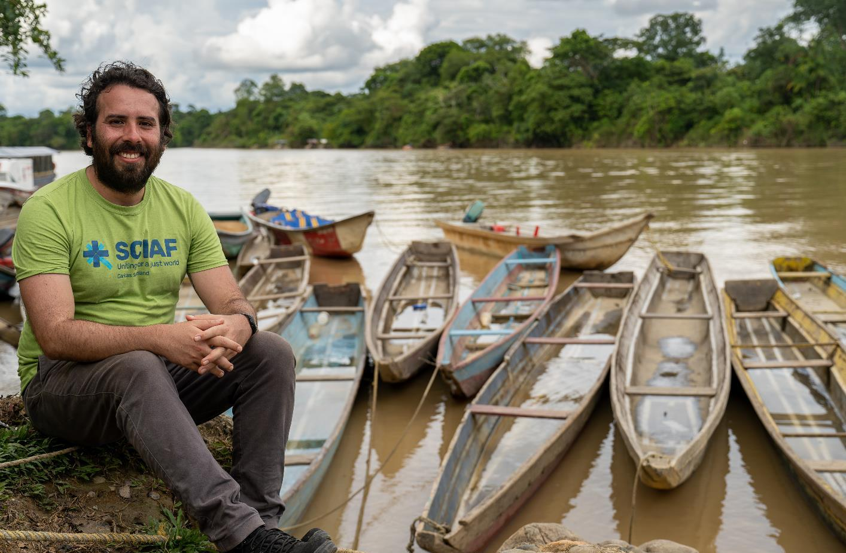
COLOMBIA
Rodrigo
Notes:
Read aloud script:
Even though Colombia is a beautiful country with amazing rivers and forests, many people face relentless violence because of conflict with armed gangs.
For those living along the River Atrato (Ah-TRAH-toh) in northwest Colombia, the river is a vital part of their lives. However, they struggle with conflict, poverty, and isolation every day.

Slide 9
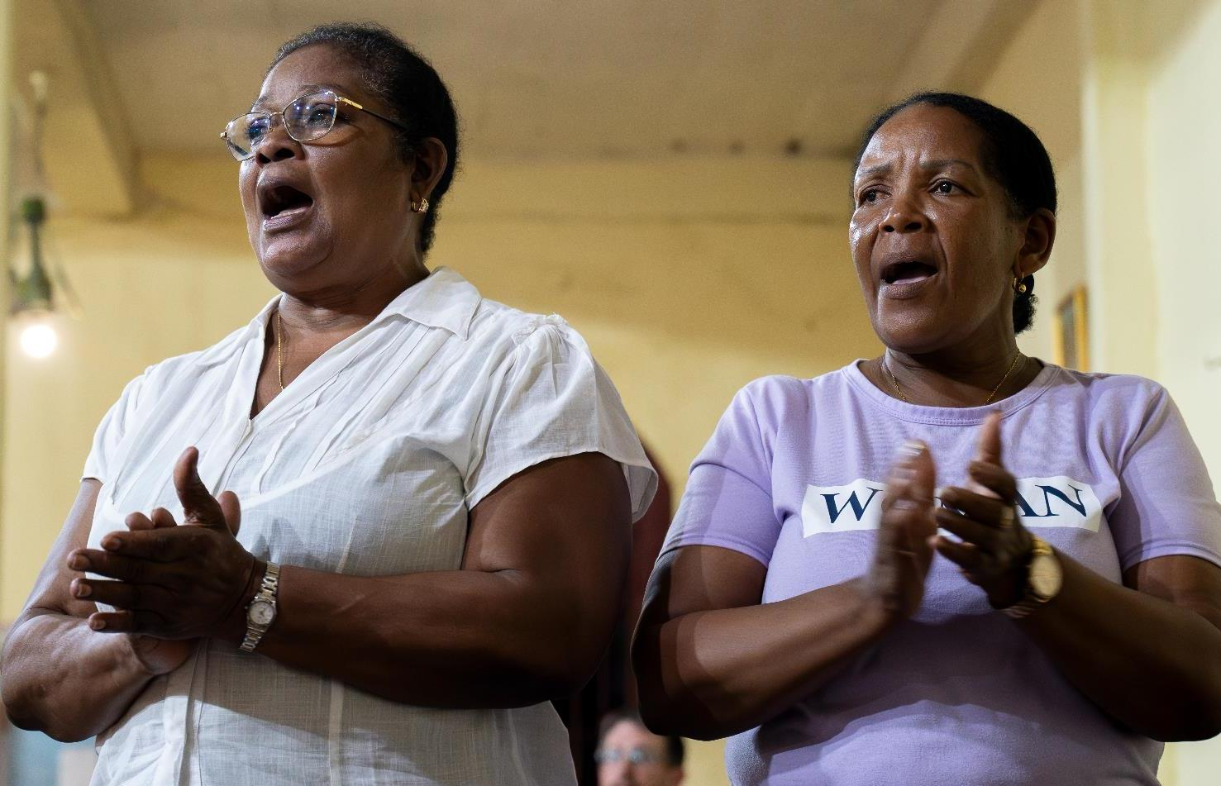
COLOMBIA
Parishioners in Colombia
Notes:
Read aloud script:
The conflict in Colombia is complex. There are many different armed groups who want control over the land and rivers to traffic people, drugs and illegally mined gold.

Slide 10
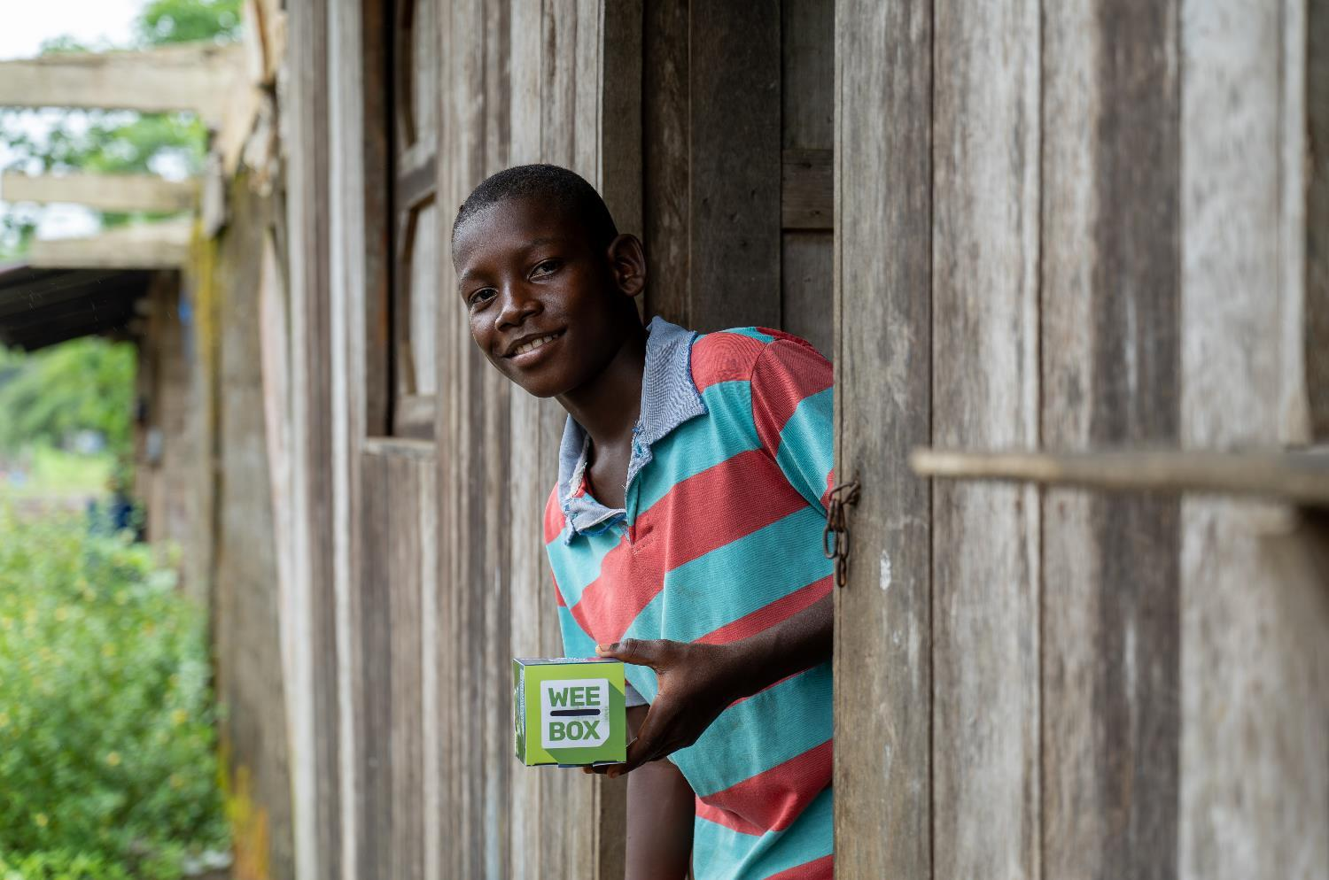
WEE BOX 2025
Notes:
Read aloud script:
This year’s WEE BOX appeal focuses on SCIAF’s work with the poorest communities in and around Chocó and the River Atrato.

Slide 11
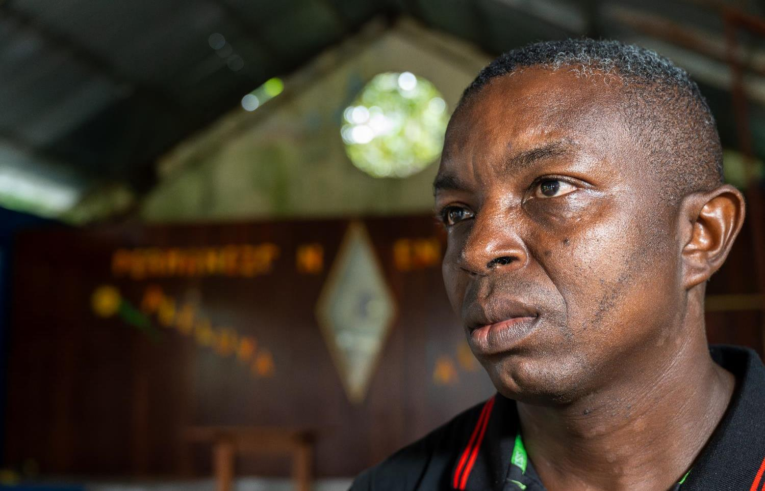
WEE BOX 2025
“When the bomb hit the room, everything went dark and smoky,
“When the darkness lifted, a little two year-old begged me not to leave him. I picked him up and took him out of the church. He died in my arms. When I got home, I just cried and cried.”
Luis
Luis
Notes:
Read aloud script:
This is Luis (L-WEES), he features on the WEE BOX this year.
Luis was sheltering in the church of San Pablo Apóstol in Colombia with his family and hundreds of local people when an armed group surrounded the building.
“When the bomb hit the room, everything went dark and smoky,” Luis told SCIAF. “When the darkness lifted, a little two year-old begged me not to leave him. I picked him up and took him out of the church. He died in my arms. When I got home, I just cried and cried.”

Slide 12
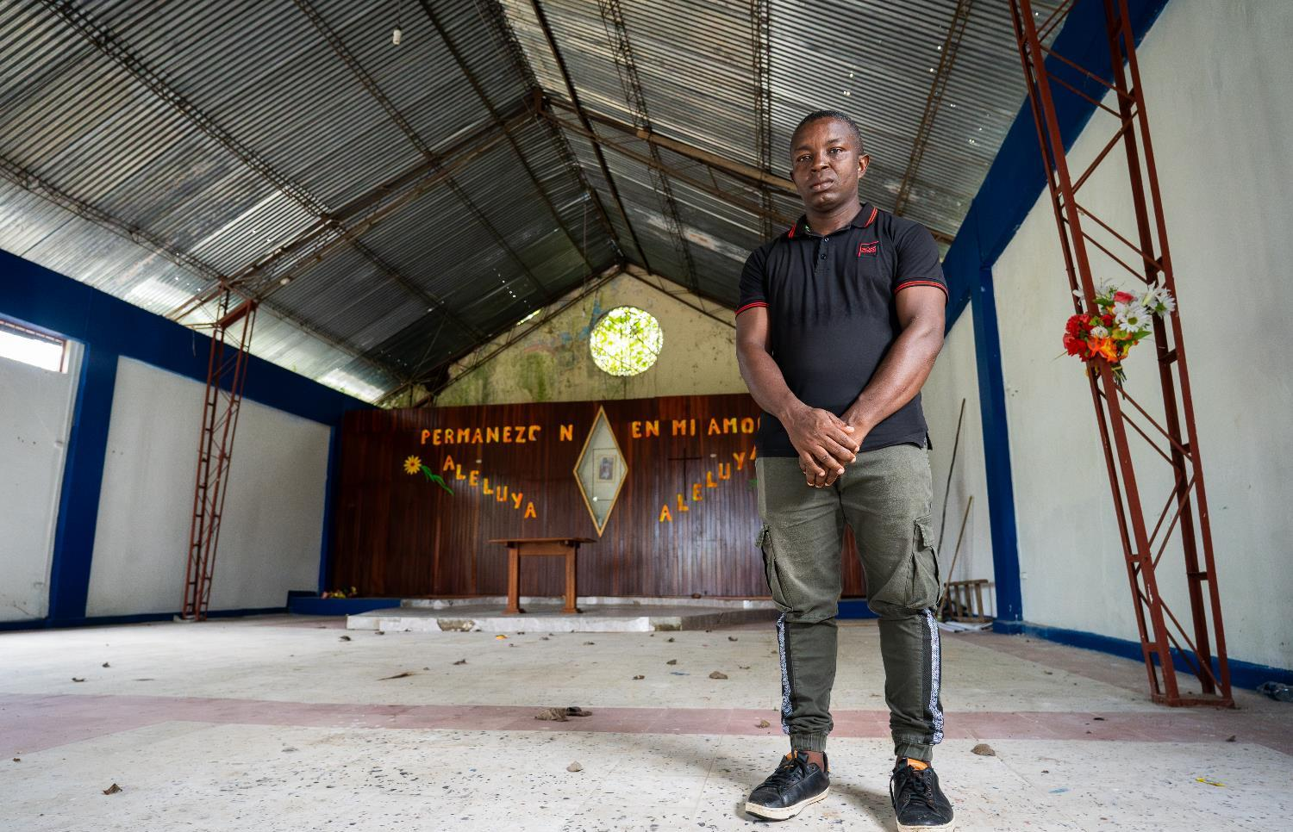
WEE BOX 2025
Miraculously, Luis’ whole family survived that terrible day. But 119 others were not so fortunate and perished in the explosion.
The attack left the church in ruins.
Notes:
Read aloud script:
Miraculously, Luis’ whole family survived that terrible day. But 119 others were not so fortunate and perished in the explosion.
The attack left the church in ruins.
But despite the carnage, the ‘mutilated Christ of Bojayá’ – a crucifix of our Lord Jesus – survived, albeit with His arms and legs missing.

Slide 13
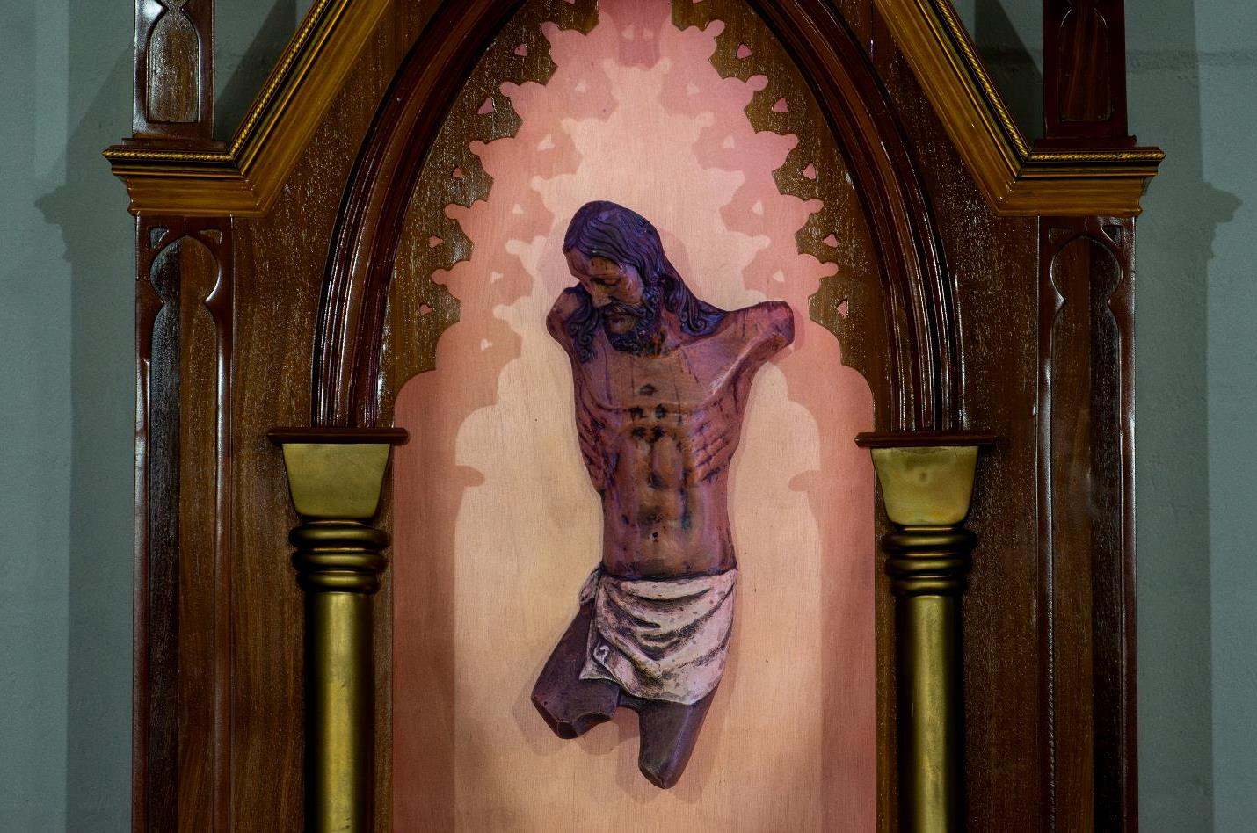
WEE BOX 2025
Notes:
Read aloud script:
But despite the carnage, the ‘mutilated Christ of Bojayá’ – a crucifix of our Lord Jesus – survived, albeit with His arms and legs missing.
Today, the relic has been venerated by many, including Pope Francis during his visit to Colombia, as a reminder of the suffering endured by communities but also as a sign of hope for a better future.

Slide 14
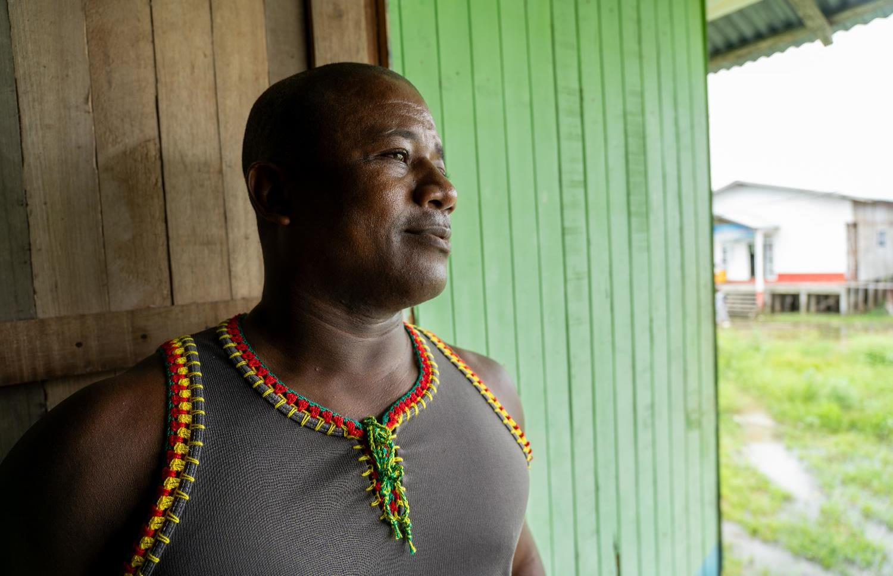
WEE BOX 2025
Enrique and his family were forced to leave their home.
Enrique
Notes:
Read aloud script:
This is Enrique (En-REE-kay).
Enrique and his family were forced to leave their home when their town was taken over by an illegal paramilitary group. They wanted access to the land so they could move drugs and illegally mined gold through the area.

Slide 15
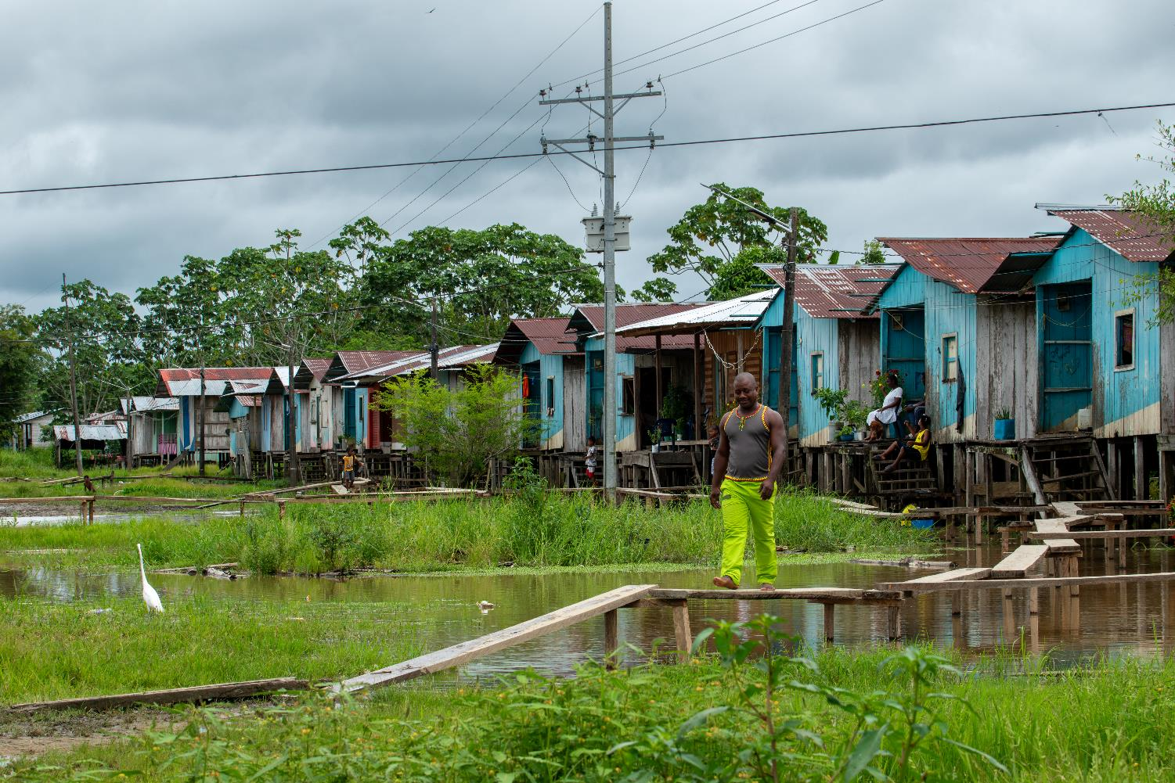
WEE BOX 2025
Enrique and his family had nowhere to go.
“When you’re displaced you have to move out quickly, or you are killed. You have to leave everything behind.”
Enrique
Enrique
Notes:
Read aloud script:
Enrique and his family had nowhere to go.
Enrique told SCIAF that “when you’re displaced you have to move out quickly, or you are killed. You have to leave everything behind.”

Slide 16
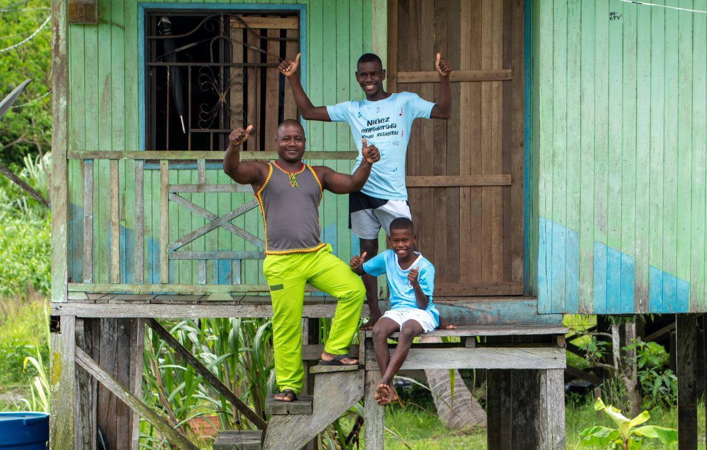
WEE BOX 2025
Enrique and family
“For those that finally returned to their homes, the state did not help – the Church, however, has helped us return with all their might.
Their presence has helped guard us from the armed groups that still operate here.”
Enrique
Enrique
Notes:
Read aloud script:
Thanks to your support of SCIAF, and the dedication and bravery of their local partners, we’ve helped displaced people like Enrique’s family return to their homes, keeping them safe during the process.
Enrique told SCIAF “for those that finally returned to their homes, the state did not help – the Church, however, has helped us return with all their might. Their presence has helped guard us from the armed groups that still operate here.”

Slide 17
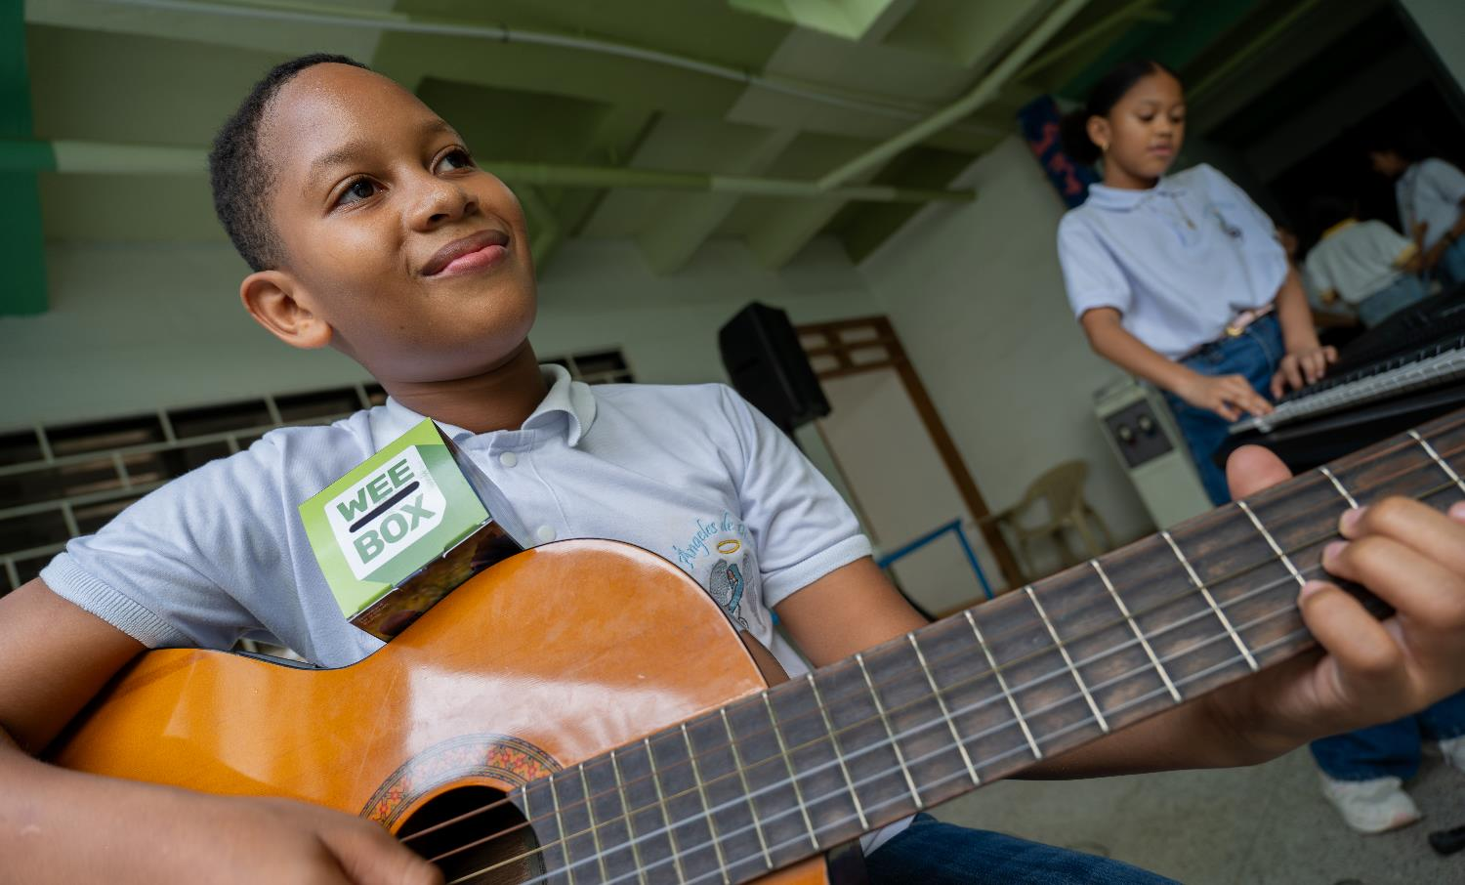
WEE BOX 2025
Safe place to play project
Notes:
Read aloud script:
The conflict has forced families from their homes all along the River Atrato, often separating families who have nowhere to go.
SCIAF help families affected by the conflict by providing safe places for children to play, to engage with music, art and sports activities.

Slide 18
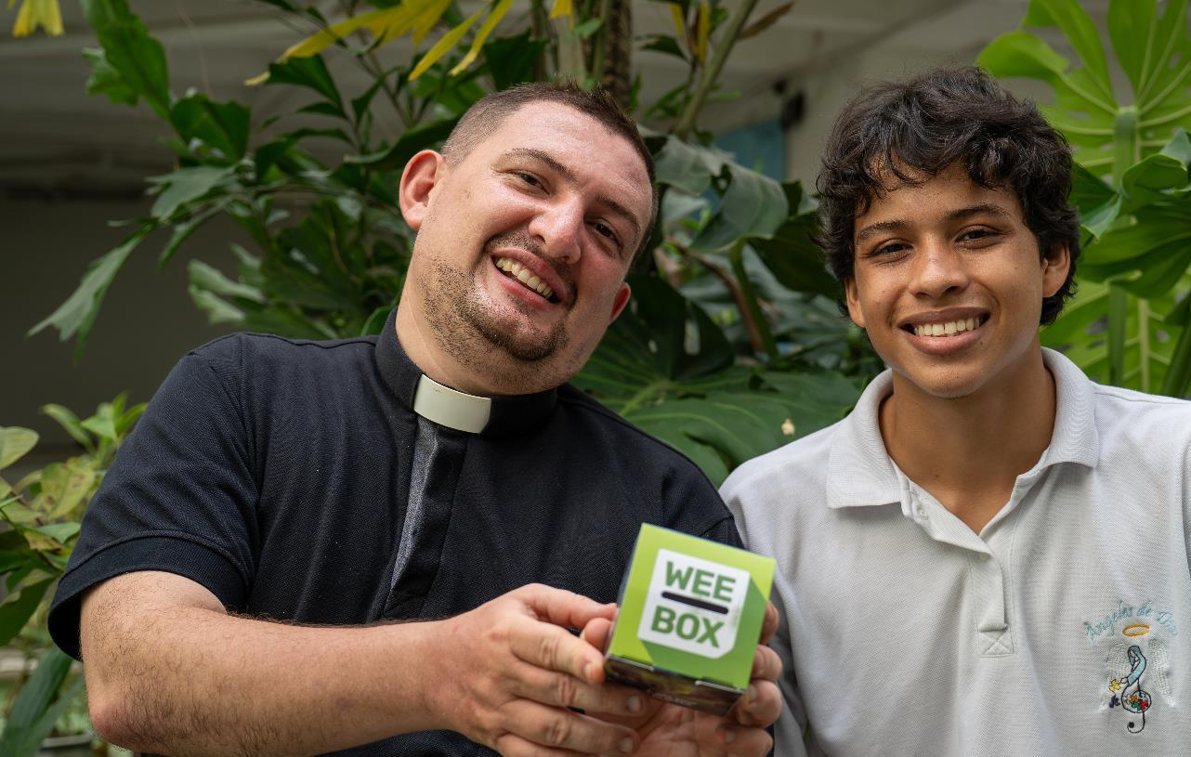
WEE BOX 2025
Safe place to play project
Notes:
Read aloud script:
This is Fr González.
SCIAF have supported their local partners to enable him to work with young people affected by conflict. He uses poetry, music and drawing to help support them spiritually and emotionally.

Slide 19
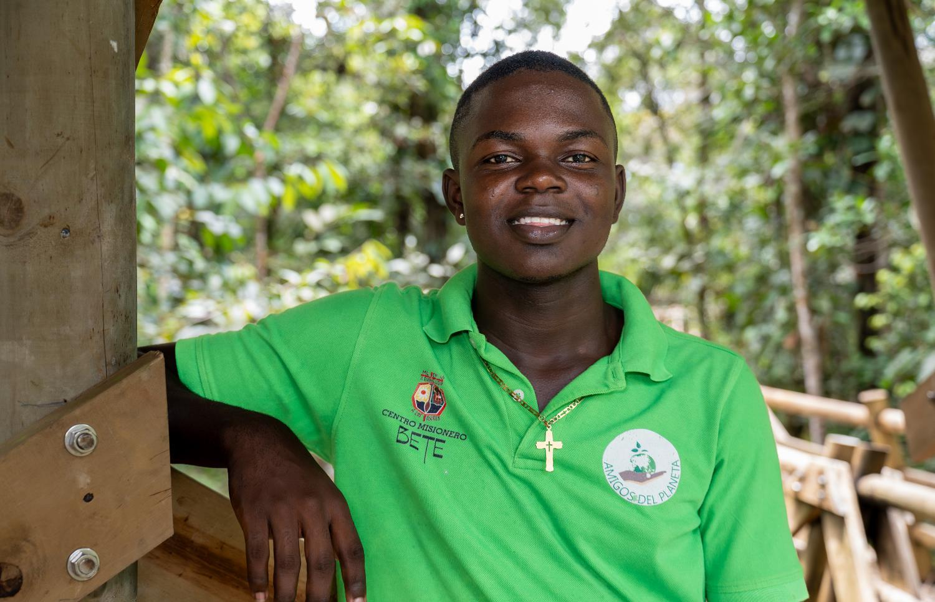
WEE BOX 2025
“With the help of Christ, Christ alive in the midst of the community, it is possible to usher in a new Colombia.”
Pope Francis
Notes:
Read aloud script:
By supporting SCIAF, we can be living signs of hope for the future and reach out to support the poorest communities around the world.
Pope Francis reminds us that “With the help of Christ, Christ alive in the midst of the community, it is possible to usher in a new Colombia.”

Slide 20

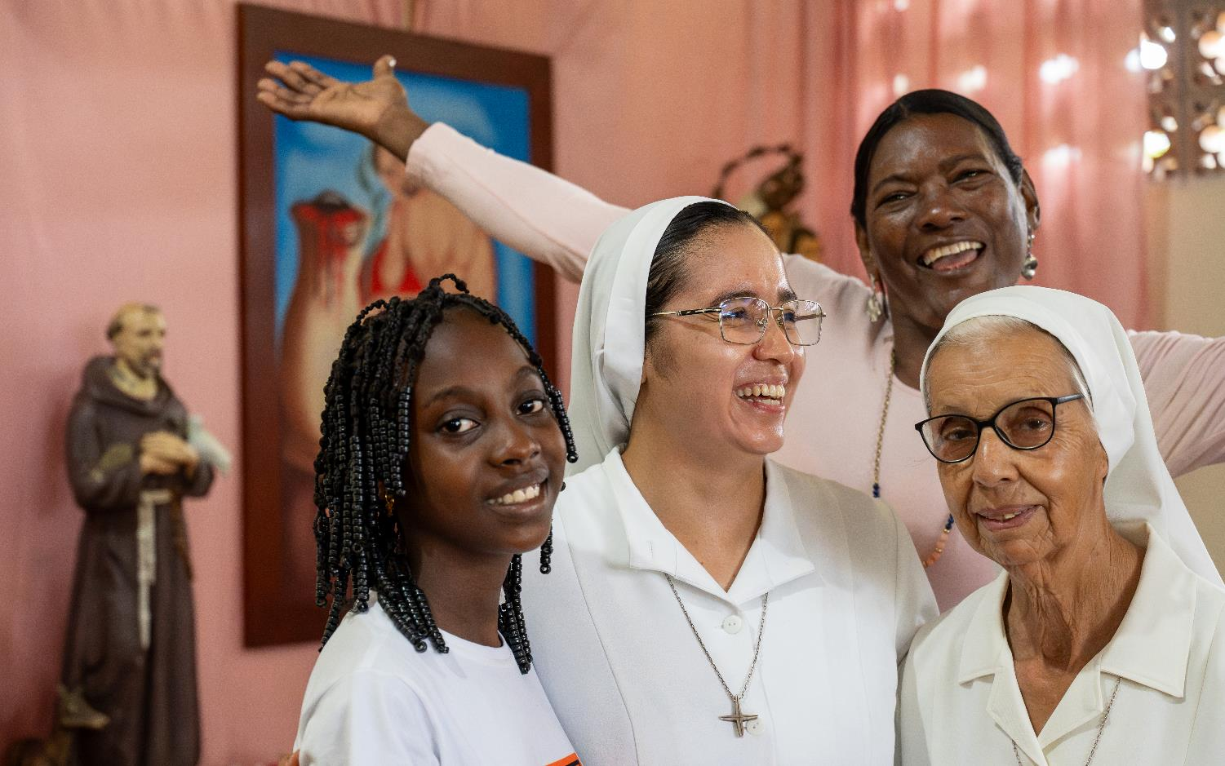
WEE BOX 2025
Notes:
Reader notes:
Use this slide to tell the audience how your parish are supporting SCIAF this Lent and ask them to join in your efforts to learn, pray and act for global justice.
Read aloud script:
This Lent we’re using our WEE BOX to make a BIG CHANGE

Slide 21
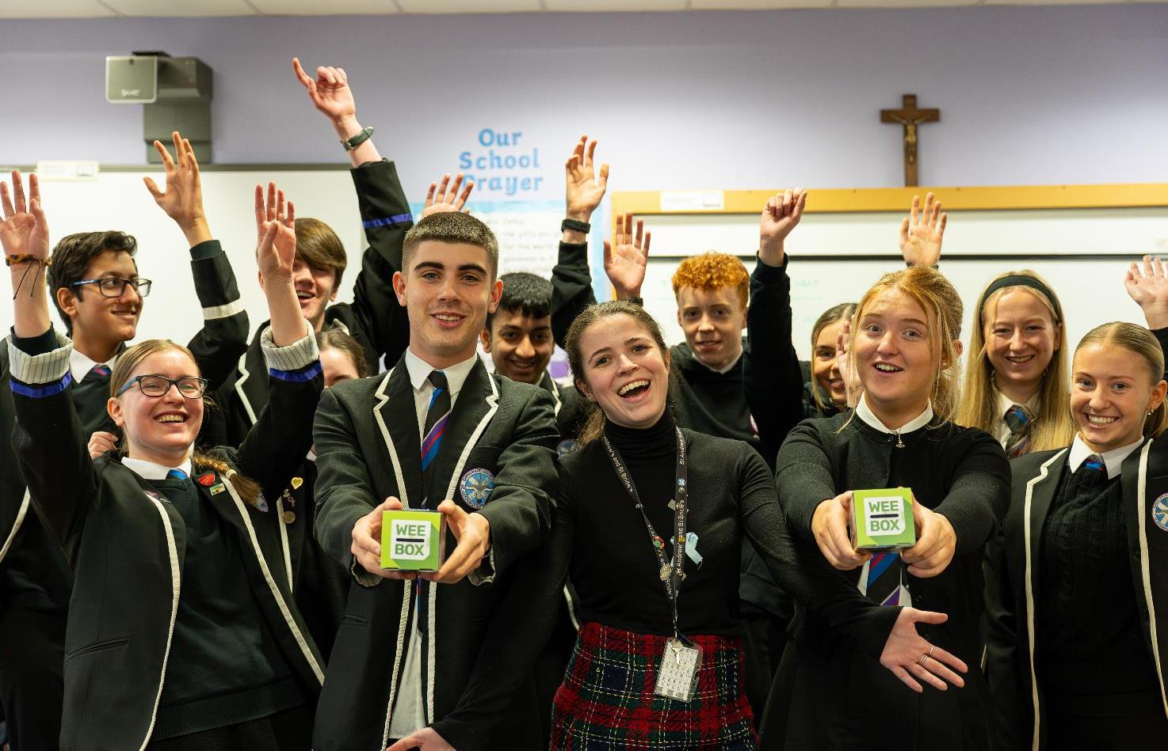
WEE BOX 2025

Slide 22
WEE BOX 2025
God of Peace and Justice
As we journey through Lent,
help us to be mindful of those
with whom we share God’s Creation,
our common home.
May our praying, fasting and giving,
help us to draw ever closer to You,
and inspire us to find new ways
to bring dignity, joy, peace and justice to others,
especially this year to the people of Colombia.
Amen
Notes:
Reader notes:
Please join us in prayer.

Slide 23

WEE BOX 2025
A JUST WORLD, FREE OF POVERTY, WHERE WE FLOURISH AND LIVE
IN HARMONY WITH EACH OTHER AND ALL CREATION.
Scottish Catholic International Aid Fund
SCIAF is the official relief and development agency of the Catholic Church in Scotland
and a proud member of the Caritas family. 7 West Nile Street, Glasgow G1 2PR.
Tel: 0141 354 5555. Scottish Charity No: SC012302. Company No: SC197327.
sciaf@sciaf.org.uk
Notes:
Thank you.

