Slide 1
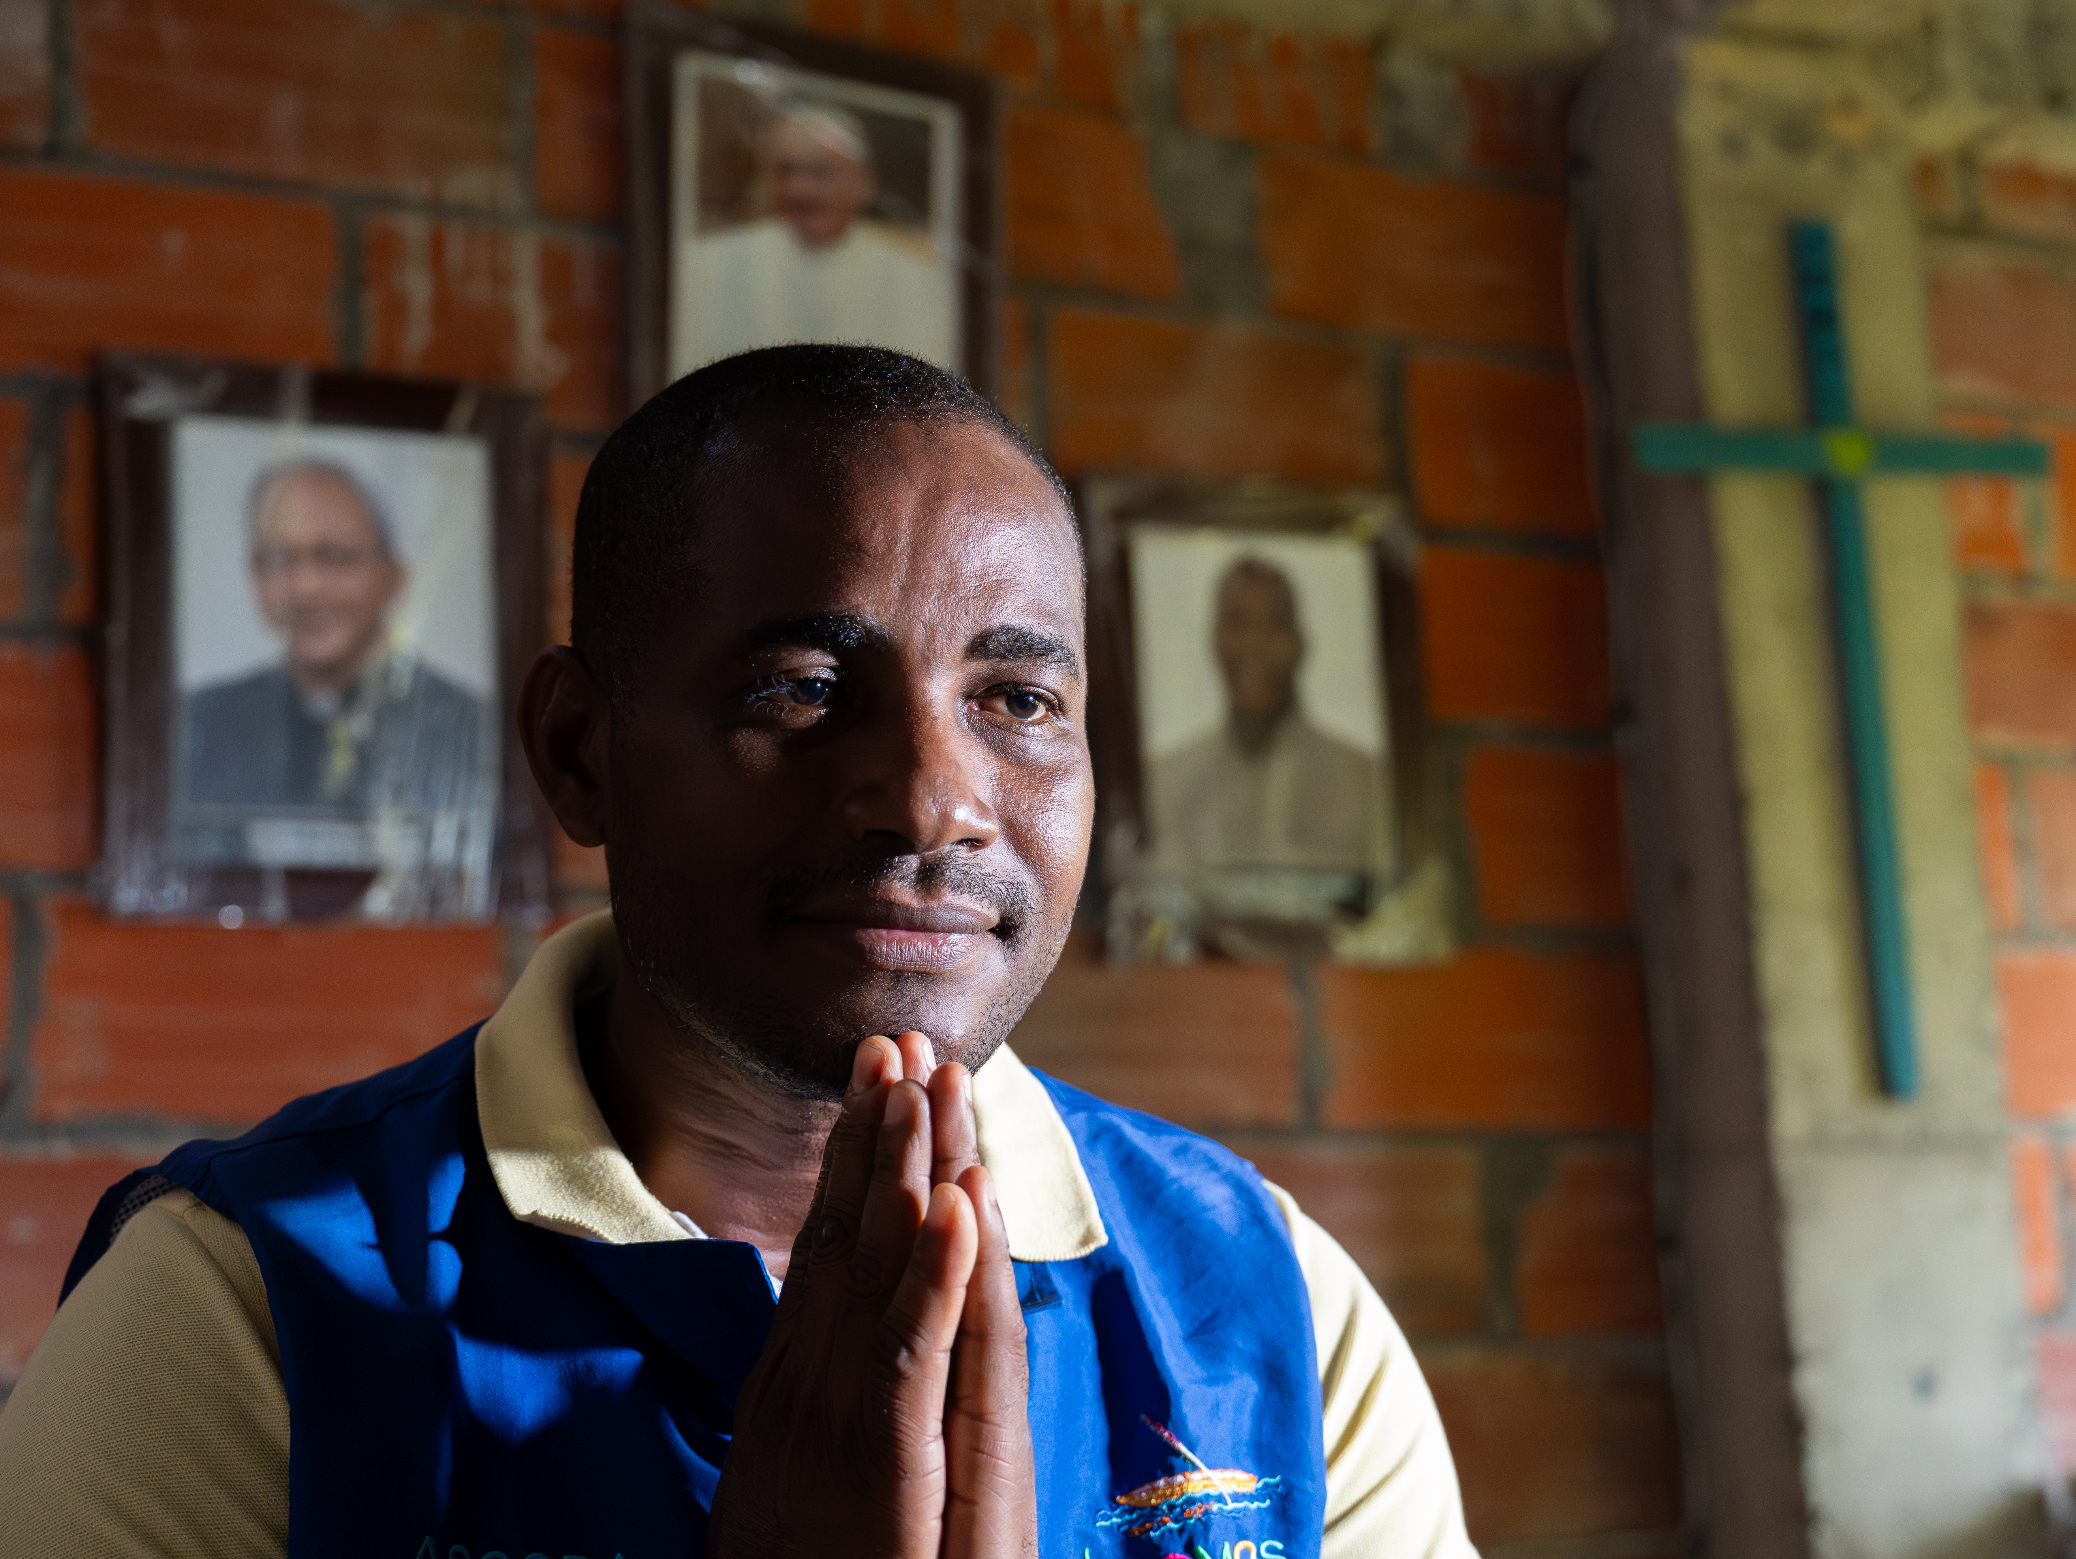



GOD OF
COMFORT
2 COR. 1:3-5

Slide 2

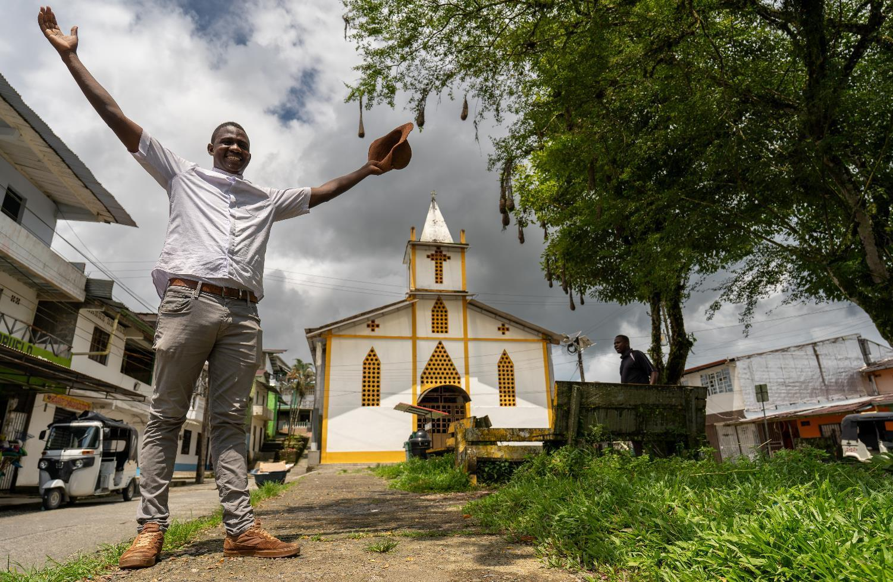
GOD OF COMFORT
“Blessed be the
God and Father
of our Lord Jesus Christ..."
Fr Daniel
Notes:
“Blessed be the God and Father of our Lord Jesus Christ…

Slide 3

GOD OF COMFORT
These words begin with praise for the source of all comfort – God Himself.
He is the ultimate source of our consolation, the One who showers us with His mercy and compassion in times of distress.
Our faith teaches us to turn to God in gratitude, recognising that He sustains us through every trial.
Notes:
These words begin with praise for the source of all comfort – God Himself. He is the ultimate source of our consolation, the One who showers us with His mercy and compassion in times of distress.
Our faith teaches us to turn to God in gratitude, recognising that He sustains us through every trial.

Slide 4
GOD OF COMFORT
“... the merciful Father and the God who gives every possible encouragement…”
Fr Daniel

Slide 5
GOD OF COMFORT
We often pray to God as the "Merciful Father” and this title underscores His boundless love and tenderness towards His children.
He is not a distant God but a compassionate Father who intimately cares for us. We are reminded of the rich wellspring of comfort that flows from His merciful heart.

Slide 6
GOD OF COMFORT
“...he supports us in every hardship...”
Fr Daniel

Slide 7
GOD OF COMFORT
We all face difficult times, both great and small, in our lives.
The beauty of our Catholic faith lies in the knowledge that God is ever-present, offering solace and strength in our times of need.
He does not abandon us in our struggles but provides a consoling embrace that offers us comfort and hope.

Slide 8
GOD OF COMFORT
“ ...so that we are able to come to the support of others, in every hardship of theirs...”
Fr Daniel

Slide 9
GOD OF COMFORT
This verse calls us to a mission of compassion and empathy for our brothers and sisters.
We are called to be vessels of God's comfort, extending His love and consolation to others – locally and globally.

Slide 10
GOD OF COMFORT
“…because of the encouragement that we ourselves receive from God.”
Fr Daniel

Slide 11
GOD OF COMFORT
Our own experiences of God's comfort strengthens us to support those who suffer, helping them find peace and healing.

Slide 12
GOD OF COMFORT
“For just as the sufferings of Christ overflow into our lives....”
Fr Daniel

Slide 13
GOD OF COMFORT
Our Catholic faith teaches us about the redemptive power of suffering.
Just as Christ bore the weight of our sins on the cross, we, too, share in His sufferings.
Our trials are not without purpose; they unite us with Christ and offer us the opportunity to participate in His transformative power.

Slide 14
GOD OF COMFORT
“…so too does the encouragement we receive through Christ.”
Fr Daniel

Slide 15
GOD OF COMFORT
Christ not only understands our pain but invites us to partake in the abundant comfort that He offers.
Through our faith in Him, we discover a wellspring of hope that overflows into the lives of others.
May we, in turn, extend His comfort to those who are in need, sharing abundantly and offering support to those most in need.

Slide 16
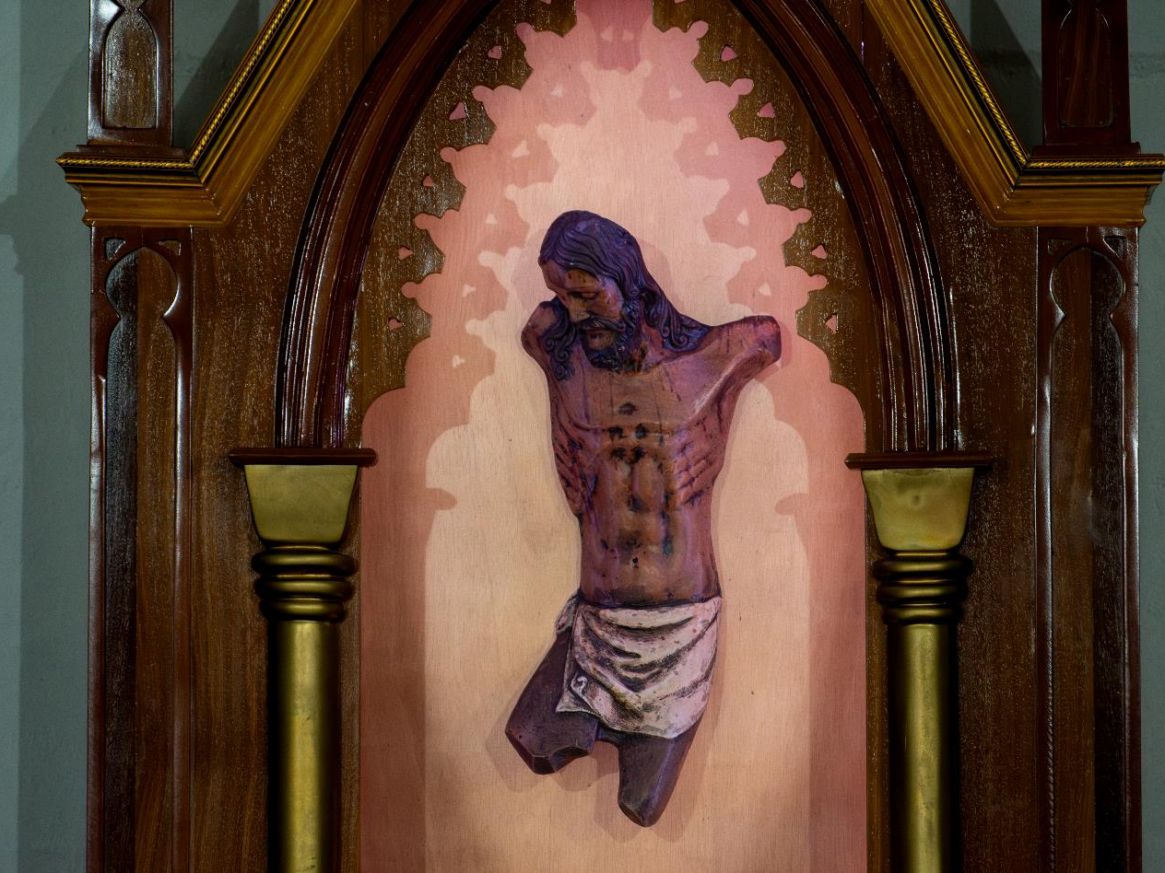
HOPE
DOES NOT DISAPPOINT
ROMANS 5: 1-5

Slide 17
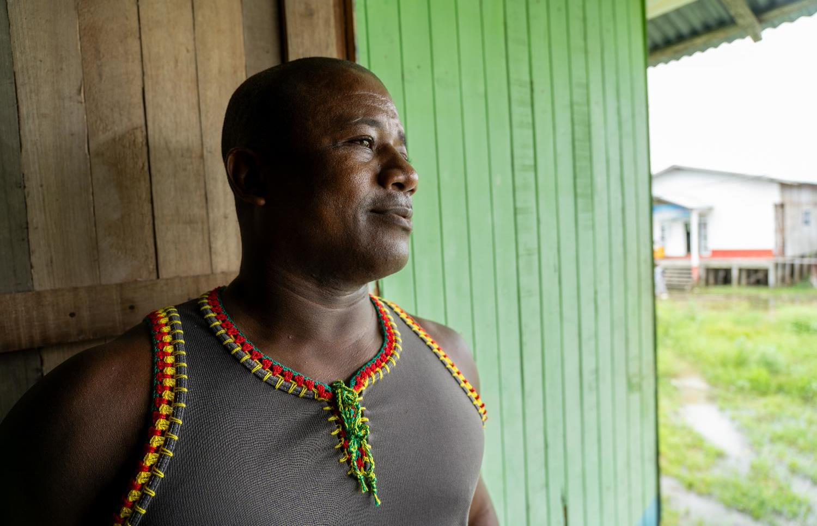
HOPE DOES NOT DISAPPOINT
"Therefore, since we have been justified by faith, we have peace with God through our Lord Jesus Christ…"
Enrique

Slide 18
HOPE DOES NOT DISAPPOINT
Our faith in Jesus Christ brings us peace with God.
This peace is not just a feeling but a deep relationship of trust and harmony with our Creator.
We are called to embrace this gift of peace and live in a way that reflects our unity with God, knowing that through Christ, all things are possible.

Slide 19
HOPE DOES NOT DISAPPOINT
"Through him we have also obtained access by faith into this grace in which we stand, and we rejoice in hope of the glory of God…"
Enrique

Slide 20
HOPE DOES NOT DISAPPOINT
Through Jesus, we have been given the gift of grace—a grace that strengthens and sustains us in our daily lives.
This grace is a reminder of God's infinite love and generosity.
We rejoice with hope, knowing that one day we will share in His glory.

Slide 21
HOPE DOES NOT DISAPPOINT
“Not only that, but we rejoice in our sufferings, knowing that suffering produces endurance…"
Enrique

Slide 22
HOPE DOES NOT DISAPPOINT
Suffering can teach us patience and perseverance, helping us to trust in God's plan even when we don’t fully understand it.
Like Jesus on the cross, we can unite our sufferings with His and grow stronger in faith.

Slide 23
HOPE DOES NOT DISAPPOINT
“…and endurance produces character, and character produces hope…”
Enrique

Slide 24
HOPE DOES NOT DISAPPOINT
When we endure challenges with faith, we grow in character, becoming more like Christ.
This inner strength leads to hope—a hope that reminds us God is always with us, guiding us through every trial.
We are invited to hold on to this hope, trusting that it will never disappoint us.

Slide 25
HOPE DOES NOT DISAPPOINT
“…and hope does not disappoint, because God’s love has been poured into our hearts through the Holy Spirit who has been given to us."
Enrique

Slide 26
HOPE DOES NOT DISAPPOINT
Our hope is steadfast because it is rooted in God's love, poured into our hearts through the Holy Spirit.
This love is a gift, freely given, reminding us that we are never alone.
The Holy Spirit dwells within us, guiding, comforting, and empowering us to live as faithful witnesses of Christ’s love in the world.

