Slide 1
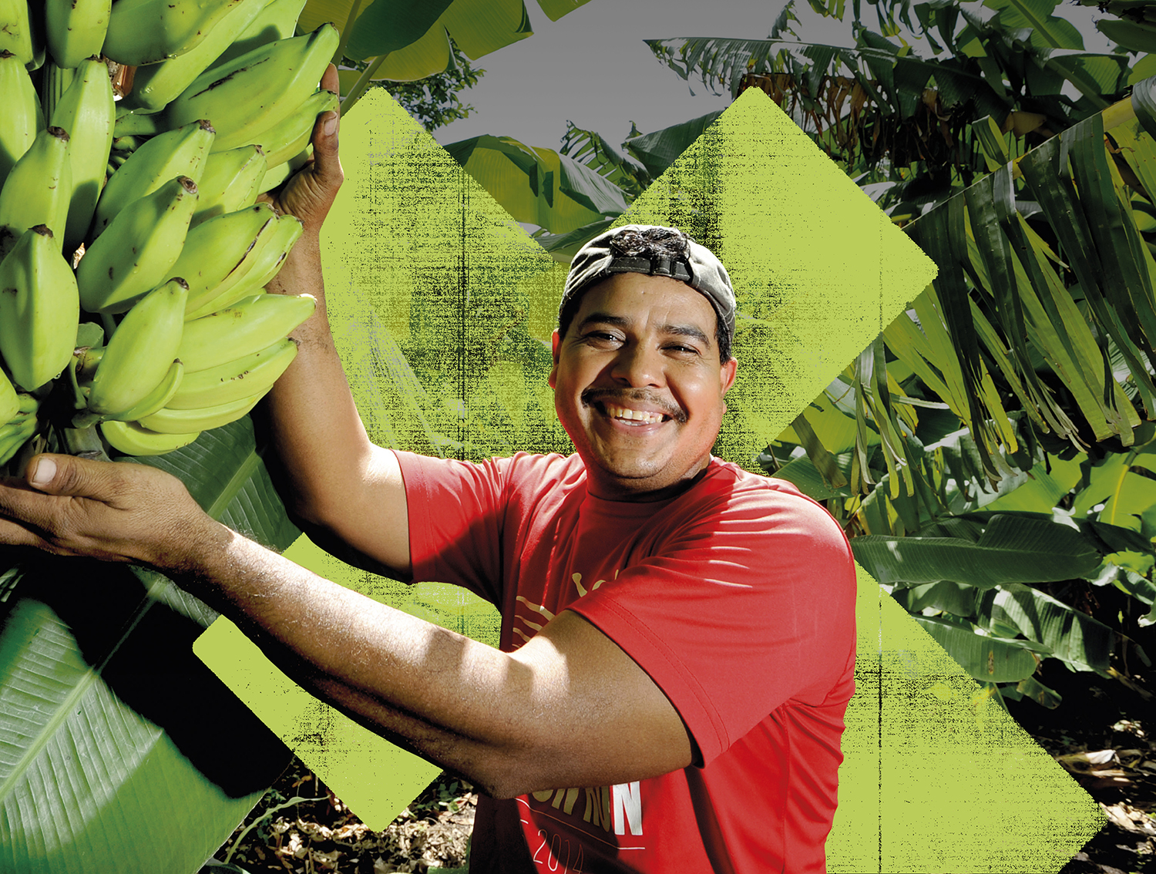

CLIMATE
CRAFTIVISM

Slide 2





WHAT WE DO
We work across Africa, Asia, Latin America, the Middle East and Europe.
Every year
we help over
1 million
people to have
a brighter future
We support people during emergencies
Together, we reach out
as Pilgrims of Hope!
Notes:
Reader notes:
Currently providing support in 13 countries (6 in Africa, 5 in Middle East & Europe, 1 in Asia and 1 in South America) for both long-term development and emergency aid. For more info on each country see www.sciaf.org.uk/our-work/countries
SCRIPT:
Evey year, through long-term development work and emergency response we help over 1 million people to recover from disaster and to have a brighter future.

Slide 3


WHAT WE DO
DEVELOPMENT EDUCATION
ADVOCACY
HUNGER
WATER
PEACE & JUSTICE
EMERGENCIES
Marilin, Colombia
Notes:
Reader notes:
More information on our work here: www.sciaf.org.uk/our-work
SCRIPT:
SCIAF work here in Scotland educating people in schools and parishes about global issues.
We tackles the root causes of these issues through advocacy and campaigning for a more just world.
Our work around the world focuses on helping people
grow enough food to eat,
providing safe clean water to communities
helping people to live in safe and peaceful communities
responding to global emergencies like floods and droughts.
Plus, support for refugees and displaced people during conflict.

Slide 4
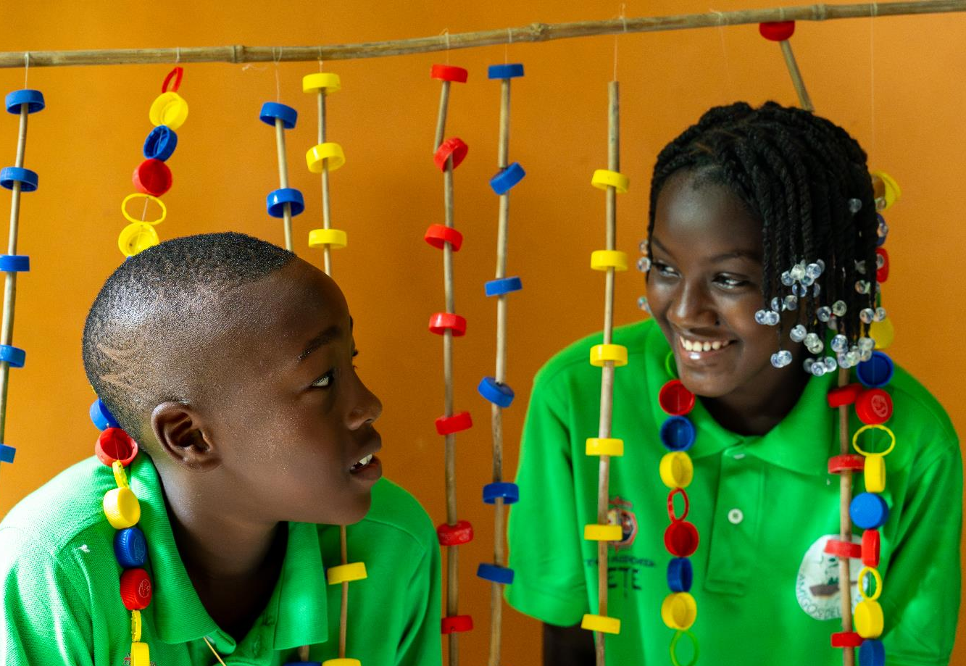
CAMPAIGN
Notes:
Reader notes:
More information on our work here: www.sciaf.org.uk/campaign
SCRIPT:
The world exists for us all, yet every day, billions of men, women and children are deprived of food, water and dignity. But it doesn't have to be this way. Together we campaign to promote justice and build peace, so that we can all live in His love and justice, free from fear and persecution.

Slide 5
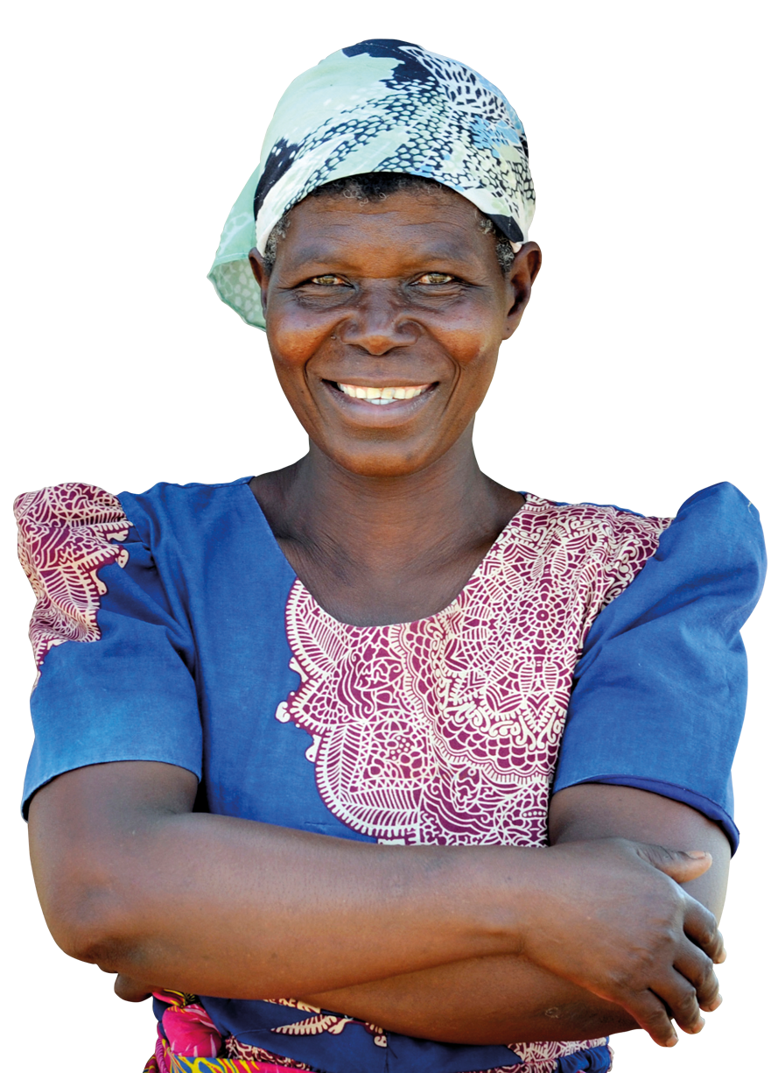



CAMPAIGN
A chorus
that cries
for the earth
Climate change affects us all. We cannot be silent.
World leaders must listen to the chorus that cries for the earth.
Together we put pressure on governments to care for the planet and create a fairer, more peaceful world.
sciaf.org.uk/campaign

Slide 6

GET INVOLVED
Get involved in climate activism through Climate Craftivism.
Craft + Activism = Craftivism
Here are some ways to get involved…

Slide 7


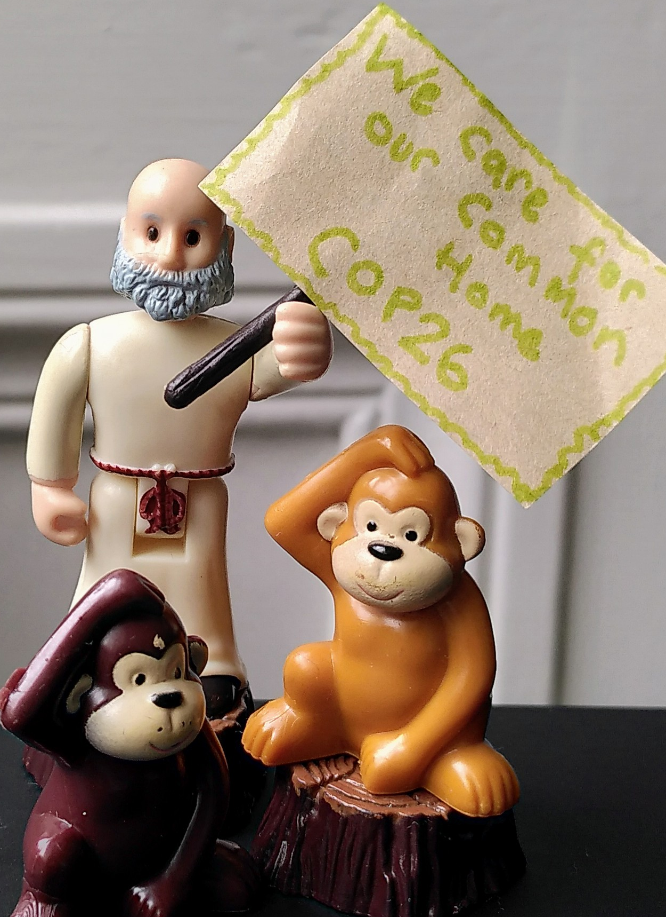
Get involved today!
Toy protest
Get everyone involved at home and send a clear message that you care about climate change.

Slide 8

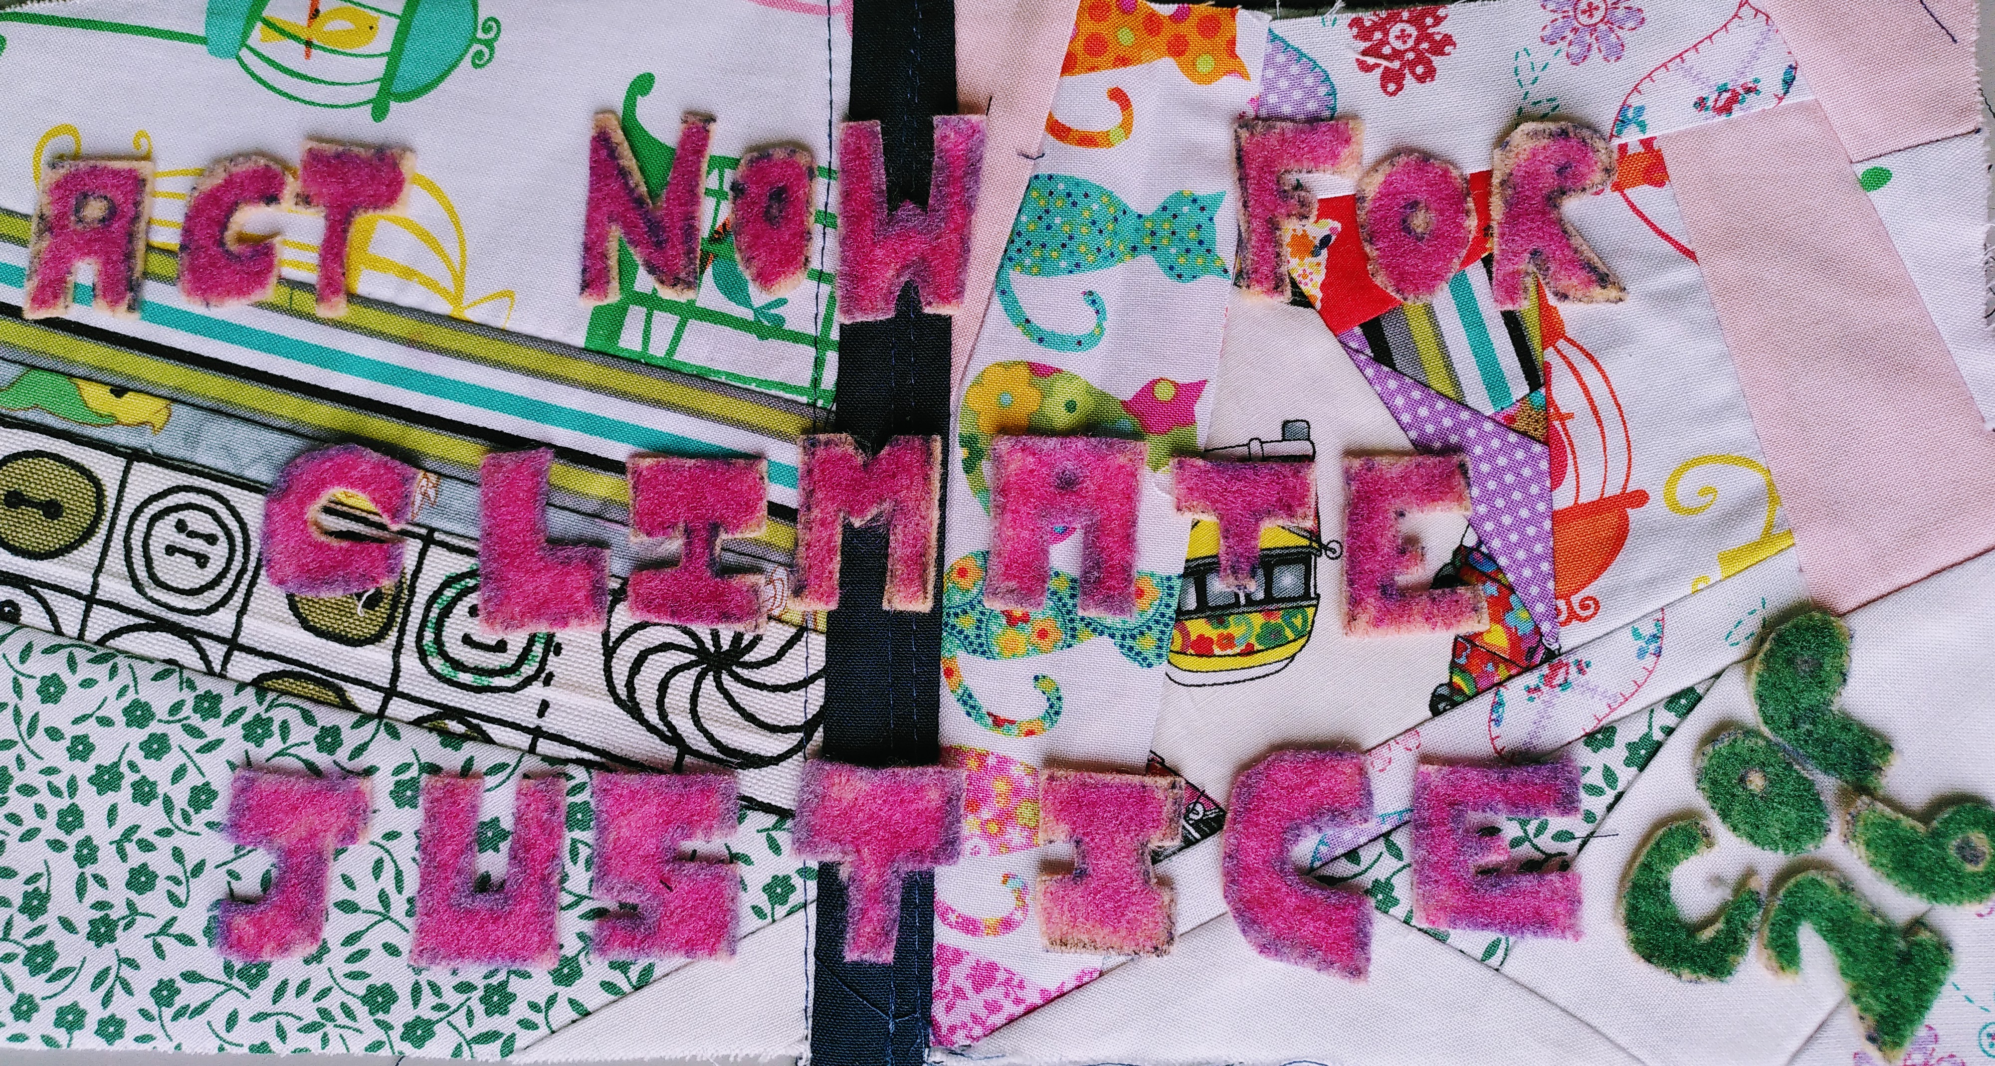
Get involved today!
Patchwork protest banner
Sew your support for climate justice and have your voice heard through a homemade banner.

Slide 9
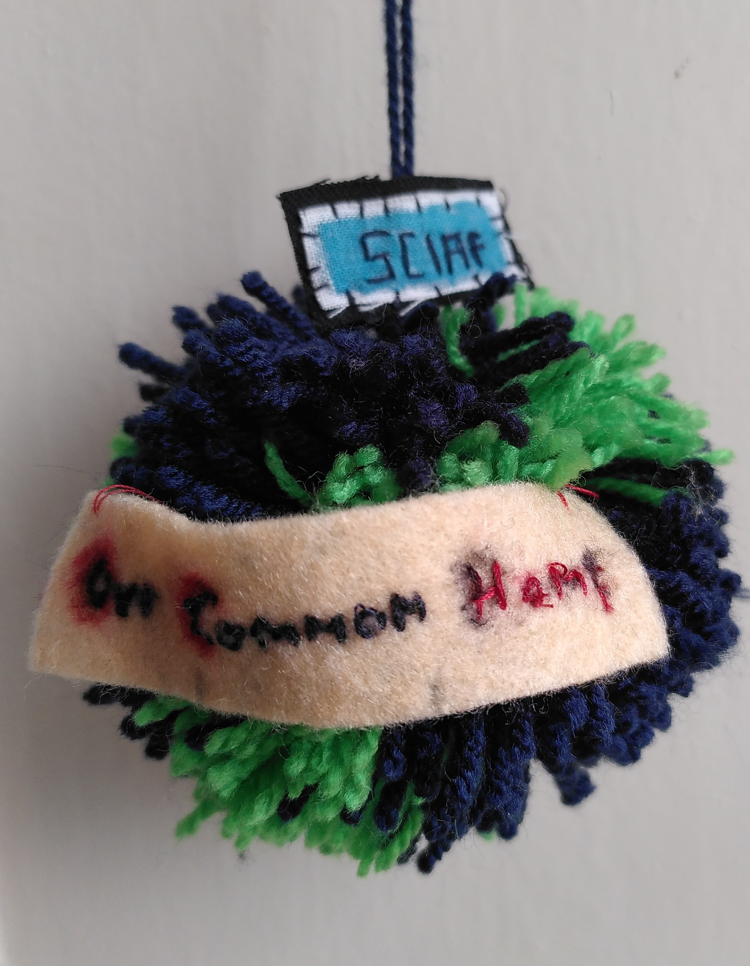
Get involved today!
Earth pom pom
Hang these around your school, parish or in your window to show you care
for the earth, our
Common Home.

Slide 10

Get involved
Share your Climate Craftivism with us
@sciaf on Twitter, Facebook and Instagram
@sciaf_insta

Slide 11
A JUST WORLD, FREE OF POVERTY, WHERE WE FLOURISH AND LIVE
IN HARMONY WITH EACH OTHER AND ALL CREATION.
Scottish Catholic International Aid Fund
SCIAF is the official relief and development agency of the Catholic Church in Scotland
and a proud member of the Caritas family. 7 West Nile Street, Glasgow G1 2PR.
Tel: 0141 354 5555. Scottish Charity No: SC012302. Company No: SC197327.
sciaf@sciaf.org.uk
Notes:
Thank you.

