Slide 1

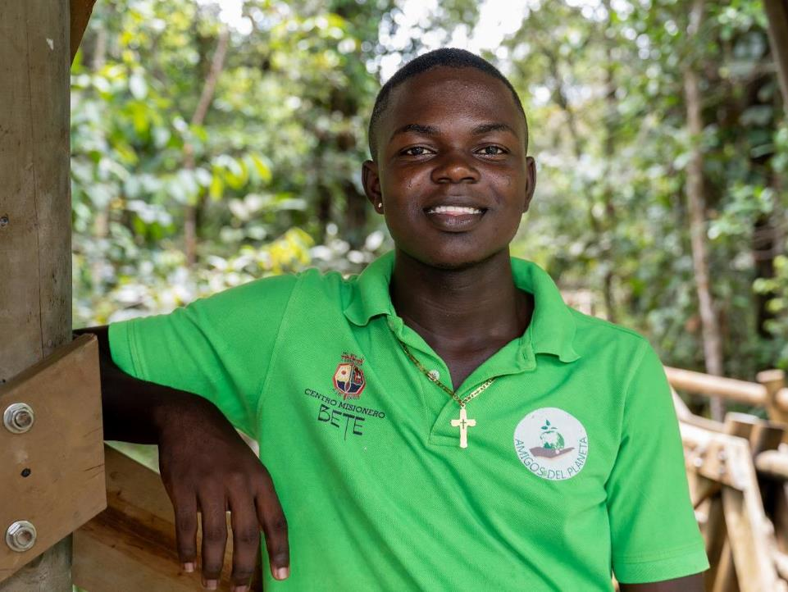

AMIGOS DEL PLANETA
COLOMBIA
Notes:
Teacher notes:
Use this PowerPoint to learn about peace, justice and environmental activism in Colombia. The PPT can then be presented by the pupils to parents, the parish, a local councilor or at assembly.
This PowerPoint is suitable for a range of ages and stages.
Feel free to amend and use the teacher notes to help write a read-aloud script suitable for the audience.

Slide 2


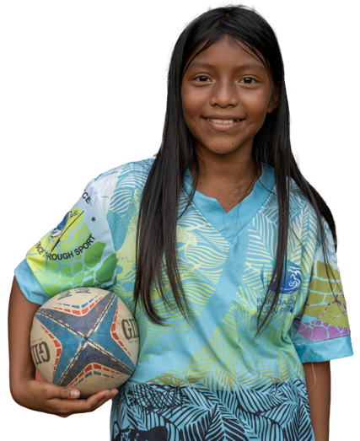
WHAT WE DO
DEVELOPMENT EDUCATION
ADVOCACY
HUNGER
WATER
PEACE & JUSTICE
EMERGENCIES
Marilin, Colombia
Notes:
More information on our work here: www.sciaf.org.uk/our-work
SCIAF work here in Scotland educating people in schools and parishes about global issues.
We tackles the root causes of these issues through advocacy and campaigning for a more just world.
Our work around the world focuses on helping people
grow enough food to eat,
providing safe clean water to communities
helping people to live in safe and peaceful communities
responding to global emergencies like floods and droughts.
Plus, support for refugees and displaced people during conflict.

Slide 3



WHAT SCIAF DO
WE WORK ACROSS AFRICA, ASIA, LATIN AMERICA, THE MIDDLE EAST AND EUROPE
Every year
we help over
1 million
people to have
a brighter future
We support people during emergencies
WE BELIEVE
A BETTER WORLD IS POSSIBLE
Notes:
Evey year, SCIAF help over 1 million people to have a brighter future.

Slide 4
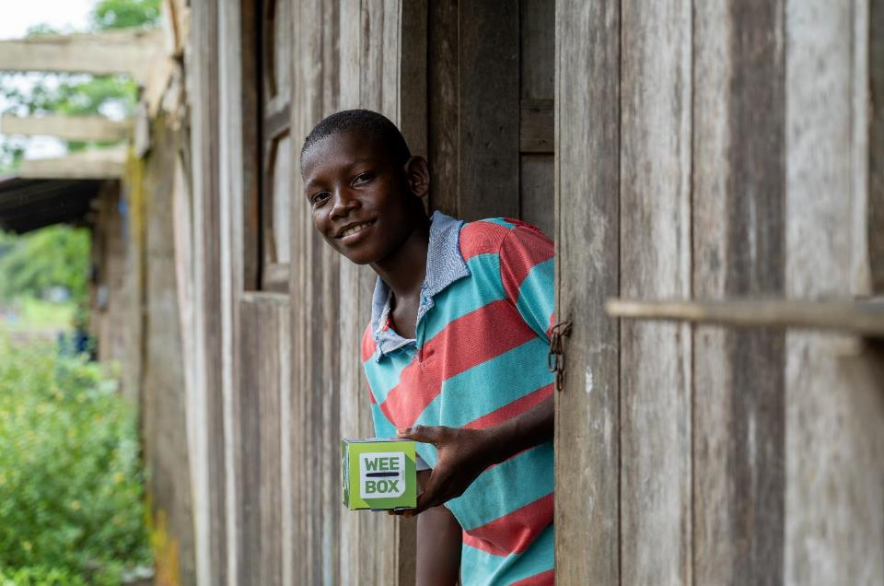
COLOMBIA
Notes:
SCIAF work with local partners in Colombia. Our WEE BOX 2025 appeal focused on communities in and around Chocó (Cho-KOH) and the River Atrato (Ah-TRAH-toh) .
Colombia is the fourth largest country in South America and home to 49 million people.
It has natural resources like oil, gold, silver, emeralds, platinum, and coal. However, the society in Colombia is very unequal, with big differences between rich areas and poorer communities.

Slide 5
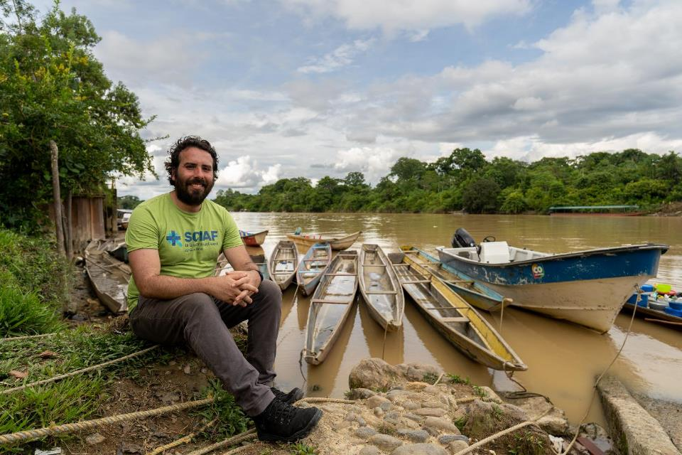
COLOMBIA
Notes:
For those living along the River Atrato (Ah-TRAH-toh) in northwest Colombia, the river is a vital part of their lives.
Even though Colombia is a beautiful country with amazing rivers and forests, many people face poverty and violence because of illegal mining and drug trafficking.
Teacher notes:
In Colombia, the exploitation of natural resources has escalated dramatically in recent decades. Vast stretches of rainforest, including areas that are home to rich biodiversity and ancient ecosystems, are being cleared for short-term profit. These forests are not just environmental treasures; they are ancestral lands for indigenous communities like the Emberá, who have lived in harmony with the land for generations. As illegal mining and drug trafficking expands, communities are being displaced, their rights violated, and their cultural heritage threatened.

Slide 6
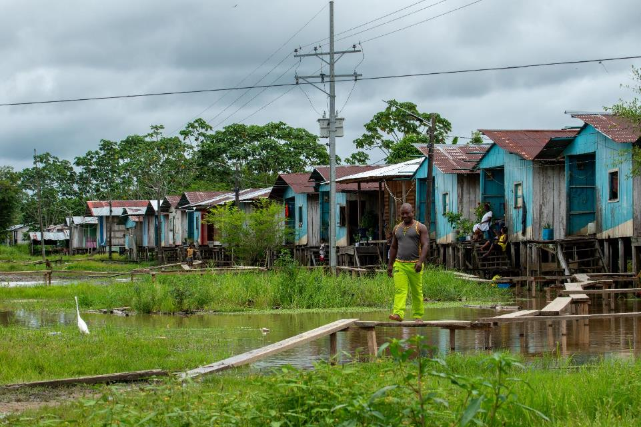
COLOMBIA
RIVER ATRATO
Pollution
Illegal gold mining
Deforestation
Conflict
Cultural impact
Human rights challenges
Enrique
Notes:
Teacher notes:
The River Atrato in Colombia has many serious environmental and social issues including illegal gold mining, drug trafficking and conflict.
Pollution: Human activity has polluted the river casing serious environmental issues.
Illegal gold mining: Miners use mercury, a toxic chemical, to help get gold out of the ground, which often ends up in the river, polluting the water, the fish and affecting the people who rely on the river. Communities relying on the river for drinking water, fishing, and agriculture suffer from mercury poisoning and waterborne diseases.
Deforestation: To make way for illegal mining often forests near the river are cut down, which causes the soil to wash into the water, making it muddy and unhealthy for the plants and animals who live there. Deforestation also reduces habitats for animals that depend on the river.
Conflict: The conflict in Colombia is complex. There are many different armed groups who want control over the land and rivers to traffic people, drugs and illegally mined gold.
Cultural impact: People are often displaced from their homes to make way for illegal mining and cannot return because the are is controlled by armed gangs. Over 6.9 million people have been forced to leave their homes because they feel unsafe. Indigenous and Afro-Colombian communities, who have deep cultural and spiritual ties to the river, face threats to their way of life.
Human rights challenges: Colombia is one of deadliest countries in the world for human rights defenders. Those who speak out on the protection of the environment and Indigenous peoples’ rights are the most frequently targeted. Over 150 human rights defenders and social activists, including some priests, were killed last year in Colombia.
Reader:
There are many issues facing those who live along the river including pollution, illegal mining, deforestation, and conflict.
Illegal gold mining uses mercury, a dangerous chemical, which pollutes the water and harms the fish and people who rely on the river for drinking, farming, and fishing.
Forests are often cut down for mining, which damages habitats for animals and makes the river unhealthy.
Dangerous gangs fight to control the land for trafficking and mining, forcing many people to leave their homes.
Indigenous and Afro-Colombian communities, who have lived in the region for many generations and have strong cultural ties to the river, are especially affected. Often the people who stand up to protect the river face serious dangers.

Slide 7
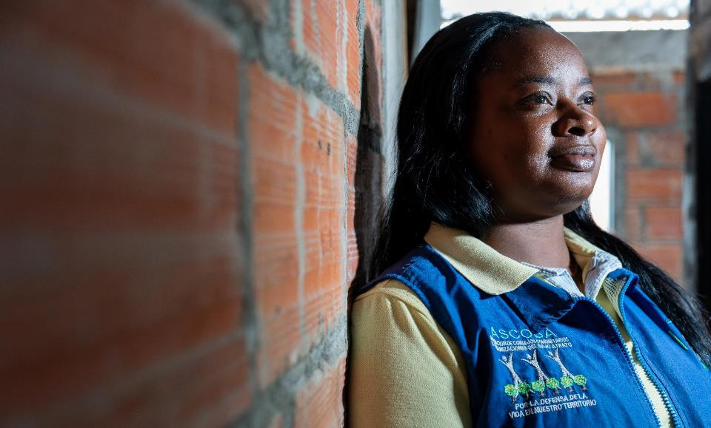
COLOMBIA
GUARDIANS OF
THE ATRATO
Environmental monitoring
Community education
Advocacy
Cultural preservation
María
Notes:
Teacher notes:
The Guardians of the Atrato were formed after the 2016 Colombian Constitutional Court ruling that granted legal rights to the Atrato River, recognizing it as a legal entity deserving of protection. The group are community volunteers, have many roles in looking after and protecting the river.
Environmental Monitoring: They observe and report on illegal activities, such as mining and deforestation, that harm the river and its ecosystems.
Community Education: They teach local communities about the importance of the river, its ecosystems, and how to use its resources sustainably.
Advocacy: The group raises awareness about the environmental and social challenges facing the river, urging the government and the public to take action.
Cultural Preservation: They work to protect the cultural and spiritual significance of the river for Indigenous and Afro-Colombian communities who have deep connections to it.
Colombia is one of deadliest countries in the world for human rights defenders and those working on the protection of land, environmental and Indigenous peoples’ rights are the most frequently targeted.
Over 150 human rights defenders and social activists, including some priests, were killed last year in Colombia.
Maria wears a top from ASCOBA (Association of Afro-Community Based Organizations) which states: "For the defense of life and our territory“
Read aloud script:
This is María, one of the Guardians of the Atrato River in Colombia.
The group were formed after a special court ruling that gave the river legal rights, meaning it must be protected like a living being.
Maria and the rest of the group are volunteers, so they do not get paid for this job, even though it can be very dangerous.

Slide 8

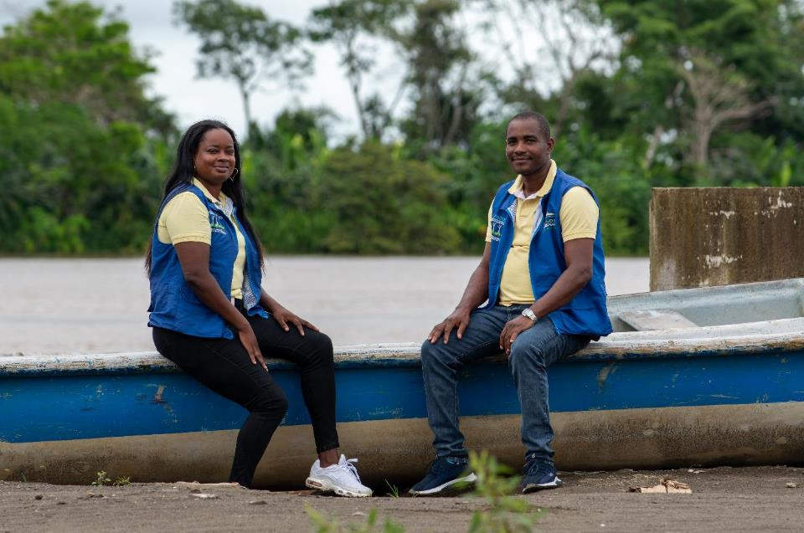
RIVER GUARDIANS
Notes:
Read aloud script:
This is Maria and Fausto, another River Guardian.
The River Guardians help the river in many ways: they watch for illegal activities like mining and cutting down trees, teach communities how to care for the river, and work to protect the cultural importance of the river for Indigenous and Afro-Colombian people. They also speak out to raise awareness about the issues.

Slide 9
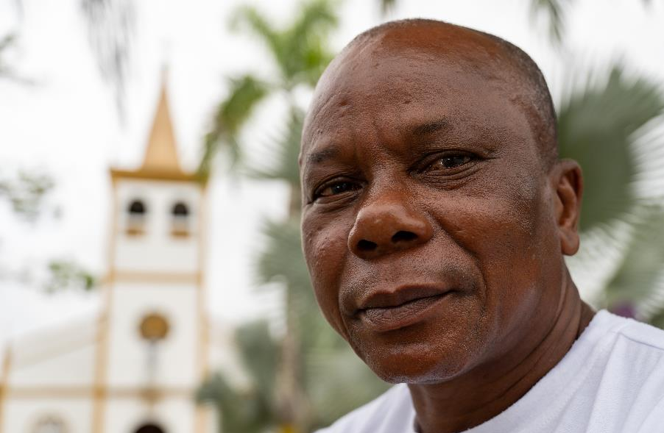
COLOMBIA
GUARDIANS OF
THE ATRATO
Illegal gold mining
Protecting the community
Speaking out
Bernandino
Notes:
This is Bernandino, he lives in Chocó, Colombia. He is also one of the Guardians of the Atrato.
Teacher notes:
Bernardino, 62, lives with his wife and has seven grown-up children. This is his story…
“One of the biggest challenges in this area is the violence and intimidation from armed groups behind illegal gold mining. These miners aren’t interested in working with the community – they just extract, regardless of the cost. The environmental damage is devastating.
Wetlands along the river, once sacred to us, have been destroyed. The rainforest where my grandparents lived is now a desert of sand mounds. Stagnant pools left by mining breed mosquitoes, spreading malaria and dengue. We’ve lost not just land, but health.
I’m helping restore eight hectares using ancestral knowledge. I started by collecting vegetable waste from the city to make organic compost. Every tree we’ve replanted is rooted in this compost.
Mining has contaminated the river and the fish, damaging our food supply and health. People here have high levels of mercury in their blood. Where once we fished plentifully, now there are almost no fish. Parts of the river have dried up because of mining waste. Sometimes, if it doesn’t rain, you have to drag your boat along the riverbed.
Those of us who resist face threats. After I spoke out at a meeting, I found a bullet on my doorstep. It wasn’t the first time. I’ve discussed this with the River Guardians and with SIEMBRA, SCIAF’s local partner. They raised the issue nationally and through the UN. The government gave me a bulletproof vest – and a phone that doesn’t work.
My daughter urges me to stop. Social leaders are being killed in Colombia. I try to shield my family from the news. But a new generation is coming, and they deserve a future. That gives us a reason to keep fighting.
SCIAF has always stood with us. My message to people in Scotland is: don’t lose heart. Please, keep supporting us.”

Slide 10
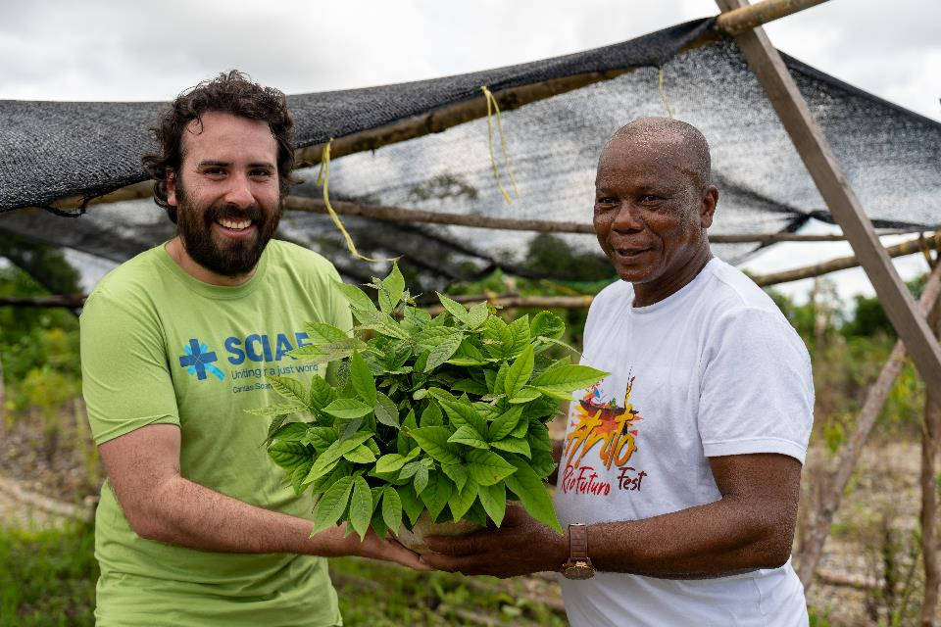
COLOMBIA
Bernandino and Rodrigo
Notes:
Bernandino and Rodrigo
Reader notes:
Bernardino is 62 and lives with his wife. They have seven grown-up children.
He lives in an area badly affected by illegal gold mining.
The mining is destroying the environment – forests have been turned into deserts, and wetlands, which were sacred to the community, are gone.
Pools of dirty water left behind by miners help spread diseases like malaria and dengue.
Bernardino is working to restore the land using traditional knowledge. He collects vegetable waste from the city to make organic compost for planting new trees.
The mining has also polluted the river and the fish. Now, there are fewer fish to eat, and many people have mercury poisoning.
He is part of a group who are supported by SCIAF who help raise awareness about the issues,
People who speak out against the miners, like Bernardino, are threatened. Once, he found a bullet on his doorstep.
Bernardino now wears a bulletproof vest for protection.
His family worry about him, but Bernardino keeps going because he wants to protect the land for future generations.
He says SCIAF has supported their community and asks people in Scotland to keep supporting their fight.

Slide 11
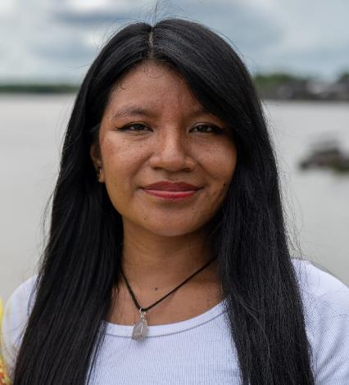
YOUNG GUARDIANS OF
THE ATRATO
Usy is one of the Young Guardians of the Atrato - a group of local young people chosen as representatives of the river.
The group speak out about issues on the river.
Usy
Notes:
Teacher notes:
Usy is one of the Young Guardians of the Atrato - a group of local young people chosen as representatives of the river. The group is supported by SCIAF’s local partners.
She speaks out about many of the issues on the river including pollution and deforestation. The group also help the communities to look after the river.
“One of the biggest impacts has been how many young people have been reached. There are loads of new leaders, focusing on positive stuff, not on the armed conflict. Our minds have been opened!” Usy

Slide 12
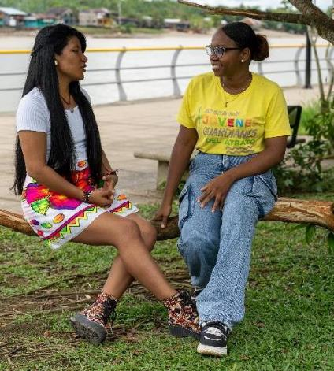
YOUNG GUARDIANS OF
THE ATRATO
Advocacy
Working with the government and decision makers to promote policies that protect the river’s rights.
Campaigning
Workshops and community events to educate people about the importance of the river and need for conservation.
Community work
Organising clean-up campaigns and days to remove waste and prevent pollution.
Usy and Nely
Notes:
Teacher notes:
Usy meets with other Young Guardians of the Atrato to work on advocacy projects, campaigning and community work to clean up the river.

Slide 13
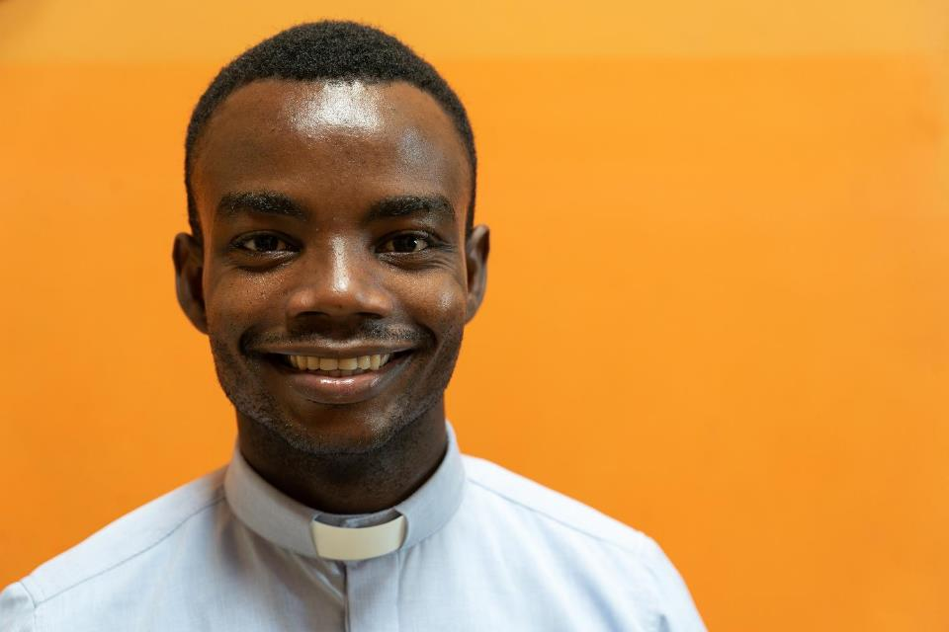
LAUDATO SI’ SCHOOLS
“Pope Francis teaches us that we are at one with nature; we are a family, and we must look after every member of our family.” Fr John
Fr John
Notes:
Read aloud script:
This is Father Fr John Hernández he leads a Laudato Si’ youth group with young parishioners along the River Atrato.
The group comes together each week to talk about their faith and use the teachings in Laudato Si’ as the inspiration for their environmental work.
Fr John told us “Pope Francis teaches us that we are at one with nature; we are a family, and we must look after every member of our family.” Fr John

Slide 14
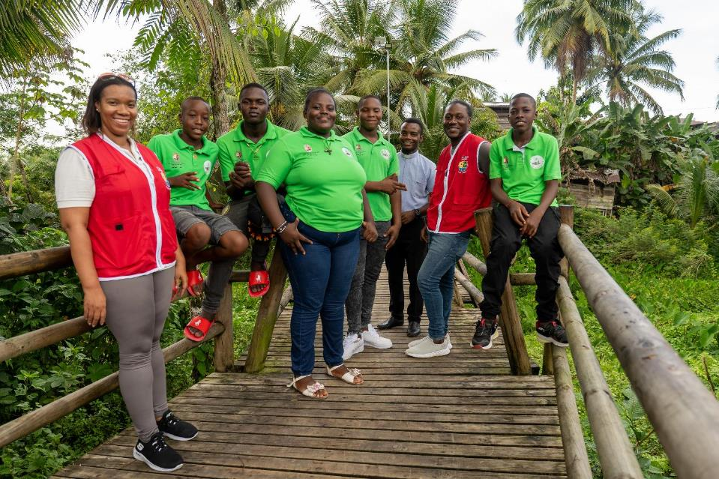
AMIGOS DEL PLANETA
Amigos Del Planeta
Notes:
Reader notes:
This is the group of young people and youth leaders along the river working on protecting the river, supported by SCIAF.

Slide 15
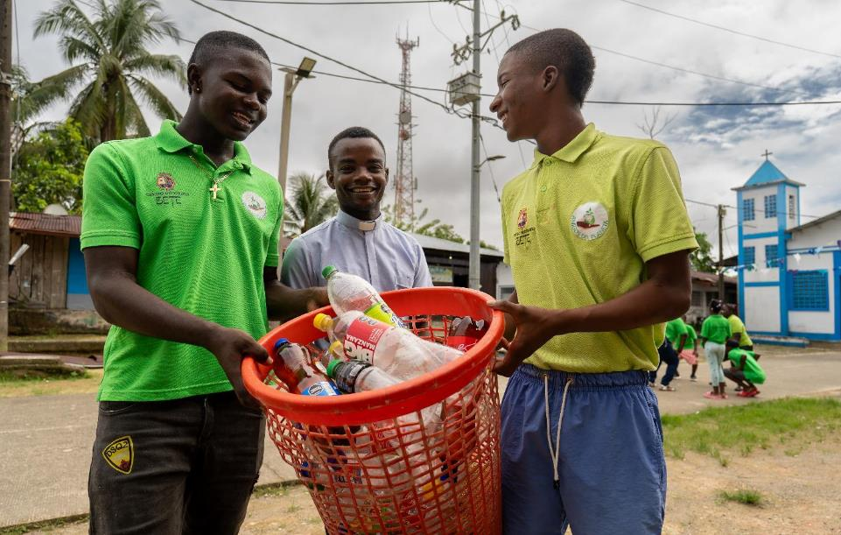
AMIGOS DEL PLANETA
The Young Friends of the Planet “Amigos Del Planeta”
Fr John and members of the youth group
Notes:
Reader notes:
The group have named themselves the Young Friends of the Planet – or “Amigos Del Planeta”
They put faith into action by campaigning on river pollution and arranging litter picking.

Slide 16
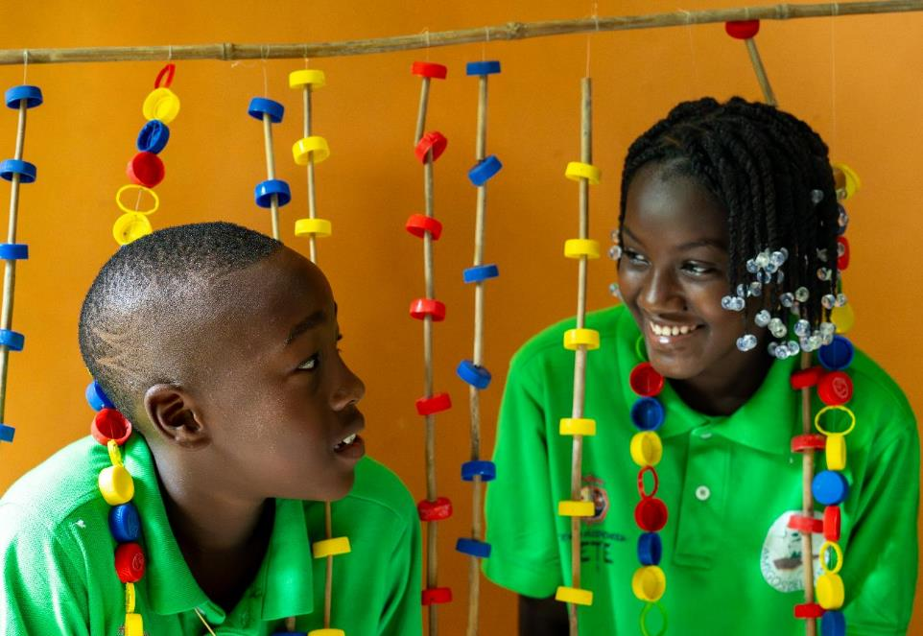
AMIGOS DEL PLANETA
Notes:
The group is made up of both boys and girls, aged from around 10-17 years old

Slide 17
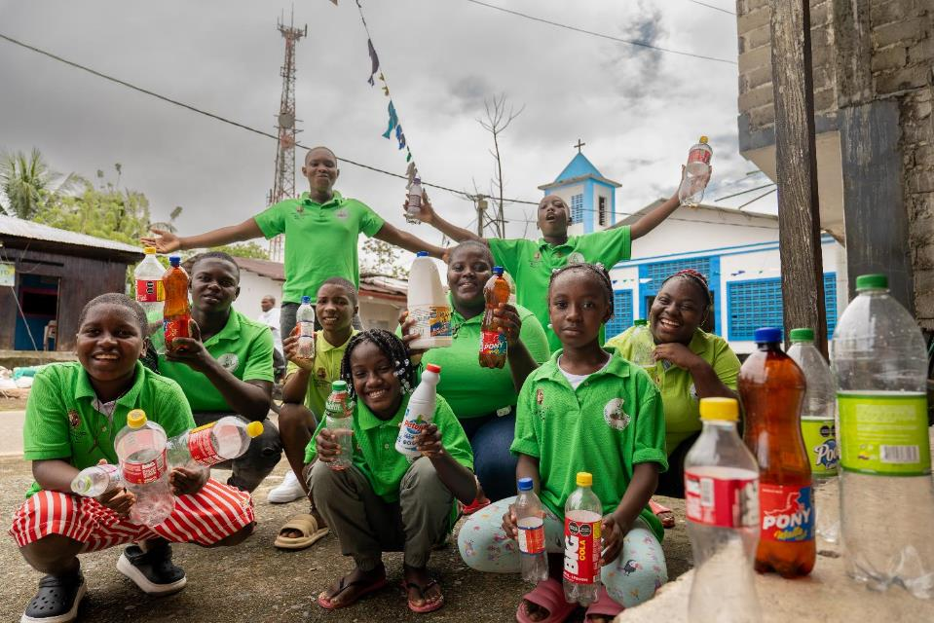
AMIGOS DEL PLANETA
Amigos Del Planeta
Notes:
Teacher notes:
The group put faith into action by campaigning on river pollution and arranging litter picking.

Slide 18
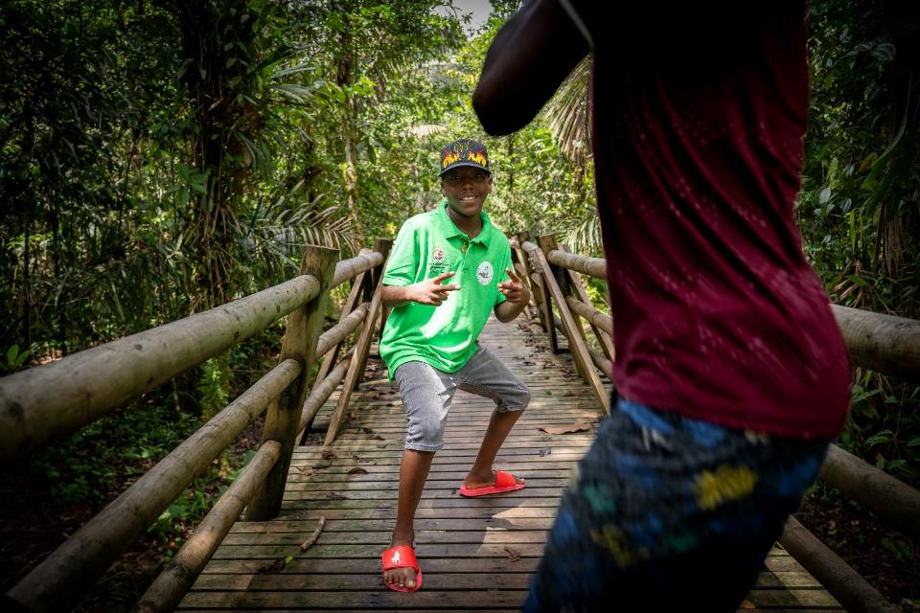
AMIGOS DEL PLANETA
Amigos Del Planeta
Notes:
Teacher notes:
These youth-led initiatives demonstrate a shared responsibility for protecting natural resources, which are vital not only to their local communities but to the planet as a whole.
By raising awareness about biodiversity loss, pollution and the rights of ecosystems, they contribute to the global movement for ecological justice.
Their collaborative actions, such as the clean up days and advocacy work reflect a deep understanding that local efforts have global impacts.

Slide 19
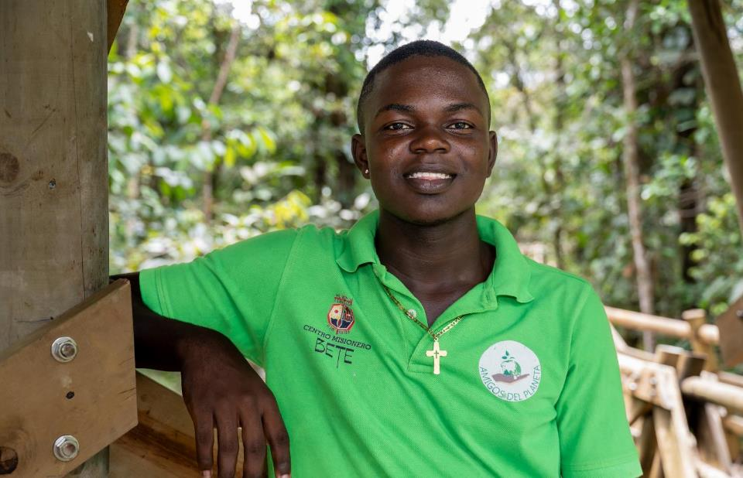
AMIGOS DEL PLANETA
ACTIVITY
Amigos Del Planeta
Notes:
Teacher notes:
Activity 1 - Discussion
Use some of these discussion questions with your class -
The issues in Colombia show the how interconnected the environment, society, poverty and injustice are. Can you think of other examples where the environment, society, and economy affect each other? - Climate change causing crop failures, leading to food insecurity and poverty. Or, pollution in rivers affecting public health and increasing healthcare costs.
What challenges do these young activists face? – lack of government support, threats from illegal mining groups, lack of support for awareness raising
Why are their actions important to the world, not just Colombia? - the Amazon and rivers like the Atrato impact global biodiversity and climate. Plus the activists work sets an example for youth-led environmental action worldwide.
What environmental issues do we face here in our community?
What did you learn from these Colombian youth activists?
How can we inspire others to care for our environment?

Slide 20
AMIGOS DEL PLANETA
ACTIVITY
WHY IS THE RIVER ATRATO A DANGEROUS PLACE?
Illegal mining
Pollution
Why?
Why?
Why?
Why?
Why?
Why?
WHY?-WHY?-WHY? CHAINS
Notes:
Teacher notes:
Activity 2 – Why? Why? Why? Chains
Learning intention: "I am developing an understanding of the root causes of environmental and societal issues and exploring solutions as an active global citizen."
If you are not familiar with this type of activity have a look at this link: https://wosdec.org.uk/methodologies/why-why-why-chains/ (you may need to copy and paste this address into your browser)
Present the initial question – Why is the River Atrato a dangerous place?
Encourage participants to brainstorm answers, such as: illegal mining, pollution and other ideas they may have. Look back to slide 2 for some ideas.
For each answer from the first 'Why?', ask: "Why does this happen?"
Example: Why is illegal mining happening near the river?
Lack of enforcement of the environmental laws.
Because people depend on mining for income
Repeat the process, probing deeper into each response asking 'Why?'
Example: Why is there a lack of enforcement of the environmental laws?
This region is extremely remote
Example: Why do people depend on mining for income?
There are a lack of opportunities for people in this area so even although it’s illegal, mining might be the only option to earn money.
Review the completed "Why?-Why?-Why?" chains with the class and highlight interconnected themes, such as poverty, lack of infrastructure etc.

Slide 21
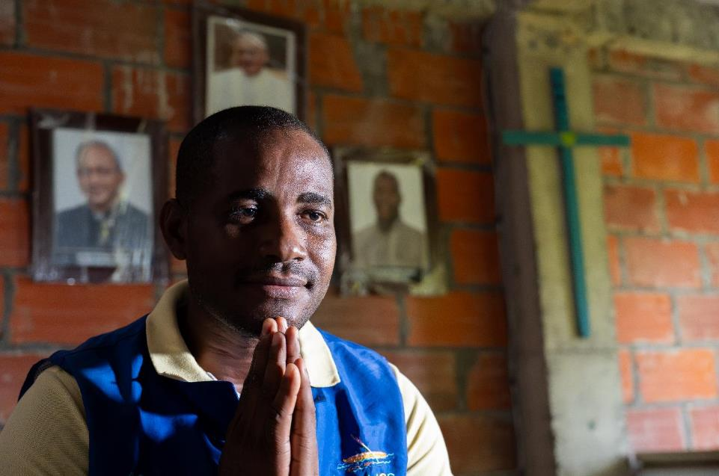
LAUDATO SI’ SCHOOLS
“A faith without ​works, a faith that ​doesn’t
get you ​involved, isn’t faith. ​It is words and ​nothing more than ​words.”
Pope Francis
Fausto, River Guardian
Notes:
Read aloud script:
“A faith without ​works, a faith that ​doesn’t get you ​involved, isn’t faith. ​It is words and ​nothing more than ​words.” Pope Francis
Pope Francis reminded us that real faith isn’t just about what we say or believe; it’s about what we do.
We show our faith through our actions - by helping others, caring for the earth, and standing up for the poor and vulnerable.

Slide 22
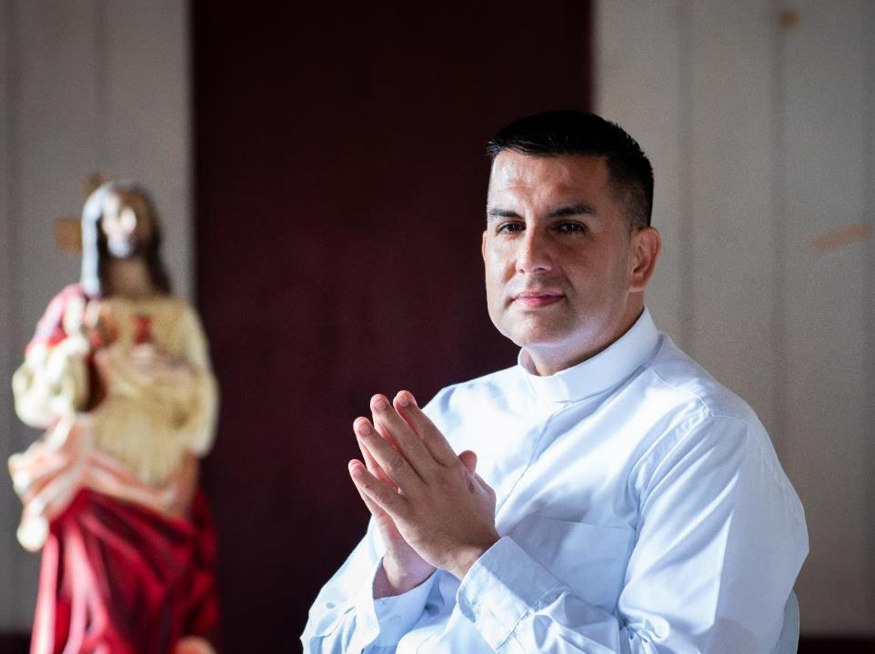
PRAY
LEARN
ACT
Notes:
Read aloud script:
Now that you’ve learned about SCIAF’s work in Colombia we invite you to pray with us.

Slide 23
LET US PRAY
TO OUR LADY OF CHIQUINQUIRÁ, PATRON SAINT OF COLOMBIA
Our Lady of Chiquinquirá
we ask you to pray for the people of Chocó
who suffer because of violence and the destruction of their land.
Lord, hear our prayer.
Protect those who are afraid,
and give strength to the River Guardians,
who speak up for the river and for their communities.
Lord, hear our prayer.
Stand beside the families facing danger,
and help us all choose peace, kindness, and justice.
Lord, hear our prayer.
We pray for healing, for courage,
and for hope to grow in Chocó and around the world.
Lord, hear our prayer.
Our Lady of Chiquinquirá,
pray for them and pray for us.
Amen.
Notes:
Prayer to Our Lady of Chiquinquirá (chee-kin-kee-RAH), Patron Saint of Colombia

Slide 24

COLOMBIA
A JUST WORLD, FREE OF POVERTY, WHERE WE FLOURISH AND LIVE
IN HARMONY WITH EACH OTHER AND ALL CREATION.
Scottish Catholic International Aid Fund
SCIAF is the official relief and development agency of the Catholic Church in Scotland
and a proud member of the Caritas family. 7 West Nile Street, Glasgow G1 2PR.
Tel: 0141 354 5555. Scottish Charity No: SC012302. Company No: SC197327.
sciaf@sciaf.org.uk

