Slide 1
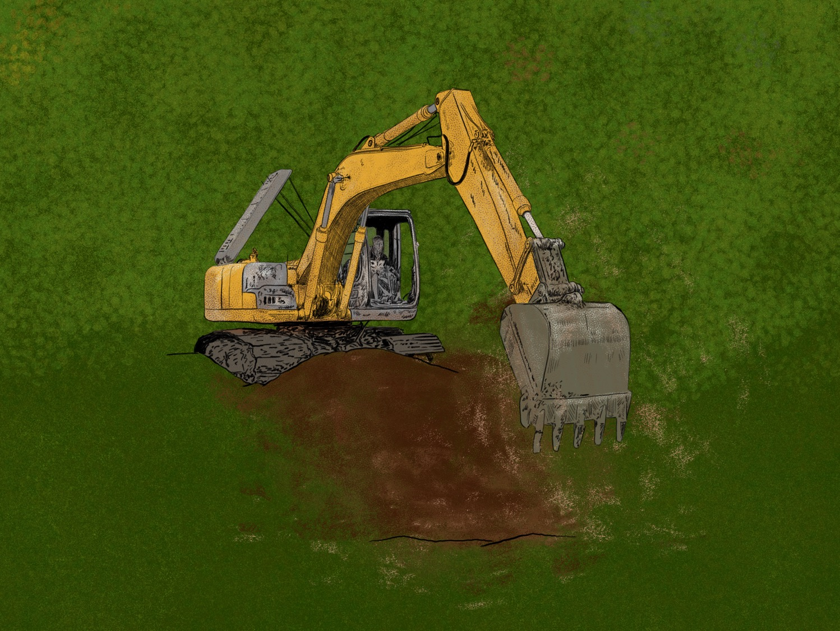

Mining in Colombia
Issue exploration

Slide 2

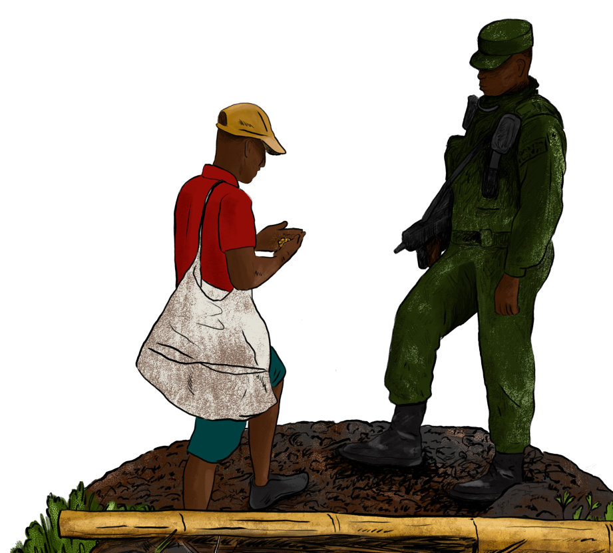
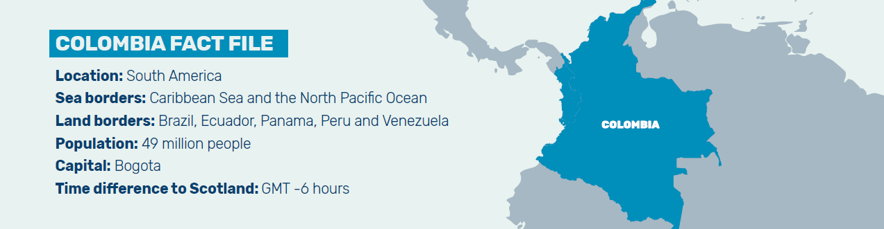
Issues
Let’s look at the issues and learn the key terms we’ll be using.
We are investigating the environmental and social impact of illegal and predatory mining in Colombia.

Slide 3

Mining
Legal mining
  Has all the proper government permits and licenses.
  Must follow environmental protection rules and labour laws.
  Is monitored by the government
Illegal mining
  Has no official permits to operate.
  Can be linked to criminal gangs and armed groups.
  Frequently causes serious pollution (e.g., mercury in rivers), deforestation and displacement of communities.
Predatory mining (minería depredadora)
  Can be legal or illegal — the key is the impact.
  Focuses on maximising mineral extraction quickly.
  Uses destructive methods, sometimes even if the mine has a permit.
  Leaves behind degraded land, polluted water, and problems in the communities.

Slide 4
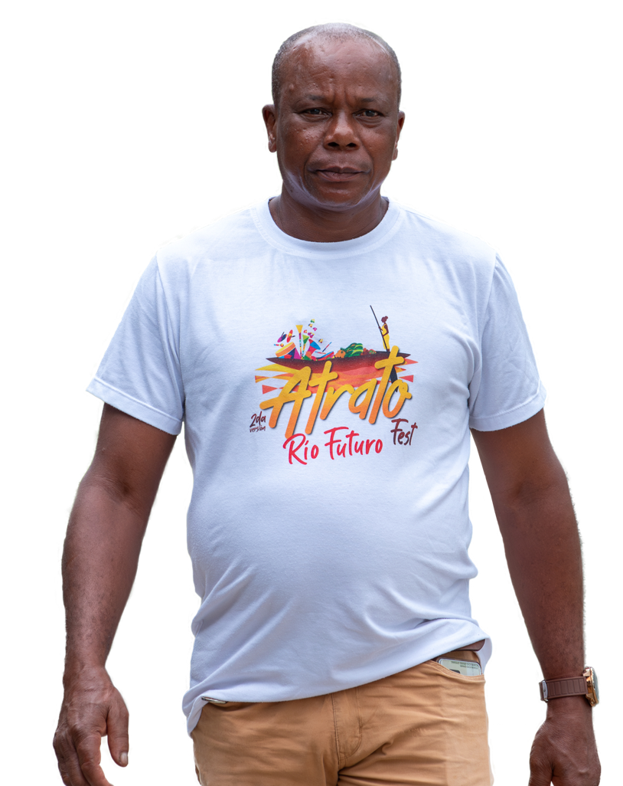
Mining
“In this area one of the most challenging things is the violence and intimidation from the armed groups behind the illegal gold business.”
Bernardino

Slide 5

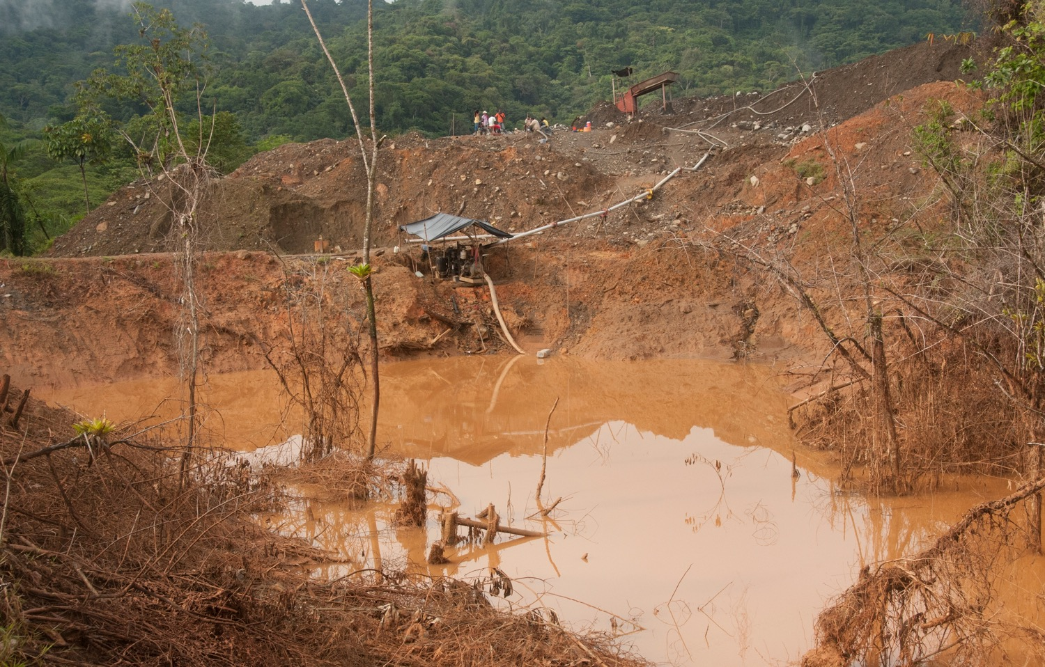
Predatory mining

Slide 6
Communities
EMBERÁ DOBIDÁ
Emberá communities are one of Colombia’s largest indigenous populations, many of whom live in Chocó – a vast region perched between Colombia’s Pacific Coast and the mountains of the Andes. With a rich cultural heritage deeply rooted in their ancestral lands the Emberá people have a strong connection to the natural world.
Despite the Constitution of 1991 (which outlined the legal duties to protect and uphold the human rights of Colombia’s ethnic minorities and indigenous peoples) Emberá communities are being forced from their ancestral lands for illegal and predatory mining, leading to mass displacements of Emberá people across the region.

Slide 7
Communities
AFRO-COLOMBIAN COMMUNITIES
Chocó, on Colombia’s Pacific Coast, is home to around 550,000 people, 90% of whom are Afro-Colombian. Spanish colonists forcibly brought enslaved people
from Africa, beginning in the 16th Century. In the 1800s, following abolition, Afro-Colombians faced continued marginalisation and discrimination leading to socioeconomic inequalities in the country.
In the early 1990’s Afro-Colombian communities were granted territorial rights in Colombia, giving a similar status to indigenous people. However, political violence and conflict between paramilitary groups, illegal miners,and government forces has forced them from their territories and displaced millions of Afro-Colombians around Colombia.

