Slide 1



GIFTS THAT
KEEP ON GIVING
Notes:
IDEA:
Introduce yourself
Tell everyone why you are giving this talk - it might be to share your learning about SCIAF Real Gifts, or to promote fundraising in your school
Ask if anyone has heard of SCIAF and SCIAF Real Gifts before? Not to worry if they haven’t – you’ll tell them everything they need to know in this talk.

Slide 2


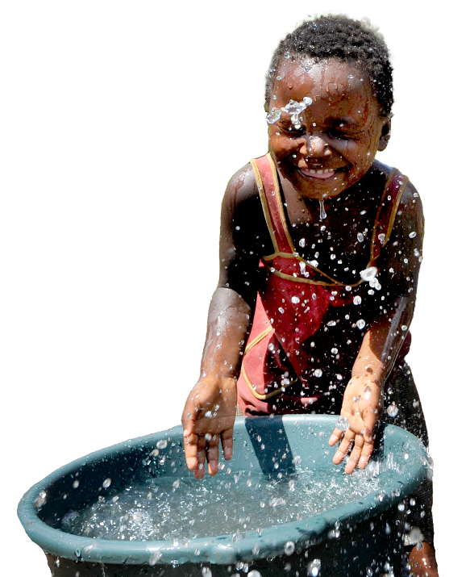





WHAT WE DO
We support people in some of the world’s poorest places. How we help:
Providing
training for farmers, seeds & tools,
water
Promoting
Peace & justice
Campaigning
& Education
here in Scotland
Notes:
SCRIPT:
SCIAF are the Scottish Catholic International Aid Fund.
They are one of the official charities of the Bishops Conference of Scotland.
SCIAF support people in some of the world’s poorest places by
Helping farmers to grow more food
Promoting peace and justice in communities
And asking decision makers around the world to protect the poorest people

Slide 3


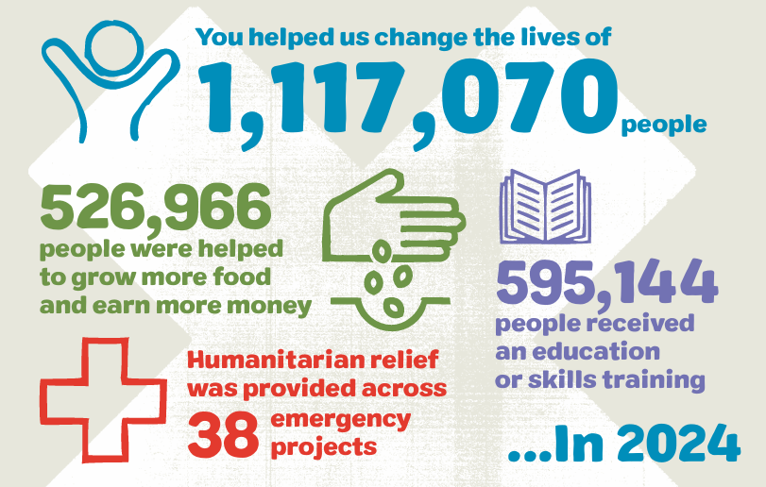
TOGETHER
WE REACH OUT IN LOVE
We work across Africa, Asia, Latin America, the Middle East and Europe.
Notes:
SCRIPT:
In 2024, with support from schools like ours, SCIAF helped over 1 million people around the world to have a brighter future.
They also responded to 38 emergencies around the world including extreme flooding, drought and war.

Slide 4


QUICK QUIZ ON HUNGER
Global hunger is decreasing.
True
False
False. The number of hungry people in the world was decreasing after decades of progress, up until 2014, and has increased each year since then.
Notes:
(optional slide)
SCRIPT:
Now it’s time for a quick quiz.
Do you think that the number of people going hungry in the world is getting smaller or bigger?
True or False – Global hunger is decreasing (getting smaller)?
Ask for hands up for True and Hands up for False.
CLICK TO REVEAL THE ANSWER WHEN EVERYONE HAS HAD A CHANCE TO READ THE QUESTIONS AND THINK ABOUT IT (2-3 MINS)
False - Global hunger is increasing. More people are going hungry in the world today than 10 years ago.
The reasons why are complicated, but here are just a few:
More extreme weather – farmers can’t grow as much food during storms, floods or droughts.
The cost of producing food is getting higher and the poorest people can’t always afford to buy food regularly.

Slide 5
QUICK QUIZ ON WATER
Under one billion people worldwide don’t have safe drinking water.
True
False
False. It’s actually over 2 billion people without access to safe drinking water, according to the United Nations in 2023.
Notes:
(optional slide)
SCRIPT:
Now a question on water.
Do you think it is True or False that under 1 billion people in the world don’t have safe water to drink?
True or False – Around one billion people worldwide don’t have access to safe drinking water?
Ask for hands up for True and Hands up for False.
CLICK TO REVEAL THE ANSWER WHEN EVERYONE HAS HAD A CHANCE TO READ THE QUESTIONS AND THINK ABOUT IT (2-3 MINS)
False.
It is actually over 2 billion people that don’t have access to safe drinking water.
So, what is safe drinking water?
Well, it means:
Water that doesn’t have harmful chemicals, bugs or diseases in it.
Water that you can find within a 30 minute round trip of your home (this might mean walking to water well or water pump in your village)
Unsafe water usually comes from lakes, ponds, rivers and streams and can make people sick. People have no choice but to drink this water because there is no safe option for them, and everyone needs water to live.

Slide 6
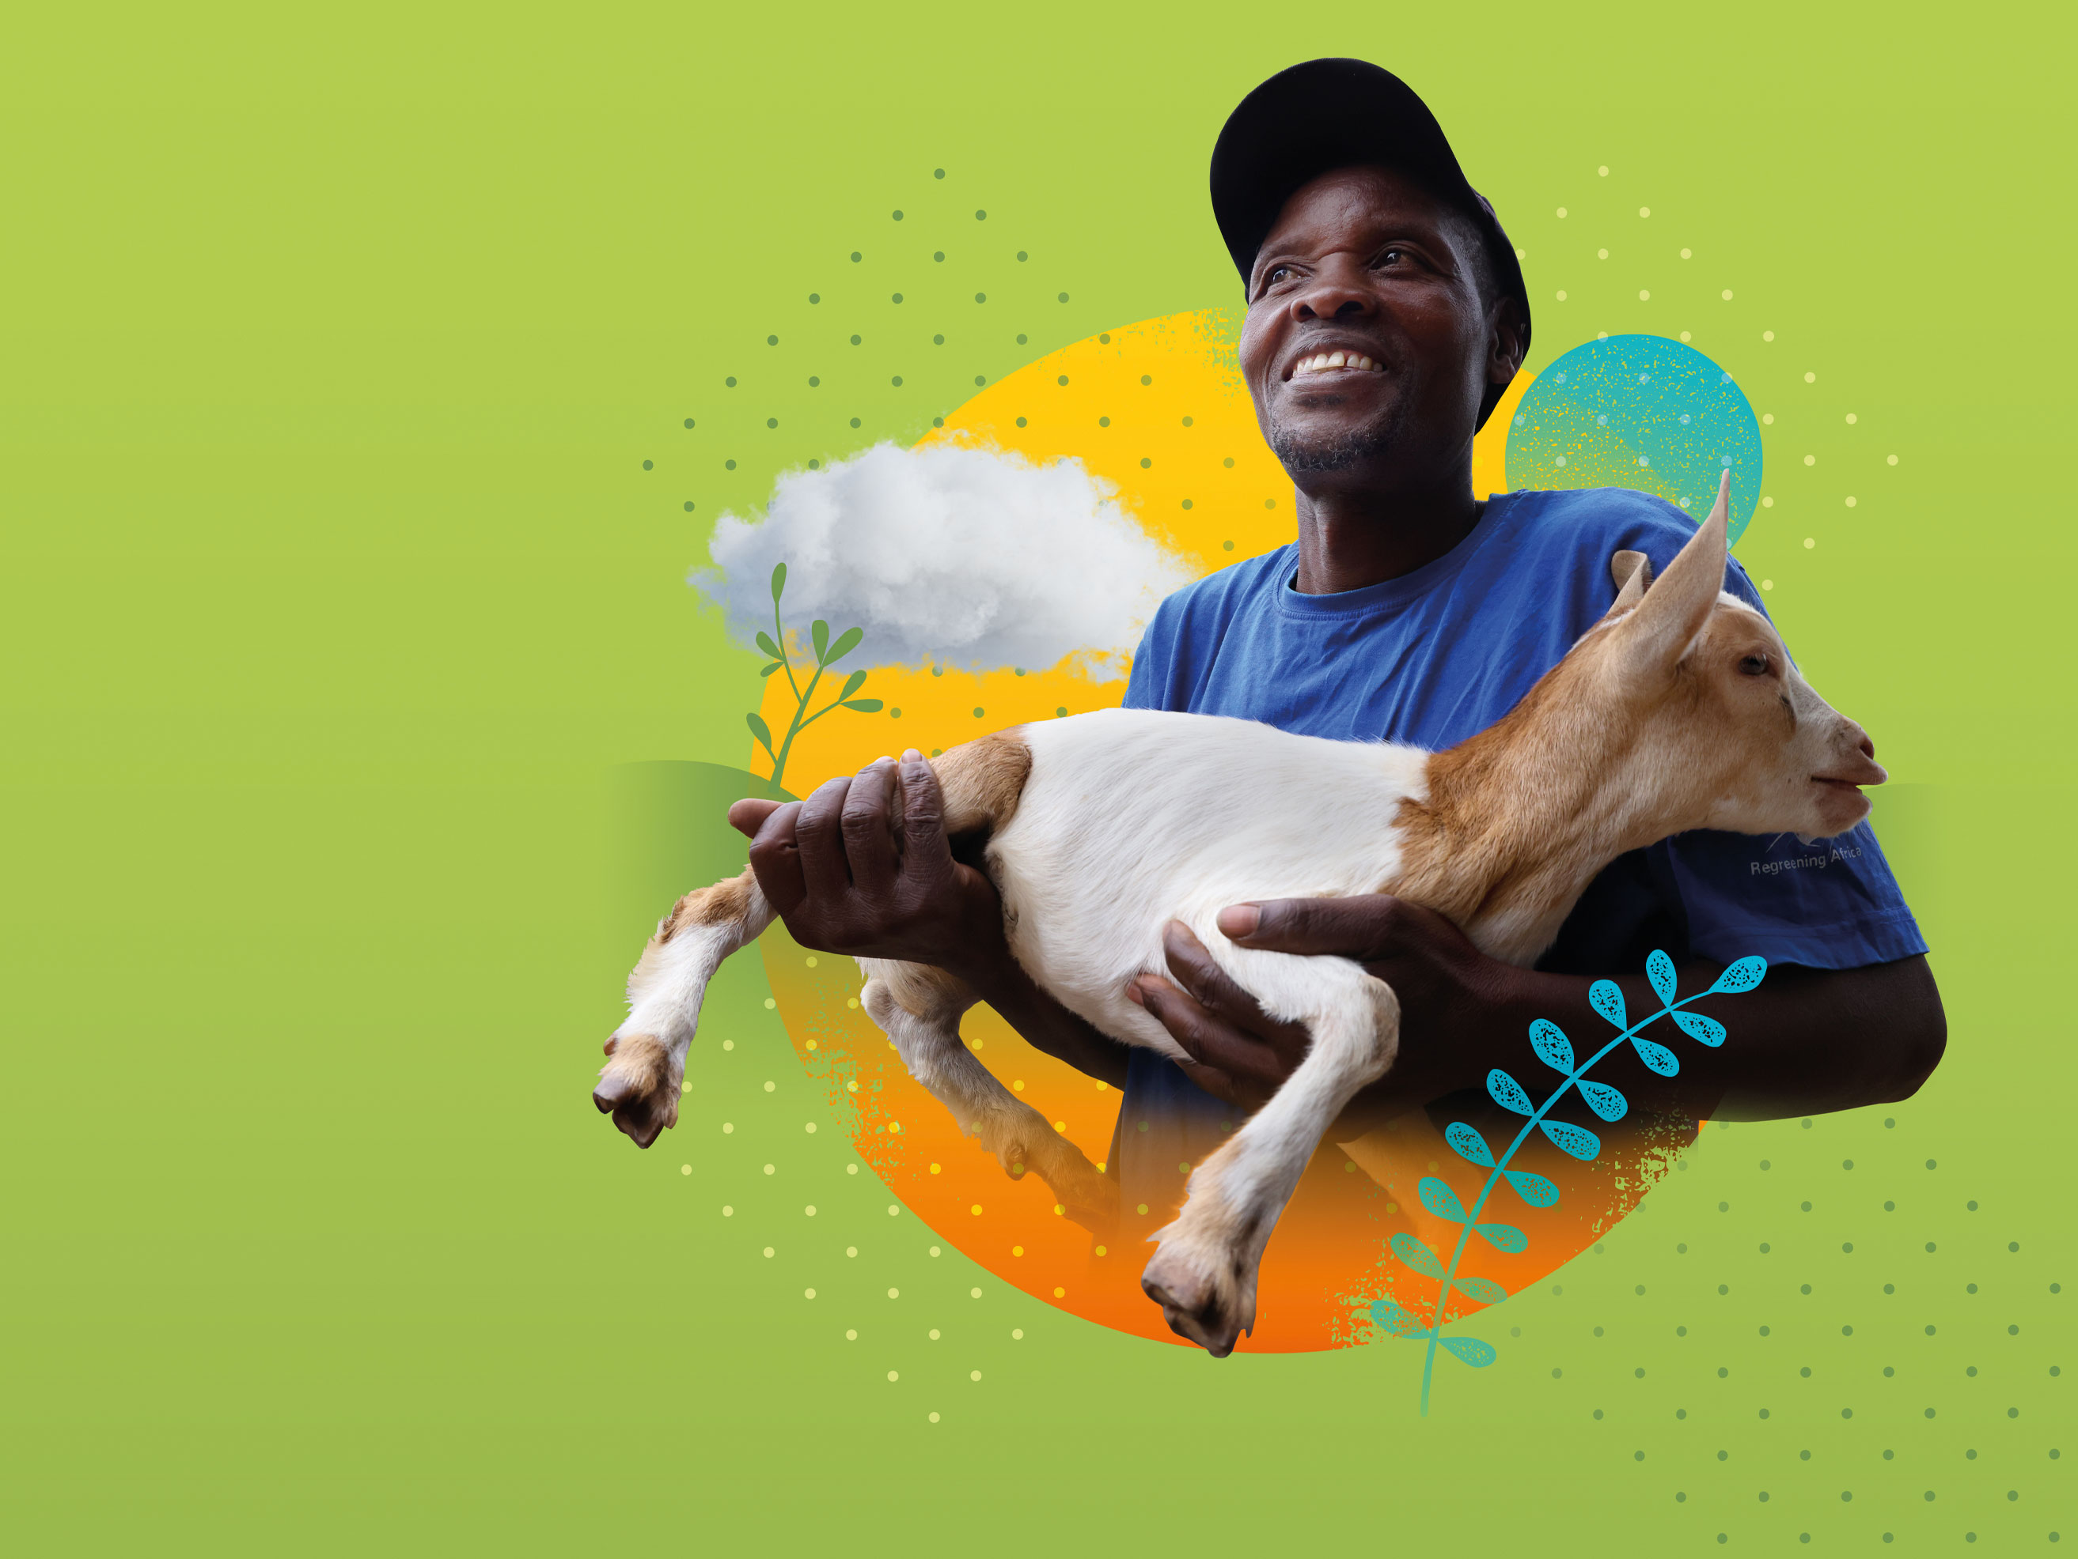

“SCIAF gave us two goats, cows, a water hose, and pumps to irrigate our fields.
Our living standards have
improved no end.”
- Vincent, Rwanda
GIFTS THAT
KEEP ON GIVING
Notes:
SCRIPT:
SCIAF Real Gifts are a way to help people in some of the worlds poorest places to have a brighter future.

Slide 7




A REAL GIFT
IS A REAL EXAMPLE
OF SCIAF’S WORK
Every Real Gift you buy supports our sisters and brothers living in poverty. Each gift is linked to a fund that gives vital support. Whether your gift supports farming and livelihoods, water or emergencies, it will go where it is needed most, supporting those most in need around the world.
Notes:
SCRIPT:
A Real Gift from SCIAF supports those most in need around the world.
Whether its farming water or emergency gifts it will go to where it is needed the most around the world.
Let’s look at some examples of Real Gifts

Slide 8




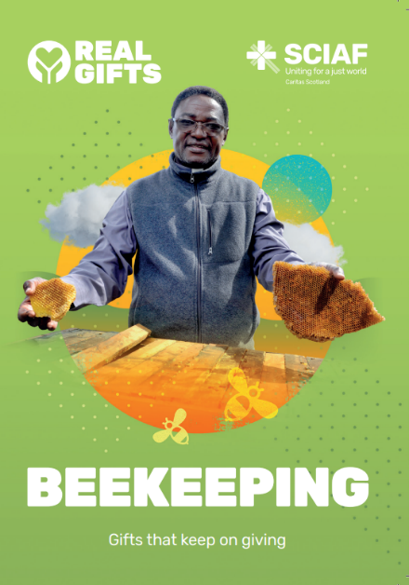
LAUDATO SI’ GIFTS
Vegetable Garden
& Beekeeping
LAUDATO SI’ REAL GIFTS
£37
Notes:
SCRIPT:
SCIAF’s Laudato Si’ Real Gifts are a way to put our faith, and our learning (as a Laudato Si’ School) into action.
This gift provides vegetable gardens and beekeeping for farmers, and it costs £37.
Let’s find out about this gift in action…

Slide 9

FARMING
Seeds, tools,
soils and training
to grow fresh fruit, vegetables and grains!
£37
Notes:
SCRIPT:
This is Martha, she lives in Rwanda.
Martha received seeds, tools and training to grow fresh and healthy fruits and vegetables near her home.
The Real Gift of a vegetable garden helps families like Martha’s to grow enough food to eat and hopefully extra to sell at local markets.
SCIAF’s partners help families share knowledge about which plants grow best, how to look after them, and how to use eco-friendly methods like composting. Families also learn which seeds grow well with different amounts of rain and how to plant a mix of crops in case some don’t grow.
This gift also gives gardening tools and watering cans to help families grow their vegetable garden.

Slide 10

FARMING
Bees sip up nectar from plants and use it to make honey, which farmers can sell.
£37
Notes:
SCRIPT:
Bees are really important minibeasts because they help plants grow by spreading the pollen for fruits, vegetables, and flowers.
They also collect nectar from plants to make honey, which beekeepers can sell at local markets.
The Real Gift of beekeeping helps farmers learn how to set up beehives, take care of the bees, and safely collect honey to sell.
This is Father Oscar, who lives in Zambia. He helps the parishioners in his Archdiocese to join the beekeeping training so they can collect and sell honey.
Did you know that Saint Ambrose is the Patron Saint of Beekeepers?!

Slide 11



FARMING GIFTS
“I used to sleep on an empty stomach. But then I received support from SCIAF. They helped me grow beans and gave
me goats. I started a kitchen vegetable garden and now grow ginger and sweet potato.”
- Savita, Zambia
Notes:
Farming gifts give the gift for nourishment. They provide the skills tools and training people need to grow more crops for themselves and their families.

Slide 12
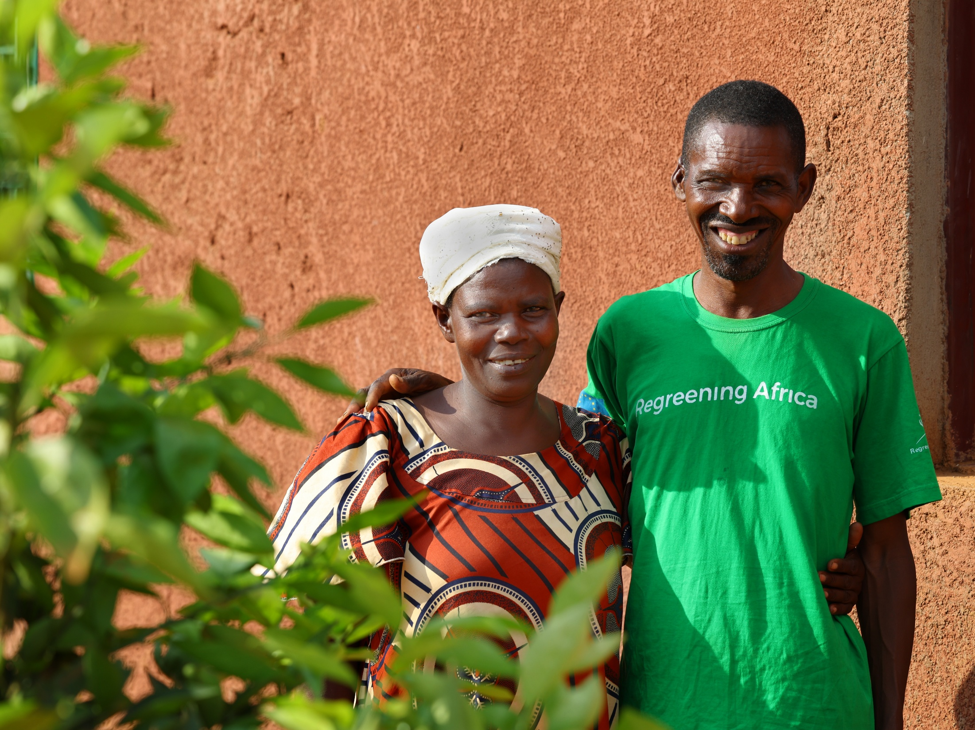
LIVESTOCK
CHANGE LIVES
Gifts like chickens, pigs, and goats help people thrive!
Aaron and Honorine, Rwanda
Notes:
SCRIPT:
You can give people the Real Gift of chickens, pigs, or goats. These gifts help communities in the poorest places to thrive.
Let’s find out about these gifts in action…

Slide 13
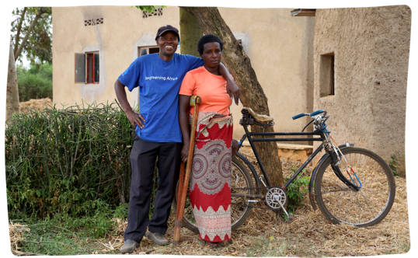

CHANGING LIVES
– Vincent and Josephine
Vincent and Josephine live in Rwanda and have six children.
The couple received farming training from people in
their community, supported by SCIAF.
They were also supported
with seeds, tools, a pig and two goats.
The children are now in
school and studying.
Notes:
SCRIPT:
This is Vincent and his wife Josephine. They are farmers from Rwanda.
Vincent and Josephine received a pig and two goats plus farming training, and seeds and tools to use on their land.

Slide 14
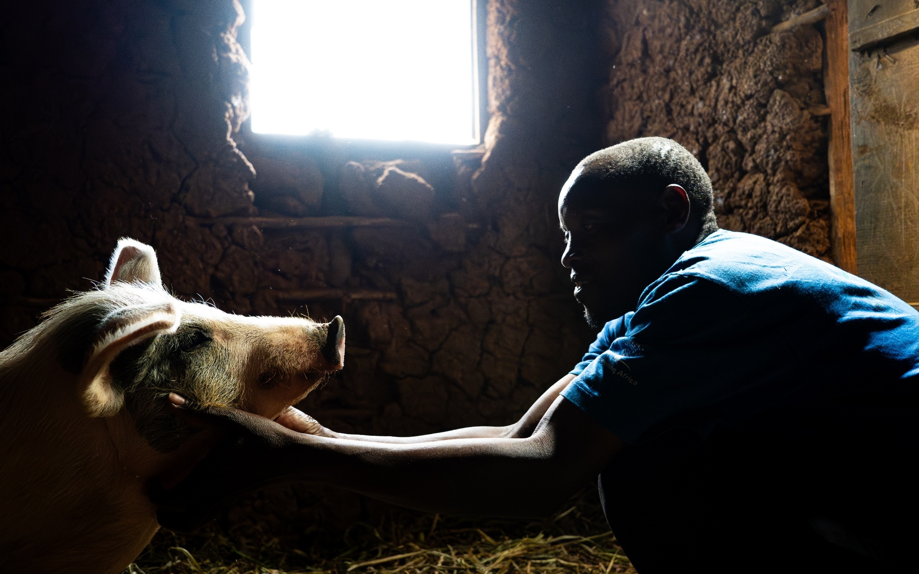
VINCENT
PIGS £70
Pigs provide high quality manure, while breeding provides a source of income.
Notes:
SCRIPT:
The gift of pigs costs £70.
The pigs droppings make excellent manure and any piglets can be sold or given to other farmers in the community.

Slide 15
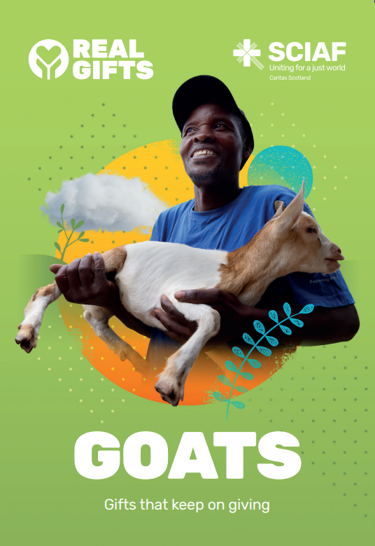

CHANGING LIVES
– Vincent and Josephine
Vincent is now a senior leader in the farming group.
“I teach in the fields so others can follow my lead. The community is a better place to live. The members are all doing well.”
- Vincent
£35
could provide goats for families like Vincent’s, providing milk and manure
Notes:
SCRIPT:
Vincent now teaches other farmers in the community.
He told SCIAF that the community is a better place to live now and the members are all doing well.
The Real Gift of Goats costs £35.

Slide 16

WATER GIFTS
We all need water for drinking, washing and cooking.
£45
Notes:
SCRIPT:
Water is very special — it’s something we need every single day to live. In many places around the world, people do not have access to this basic right. However,
your gift can help people access clean water for drinking, cooking and cleaning. This help create safer, healthier communities.

Slide 17
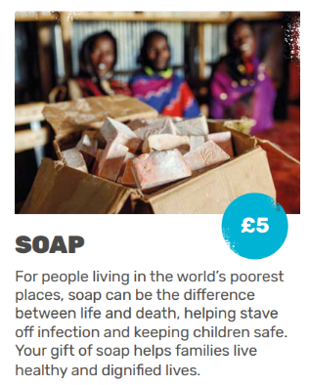
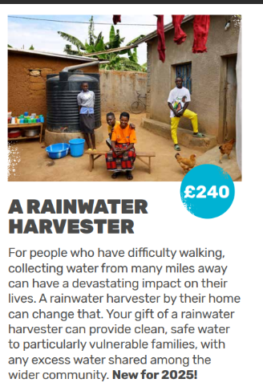
WATER GIFTS
£45
Notes:
SCRIPT:
Water gifts help communities tackle both the causes and consequences of dirty water.

Slide 18
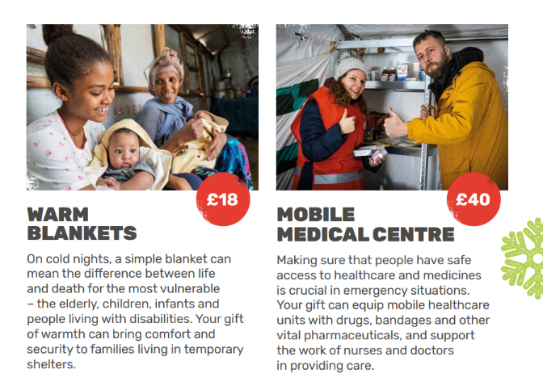


EMERGENCY RELIEF IN REAL-TIME
Supporting people during their darkest hours
£9
Notes:
SCRIPT:
SCIAF also responds to emergencies around the world.
Emergency gifts provide help and care for people in their time of need.
When people have to leave their homes because of a flood or even a war, SCIAF can provide warm blankets and medical help.
These two gifts provide emergency relief for people all over the world.

Slide 19
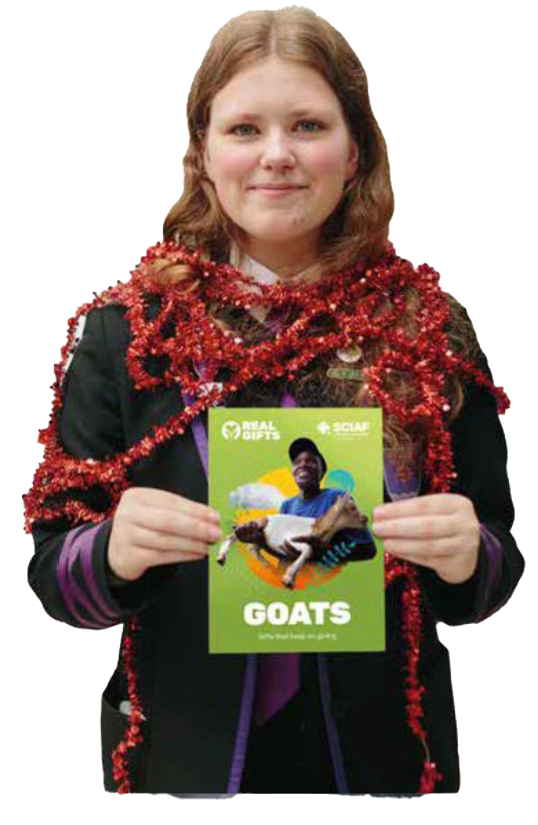


A REAL GIFT IS A REAL EXAMPLE OF SCIAF’S WORK
£4
Sale or Return
£6
Notes:
(optional slide)
IDEA:
Tell the school community about a Real Gifts Stall that you have running in the school and how they can buy Real Gifts.
There are additional mini Gifts only available for Sale or Return stalls in your school (they aren’t in the catalogue) including Seeds which cost £4 and a Watering Can costing £6.

Slide 20
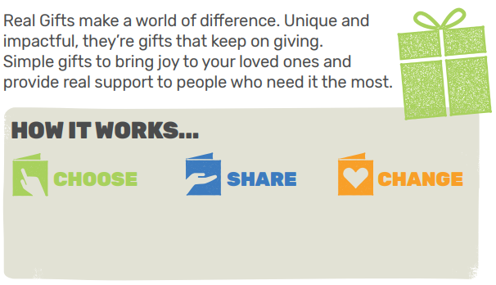
GIFTS THAT KEEP ON GIVING
Real Gifts make a world of difference, Unique and impactful, they’re the gifts that keep on giving.
Browse which gifts your class would like to buy.
Tell the whole school community about Real Gifts and fundraising.
Your gift will make a real difference to the lives of people around the world.
Notes:
(optional slide)
SCRIPT:
So, how does all this work?
First we choose which gifts we would like to buy as a class or whole school.
Then, we tell the whole school community about our plans to fundraise for SCIAF Real Gifts.
And when we have completed our fundraising and given the money to SCIAF our Real Gifts make a big difference to people around the world.

Slide 21
REAL GIFTS PRAYER
Dear God,
May these Real Gifts bring hope and help to those who need it most.
May they bring nourishment, happiness, and brighter futures.
Help us to show Your love in action this Advent.
We ask this in Jesus’ name.
Amen
Join us in prayer
Notes:
SCRIPT:
Let us pray together.
In the name of the Father, the Son and the Holy Spirit…

Slide 22


GIFTS THAT
KEEP ON GIVING
Thanks to Real Gifts, SCIAF supports people to lift themselves out of poverty, provides relief during emergencies, and safeguards our environment.
SCIAF works in partnership with grassroots civil and church organisations around the world, supporting communities to bring about lasting change and putting pressure on governments to do the right thing.
Join us now to build a better world!
sciaf.org.uk
Scottish Catholic International Aid Fund
SCIAF is the official relief and development agency of the Catholic Church in Scotland
and a proud member of the Caritas family. 196 Clyde Street, Glasgow, G1 4JY.
Tel: 0141 354 5555. Scottish Charity No: SC012302. Company No: SC197327.
Notes:
Thank you for listening

