Slide 1
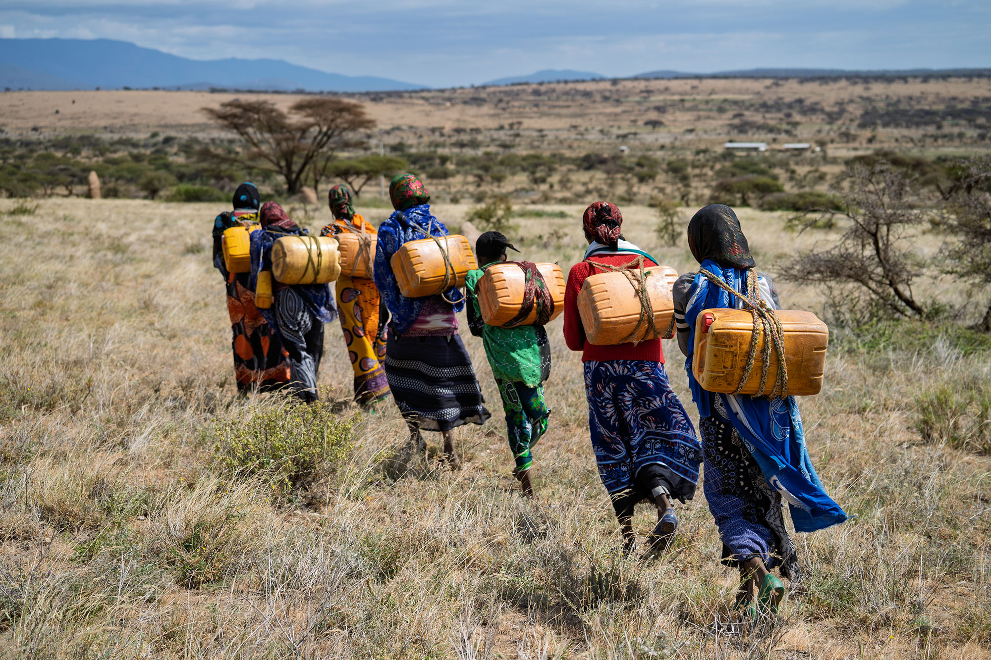



WEE BOX 2026
SECONDARY ASSEMBLY
Notes:
SCIAF is the official aid and development agency of the Catholic church in Scotland. For over 60 years we have partnered with other church organisations around the world to empower people to lift themselves out of poverty.

Slide 2




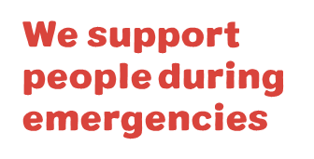
WHAT WE DO
WE WORK ACROSS AFRICA, ASIA, LATIN AMERICA, THE MIDDLE EAST AND EUROPE.
Every year
we help over
1 million
people to have
a brighter future
WE CAN DO THIS BECAUSE OF YOU!
Notes:
Reader notes:
Currently providing support in 13 countries (6 in Africa, 5 in Middle East & Europe, 1 in Asia and 1 in South America) for both long-term development and emergency aid. For more info on each country see www.sciaf.org.uk/our-work/countries
SCRIPT:
Evey year, through long-term development work and emergency response we help over 1 million people to recover from disaster and to have a brighter future.

Slide 3
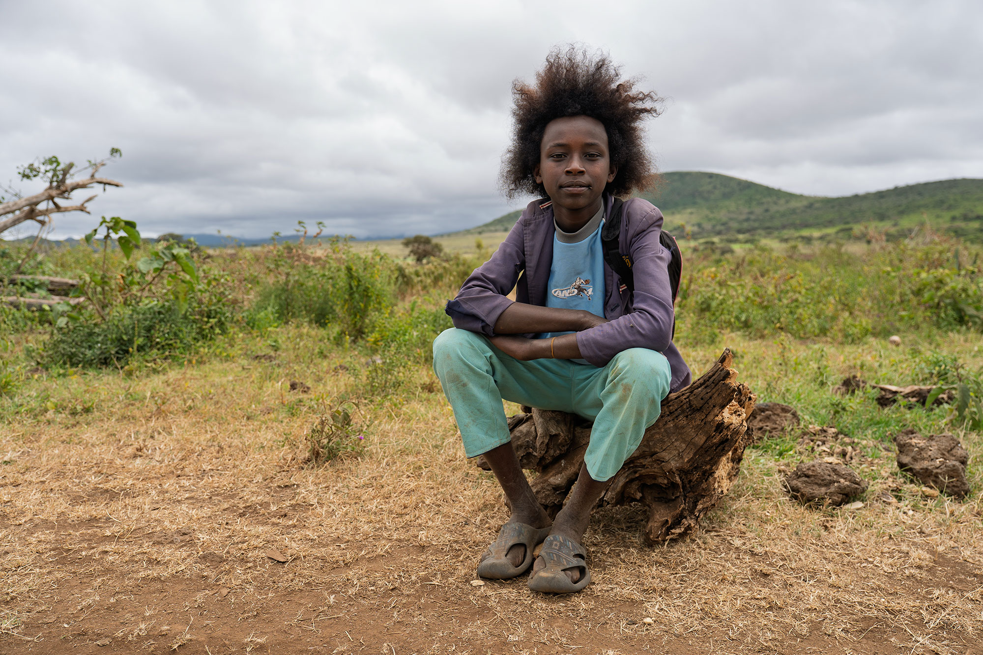
EDUCATION
ADVOCACY
HUNGER
WATER
PEACE & JUSTICE
EMERGENCIES
Notes:
Reader notes:
More information on our work here: www.sciaf.org.uk/our-work
SCRIPT:
SCIAF work here in Scotland educating people in schools and parishes about global issues.
We tackle the root causes of these issues through advocacy and campaigning for a more just world.
Our work around the world focuses on helping people
•grow enough food to eat,
•providing safe clean water to communities
•helping people to live in safe and peaceful communities
•responding to global emergencies like floods and droughts.
•Plus, support for refugees and displaced people during conflict.

Slide 4

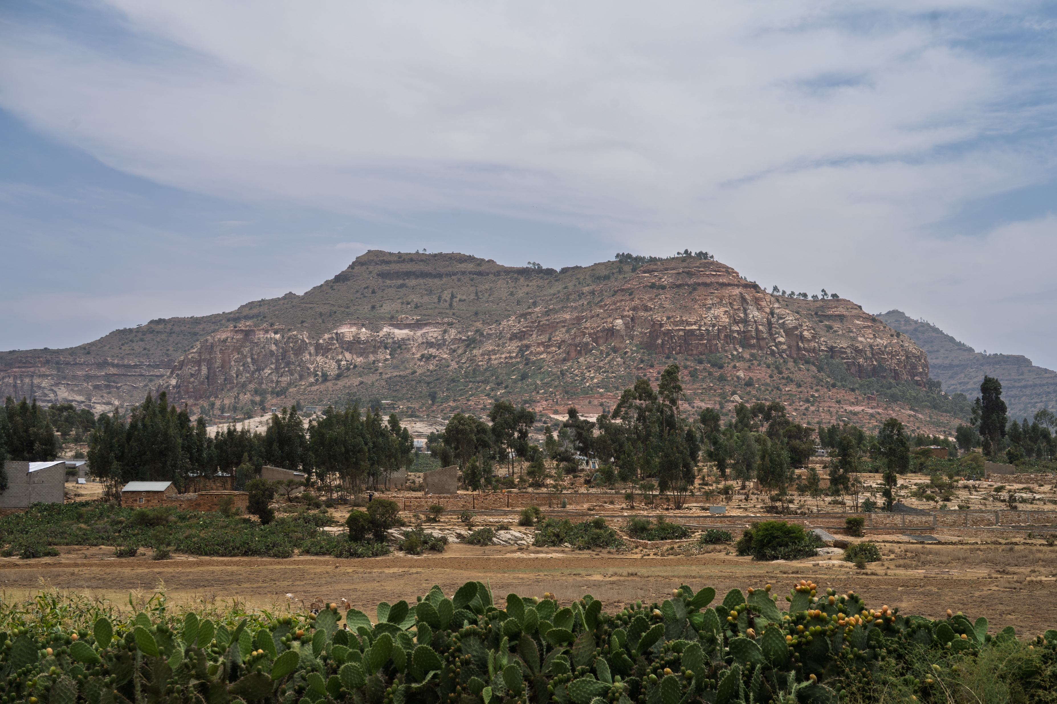
ETHIOPIA
Notes:
[Script]: This years focus country is Ethiopia Suggested Questions:
Can anyone tell me where Ethiopia is?
What are these plants at the front of this picture ? (cactus)
Does anyone know what conditions a cactus needs to grow? (lots of sun, not a lot of water) So what does this tell you about the climate?

Slide 5
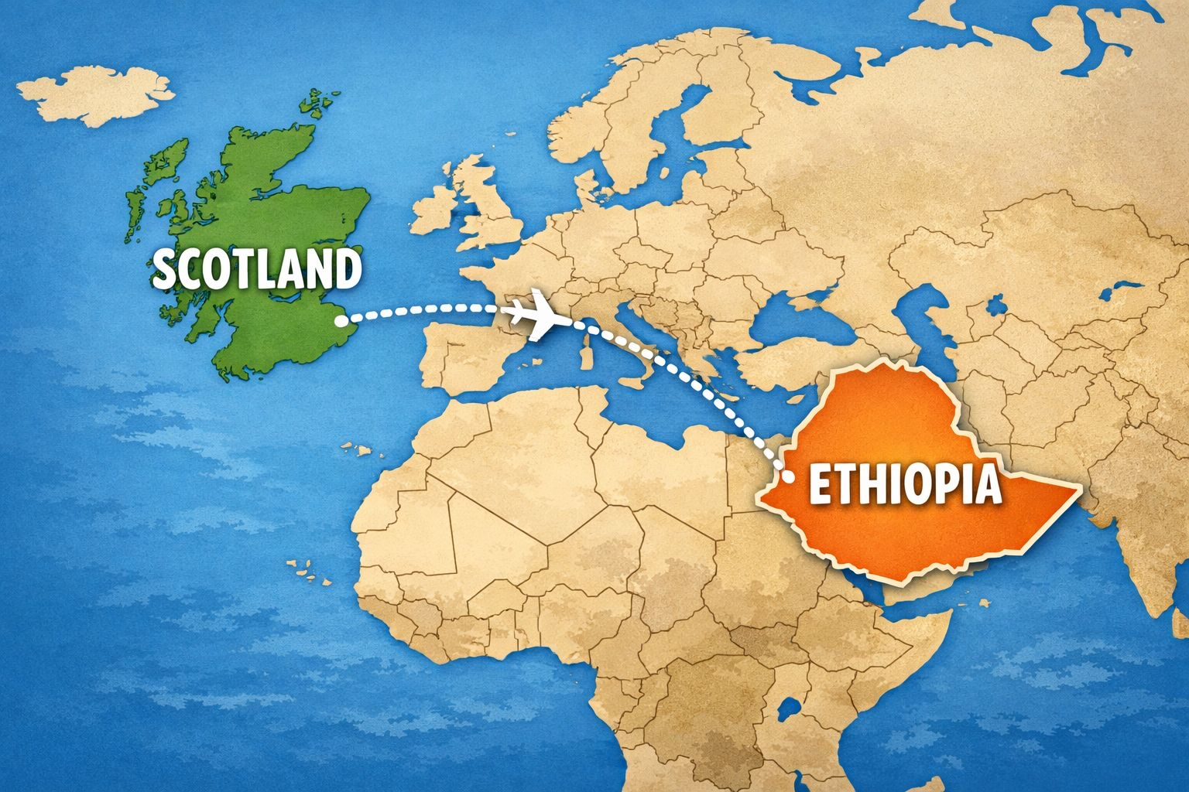
ETHIOPIA
Notes:
Country Facts:
Ethiopia is almost 6,000km/3700 miles from Scotland
It is an 8 hour flight from London
Ethiopia is 14 x bigger than Scotland
Their population is 24 times larger than Scotland's population
The capital city of Ethiopia, Addis Abada has as many people as all of the people in Scotland!!

Slide 6
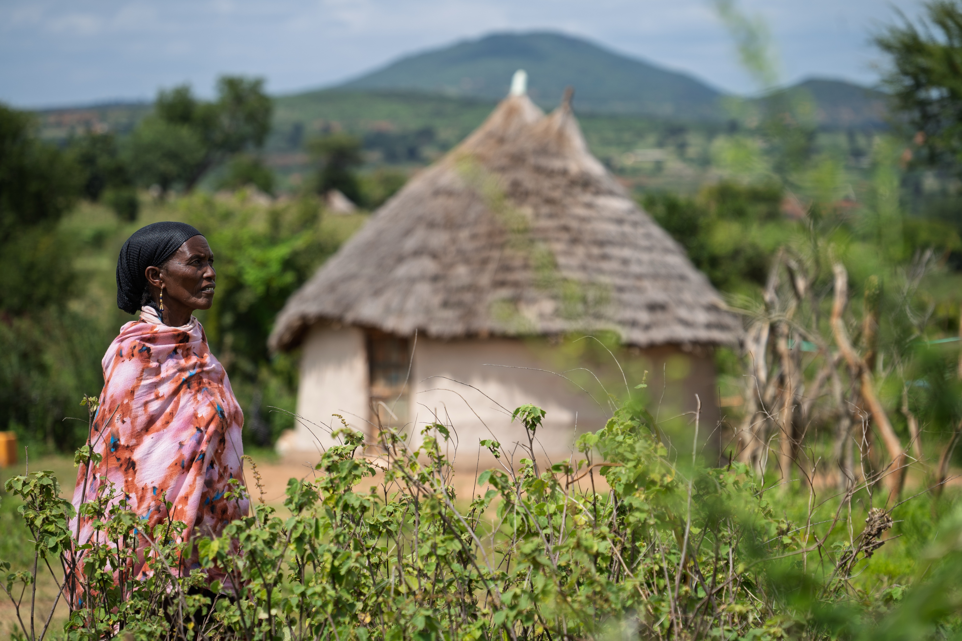
ETHIOPIA
Notes:
[Script]: Many people in Ethiopia live in rural, remote areas. They keep animals such as chickens, goats, and sometimes cows, they also grow crops to feed their families, One of the biggest problems for farmers is the unpredictable weather. There can be many months with little or no rain, then downpours can cause severe flooding.

Slide 7
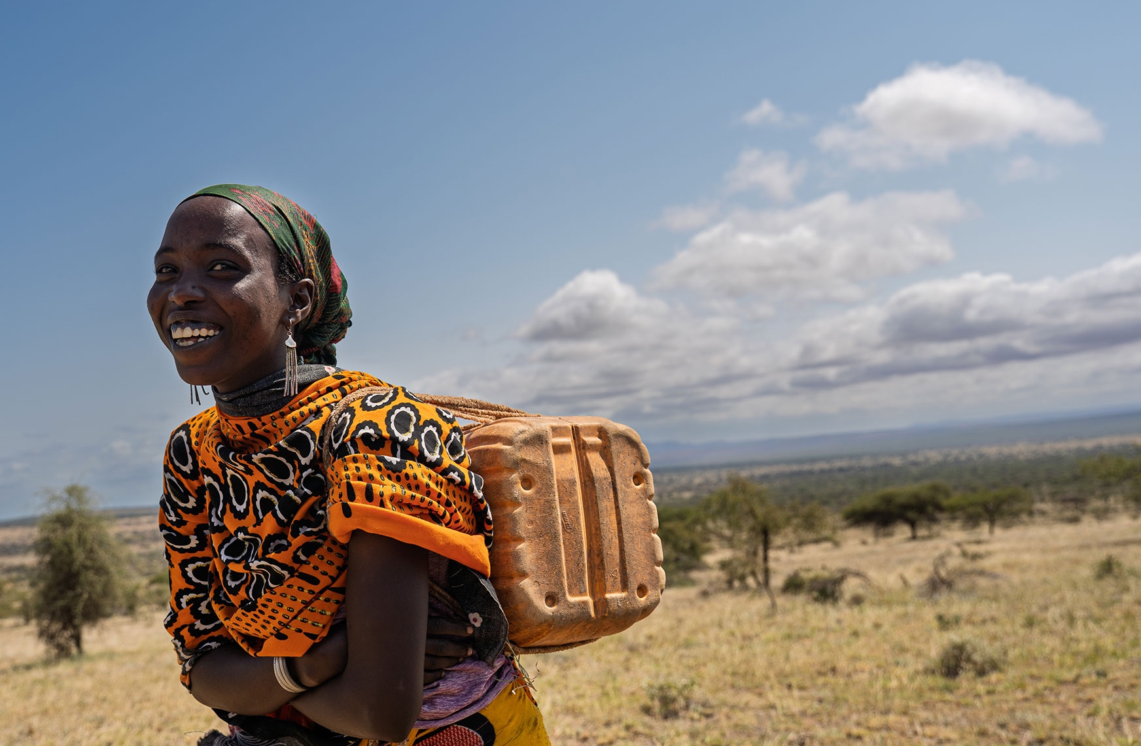
ETHIOPIA
WATER IS LIFE
YET, FOR MANY,
CLEAN WATER
IS HARD TO REACH
Notes:
[Script]: In Scotland, we are incredibly lucky to be able to turn on the tap and have fresh drinking water every day. However, in some countries, like Ethiopia, some people have to walk for up to 4 hours to reach clean water. In Ethiopia usually woman and children walk for water while the men try to make money for the family. The long walk can be very dangerous for women and children and for many, because the walk is so long it means that they cannot go to school.
Clean water isn't only important for drinking, it's also important to stay clean and healthy too.

Slide 8
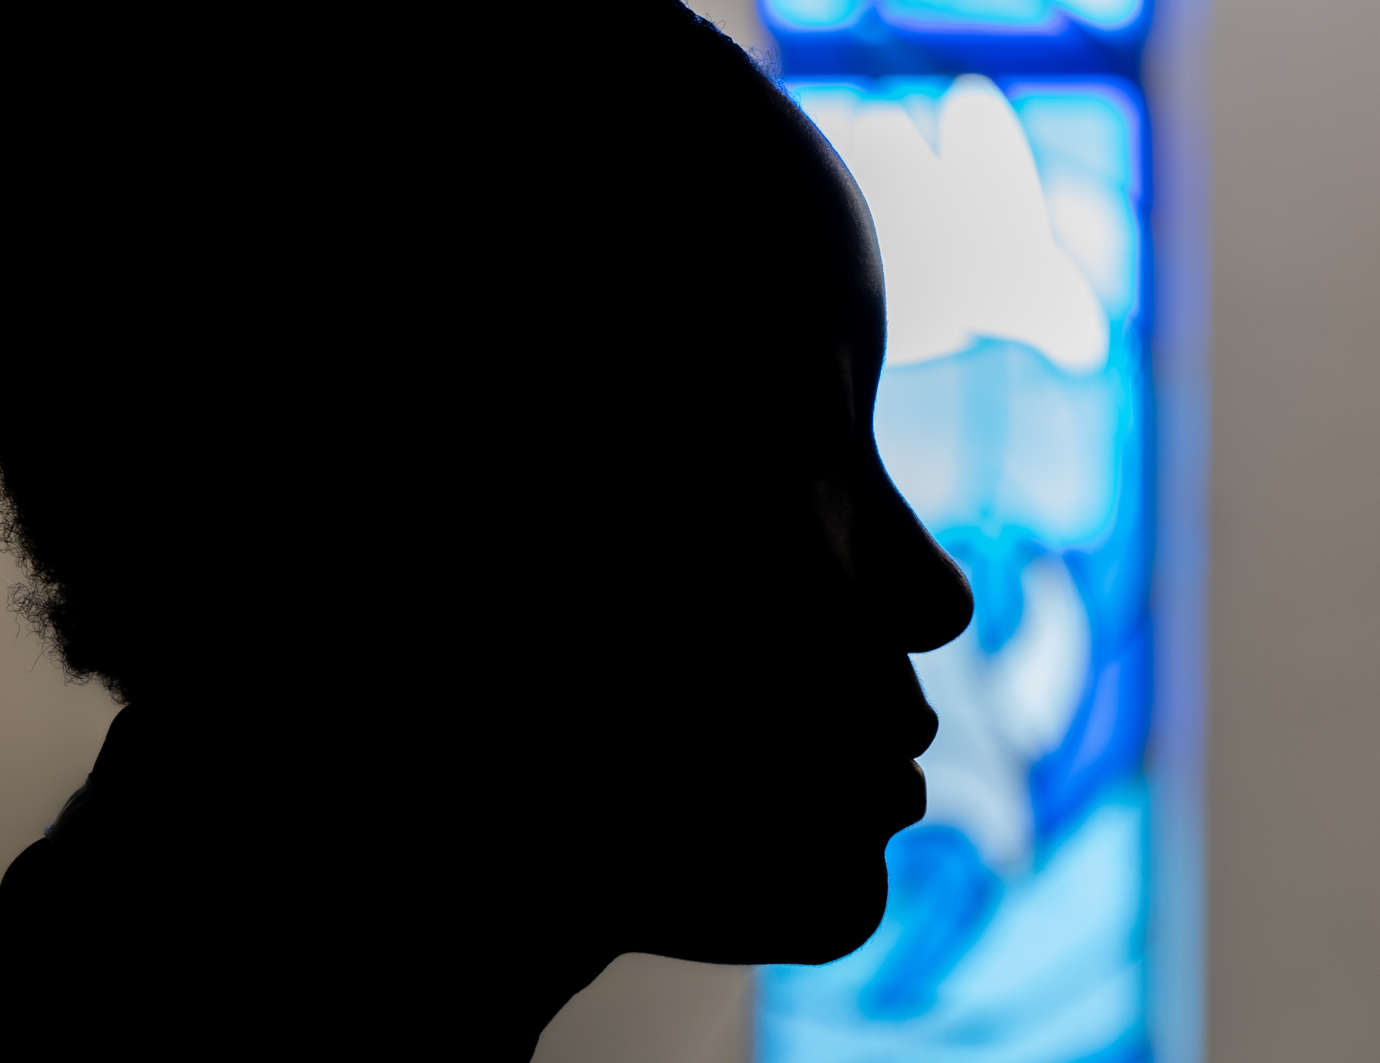
WEE BOX 2026
LENT Prayer, Fasting, Almsgiving
Notes:
Script: It is a very important time in the Church just now- Lent. During Lent the Church asks us to do 3 things in particular to prepare for Easter. Prayer, fasting and almsgiving.
Q: Can anyone tell me how long Lent lasts for? [40 days]
So over those 40 days we're asked to do these things.
Prayer is simple, it can be prayers you know like Hail Mary, Our Father or it can be simply talking to God, telling him about your day, asking him for guidance or help with friends, with your exams, or with day to day life.
Fasting, a common misconception about fasting is that it's a diet but it's actually about making a little sacrifice to God. Whether that's saying no to chocolate or sweeties during Lent or helping at home with the chores that you don't enjoy doing, or maybe not playing a game but saying a prayer instead- just showing God you are thinking about him!
Almsgiving is simply reaching out to someone to show love. We know that God has asked us to love one another as I have loved you. So we want to put our faith into action during Lent! That can be something simple like spending quality time with family, or giving a little pocket money to charity. That's where SCIAF comes in...

Slide 9
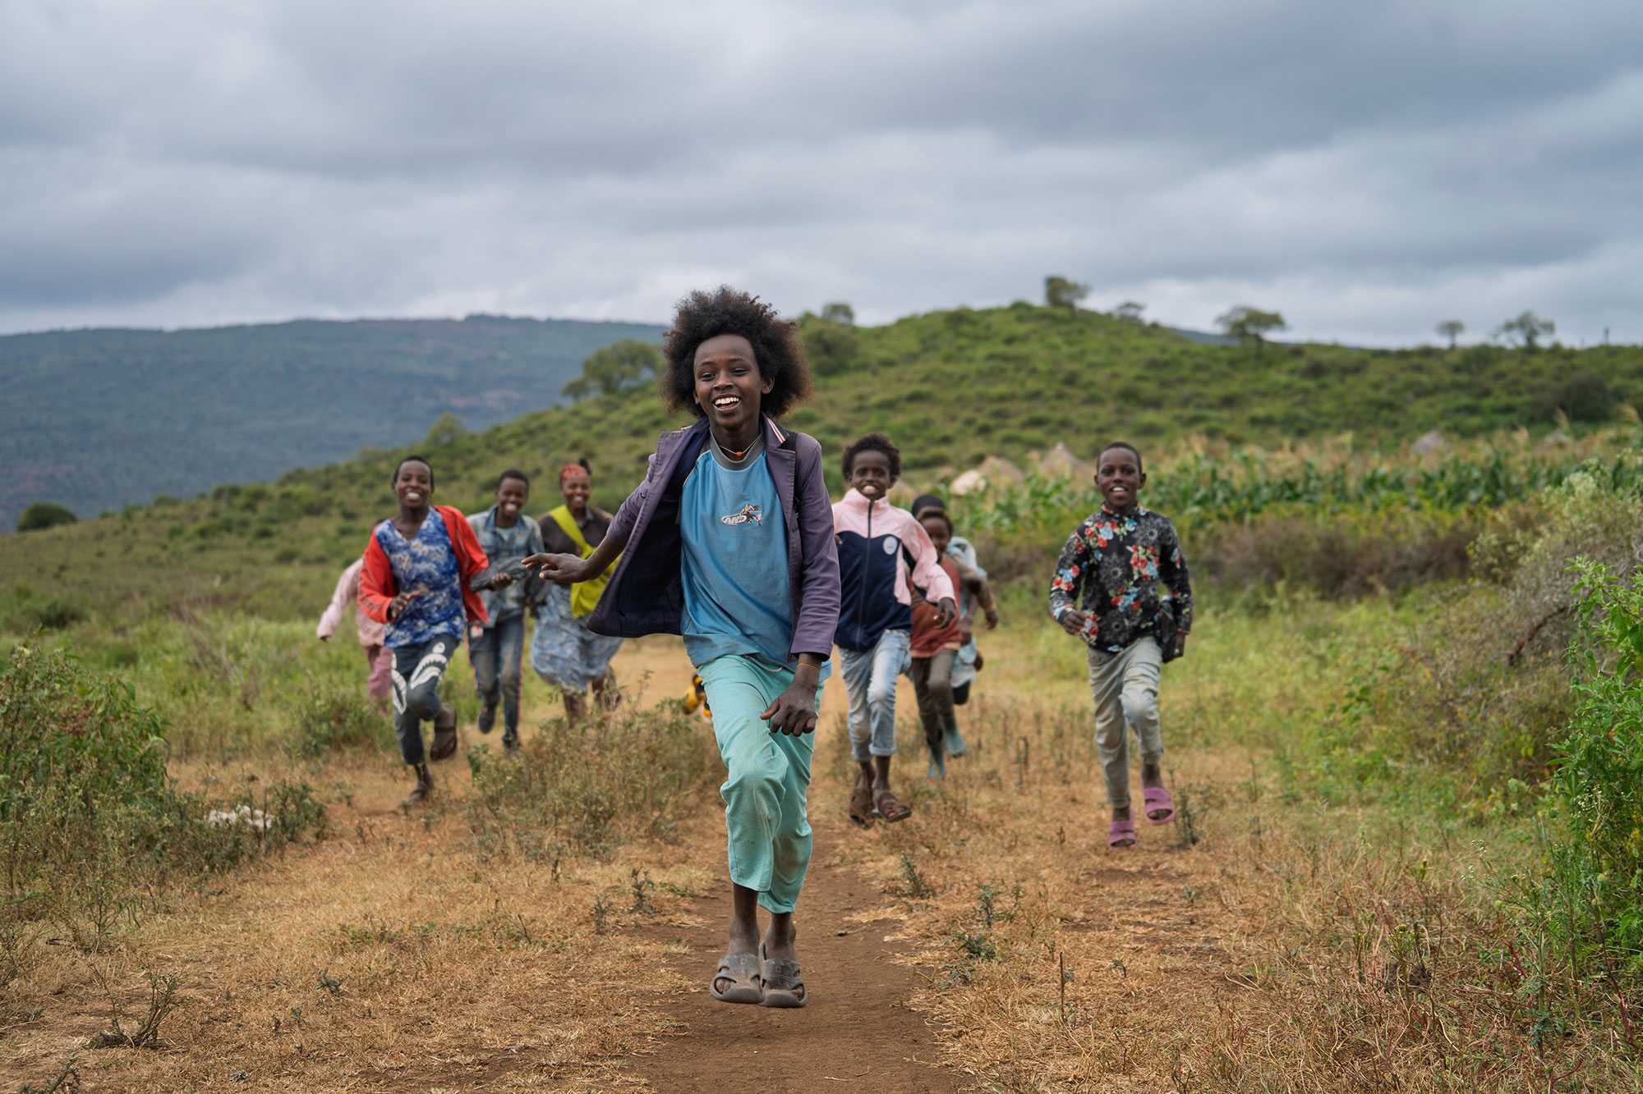
LET JUSTICE FLOW.
SHARE WATER. SHARE HOPE.
Notes:
[Script]:SCIAF’s local partners in Ethiopia, and around the world, are bringing water to the women, girls, and communities who need it most. Together, we dig wells near homes, repair pumps, and ensure that water keeps flowing, whatever the weather.
T

Slide 10
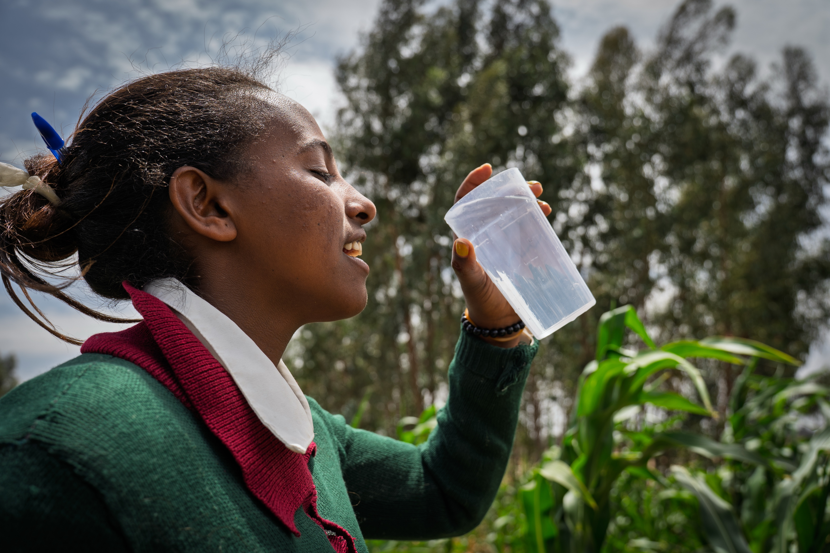
Hirit's story:
Notes:
Hirit lives in a rural village in Ethiopia, she is 24 years old.
Hirit said:
“A good day is a day when I’m not anxious. A day without any problems is what I call a good day. If you're out of trouble, free from stress, and everything is peaceful, then that’s a good day.

Slide 11
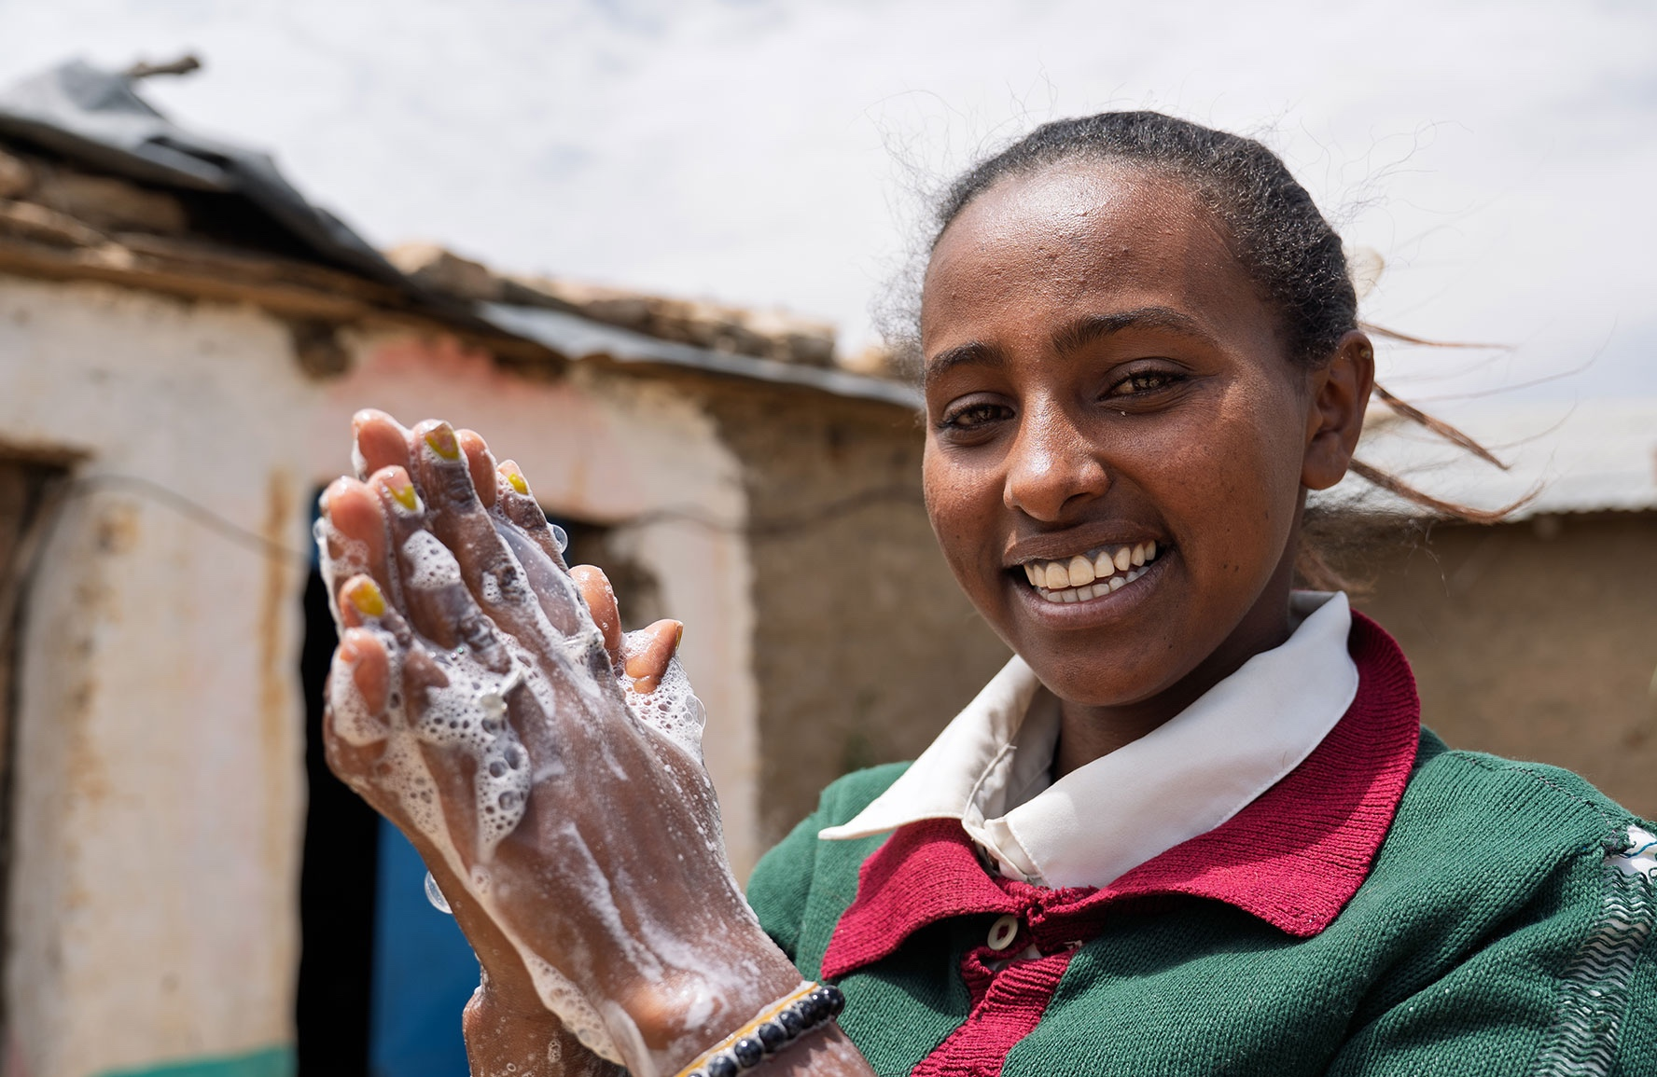
Hirit's story
Notes:
SCRIPT:
When a couple of members of staff from SCIAF visited Ethiopia they had the opportunity to speak to speak to Hirit and learn more about her story and the daily struggles she endured without regular access to clean safe water.
Hirit told us, that Life before this was very difficult. They used to walk five hours just to get water. The place they fetched water from was unsafe – the cows and other animals drank from it. Even dead animals were sometimes found in the water but with this being their only option for many miles, they were forced to drink the water.

Slide 12
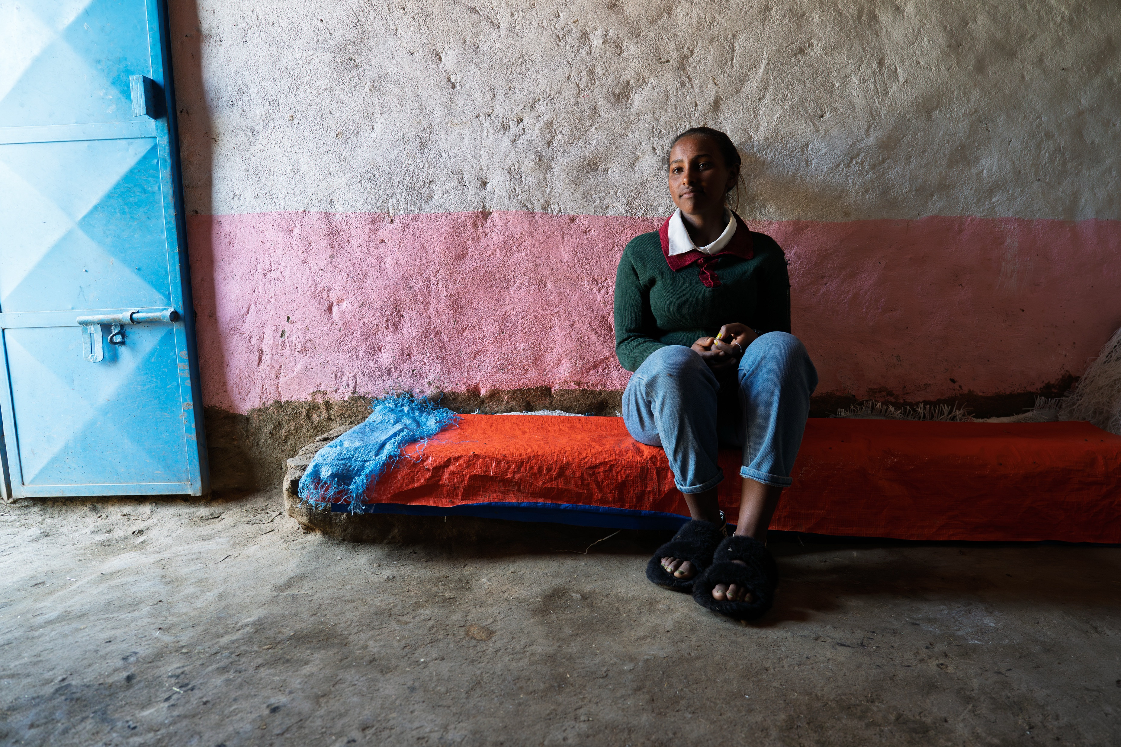
Hirit's story:
Notes:
Hirit told us that often woman and girls would try to avoid going to fetch water as it was so dangerous. People were often attacked or threatened. Additionally knowing the water was unclean and causing diseases was always on their mind- but they didn’t have another option.
Hirit said
“We had no other choice. We had to drink it. Sometimes it felt like drinking that water was worse than dying."

Slide 13
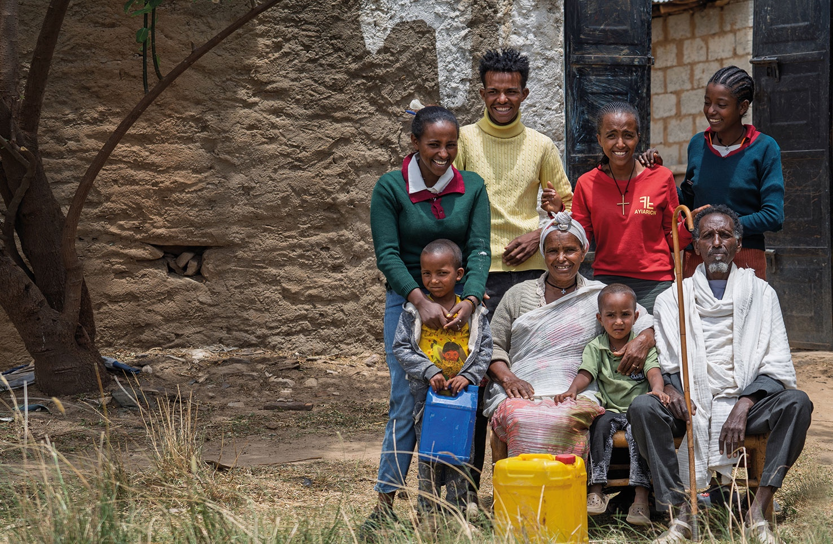
Hirit's story:
“BEFORE,
WE USED TO TRAVEL LONG DISTANCES FOR WATER. NOW IT’S
NEARBY"
Notes:
“The water point has solved many of the problems for us women. It has especially helped young girls like me.
“Before, we used to go to school with dirty clothes, dirty bags, and unwashed hair. But now, we can stay clean. Overall, it’s much better for girls now.

Slide 14
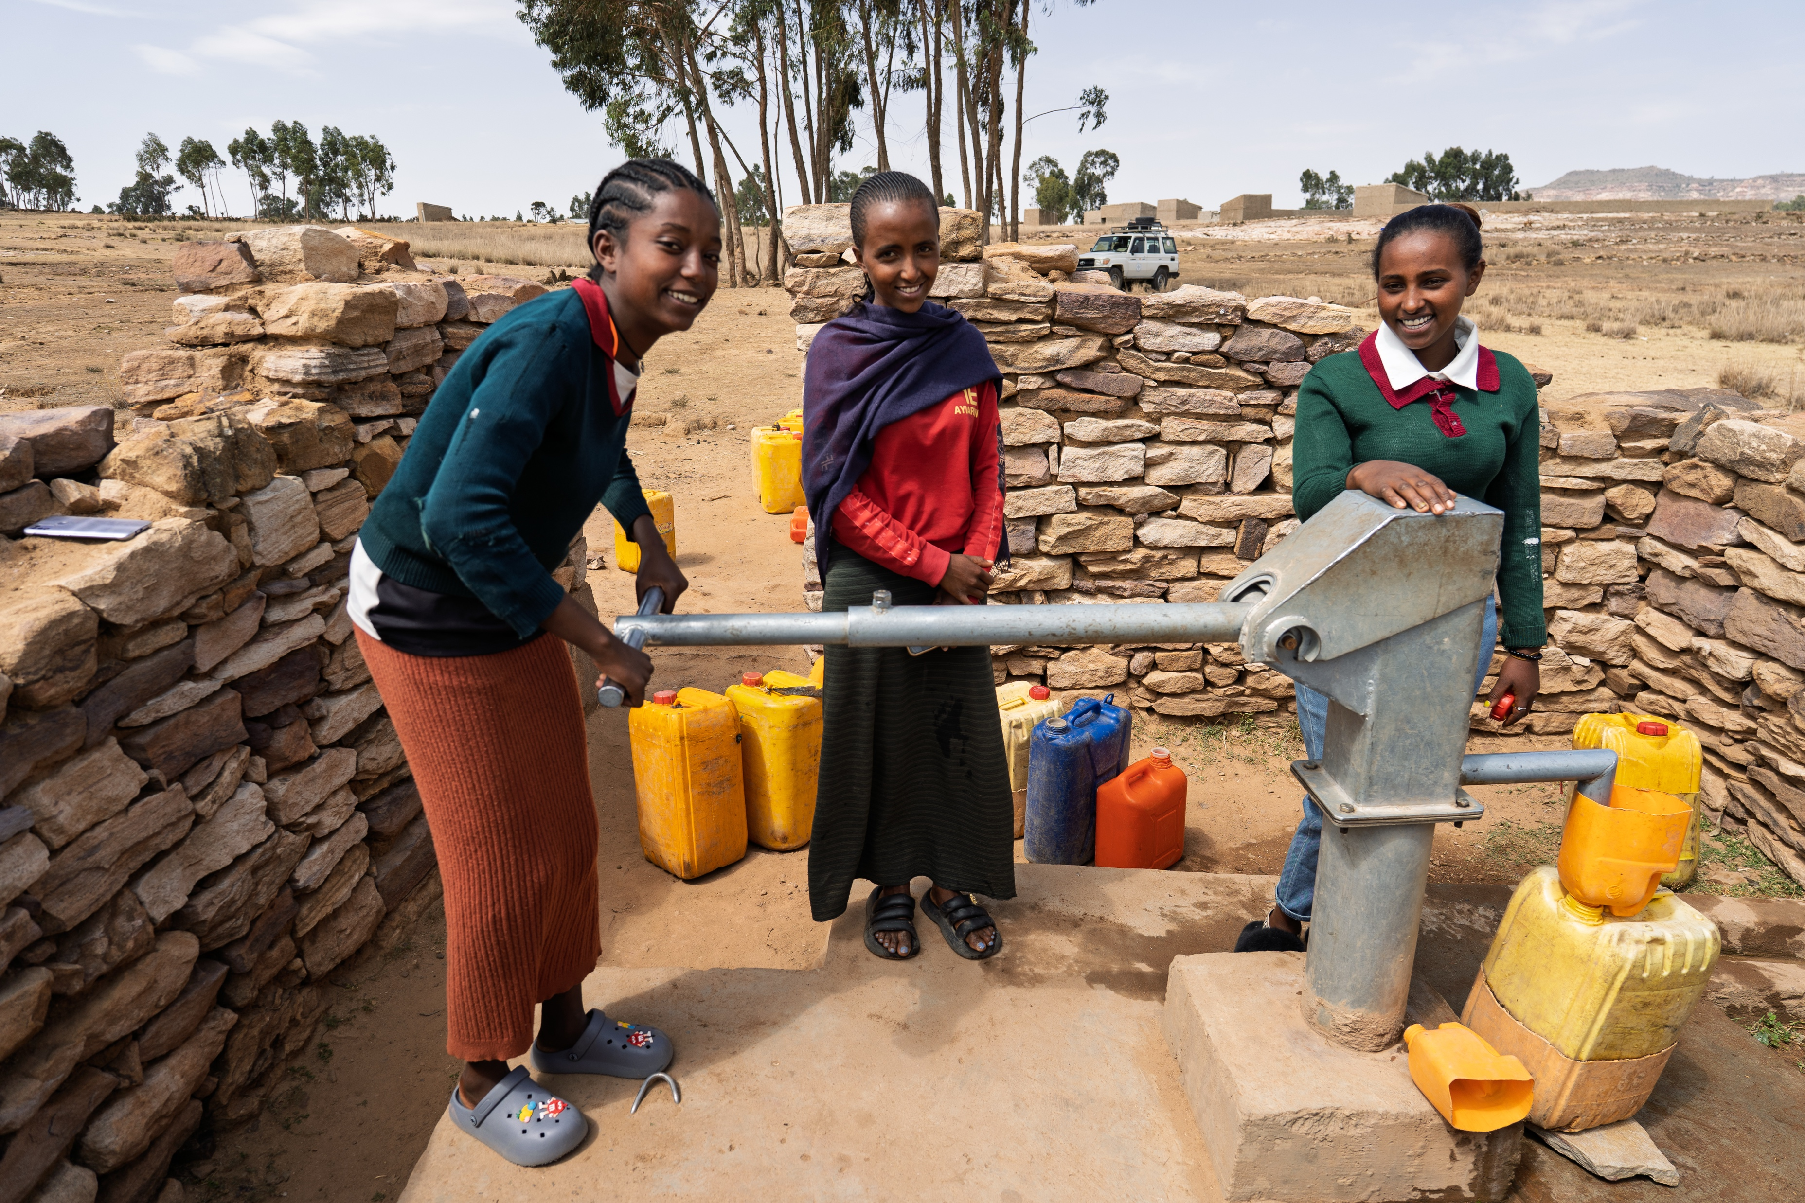
Hirit's story:
Notes:
Hirit said:
“I hope to continue doing well in school and reach the highest level so I can serve my family and my community. I want to pursue a career in business. But I really want to finish my education."

Slide 15
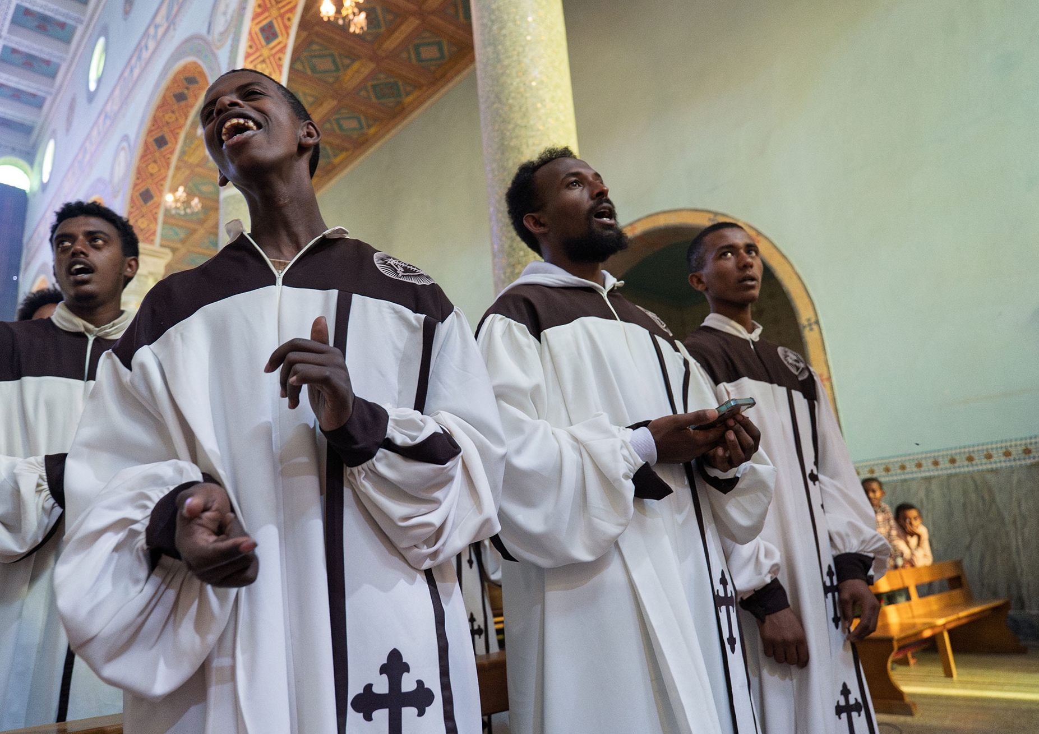

ETHIOPIA
“Without water it is not possible to live.” Pope Leo XIV
Notes:
An obvious quote from Pope Leo but I guess it highlights how vital water is and highlights the problem we have that billions don't have access to clean safe water.

Slide 16
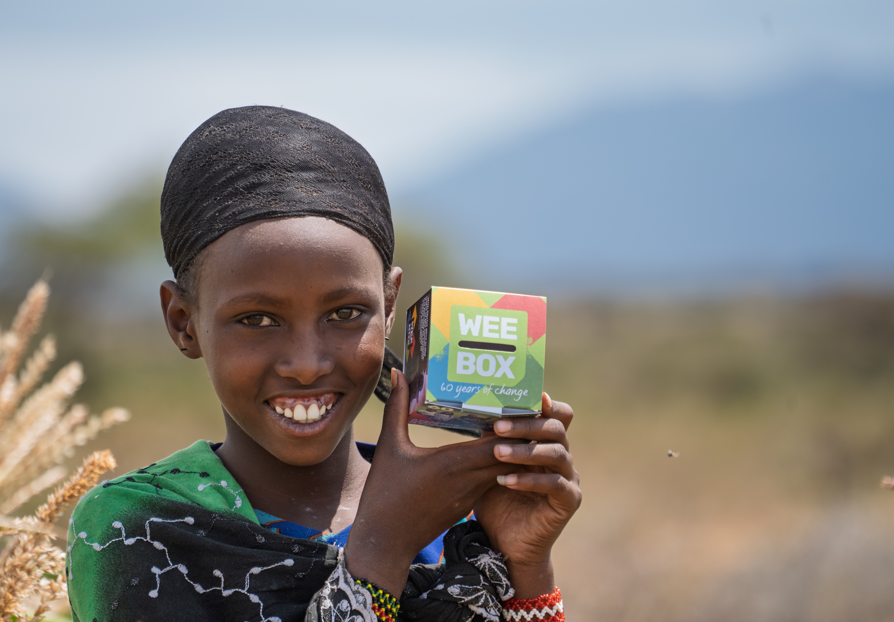
WEE BOX 2026
THIS LENT,
USE YOUR
WEE BOX
TO MAKE A
BIG CHANGE
Notes:
You can use your WEE BOX to make a BIG CHANGE this Lent, for people in Ethiopia and all around the world!
Every year the people of Scotland come together and use their WEE BOX to be part of something bigger. Sometimes it can feel like what you donate alone can't do much so that's why it's important that we do our bit to contribute to the bigger picture! Who remembers how many people we help every year? [over 1 million] We cant do that without the help of our SCIAF community here in Scotland and that community, the catholic community includes all of you!

Slide 17

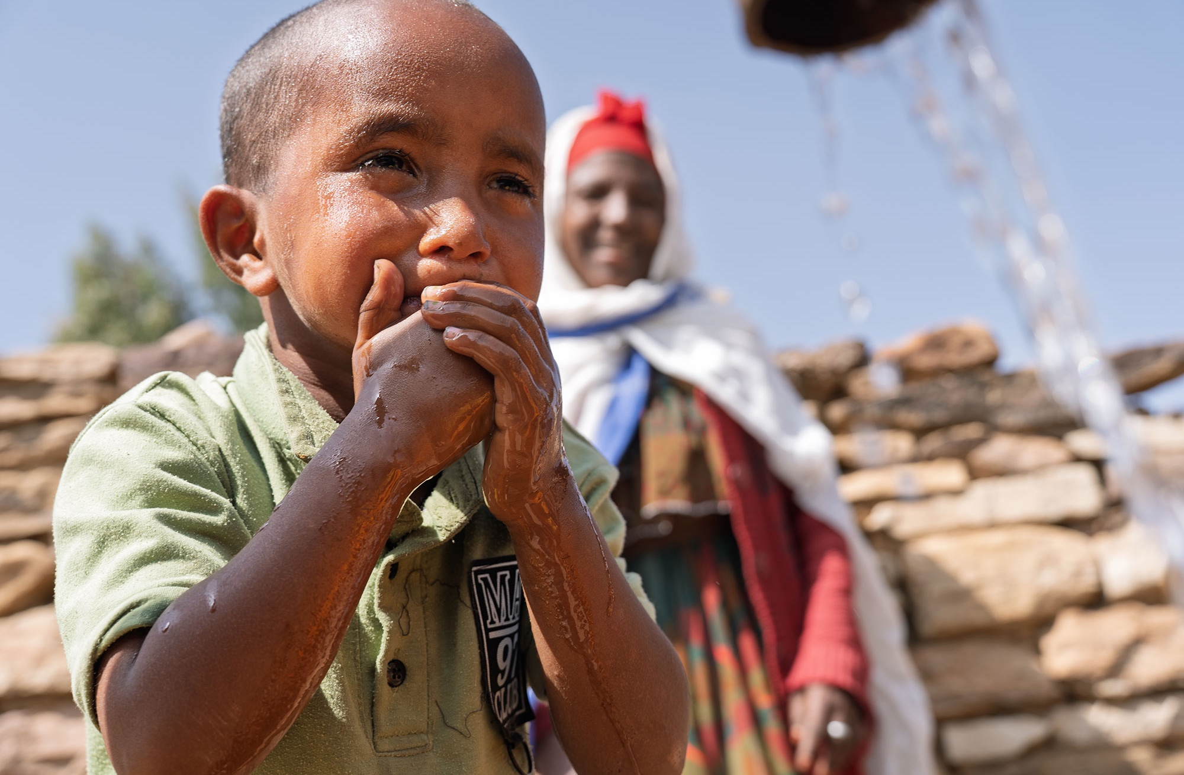
ETHIOPIA
£40 gives people access to clean water for drinking, sanitation and improved hygiene
£240 can install a rainwater harvester at home, helping families collect safe, clean water
£1,200 brings water to a village through taps, wells, irrigation systems and rainwater harvesters.
Notes:
It sometimes helps to know what your kind donations are doing so here's an idea of what money can provide. Please note that £1,200 is not simply one water point. It's often equipping a village with multiple water points and irrigation systems to crops. It's installing rainwater harvesters and storage tanks.

Slide 18

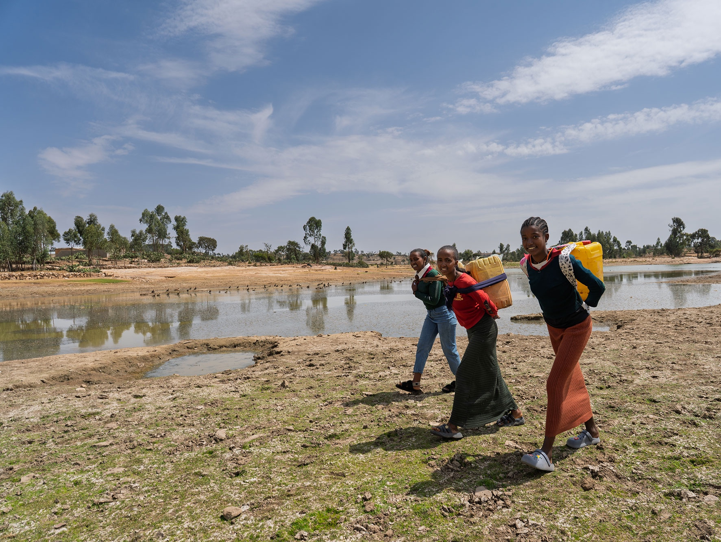
“We used to walk five hours just to get water. Now, we have clean water near our home.
Hirit, Ethiopia
This Lent, Walk for Water in return for donations to our WEE BOX Appeal. Walk our virtual route along the Blue Nile river in Ethiopia as a class or a school and fundraise for SCIAF's work!
Walk in solidarity today
sciaf.org.uk/biglentwalk
Notes:
The Big Lent Walk is a really easy way to walk in solidarity with your sisters and brothers who are often walking hours and hours for water each day. Get yourself sponsored, and walk together as a school. You can find more information to support your walk online including nice little reflections. Your challenge is to walk the length of the Blue Nile that starts in Ethiopia and is the countries longest river.

Slide 19
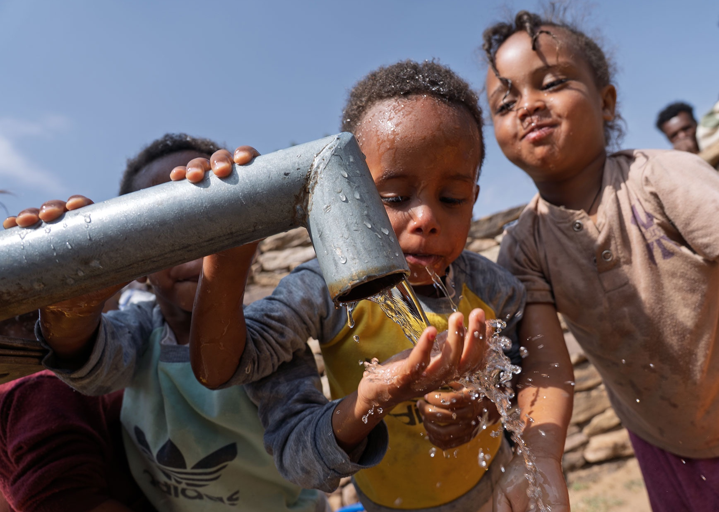
ETHIOPIA
Don’t cut aid.
Save lives!
Tell the Prime Minister to stop cutting aid and return to 0.7% immediately.
Helping the world’s poorest people access water and sanitation – and other forms of vital aid – is a matter of life and death.
Take action now.
sciaf.org.uk/aidcuts
Notes:
When Sir Keir Starmer won the UK General Election, he promised to return the aid budget to 0.7%. It could have been a lifeline for the world’s poorest people – while making the world a safer place for all.
But the Prime Minister didn’t keep his promise.
Instead, aid spending is now set to be slashed again. And it’s the world’s poorest people that will lose out: those in need of water, sanitation and hygiene in places like Ethiopia; those struggling to rebuild after war or natural disasters around the world.
The UK Government should not balance the books on the backs of the poorest. Restoring the 0.7% aid commitment is an act of solidarity from one of the richest nations in history – and an investment in a fairer, better world for all.
Don’t cut aid. Save lives!

Slide 20

WEE BOX BUILD CHALLENGE
Notes:
WEE BOX CHALLENGE:
Take about 3 WEE BOXES along to the school with you then ask for volunteers (ask the teachers to pick if nobody is eager)
Show them how to build a WEE BOX
Give them a practice run then use a timer on your phone to see who can make their WEE BOX the quickest! (best to do all together and see who is the fastest to save time, also if you don’t have a timer, just see who out of the group does it the quickest)
TOP TIP: make it exciting, get the rest of the pupils to cheer them on!

Slide 21
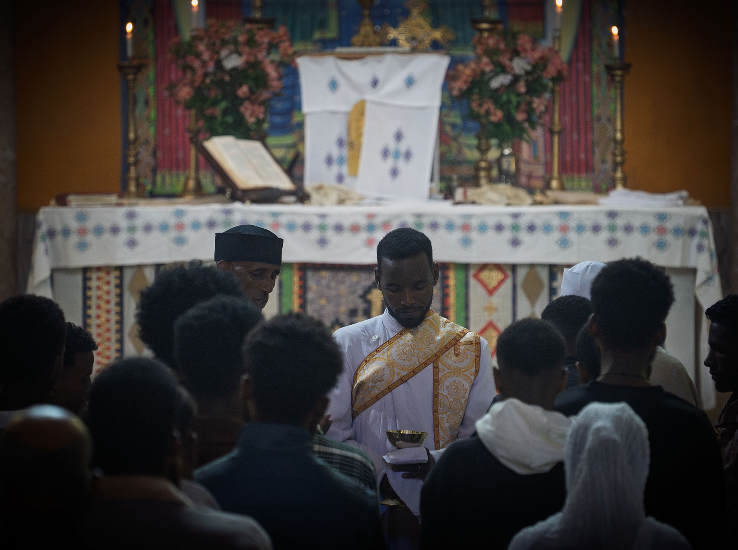
ETHIOPIA
“BUT LET JUSTICE ROLL ON LIKE A RIVER, RIGHTEOUSNESS LIKE A NEVER-FAILING STREAM!” Amos 5:24
Notes:
Scripture often uses water in simile's and metaphors. Jesus tells the Samaritan woman that the water He gives "will become in them a spring of water welling up to eternal life," meaning a continuous, internal source of spiritual sustenance, not just physical relief. Scripture is full of references to water.

Slide 22
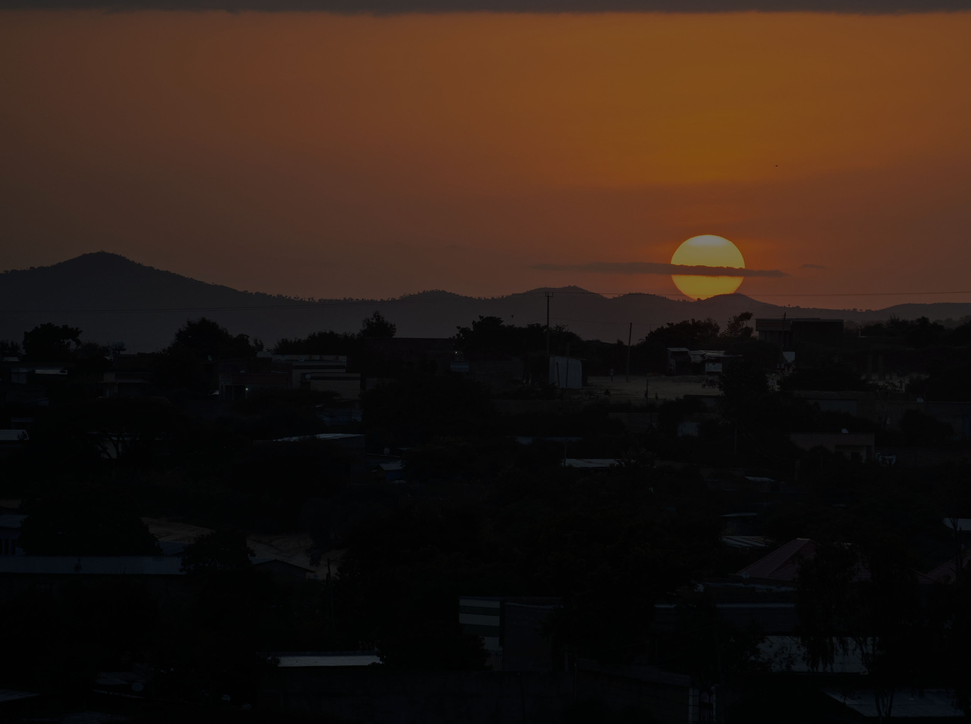
ETHIOPIA
WEE BOX Prayer
for 2026
LEADER: Sign of the Cross
LEADER: We thank You for the gift of water that gives us life
All repeat
LEADER: Bless the work of SCIAF and the people of Ethiopia
All repeat
LEADER: Help us share Your love, like water, with those in need
All repeat
LEADER: Teach us how we can better love our neighbour
All repeat
ALL TOGETHER: Amen.

Slide 23
A JUST WORLD, FREE OF POVERTY, WHERE WE FLOURISH AND LIVE
IN HARMONY WITH EACH OTHER AND ALL CREATION.
Scottish Catholic International Aid Fund
SCIAF is the official relief and development agency of the Catholic Church in Scotland
and a proud member of the Caritas family. 196 Clyde Street, Glasgow G1 4JY.
Tel: 0141 354 5555. Scottish Charity No: SC012302. Company No: SC197327.
sciaf@sciaf.org.uk

