Slide 1
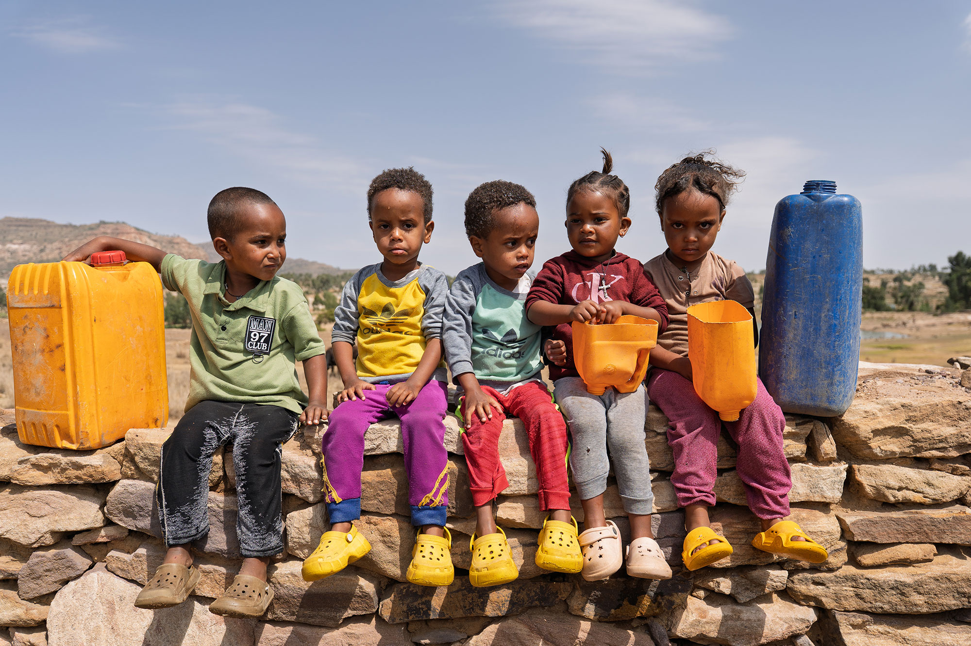



WEE BOX 2026
Primary Assembly
Notes:
Reader notes:
This PowerPoint looks at the impact of SCIAF's work in Ethiopia.
Intro: Slides 1-3 (3-5 mins)
Ethiopia overview: Slides 4-10 (5-7 mins)
Slide about Lent: slide 11
WEE BOX: Slides 12-20 (10 mins) without activity (10 mins for shortened activity)
Prayer and Thank you: Slide 21 (2 mins)
Introduce yourself as a volunteer for SCIAF. Feel free to say how long you’ve been volunteering with us and a wee bit about yourself.
SCRIPT:
SCIAF are one of the official charities of the Bishops Conference of Scotland.
Questions:
What do the letters in SCIAF stand for?
SCIAF started in 1965 – does anyone know how long ago that was (61 years ago)
What do we think are in these containers?

Slide 2





WHAT WE DO
WE WORK ACROSS AFRICA, ASIA, LATIN AMERICA, THE MIDDLE EAST AND EUROPE.
Every year
we help over
1 million
people to have
a brighter future
WE CAN DO THIS BECAUSE OF YOU!
Notes:
Reader notes:
Currently providing support in 13 countries (6 in Africa, 5 in Middle East & Europe, 1 in Asia and 1 in South America) for both long-term development and emergency aid. For more info on each country see www.sciaf.org.uk/our-work/countries
SCRIPT:
Evey year, through long-term development work and emergency response we help over 1 million people to recover from disaster and to have a brighter future.

Slide 3
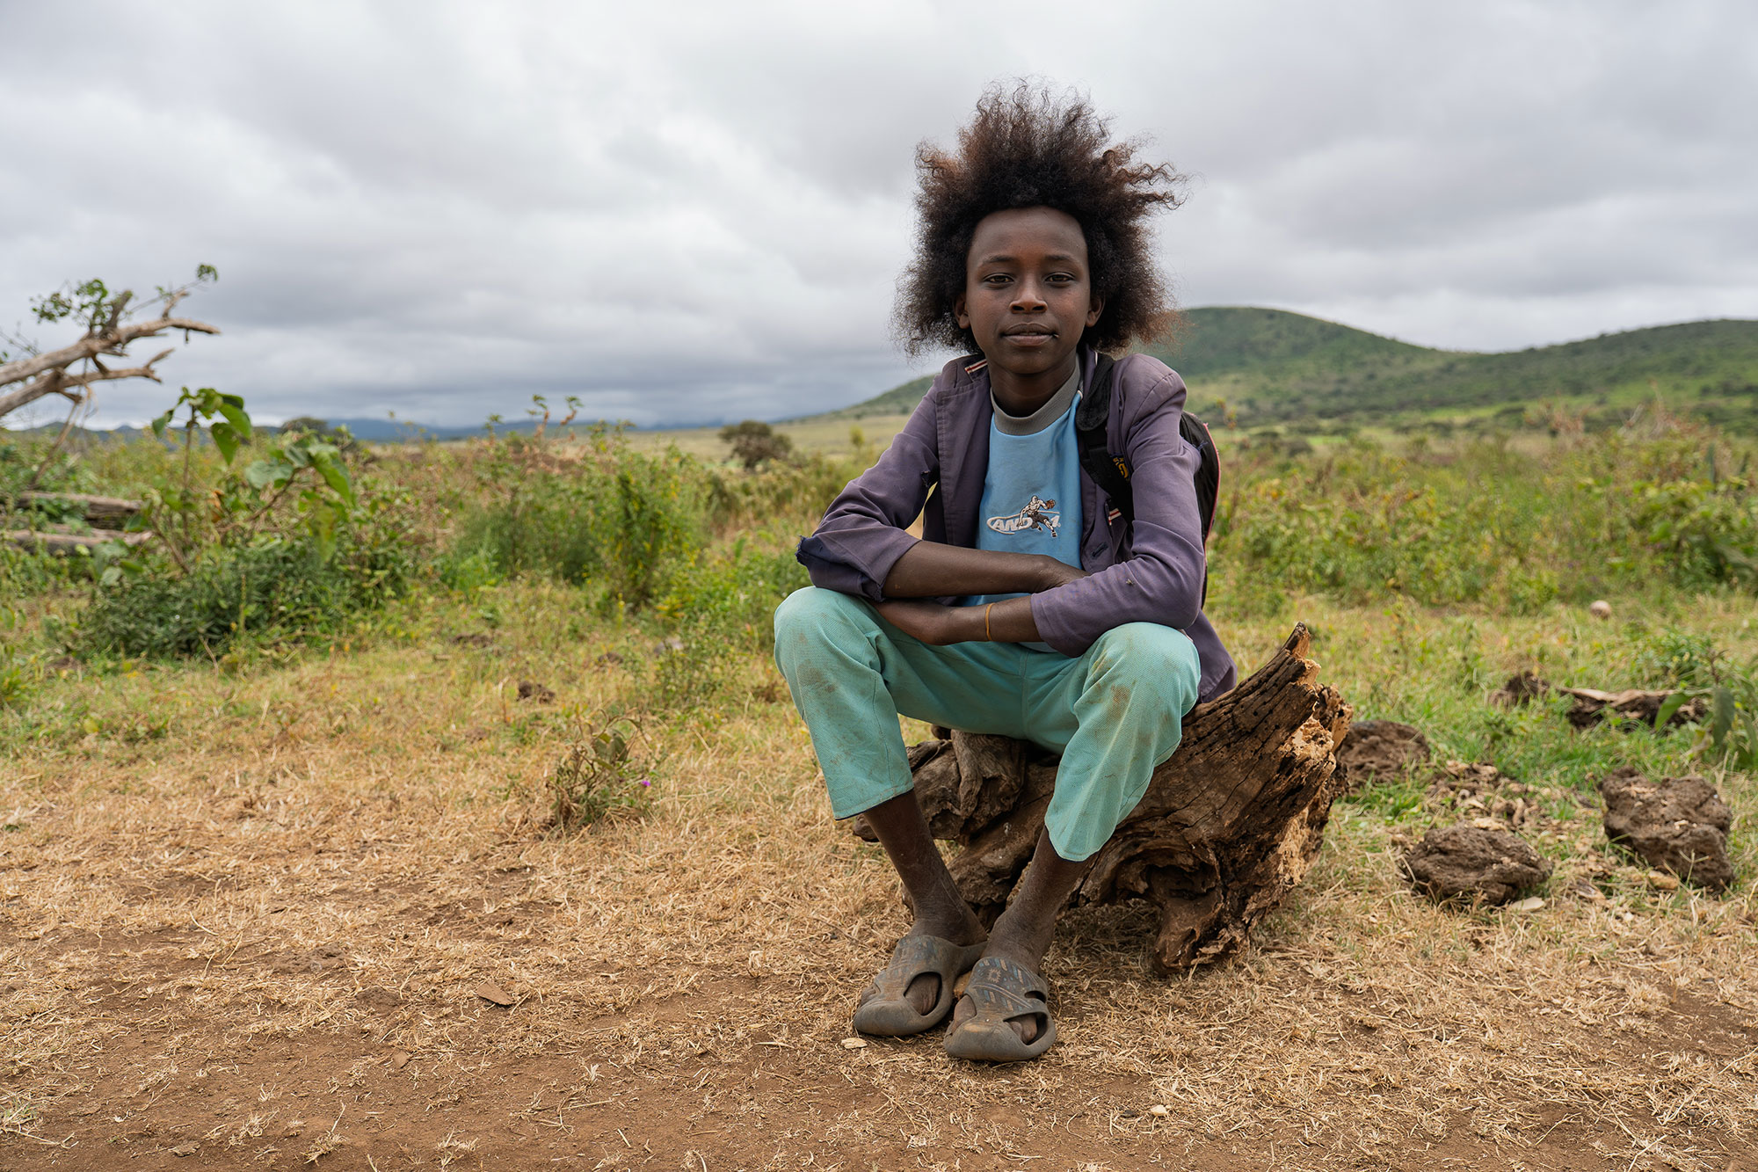
EDUCATION
ADVOCACY
HUNGER
WATER
PEACE & JUSTICE
EMERGENCIES
Notes:
Reader notes:
More information on our work here: www.sciaf.org.uk/our-work
SCRIPT:
SCIAF work here in Scotland educating people in schools and parishes about global issues.
We tackle the root causes of these issues through advocacy and campaigning for a more just world.
Our work around the world focuses on helping people
•grow enough food to eat,
•providing safe clean water to communities
•helping people to live in safe and peaceful communities
•responding to global emergencies like floods and droughts.
•Plus, support for refugees and displaced people during conflict.

Slide 4

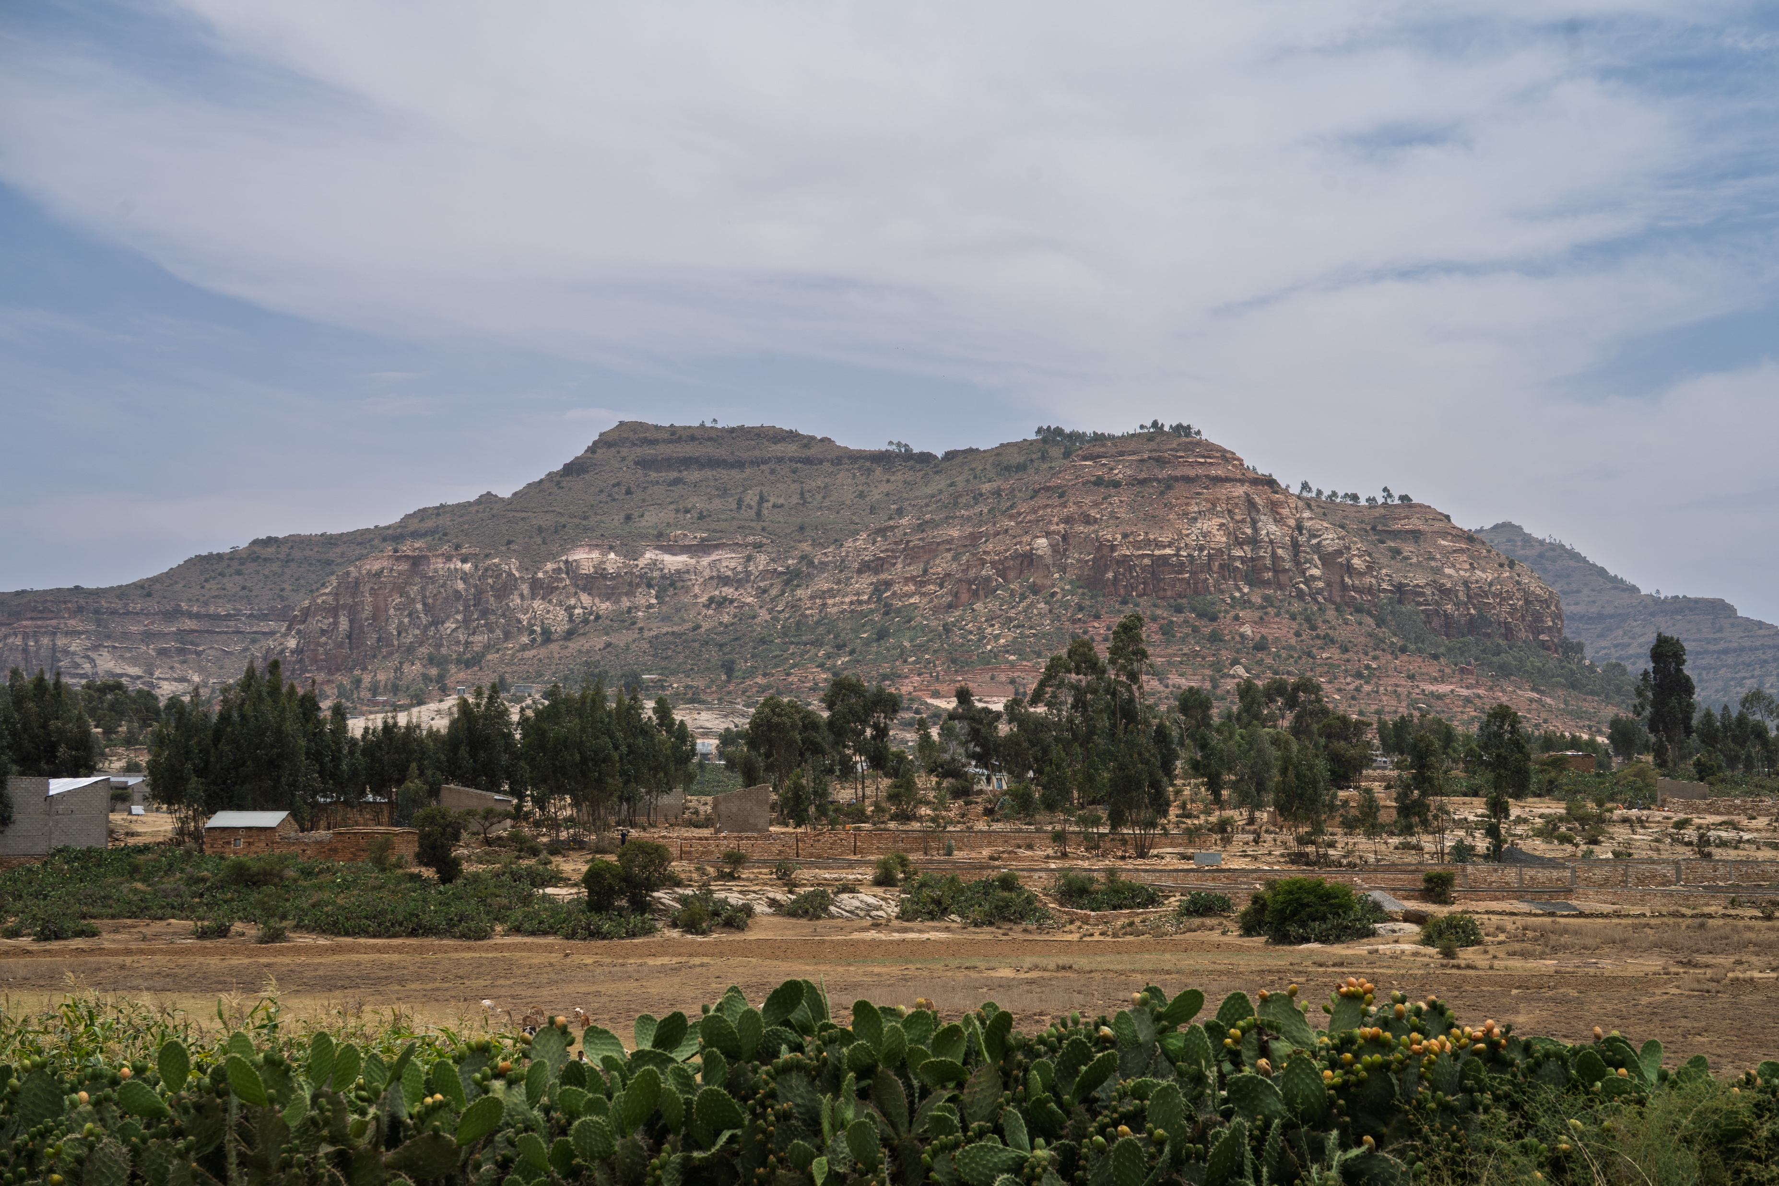
ETHIOPIA
Notes:
[Script]: This years focus country is Ethiopia Suggested Questions:
Can anyone tell me where Ethiopia is?
What are these plants at the front of this picture ? (cactus)
Does anyone know what conditions a cactus needs to grow? (lots of sun, not a lot of water) So what does this tell you about the climate?

Slide 5
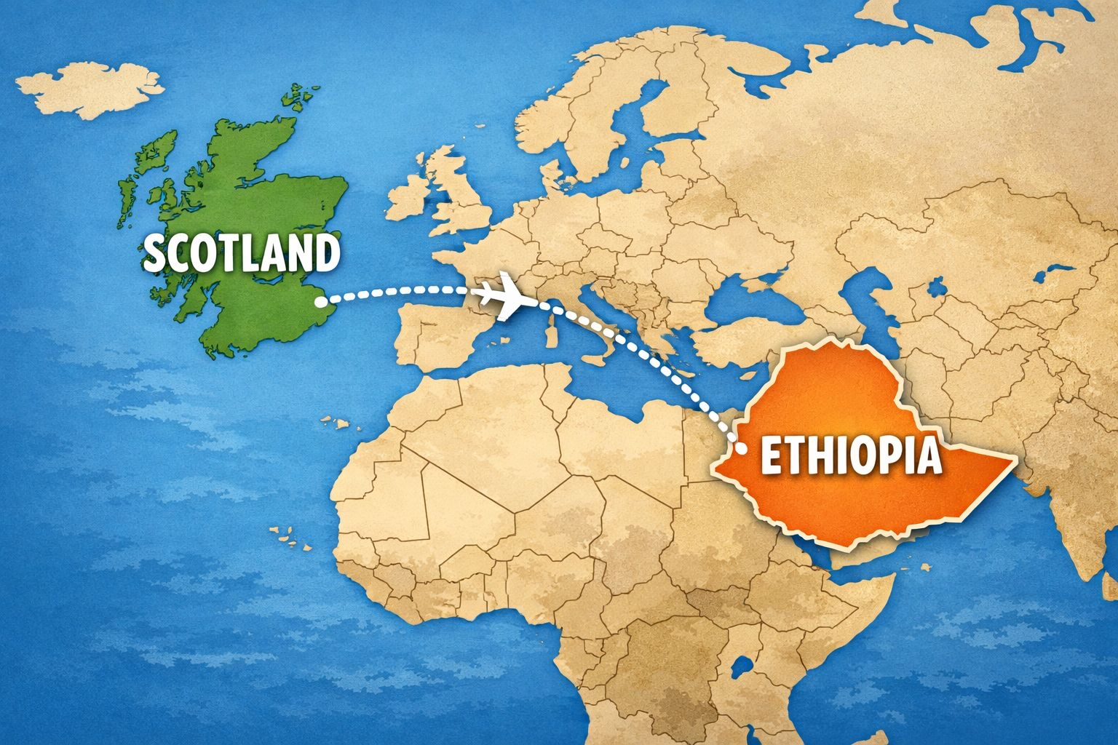

ETHIOPIA
Notes:
Country Facts:
Ethiopia is almost 6,000km/3700 miles from Scotland
It is an 8 hour flight from London
Ethiopia is 14 x bigger than Scotland
Their population is 24 times larger than Scotland's population
The capital city of Ethiopia, Addis Abada has as many people as all of the people in Scotland!!
Can anyone tell me what colours are in the flag of Ethiopia? (green, yellow, red, blue)

Slide 6
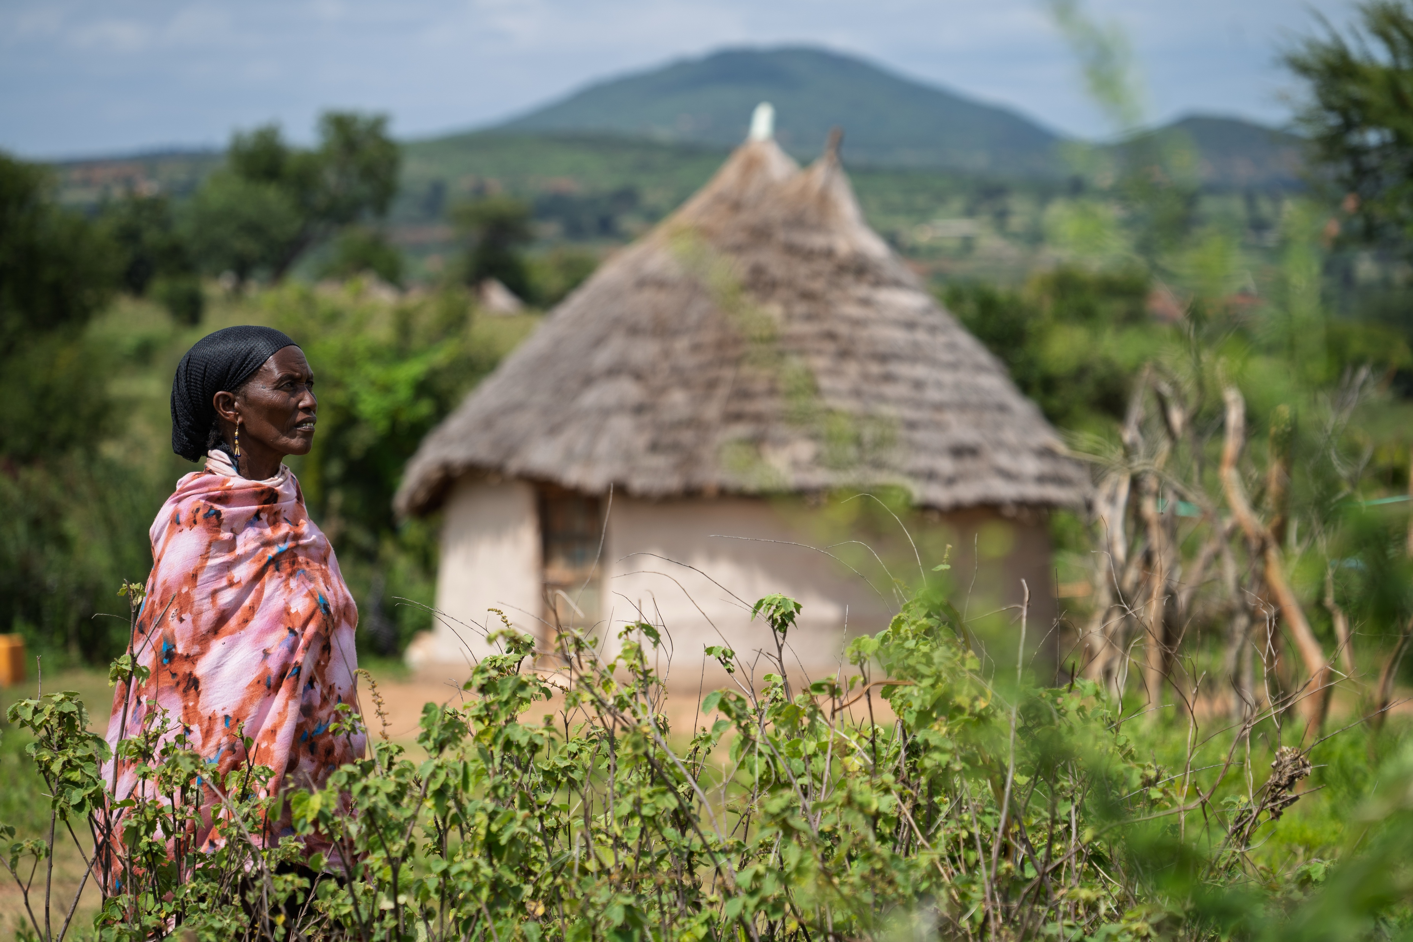
ETHIOPIA
Notes:
[Script]: Many people in Ethiopia live in the countryside

Slide 7
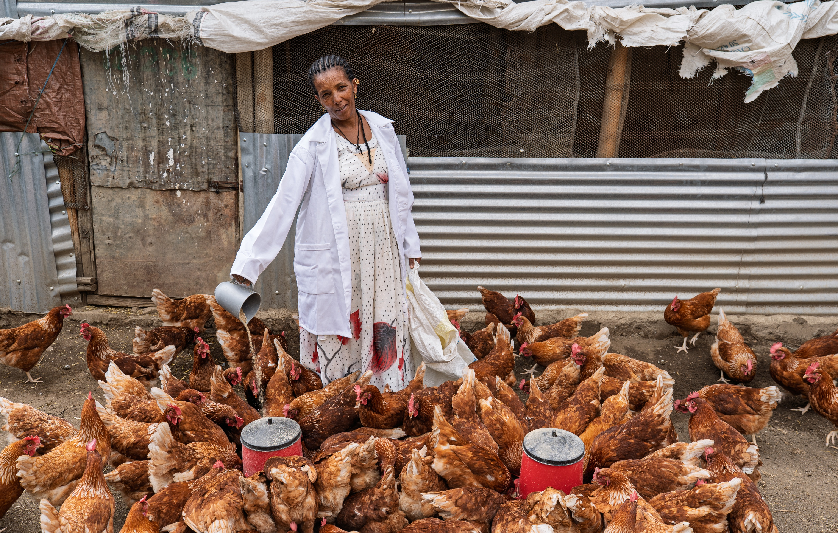
ETHIOPIA
Notes:
[Script]: They keep animals such as chickens, goats, and sometimes cows, they also grow crops to feed their families.

Slide 8
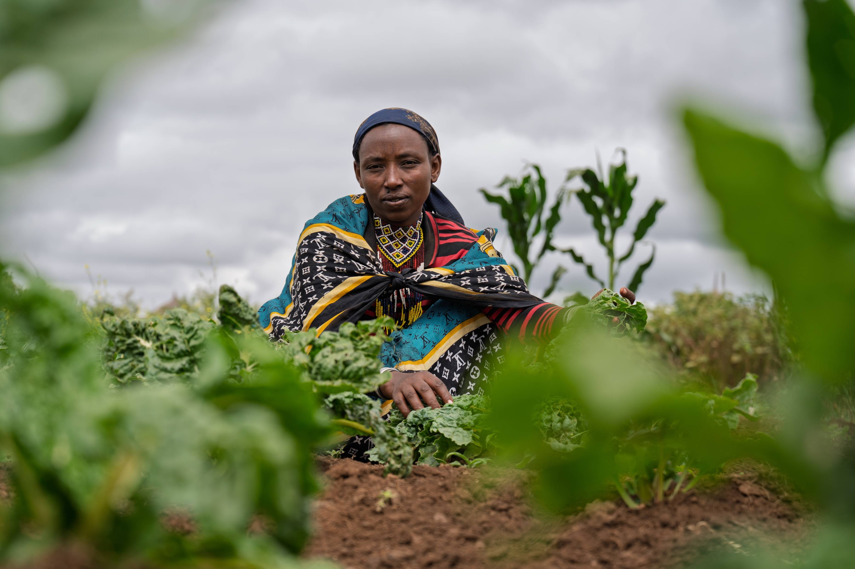
ETHIOPIA
Notes:
[Script]:One of the biggest problems for farmers is the unpredictable weather. There can be many months with little or no rain, then downpours can cause severe flooding.

Slide 9
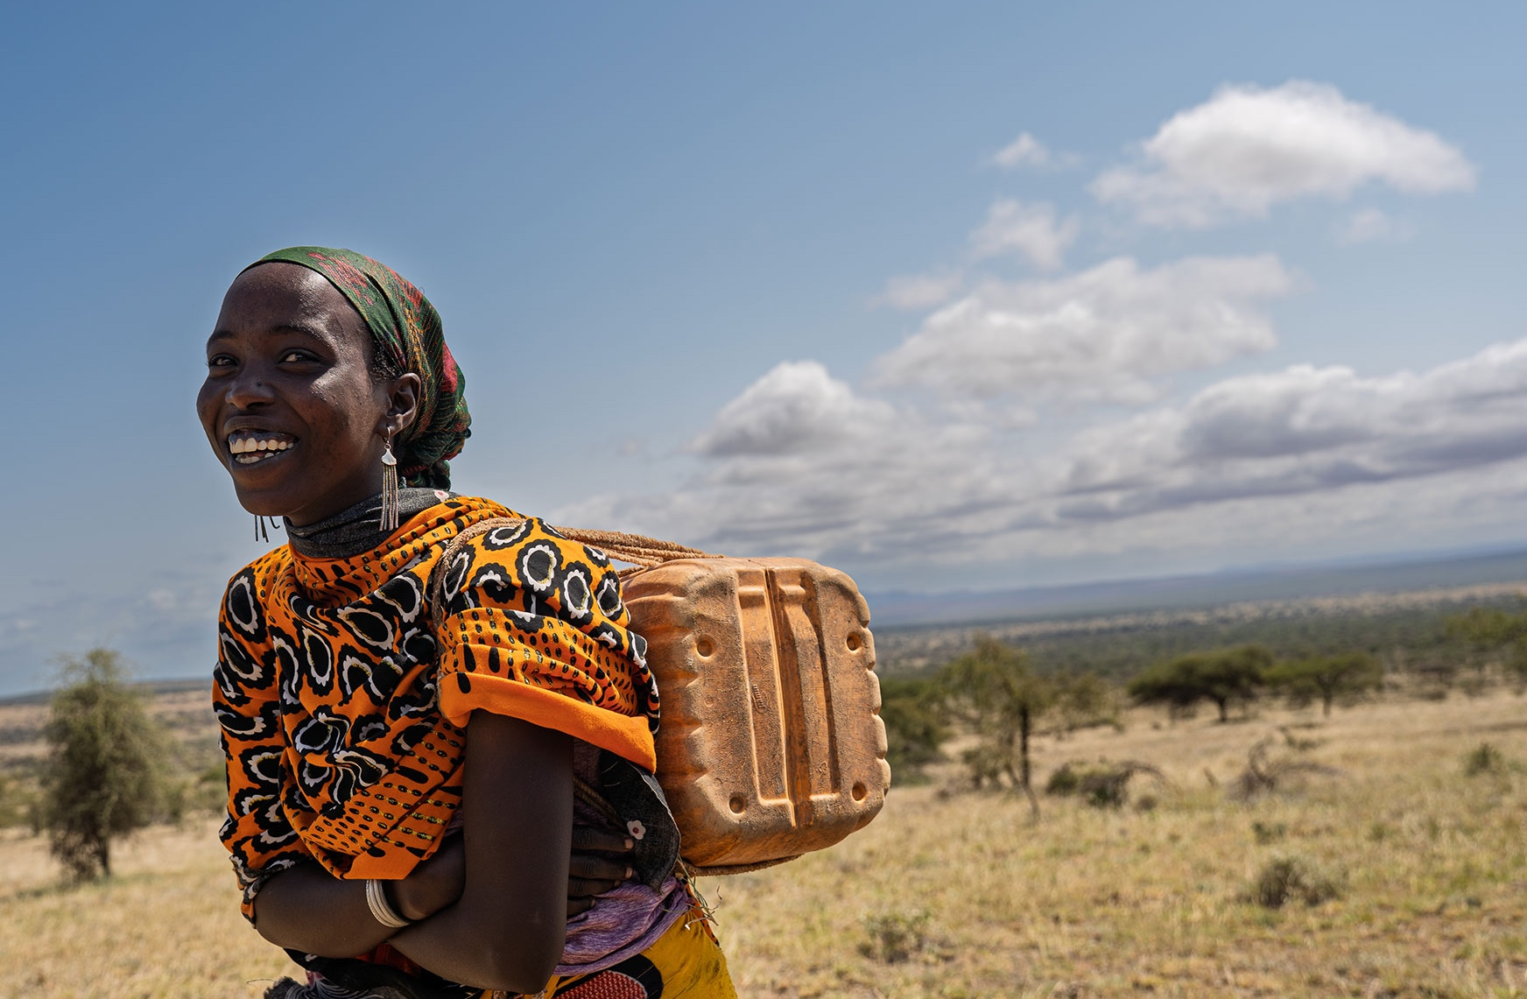
ETHIOPIA
WATER IS LIFE
YET, FOR MANY,
CLEAN WATER
IS HARD TO REACH
Notes:
[Script]: In Scotland, we are incredibly lucky to be able to turn on the tap and have fresh drinking water every day. However, in some countries, like Ethiopia, some people have to walk for up to 4 hours to reach clean water. In Ethiopia usually woman and children walk for water while the men try to make money for the family. The long walk can be very dangerous for women and children and for many, because the walk is so long it means that they cannot go to school.
Clean water isn't only important for drinking, it's also important to stay clean and healthy too.

Slide 10
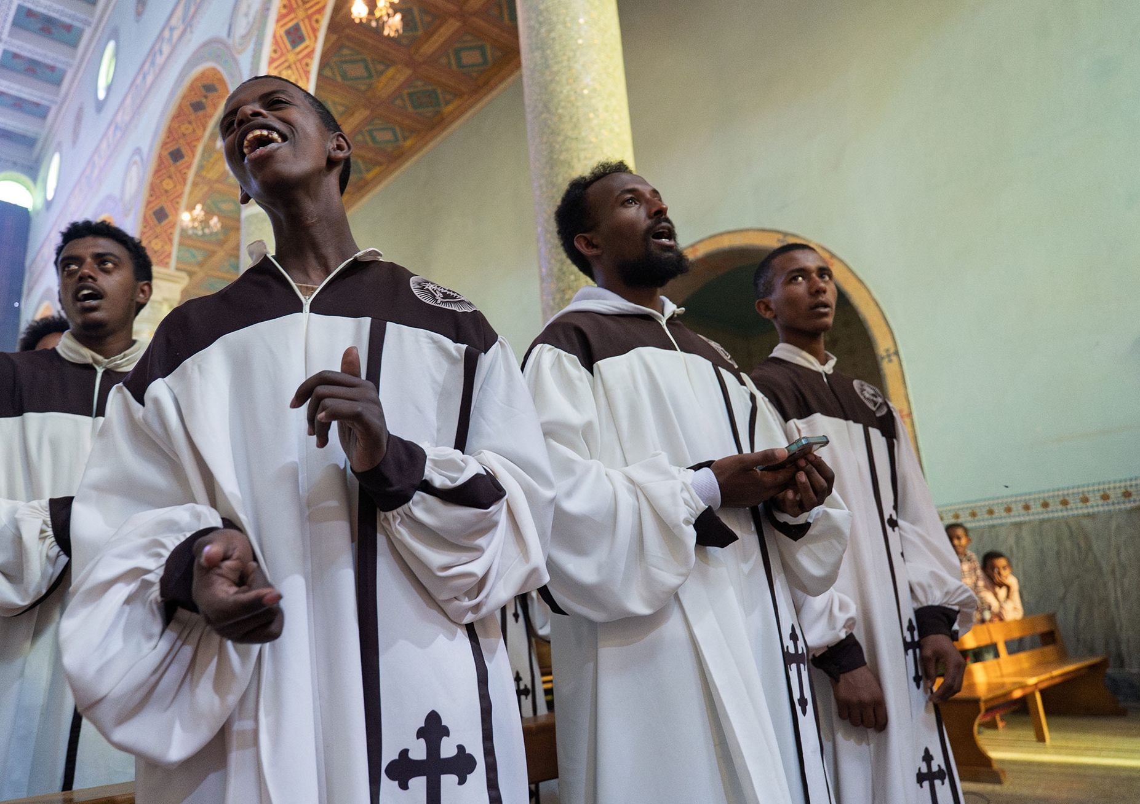

ETHIOPIA
“Without water it is not possible to live.” Pope Leo XIV
Notes:
This seems like a very obvious statement to make but it highlights how vital water is and that without it, life is impossible

Slide 11
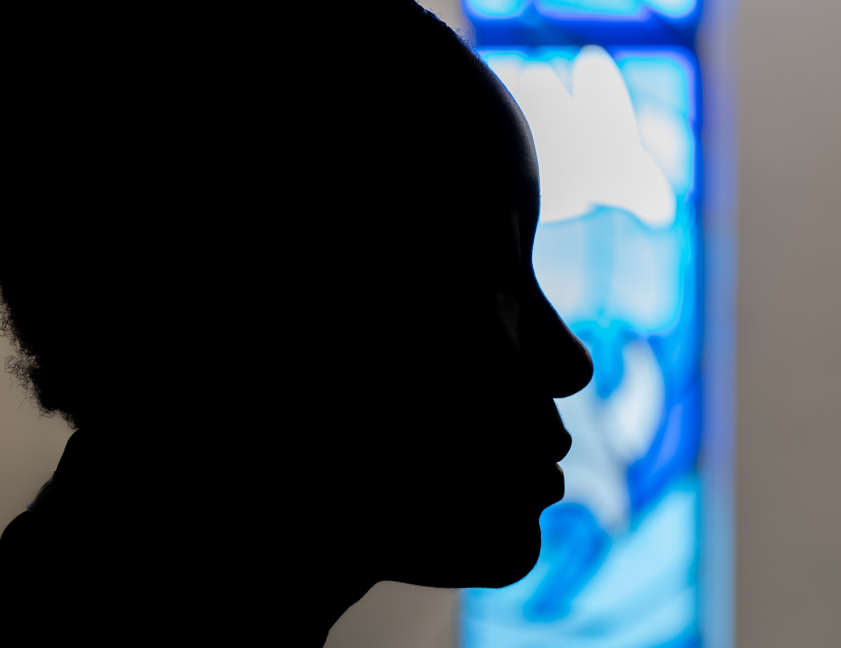
WEE BOX 2026
LENT Prayer, Fasting, Almsgiving
Notes:
Script: It is a very important time in the Church just now- Lent. During Lent the Church asks us to do 3 things in particular to prepare for Easter. Prayer, fasting and almsgiving.
Q: Can anyone tell me how long Lent lasts for? [40 days]
Prayer is simple, it can be prayers you know like Hail Mary, Our Father or it can be simply talking to God, telling him about your day, asking him for guidance or help with friends, with your behaviour or with your feelings!
Fasting, usually one for the grown ups but we can do a little bit of fasting ourselves. Fasting isn't going on a diet it's about making a little sacrifice to God. Whether that's saying no to chocolate or sweeties during Lent or helping your grown ups at home with the chores that you don't enjoy doing, or maybe not playing a game but saying a prayer instead- just showing God you are thinking about him!
Almsgiving- that's a bit of a tougher word- but almsgiving is simply reaching out to someone to show love. We know that God has asked us to love one another as I have loved you. So we want to put our faith into action during Lent! That can be sharing your favourite toy, or giving a little pocket money to charity. That's where SCIAF comes in...

Slide 12
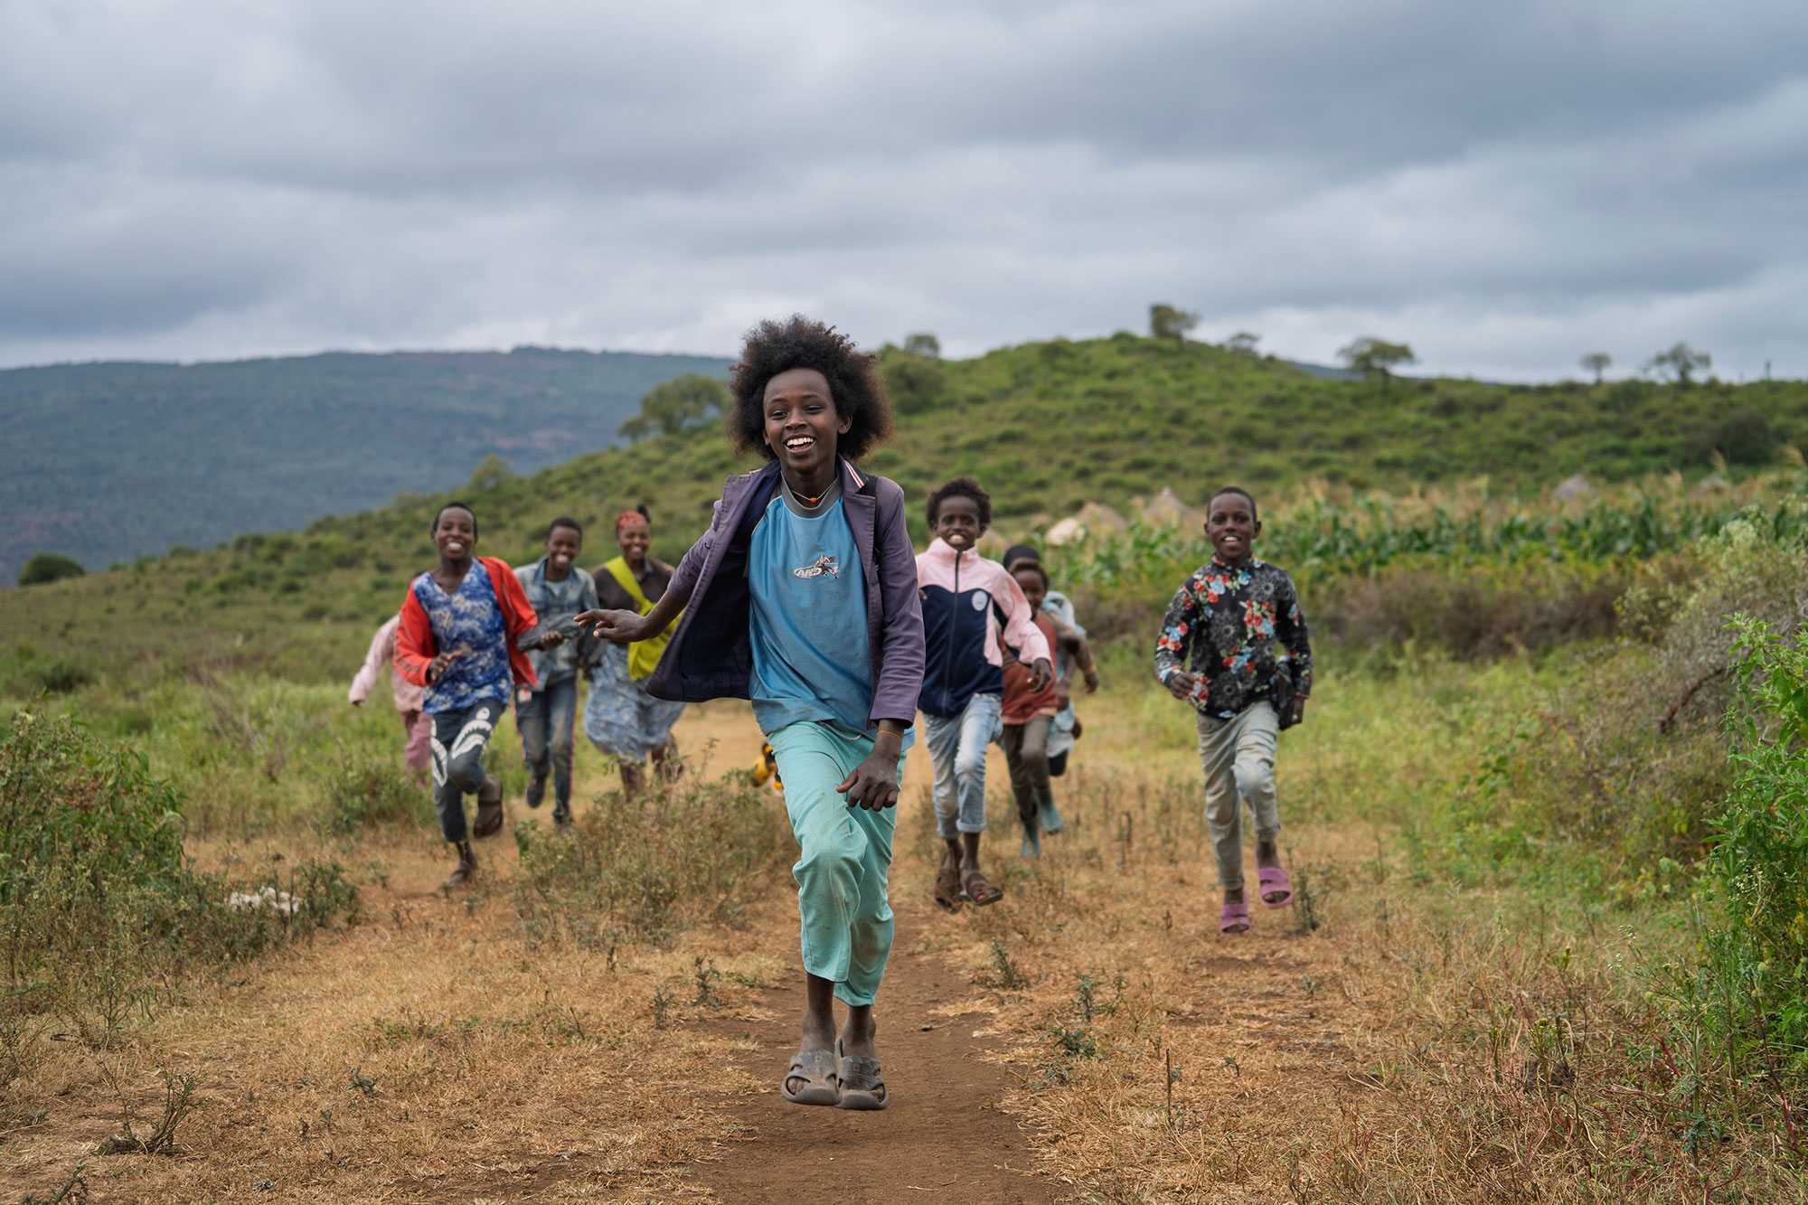
LET JUSTICE FLOW.
SHARE WATER. SHARE HOPE.
Notes:
[Script]:SCIAF’s local partners in Ethiopia, and around the world, are bringing water to the women, girls, and communities who need it most. Together, we dig wells near homes, repair pumps, and ensure that water keeps flowing, whatever the weather.
This is Jeldesa and his friends, playing in Ethiopia.
(play day in the life video if time permits)

Slide 13
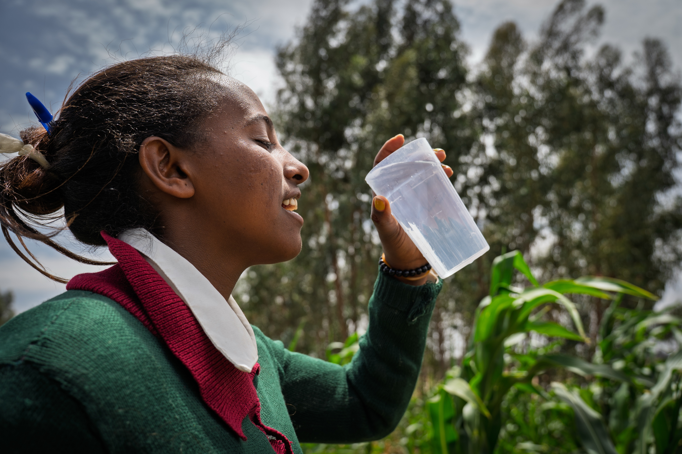
CLEAN WATER CHALLENGE
Notes:
Notes: this 3 question quiz will let children guess with a show of hands which water is clean and safe and what water is unsafe. The idea is that it isn't always easy to tell what water is clean and what water is dirty and explaining that at SCIAF we make sure that people don't have to make that risky decision.

Slide 14
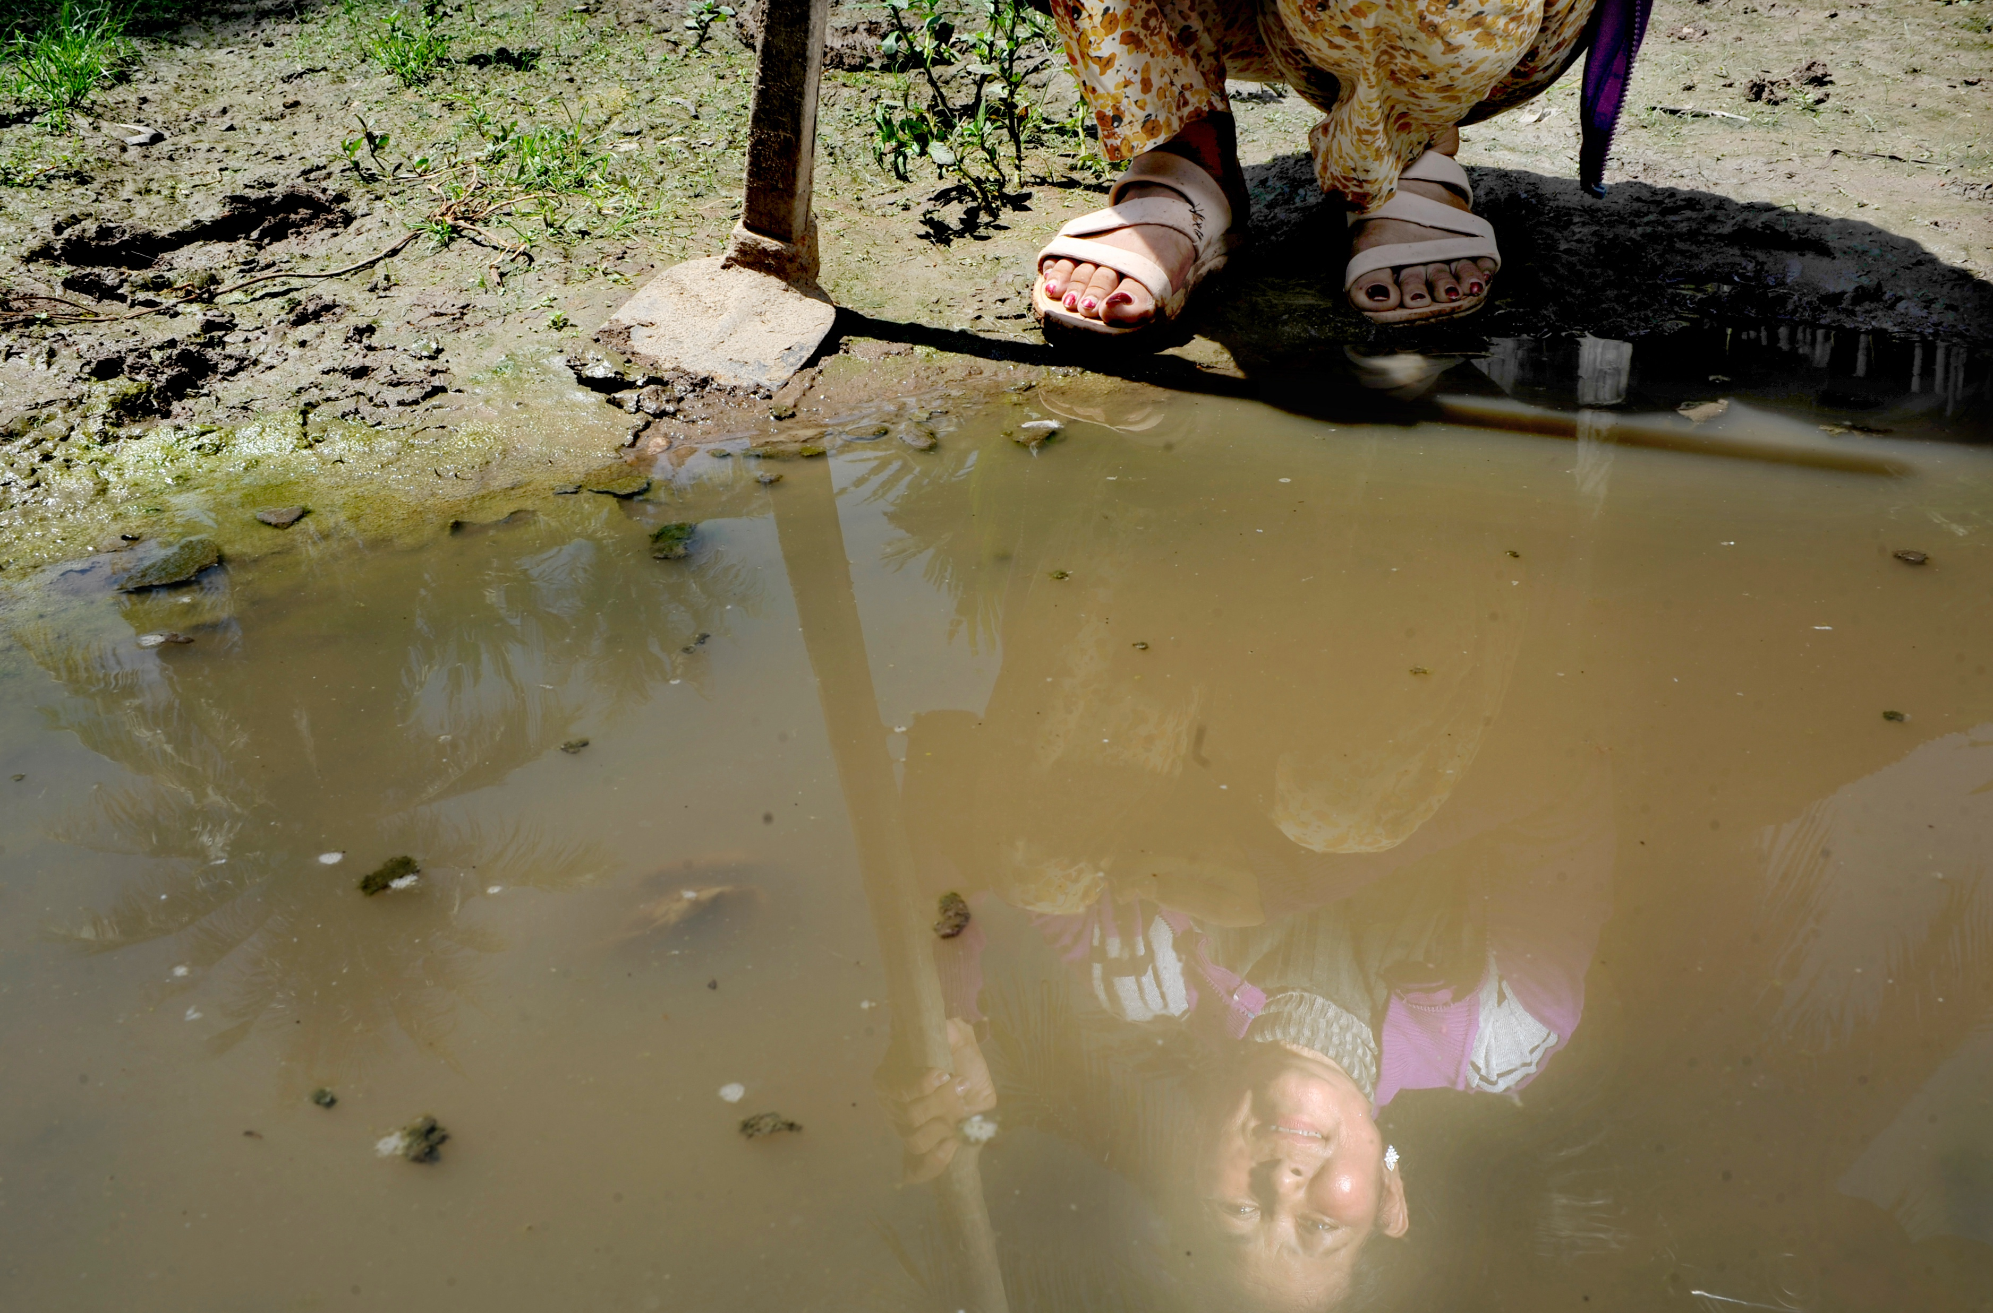
QUESTION 1:
HANDS UP if you think the Water in the picture is clean water!
Notes:
No, this water wouldn't be safe to drink! It is still, stagnant and animal waste collects and it is not nice water!

Slide 15
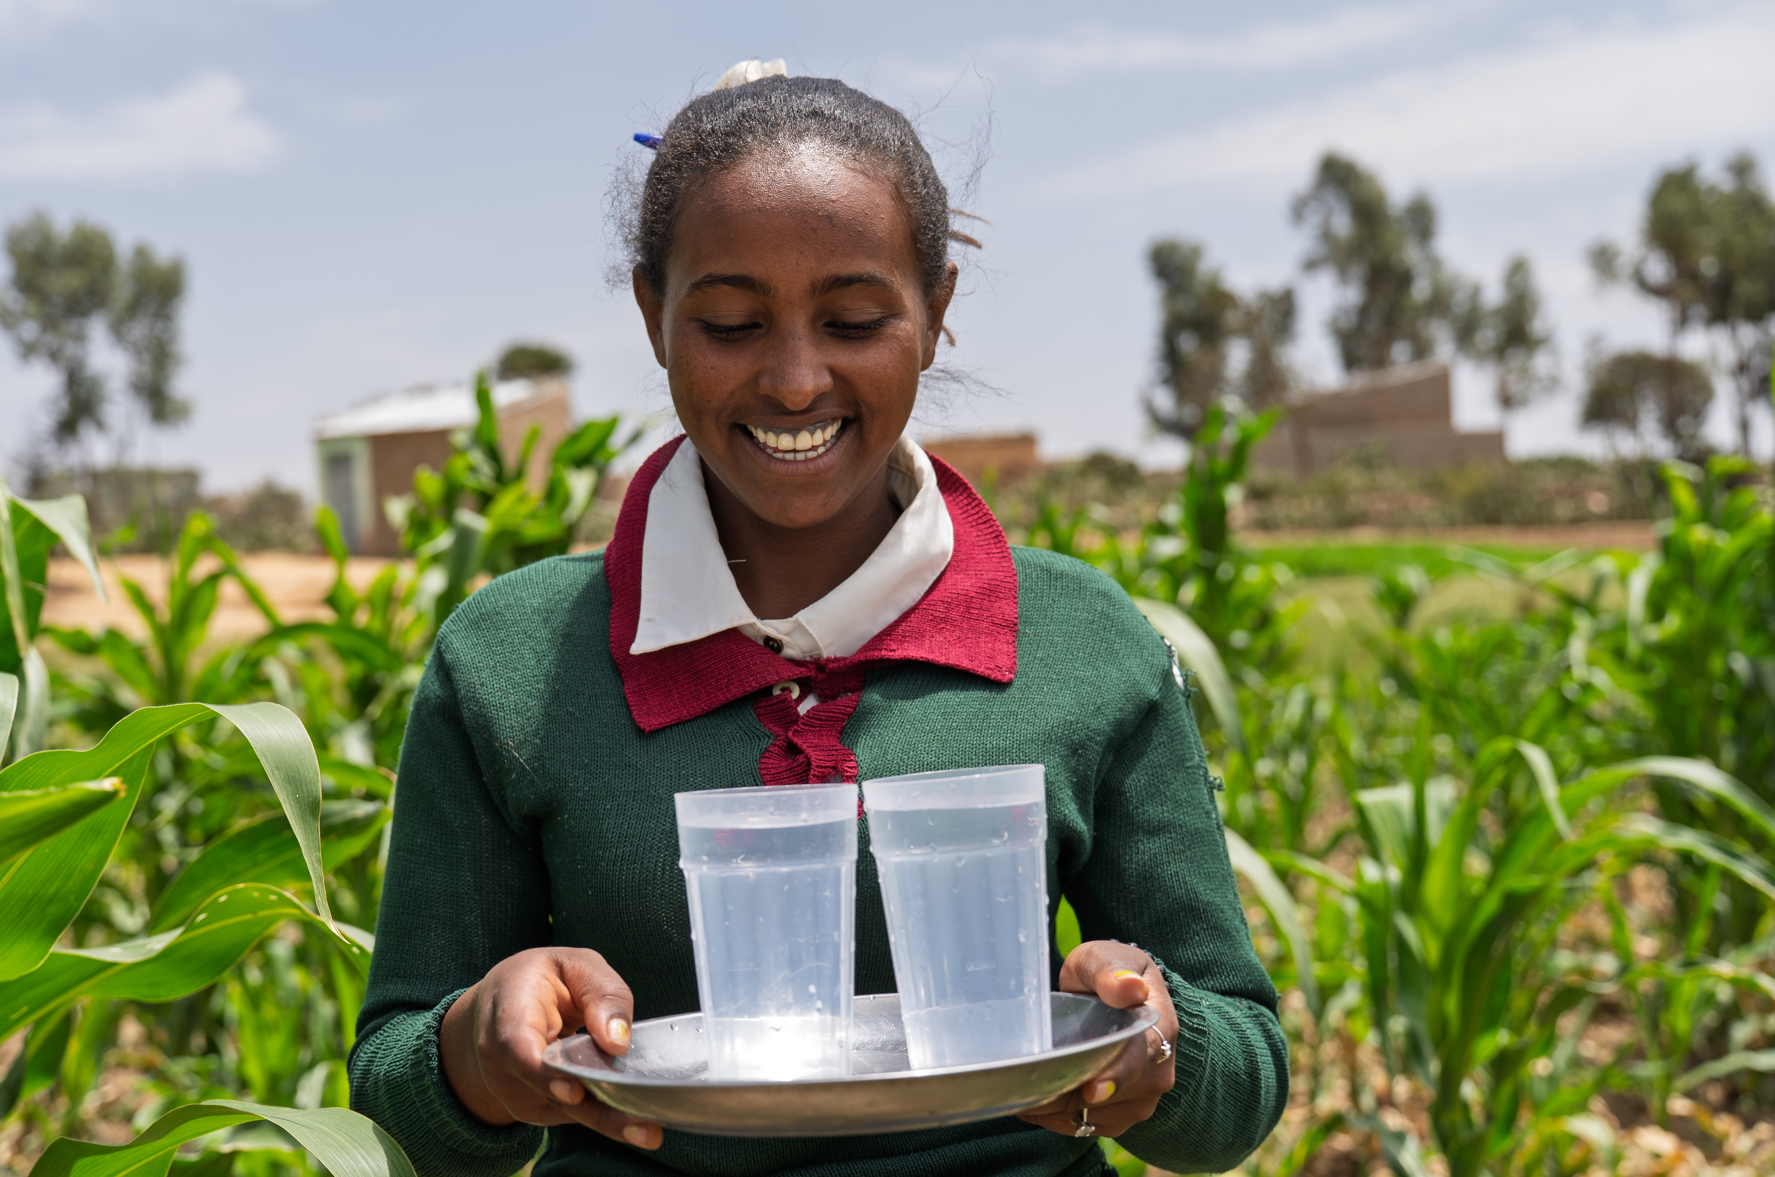
QUESTION 2:
HANDS UP if you think the Water in the picture
is clean water!
Notes:
Yes this Water IS safe to drink, it was collected by Hirit here from a water pump that SCIAF and it's parters installed in her village.

Slide 16
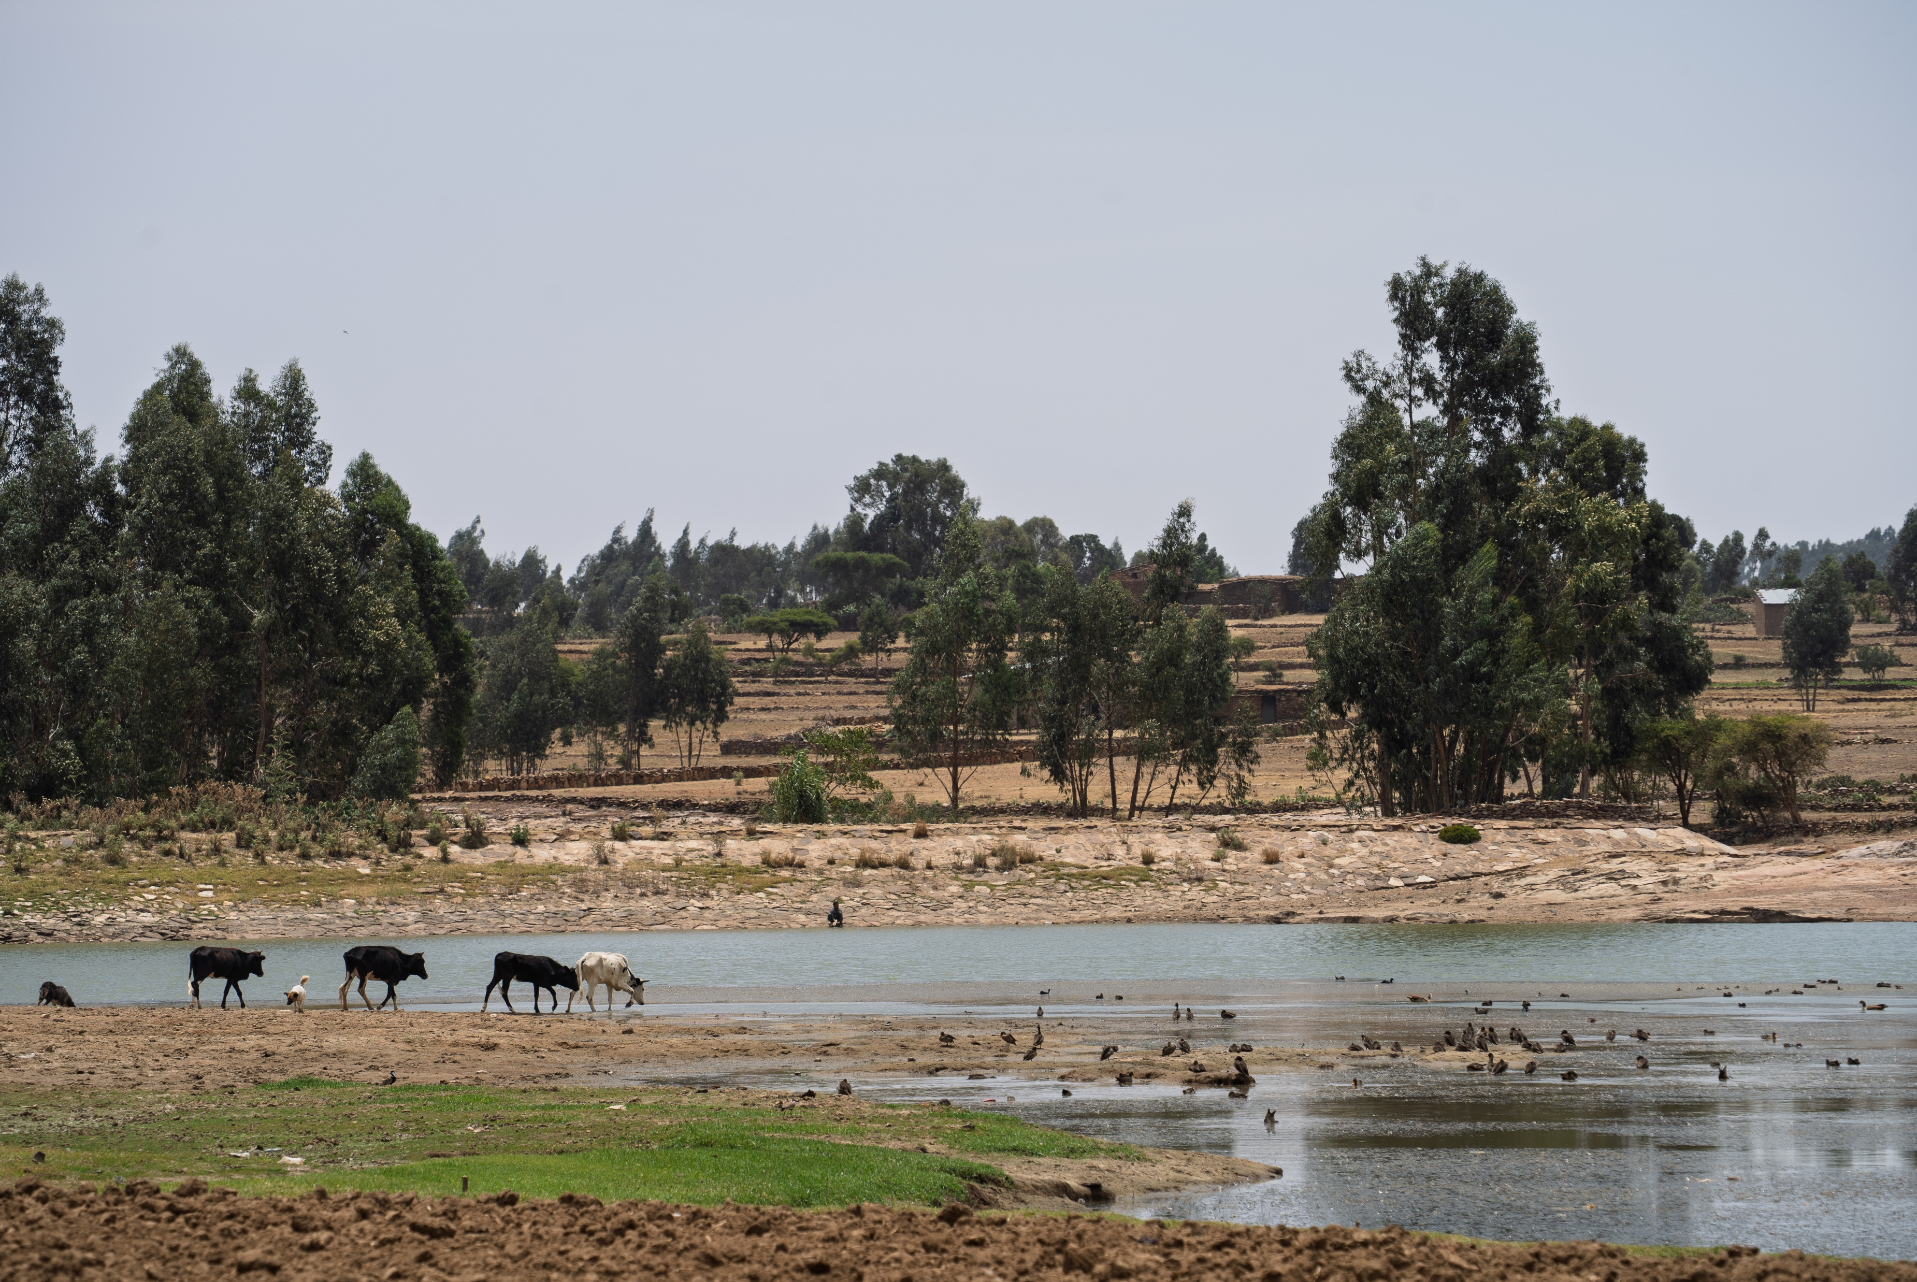
QUESTION 3:
HANDS UP if you think the Water in the picture
is clean water!
Notes:
No this water wouldn’t be safe to drink because there are animals around it which would be drinking it or maybe doing the toilet around it which would make the water very unsafe!

Slide 17
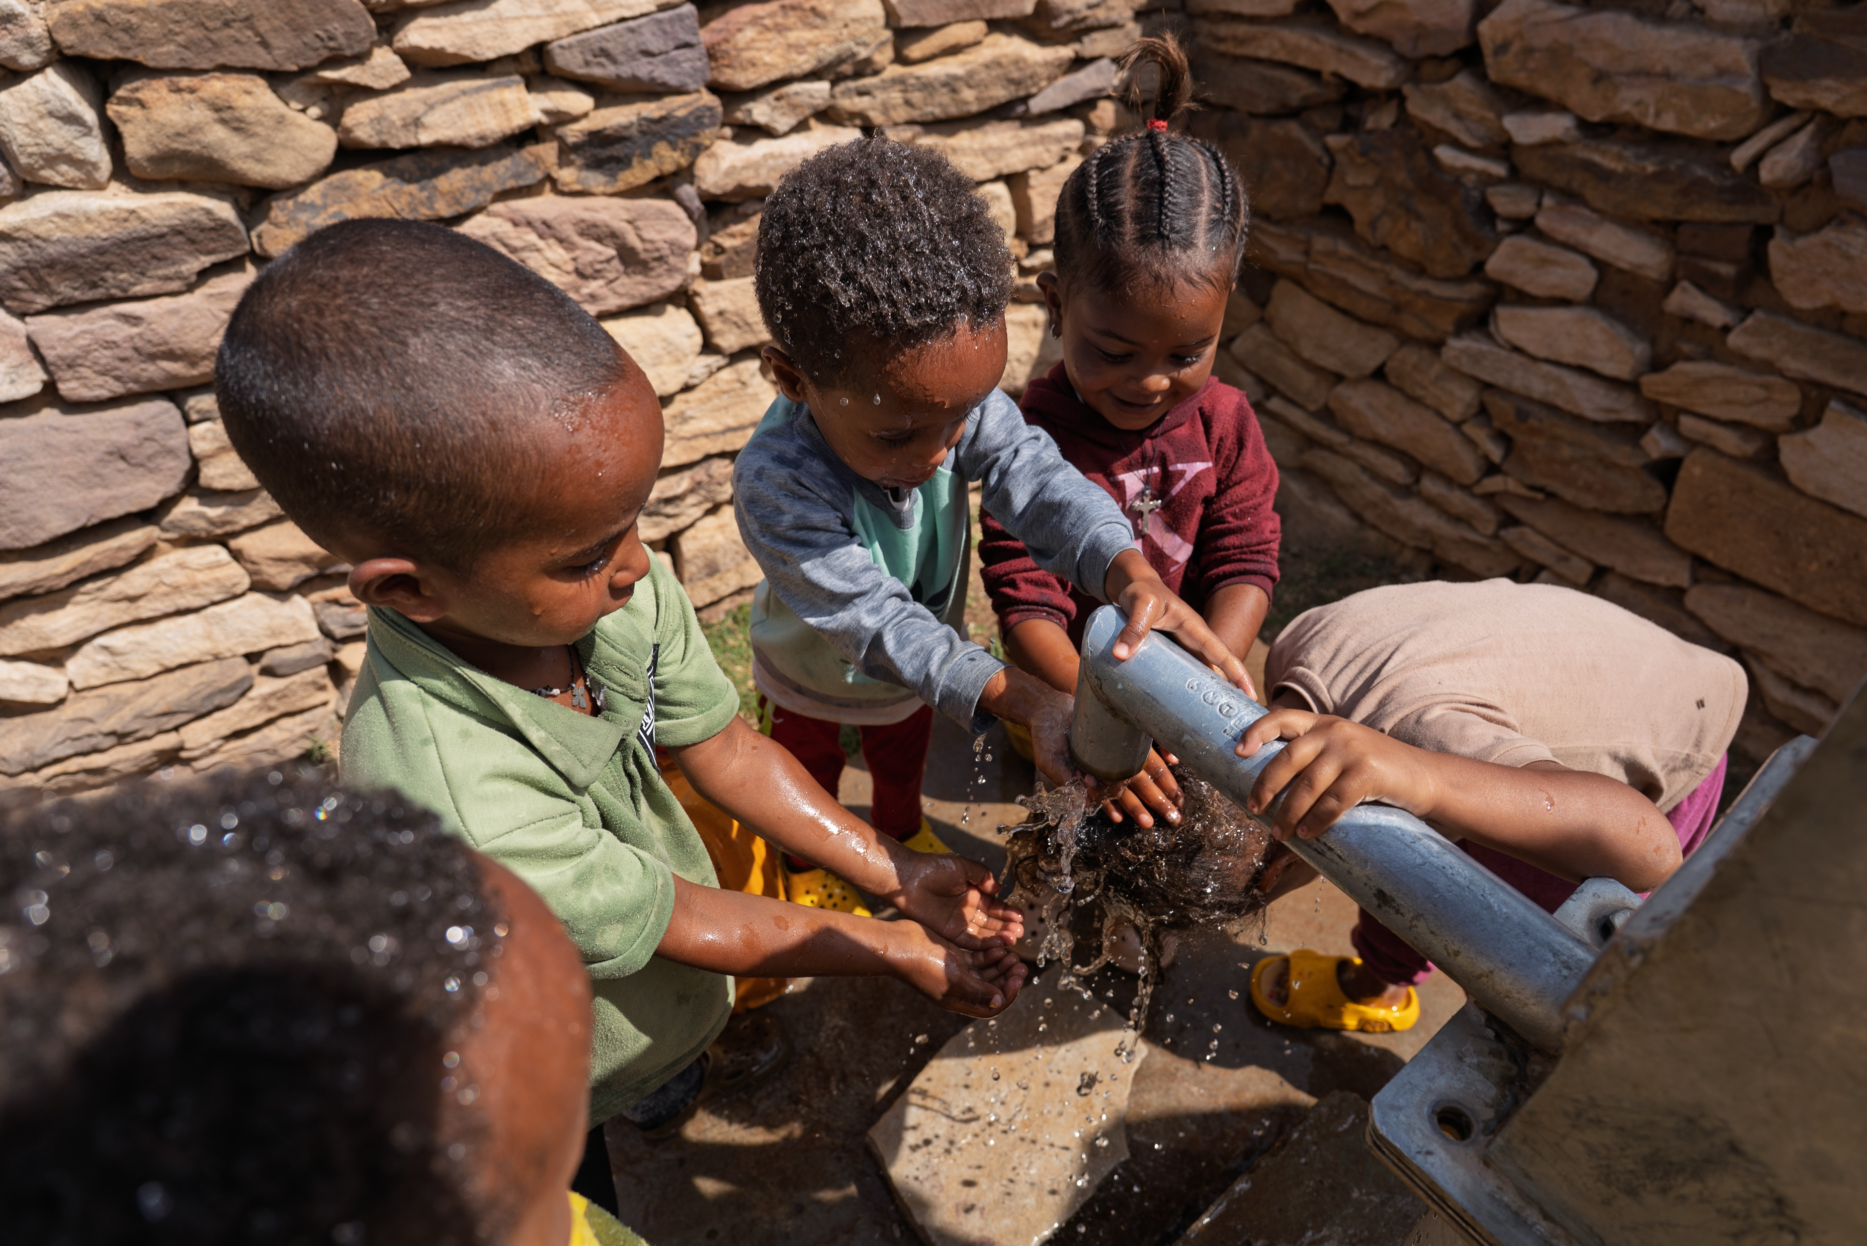
CLEAN SAFE WATER
SCIAF makes sure that people don't have to guess whether or not their water is safe!
Notes:
Guessing whether water is safe can be very difficult, that's why SCIAF makes sure that nobody has to guess whether or not the water they are drinking is safe. We provide water pumps to ensure clean safe water which is available close to home. Water filters to test that the water people are drinking is safe are often provided too.

Slide 18
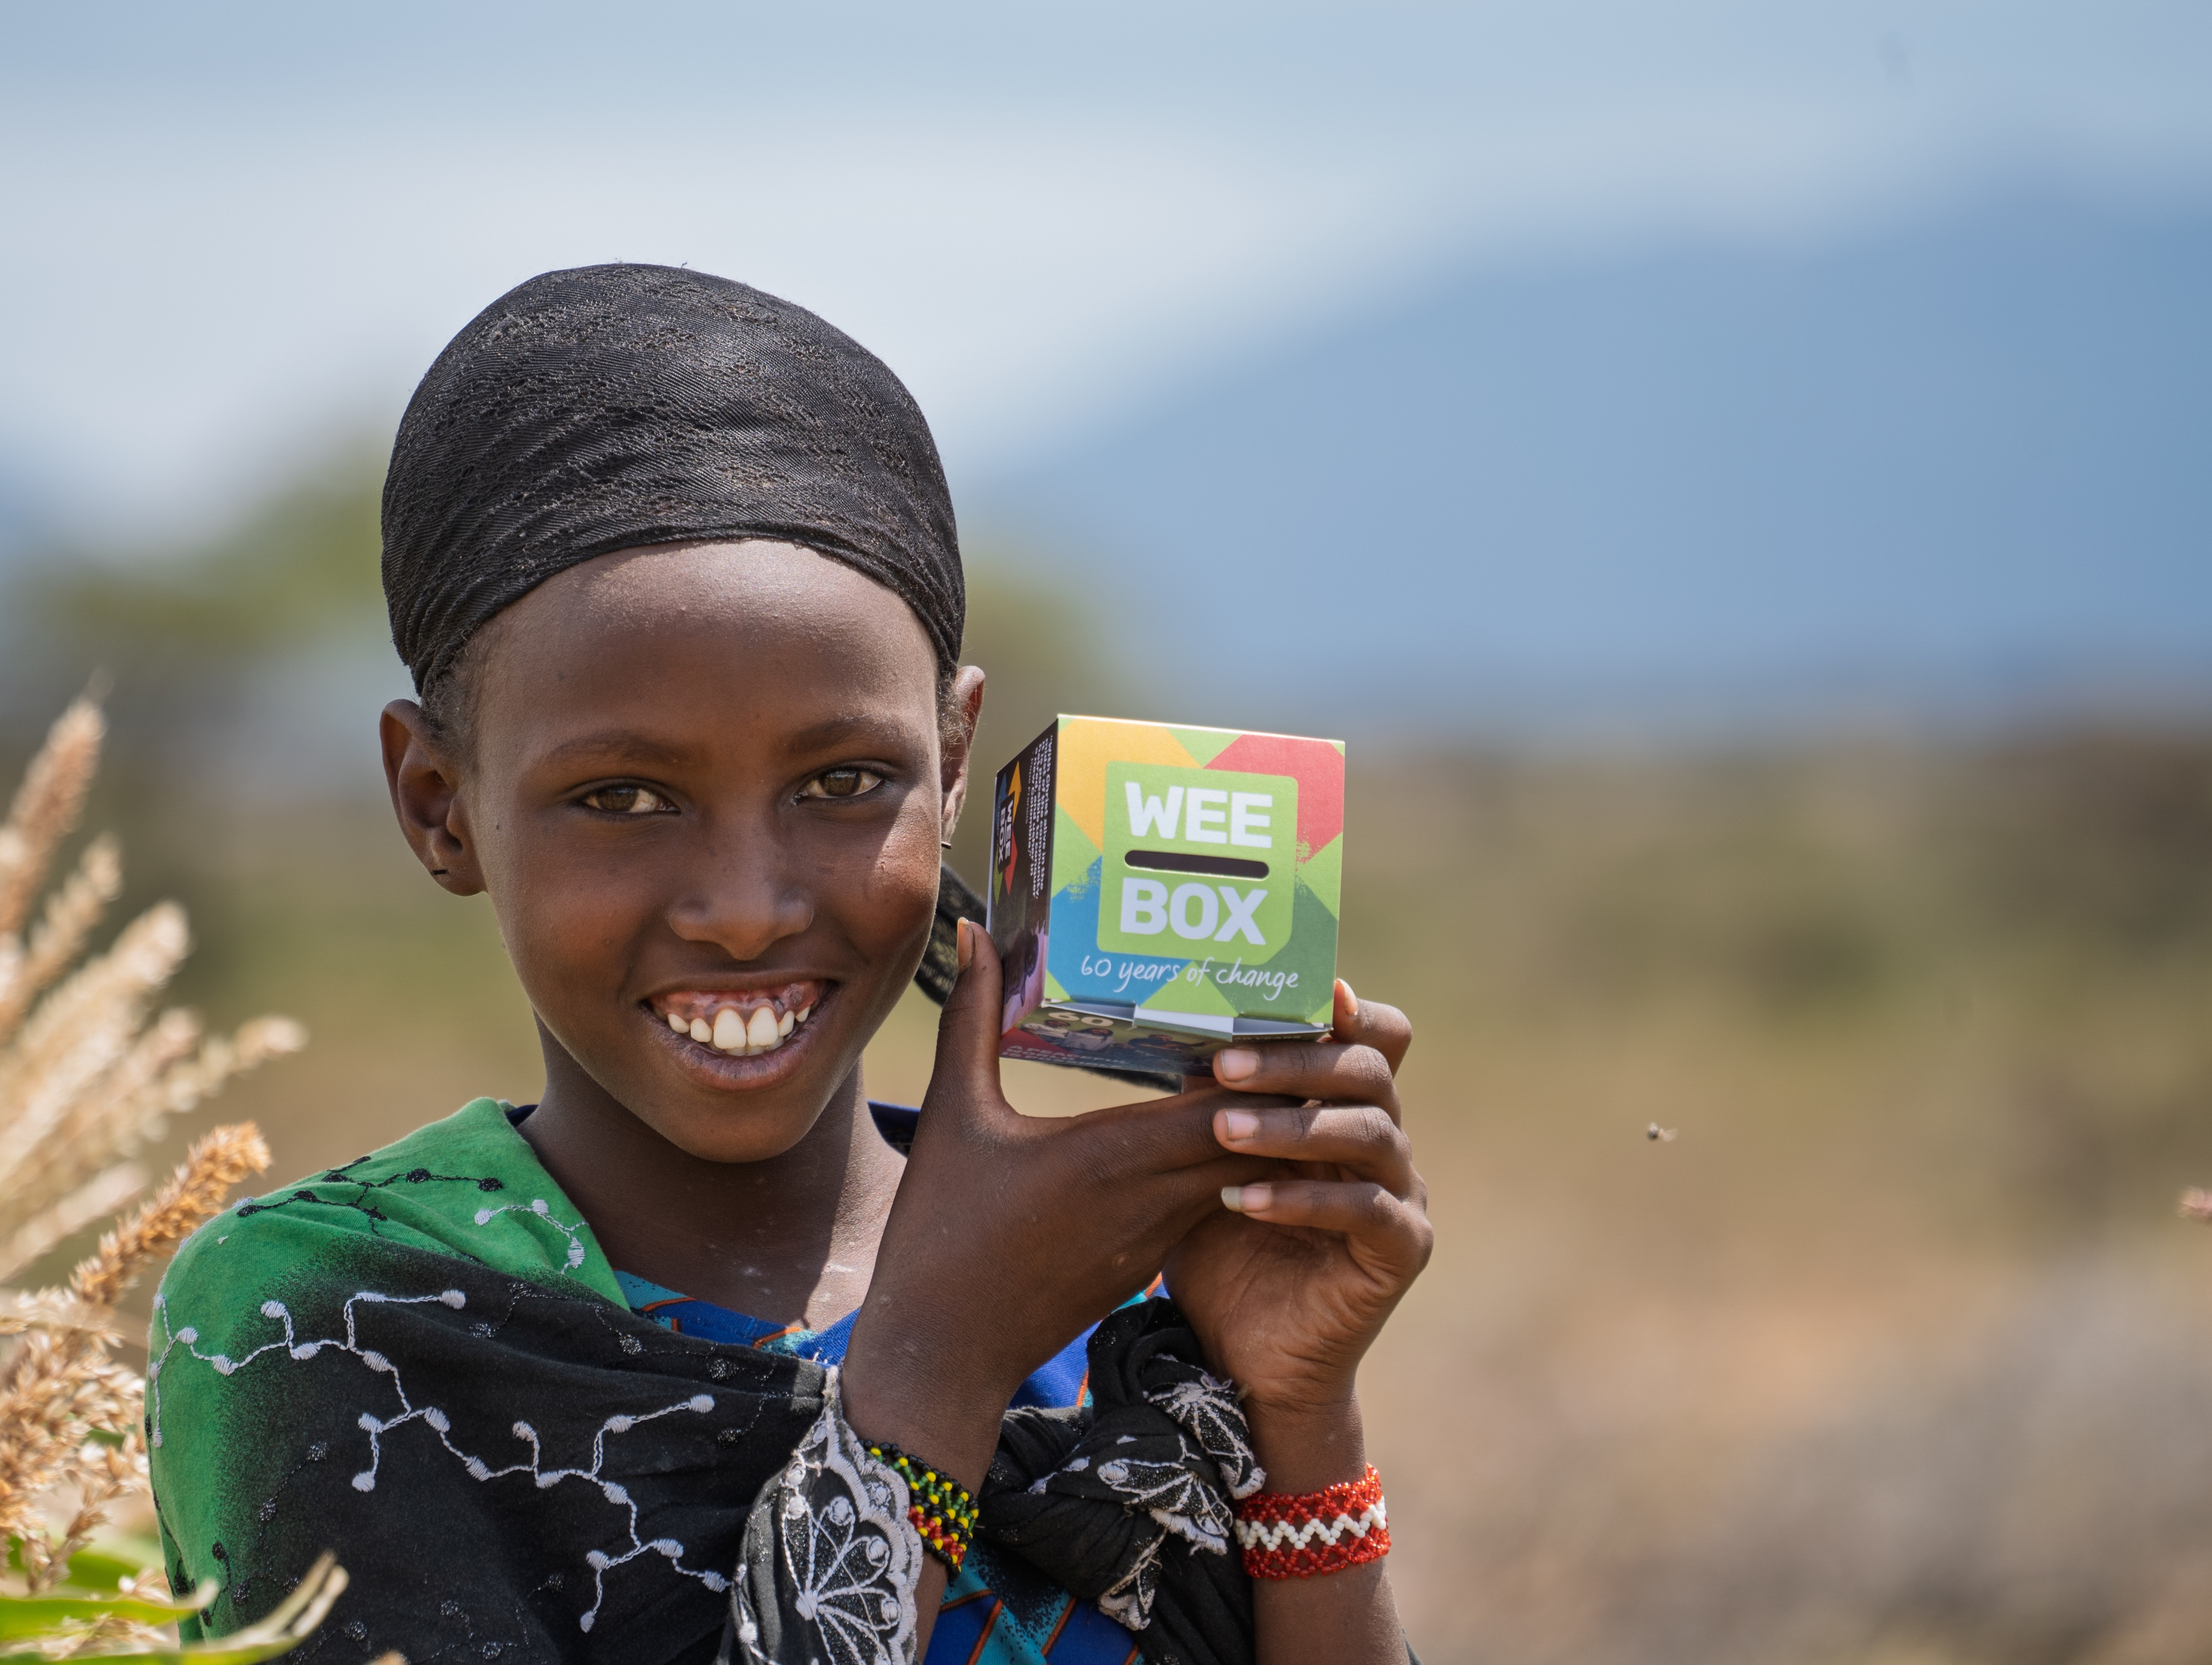
WEE BOX 2026
THIS LENT,
USE YOUR
WEE BOX
TO MAKE A
BIG CHANGE
Notes:
You can use your WEE BOX to make a BIG CHANGE this Lent, for people in Ethiopia and all around the world!
(Hold up a pound coin)
Do you think this is a lot of money?
What could you buy with it?
Do you think this could help someone in Ethiopia? Do you think it's enough?
No? Ok well what if everyone in your class gave £1 or if everyone in the school gave £1
Every year the people of Scotland come together and use their WEE BOX to be part of something bigger. Sometimes it can feel like what you donate alone can't do much so that's why it's important that we do our bit to contribute to the bigger picture! One piece of a jigsaw doesn't look like much on it's own but when lots of pieces come together it can create an amazing picture. The Bible describes the church like a body. Lots of parts but one body. Who remembers how many people we help every year? [over 1 million] We cant do that without the help of our SCIAF community here in Scotland and that community, the catholic community includes all of you!

Slide 19

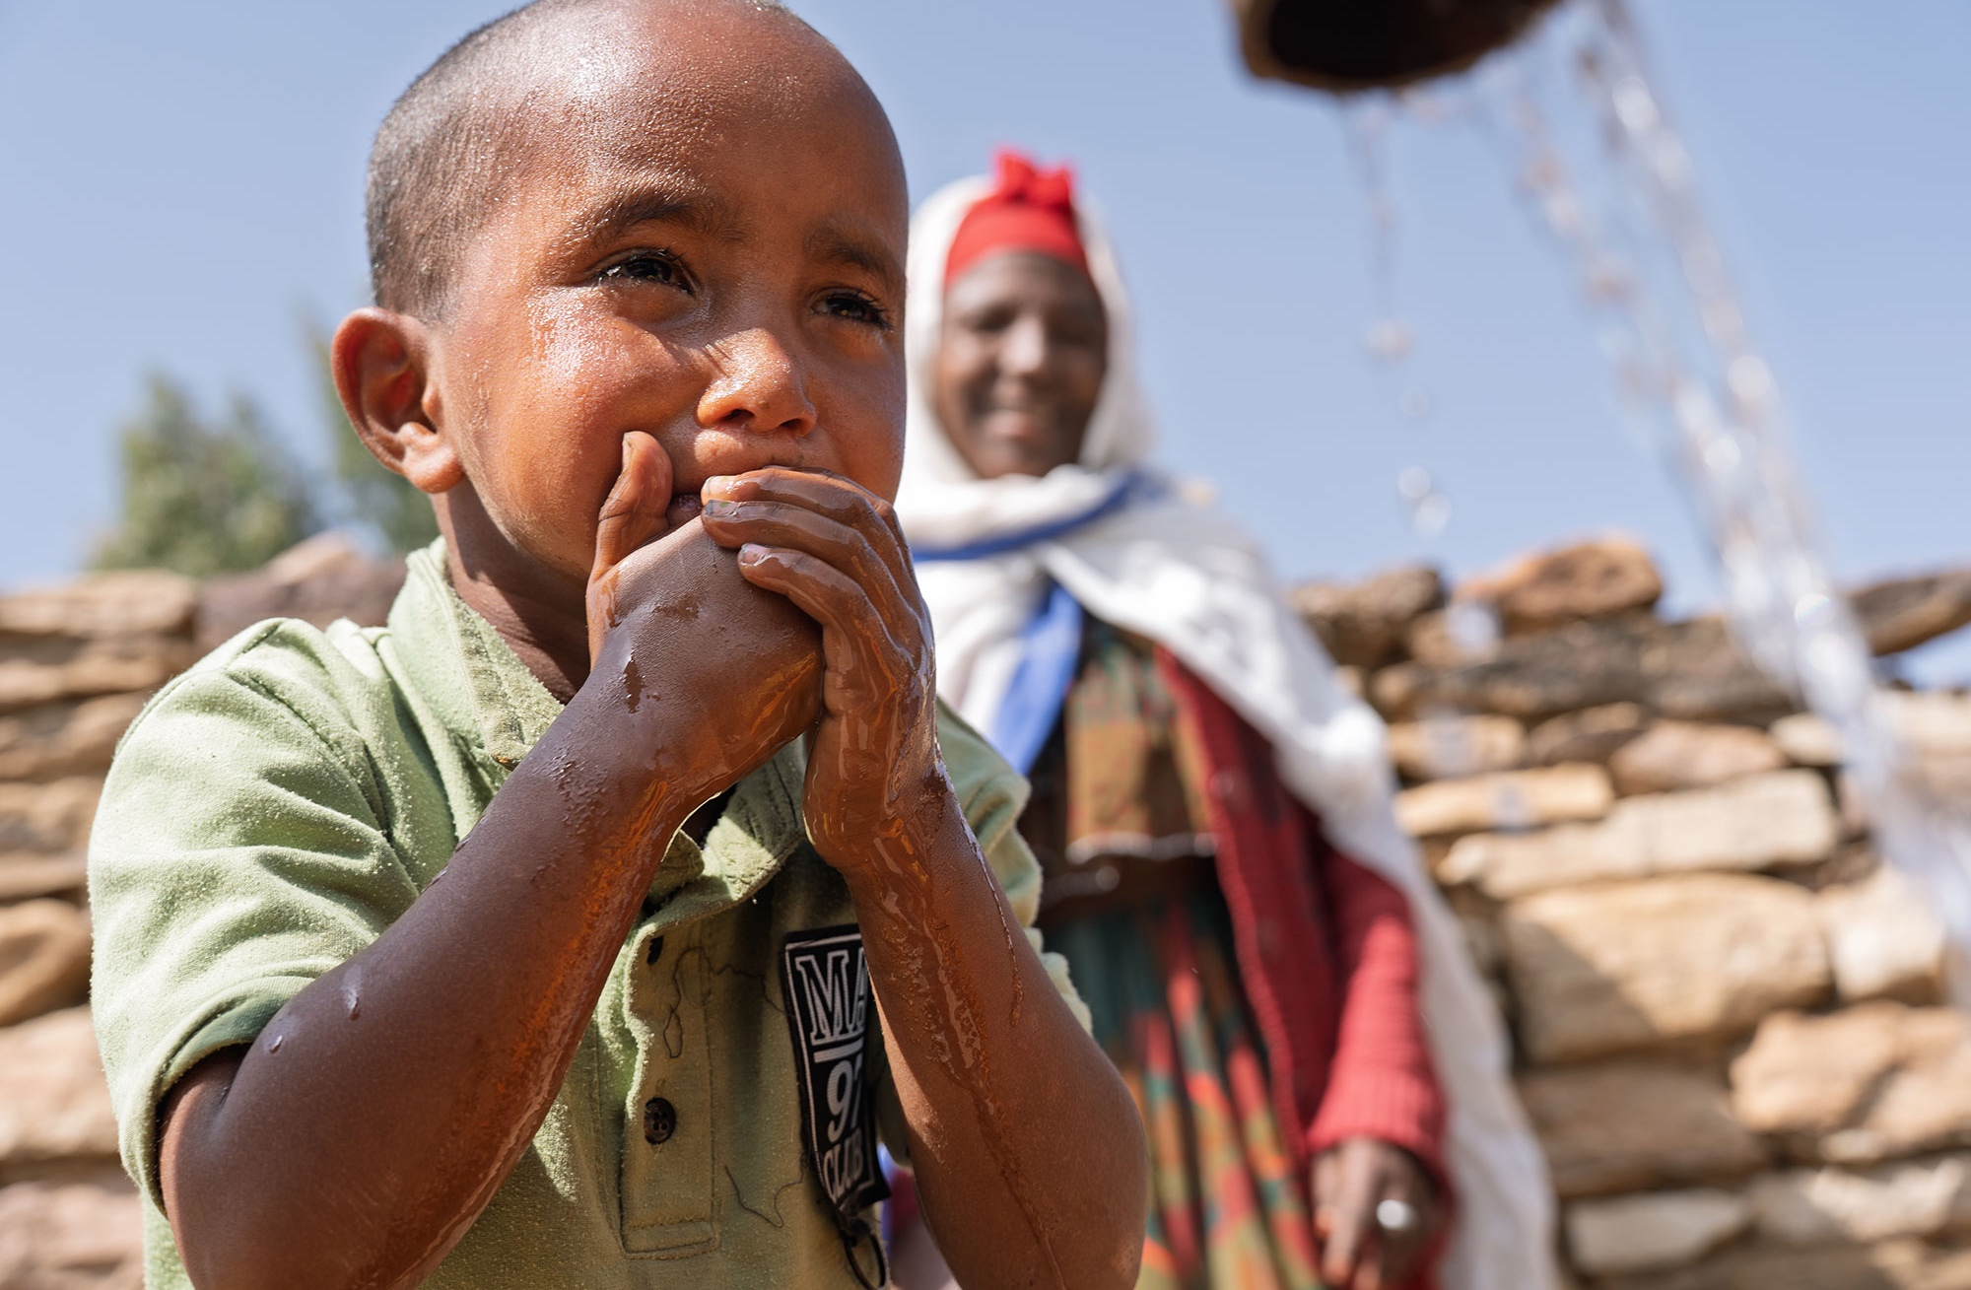
ETHIOPIA
£40 gives people access to clean water for drinking, sanitation and improved hygiene
£240 can install a rainwater harvester at home, helping families collect safe, clean water
£1,200 brings water to a village through taps, wells and irrigation systems

Slide 20

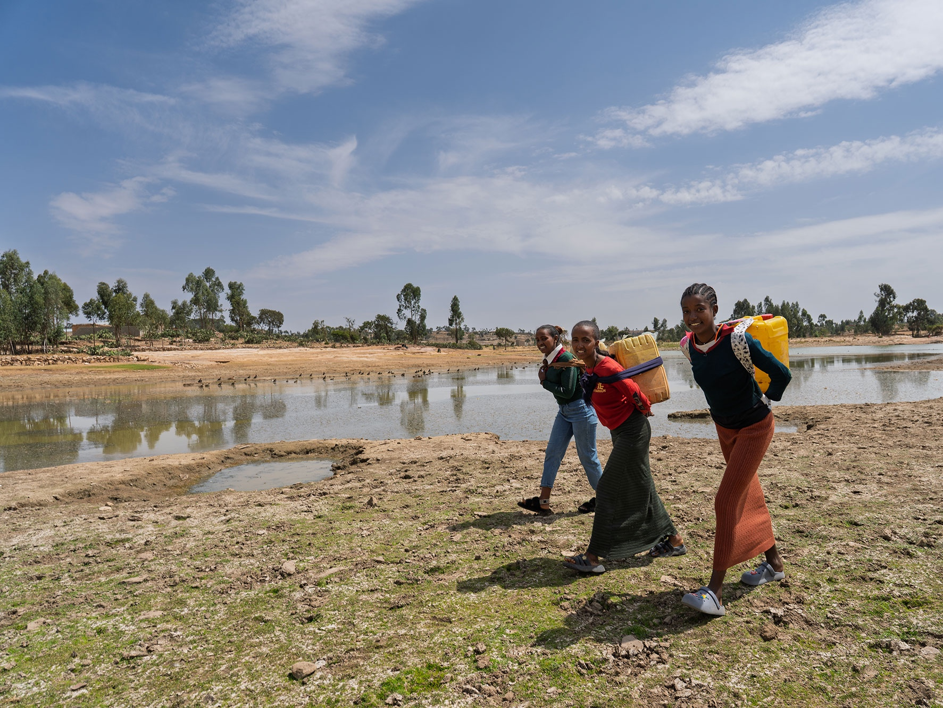
This Lent, Walk for Water in return for donations to our WEE BOX Appeal. Walk our virtual route along the Blue Nile river in Ethiopia as a class or a school and fundraise for SCIAF's work!
Walk in solidarity today
sciaf.org.uk/biglentwalk
Notes:
The Big Lent Walk is a really easy way to walk in solidarity with your sisters and brothers who are often walking hours and hours for water each day. Get yourself sponsored, and walk together as a school. You can find more information to support your walk online including nice little reflections. Your challenge is to walk the length of the Blue Nile that starts in Ethiopia and is the country's longest river.

Slide 21

WEE BOX BUILD CHALLENGE
Notes:
WEE BOX CHALLENGE:
Take about 3 WEE BOXES along to the school with you then ask for volunteers (ask the teachers to pick if nobody is eager)
Show them how to build a WEE BOX
Give them a practice run then use a timer on your phone to see who can make their WEE BOX the quickest! (best to do all together and see who is the fastest to save time, also if you don’t have a timer, just see who out of the group does it the quickest)
TOP TIP: make it exciting, get the rest of the pupils to cheer them on!

Slide 22
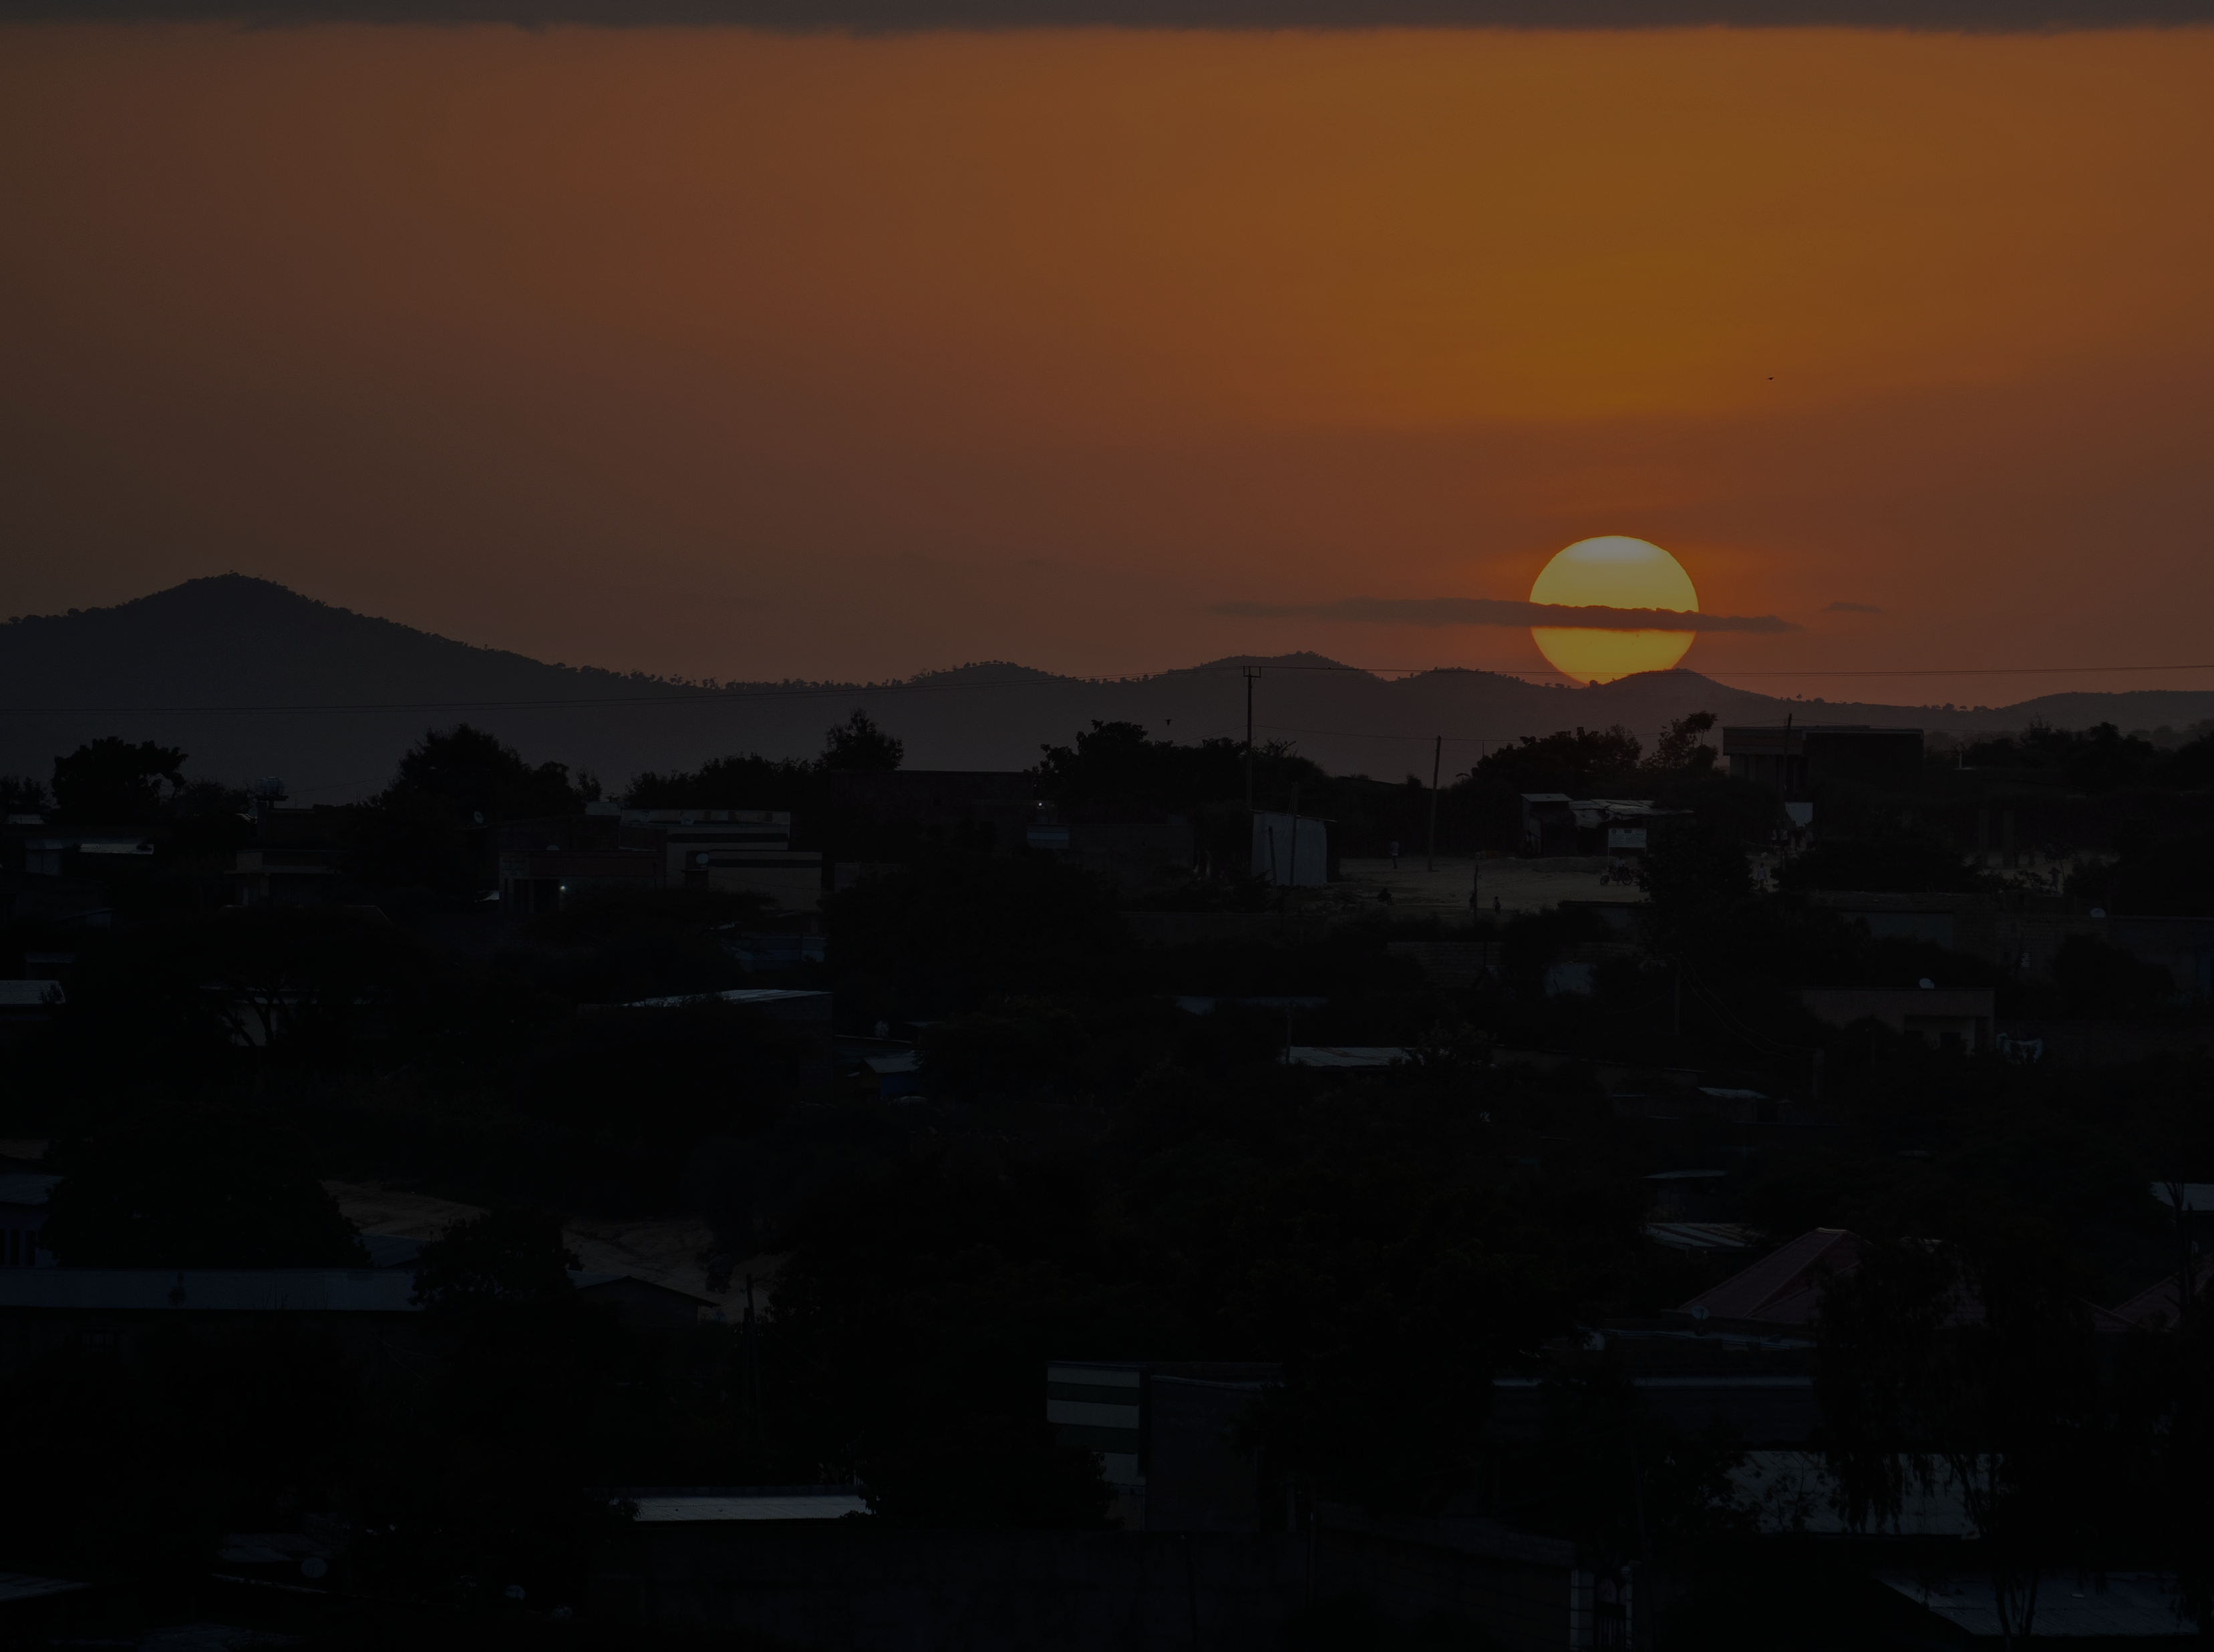
ETHIOPIA
WEE BOX Prayer
for 2026
LEADER: Sign of the Cross
LEADER: We thank You for the gift of water that gives us life
All repeat
LEADER: Bless the work of SCIAF and the people of Ethiopia
All repeat
LEADER: Help us share Your love, like water, with those in need
All repeat
LEADER: Teach us how we can better love our neighbour
All repeat
ALL TOGETHER: Amen.

Slide 23
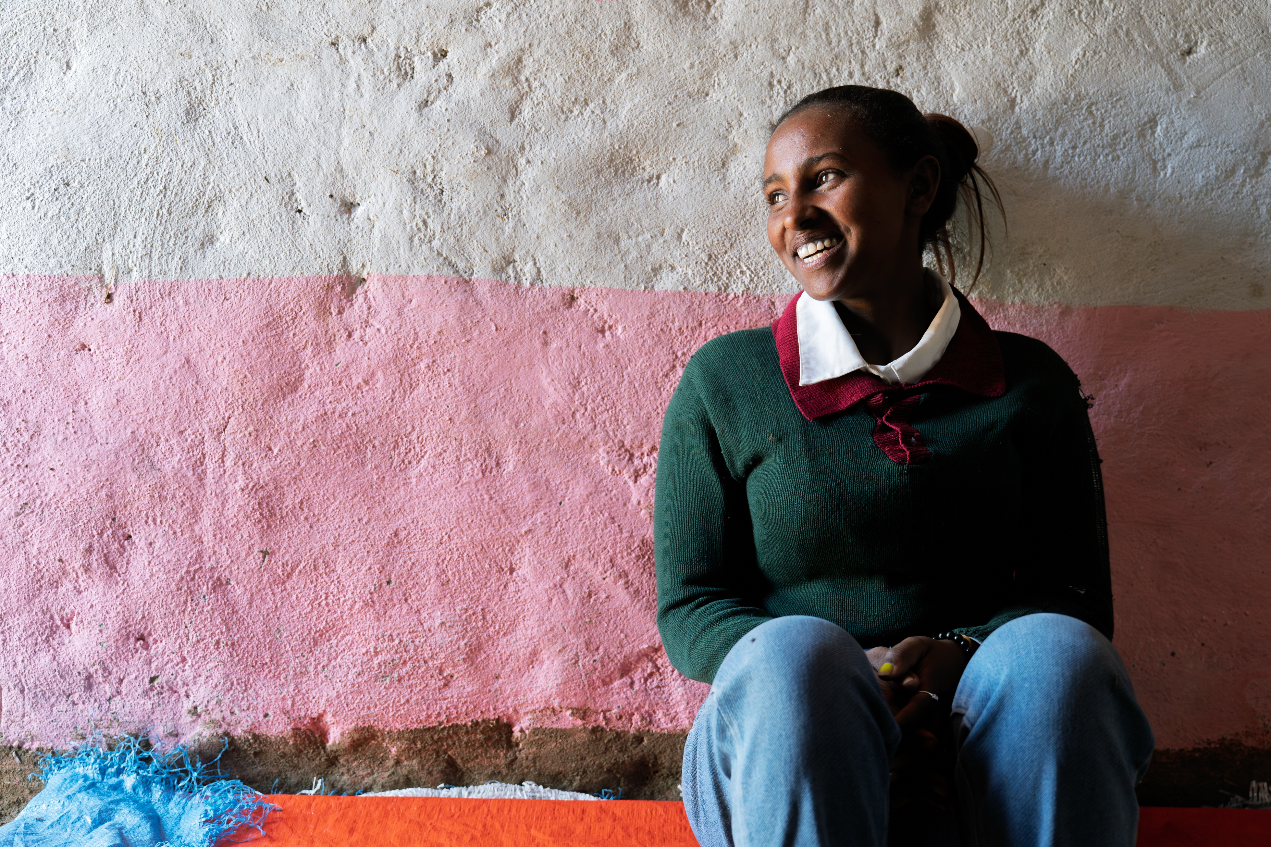
THANK YOU

Slide 24
A JUST WORLD, FREE OF POVERTY, WHERE WE FLOURISH AND LIVE
IN HARMONY WITH EACH OTHER AND ALL CREATION.
Scottish Catholic International Aid Fund
SCIAF is the official relief and development agency of the Catholic Church in Scotland
and a proud member of the Caritas family. 196 Clyde Street, Glasgow G1 4JY.
Tel: 0141 354 5555. Scottish Charity No: SC012302. Company No: SC197327.
sciaf@sciaf.org.uk

