Slide 1
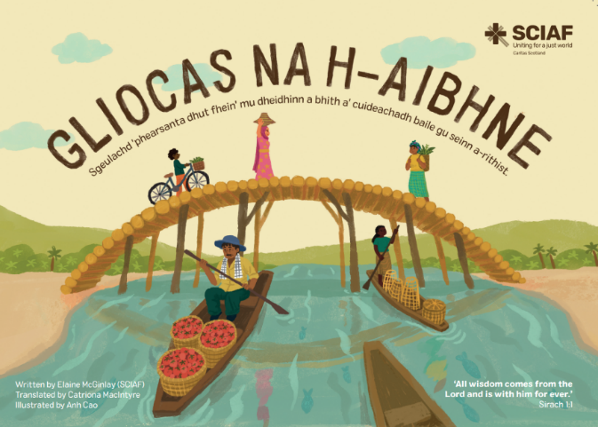

Slide 2
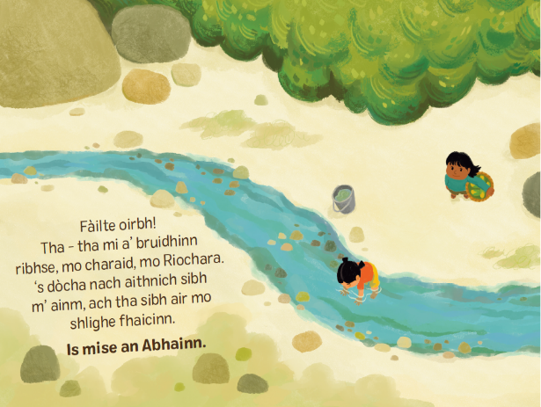
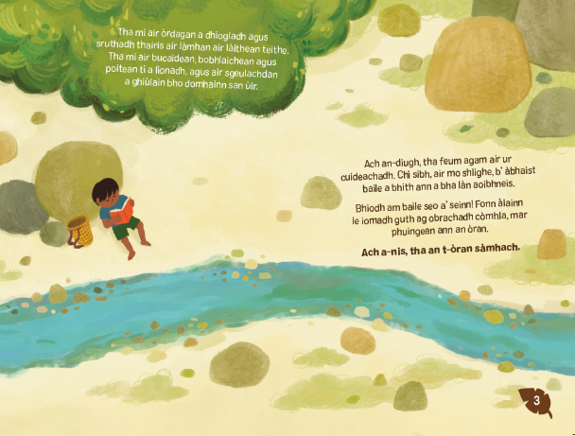

Slide 3
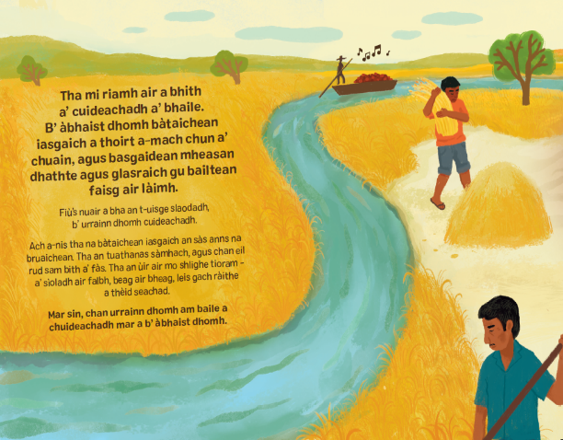
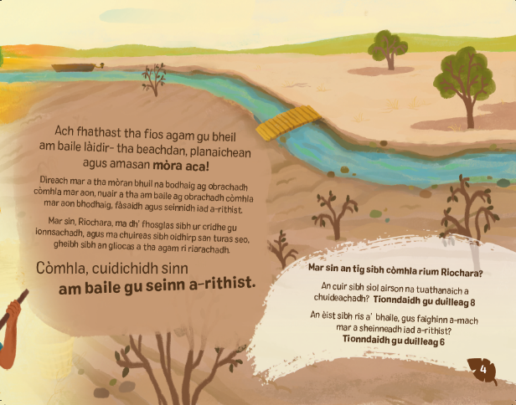

Slide 4
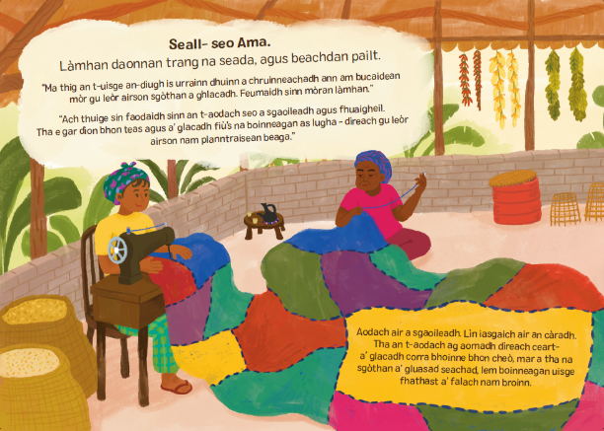
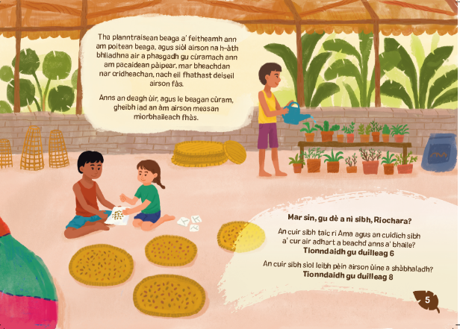

Slide 5
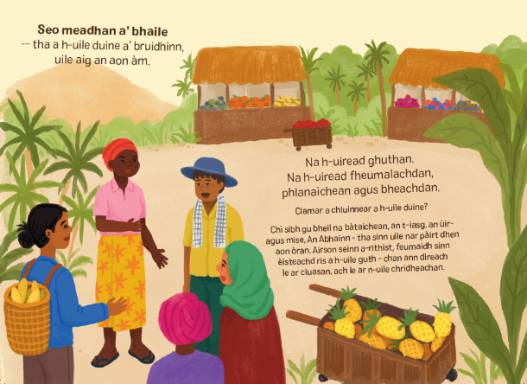
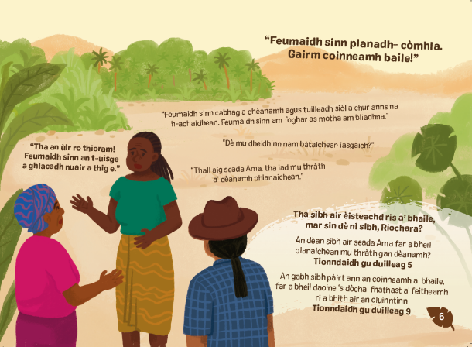

Slide 6
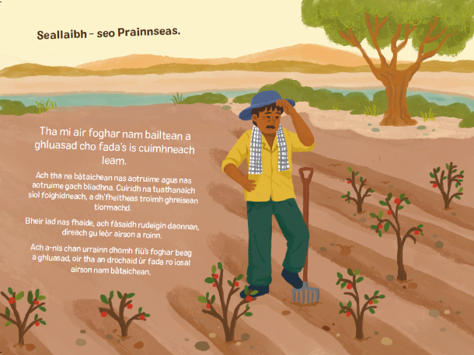
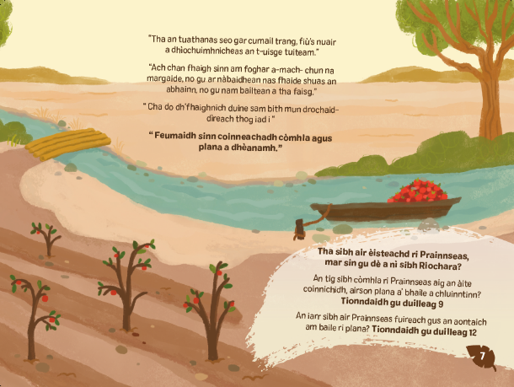

Slide 7
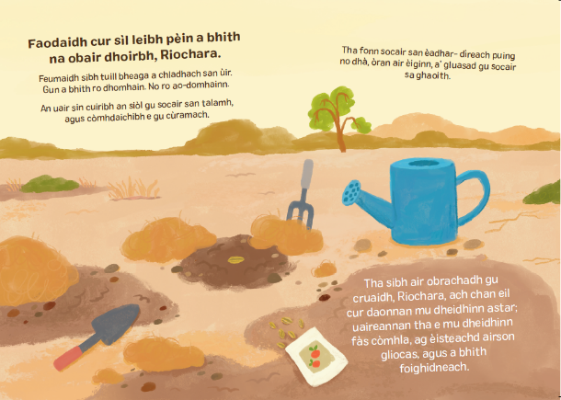
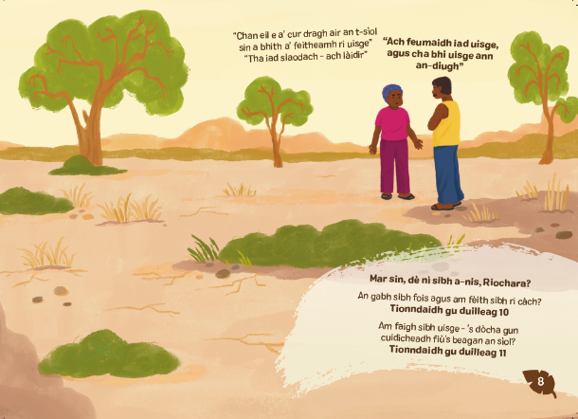

Slide 8
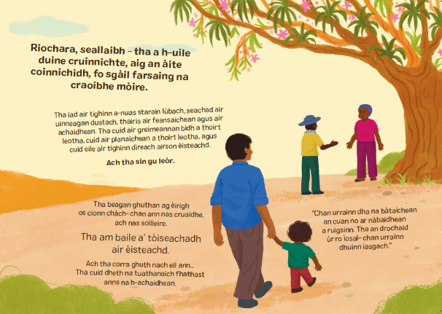
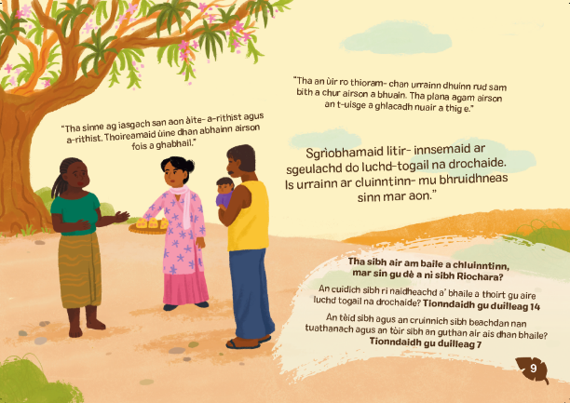

Slide 9
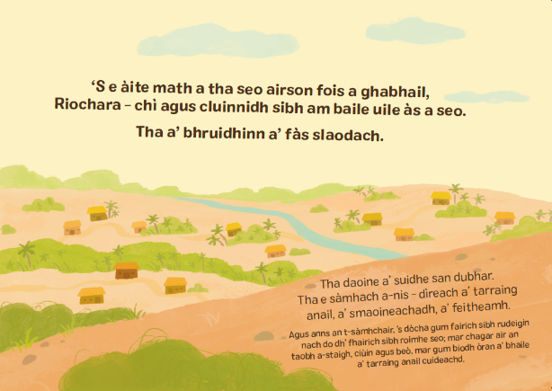
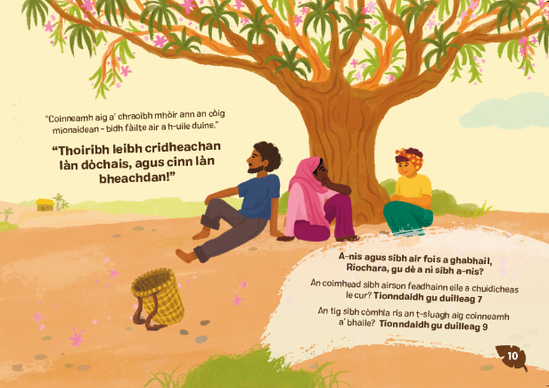

Slide 10
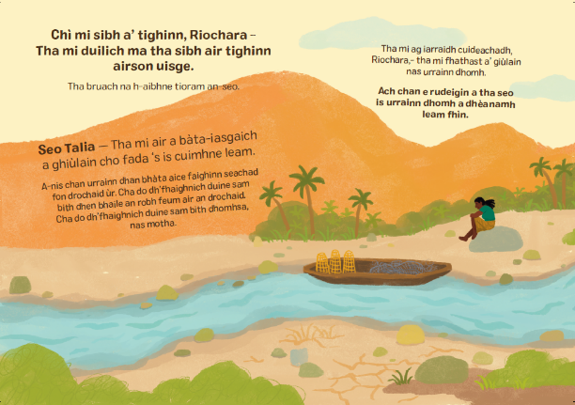
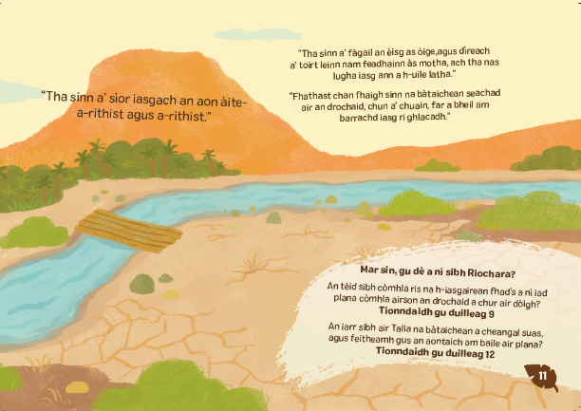

Slide 11
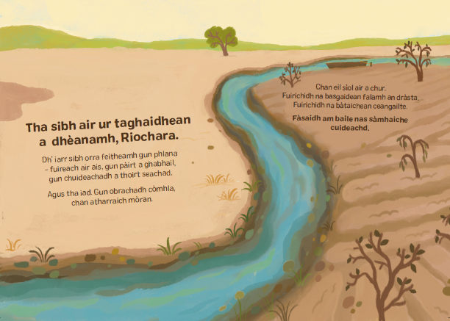
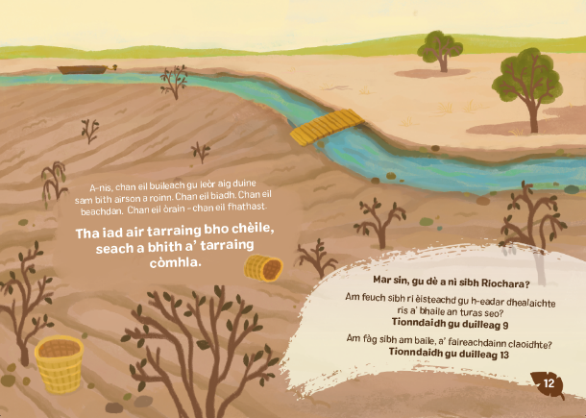

Slide 12
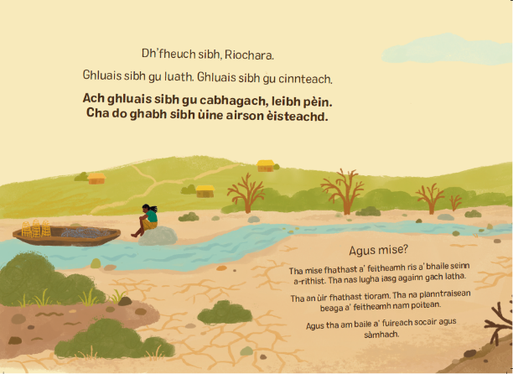
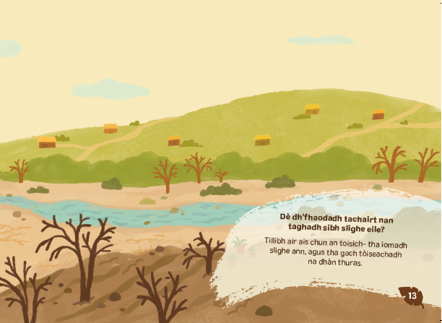

Slide 13
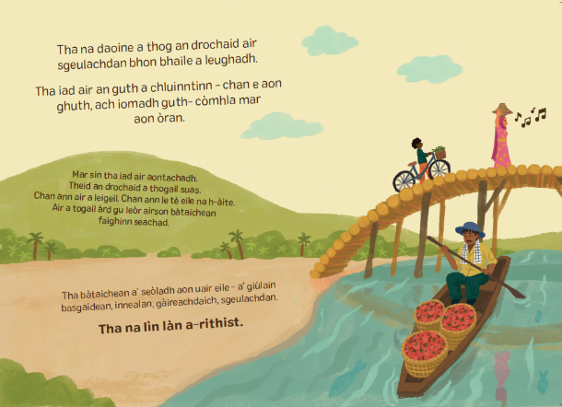
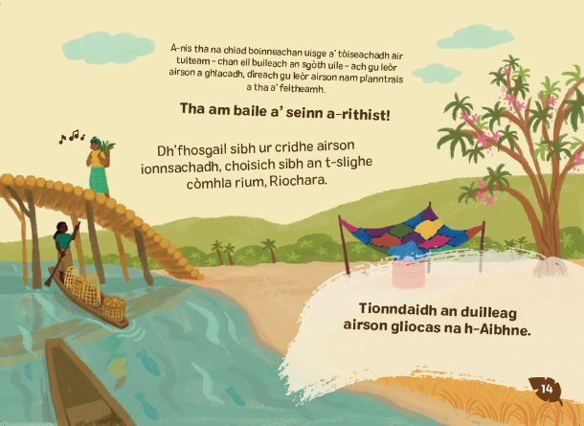

Slide 14
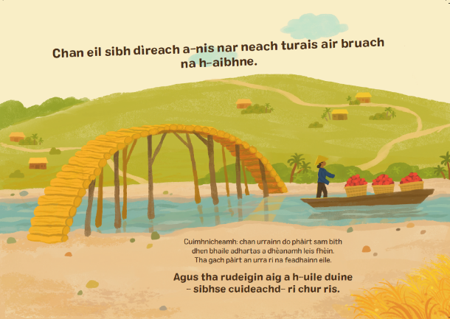
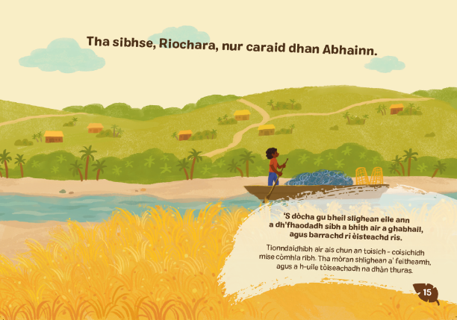

Slide 15



Meet the people…

Slide 16
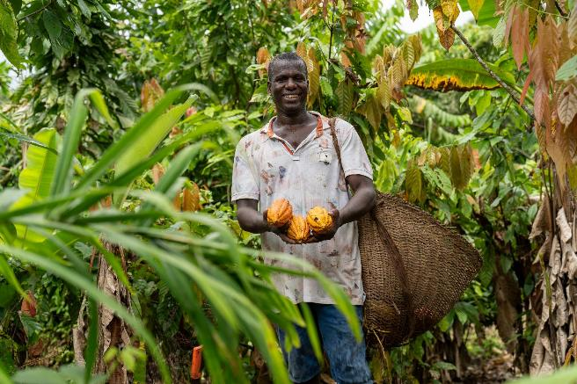
Arcadio, Colombia
Notes:
This is Arcadio (Ahr-CAH-dee-oh). He grows cocoa in a very rural area in Colombia.
He takes his cocoa by boat to sell to communities along the River Atrato (Ah-TRAH-toh).

Slide 17
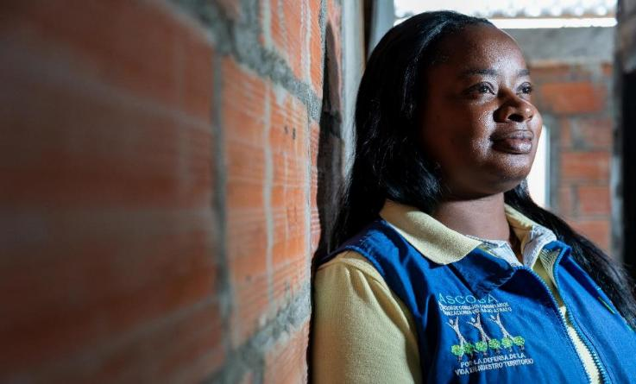
Maria, Colombia
Notes:
This is María, one of the Guardians of the Atrato (Ah-TRAH-toh) River in Colombia.
She is a volunteer who makes sure the river is protected and looked after by everyone who lives there.

Slide 18
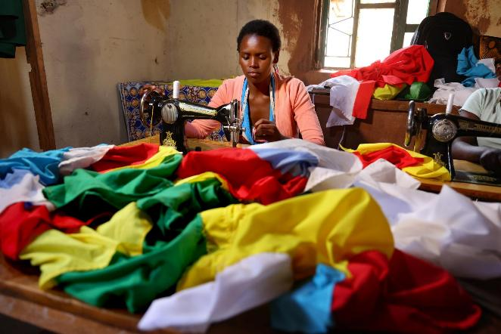
Sonia, Rwanda
Notes:
This Sonia, she lives in Rwanda.
SCIAF partners helped her with training in tailoring and sewing, and now makes clothes to sell.
She is a talented designer and dressmaker.

Slide 19
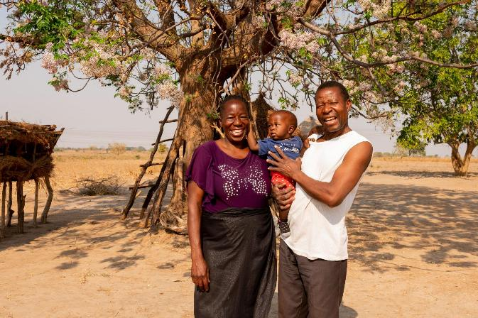
Georgina & Marco, Zambia
Notes:
This is Georgina, her husband Marco and their son Tafara. They live in Zambia..
SCIAF’s partners provided training for Marco to grow maize, nuts and sweet potatoes.
Baby Tafara was the first of their 4 children to be born in a local clinic, which was repaired by SCIAF’s partners, instead of a hospital far away from their home in the city.

Slide 20
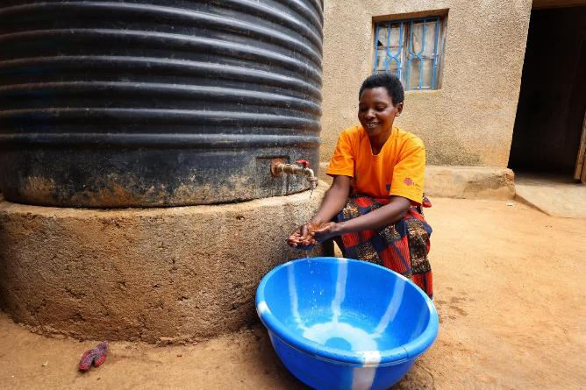
Julien, Rwanda
Notes:
This is Julien, she lives in Rwanda.
She is collecting water from outside her house. This giant tub collects and stores rainwater safely so that it can be used for washing, drinking and watering plants and crops.

Slide 21
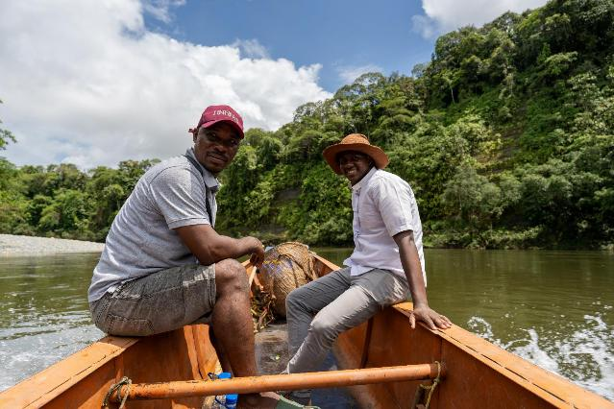
Fr Daniel, Colombia
Notes:
This is Father Daniel (on the right), he is a parish priest in Chocó (Cho-KOH), one of the poorest parts of Colombia.
He travels by boat along the River Atrato (Ah-TRAH-toh) to meet parishioners and to serve the community

Slide 22
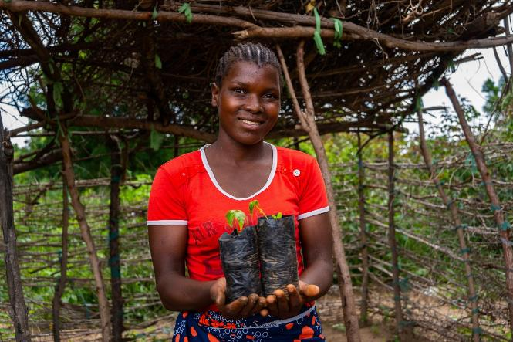
Ester, Malawi
Notes:
This is Ester, she lives in Malawi.
She is holding tree saplings from the tree nursery.

Slide 23
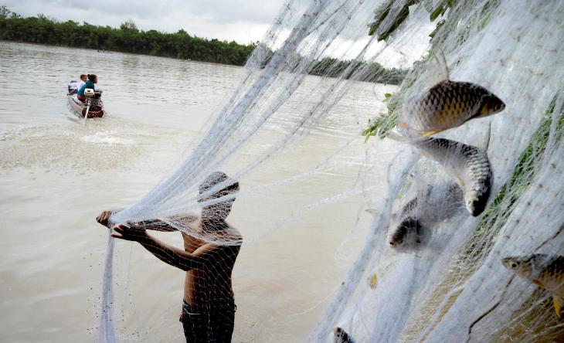
Lang family, Cambodia
Notes:
This is the Lang family. They live in Cambodia.
SCIAF partners have helped them to protect the river from illegal fishing, so there is enough fish for everyone.

Slide 24
A just world, free of poverty, where we flourish and live
in harmony with each other and all creation.
Scottish Catholic International Aid Fund
SCIAF is the official relief and development agency of the Catholic Church in Scotland
and a proud member of the Caritas family. 196 Clyde Street, Glasgow, G1 4JY.
Tel: 0141 354 5555. Scottish Charity No: SC012302. Company No: SC197327.
sciaf@sciaf.org.uk

