Slide 1
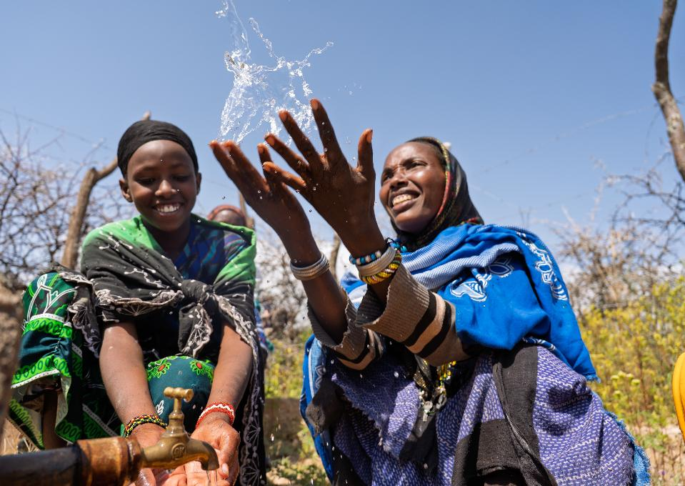



WEE BOX 2026
PARISH PRESENTATION

Slide 2




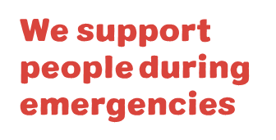
WHAT WE DO
WE WORK ACROSS AFRICA, ASIA, LATIN AMERICA, THE MIDDLE EAST AND EUROPE.
Every year
we help over
1 million
people to have
a brighter future
WE CAN DO THIS BECAUSE OF YOU!
Notes:
Reader notes:
SCIAF is the official agency of the Bishops' Conference in Scotland. For over 60 years we have partnered with Church organisations across the world, not only to help respond in times of disaster but to work with our partners to help communities to thrive sustainably. We are not interested in a quick fix that keeps people poor but we believe in the inherent dignity of the human person and the gifts they have been given by God to help people to help themselves.
Currently providing support in 13 countries (6 in Africa, 5 in Middle East & Europe, 1 in Asia and 1 in South America) for both long-term development and emergency aid. For more info on each country see www.sciaf.org.uk/our-work/countries
SCRIPT:
Evey year, through long-term development work and emergency response we help over 1 million people to recover from disaster and to have a brighter future.

Slide 3
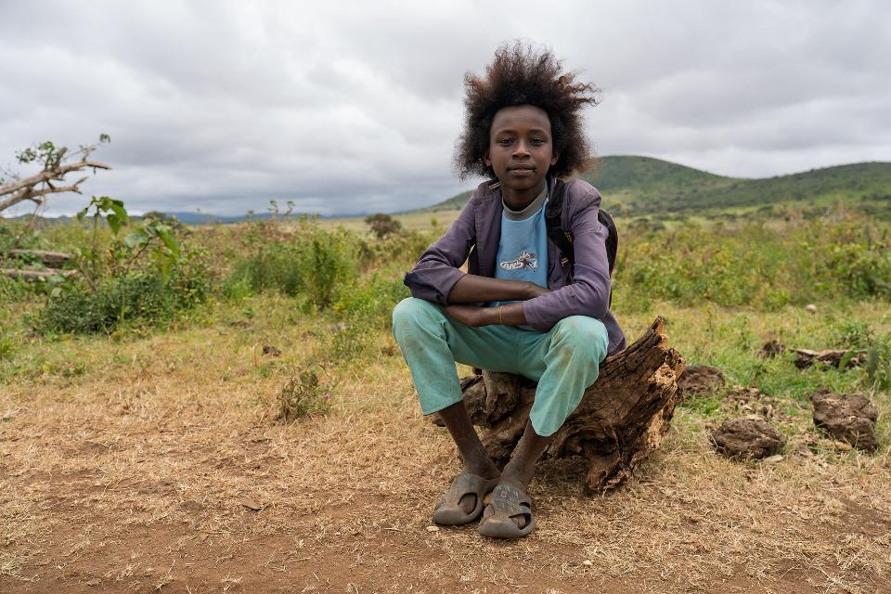

EDUCATION
ADVOCACY
HUNGER
WATER
PEACE & JUSTICE
EMERGENCIES
Notes:
Reader notes:
More information on our work here: www.sciaf.org.uk/our-work
SCRIPT:
SCIAF work here in Scotland educating people in schools and parishes about global issues.
We tackles the root causes of these issues through advocacy and campaigning for a more just world.
Our work around the world focuses on helping people
•grow enough food to eat,
•providing safe clean water to communities
•helping people to live in safe and peaceful communities
•responding to global emergencies like floods and droughts.
•Plus, support for refugees and displaced people during conflict.

Slide 4


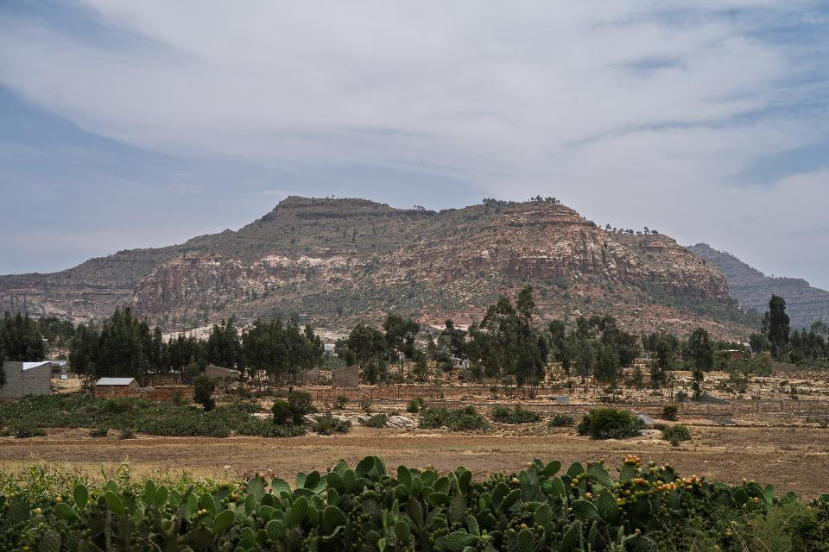
ETHIOPIA
Notes:
[Script]: This years focus country is Ethiopia
Ethiopia is a beautiful, vibrant country with stunning highlands as well as desserts and lowlands. Known as the birthplace of coffee it boasts some of world's best quality coffee. Most of the population are employed in agriculture.
In Ethiopia today, millions of people are facing a return to devastating poverty. Despite decades of progress, recent war has torn families apart, extreme weather has devastated the landscapes and livelihoods, and now international aid cuts risk decimating vital services.

Slide 5
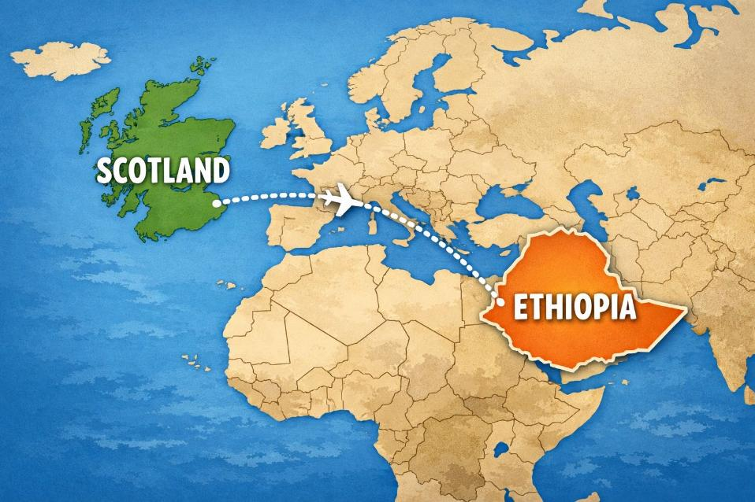
ETHIOPIA
Notes:
Country Facts:
Ethiopia is almost 6,000km/3700 miles from Scotland
It is an 8 hour flight from London
Ethiopia is 14 x bigger than Scotland
Their population is 24 times larger than Scotland's population (130 million)
The capital city of Ethiopia, Addis Abada has as many people as all of the people in Scotland!!

Slide 6
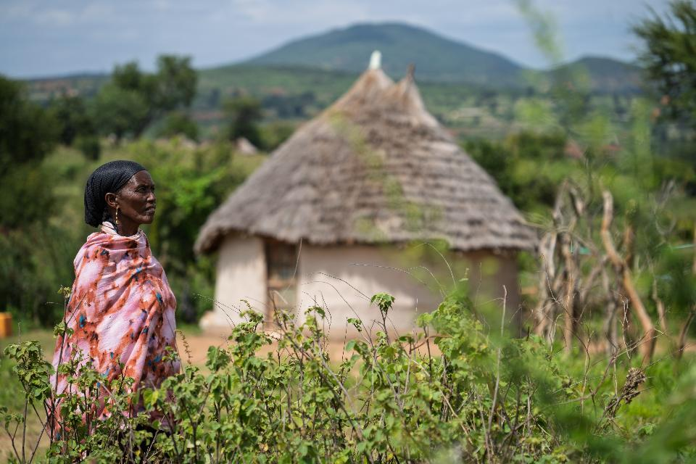
ETHIOPIA
Notes:
[Script]: Many people in Ethiopia live in rural, remote areas.
They keep animals such as chickens, goats, and sometimes cows and they also grow crops to feed their families. One of the biggest problems for farmers is the unpredictable weather. There can be many months with little or no rain, then downpours can cause severe flooding.

Slide 7
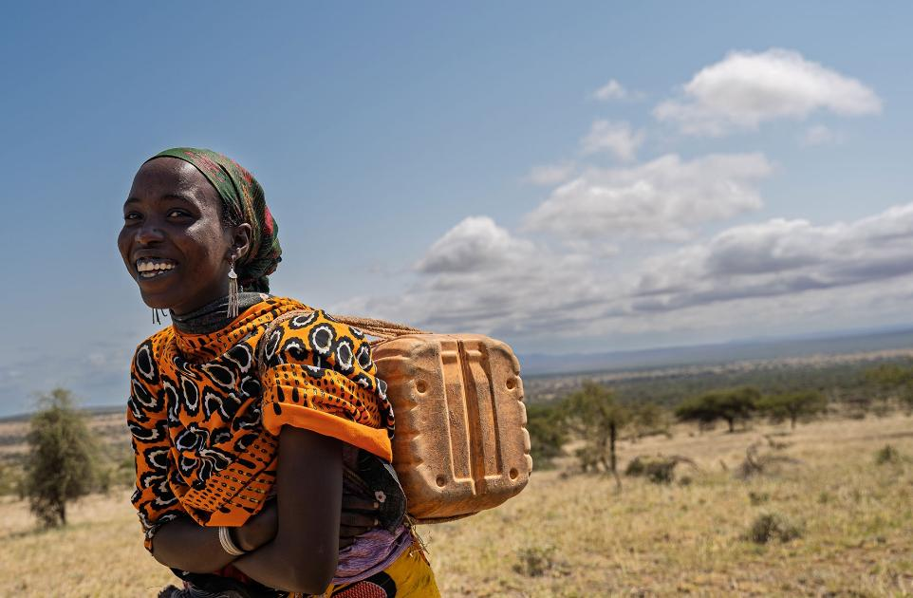
ETHIOPIA
WATER IS LIFE
YET, FOR MANY,
CLEAN WATER
IS HARD TO REACH
Notes:
[Script]: In Scotland, we are incredibly blessed to be able to turn on the tap and have fresh drinking water every day. However, in some countries, like Ethiopia, some people have to walk for up to 4 hours to reach clean water. In Ethiopia usually woman and children walk for water while the men try to make money for the family. The long walk can be very dangerous for women and children and for many, because the walk is so long it means that they cannot go to school.
Clean water isn't only important for drinking, it's also important to stay clean and healthy too.
Most of us will remember how often during covid times we were told to Wash our hands, to reduce the risk of spreading disease. For countries like Ethiopia, sickness and infection spread so quickly because drinking water takes priority over using it to wash. At a sometimes 8 hour trip, it can be seen as a luxury.
43% of the population does not have access to an improved water source and 28% practice open defecation. (WHO)
The majority of health facilities in Ethiopia lack access to clean water and only about 32% have access to safe water. (WHO)
17% of childhood deaths are associated with diarrhea (EDHS 2011) which remains the third leading cause of under-five mortality attributed to poor water, sanitation and hygiene.

Slide 8
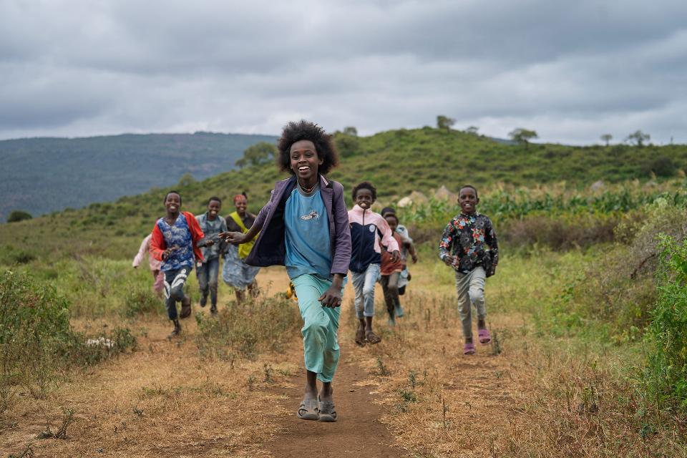
LET JUSTICE FLOW.
SHARE WATER. SHARE HOPE.
Notes:
[Script]:SCIAF’s local partners in Ethiopia, and around the world, are bringing water to the women, girls, and communities who need it most. Together, we dig wells near homes, repair pumps, and ensure that water keeps flowing, whatever the weather.
Your generosity gives people access to the most essential human need: access to clean, safe water. This simple gift helps people endure even the toughest times.

Slide 9
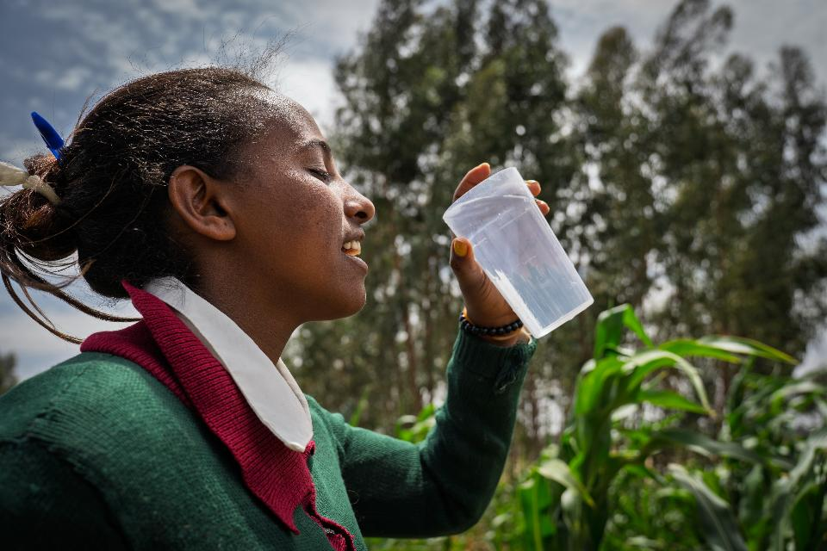
Hirit's story:
Notes:
Hirit lives in a rural village in Ethiopia, she is 24 years old.
Hirit said:
“A good day is a day when I’m not anxious. A day without any problems is what I call a good day. If you're out of trouble, free from stress, and everything is peaceful, then that’s a good day.

Slide 10
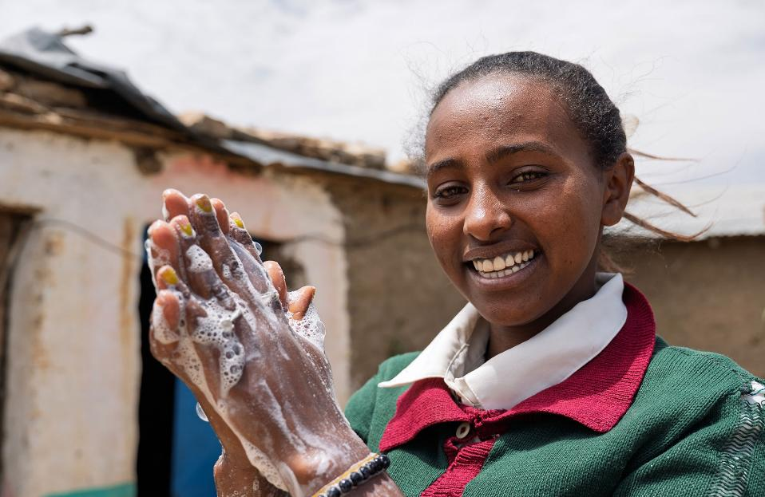
Hirit's story
Notes:
SCRIPT:
When a couple of members of staff from SCIAF visited Ethiopia they had the opportunity to speak to speak to Hirit and learn more about her story and the daily struggles she endured without regular access to clean safe water.
Hirit told us, that Life before this was very difficult. They used to walk five hours just to get water. The place they fetched water from was unsafe – the cows and other animals drank from it. Even dead animals were sometimes found in the water but with this being their only option for many miles, they were forced to drink the water.

Slide 11
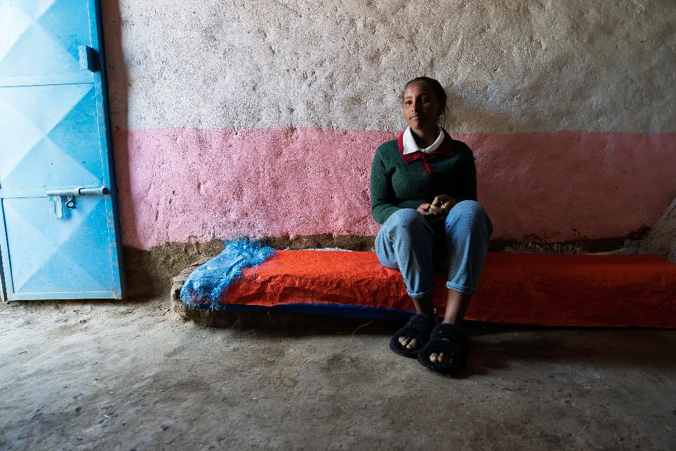
Hirit's story:
Notes:
Hirit told us that often woman and girls would try to avoid going to fetch water as it was so dangerous. People were often attacked or threatened. Additionally knowing the water was unclean and causing diseases was always on their mind- but they didn’t have another option.
Hirit said
“We had no other choice. We had to drink it. Sometimes it felt like drinking that water was worse than dying.

Slide 12
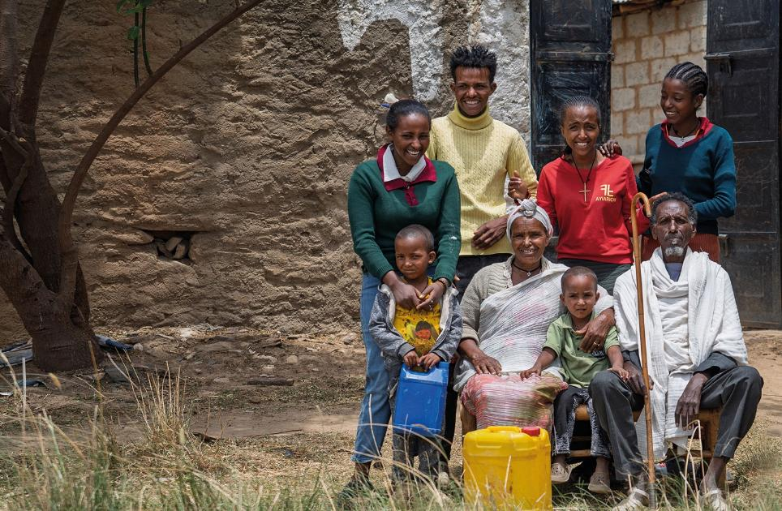
Hirit's story:
“BEFORE,
WE USED TO TRAVEL LONG DISTANCES FOR WATER. NOW IT’S
NEARBY"
Notes:
“The water point has solved many of the problems for us women. It has especially helped young girls like me.
“Before, we used to go to school with dirty clothes, dirty bags, and unwashed hair. But now, we can stay clean. Overall, it’s much better for girls now.

Slide 13
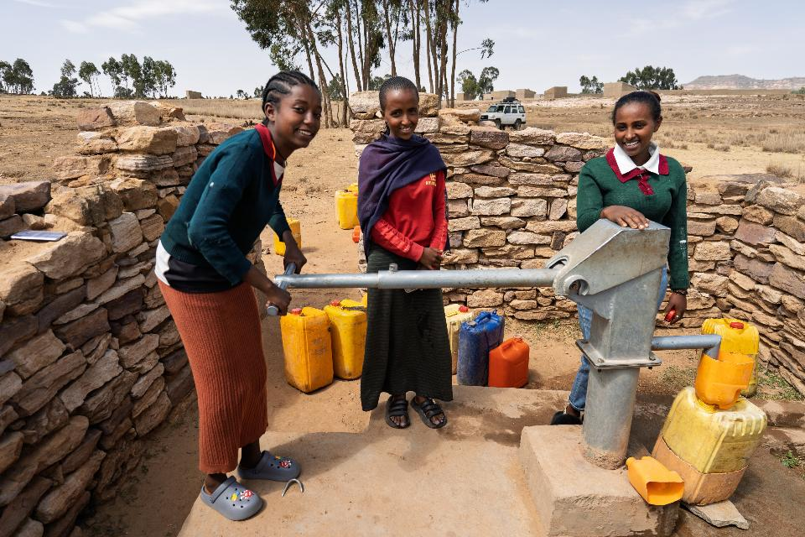
Hirit's story:
Notes:
Hirit said:
“I hope to continue doing well in school and reach the highest level so I can serve my family and my community. I want to pursue a career in business. But I really want to finish my education."

Slide 14
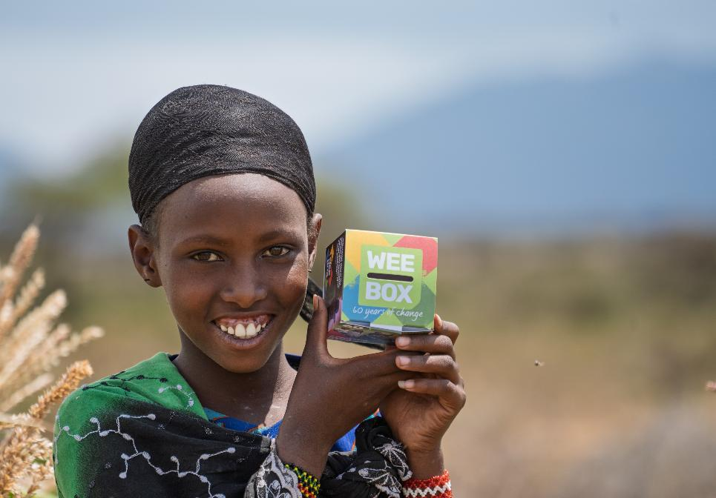
WEE BOX 2026
THIS LENT,
USE YOUR
WEE BOX
TO MAKE A
BIG CHANGE
Notes:
You can use your WEE BOX to make a BIG CHANGE this Lent, for people in Ethiopia and all around the world!
Every year the people of Scotland come together and use their WEE BOX to be part of something bigger. Sometimes it can feel like what we donate alone can't do much so that's why it's important that we do our bit to contribute to the bigger picture! We cant help over a million people year without the help of our SCIAF family here in Scotland.

Slide 15

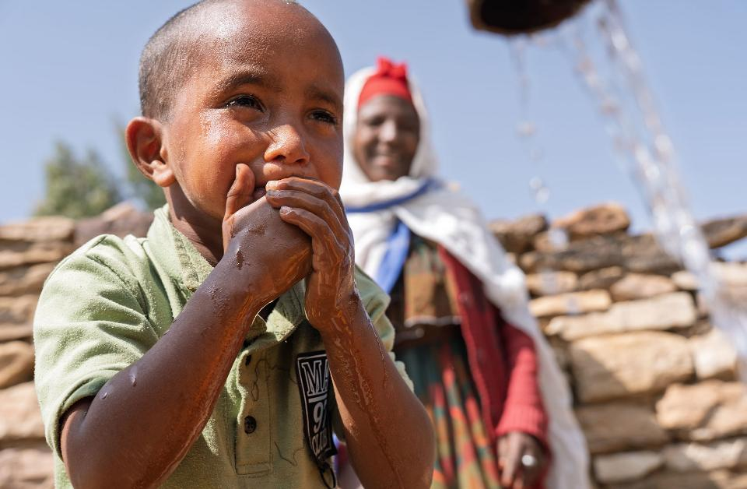
ETHIOPIA
£40 gives people access to clean water for drinking, sanitation and improved hygiene
£240 can install a rainwater harvester at home, helping families collect safe, clean water
£1,200 brings water to a village through taps, wells, irrigation systems and rainwater harvesters.
Notes:
It sometimes helps to know what your kind donations are doing so here's an idea of what money can provide. Please note that £1,200 is not simply one water point. It's often equipping a village with multiple water points and irrigation systems to crops. It's installing rainwater harvesters and storage tanks.

Slide 16
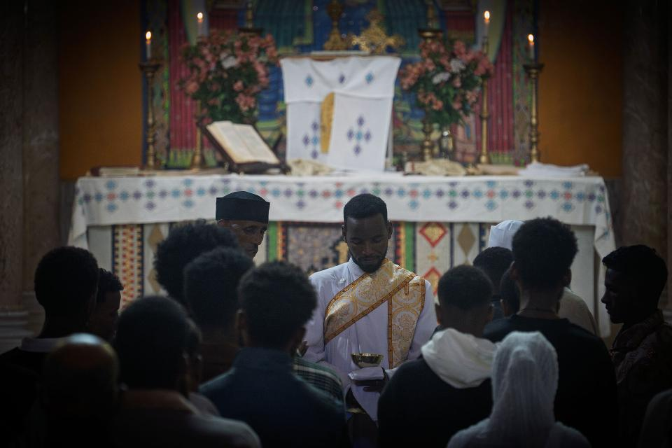
ETHIOPIA
“BUT LET JUSTICE ROLL ON LIKE A RIVER, RIGHTEOUSNESS LIKE A NEVER-FAILING STREAM!” Amos 5:24
Notes:
Scripture often uses water in simile's and metaphors. Jesus tells the Samaritan woman that the water He gives "will become in them a spring of water welling up to eternal life," meaning a continuous, internal source of spiritual sustenance, not just physical relief. Scripture is full of references to water.

Slide 17
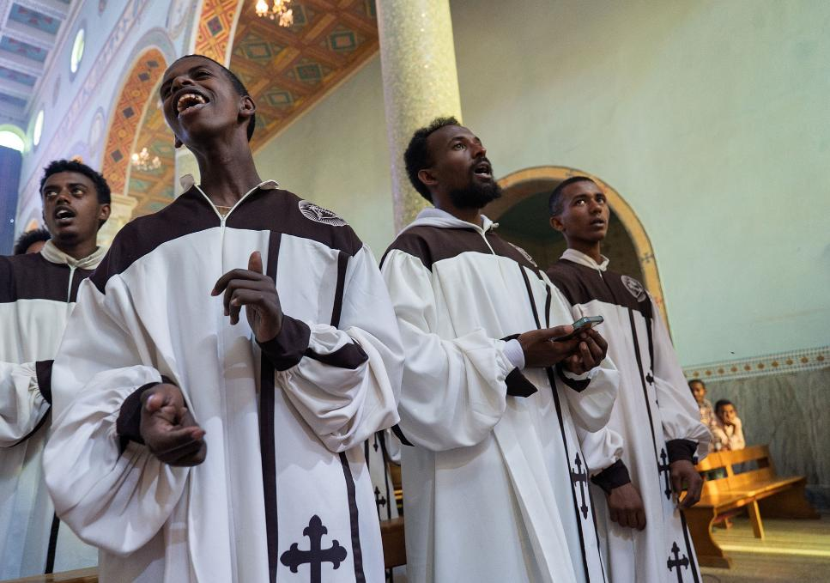

ETHIOPIA
“Without water it is not possible to live.” Pope Leo XIV
Notes:
Pope Leo states an obvious point here but it simply shows how precious water is and how everyone needs it!

Slide 18


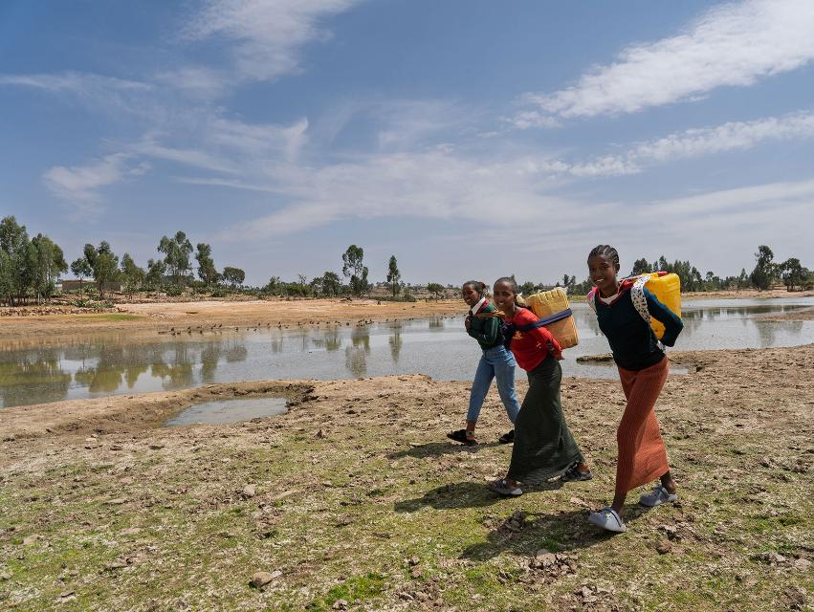
This Lent, Walk for Water in return for donations to our WEE BOX Appeal. Commit to a distance, contact your friends and family for sponsorship, then get going!
Walk in solidarity today
sciaf.org.uk/biglentwalk
Notes:
The Big Lent Walk is a really easy way to walk in solidarity with your sisters and brothers who are often walking hours and hours for water each day. Get yourself sponsored, join as a parish and walk together, it's up to you.

Slide 19

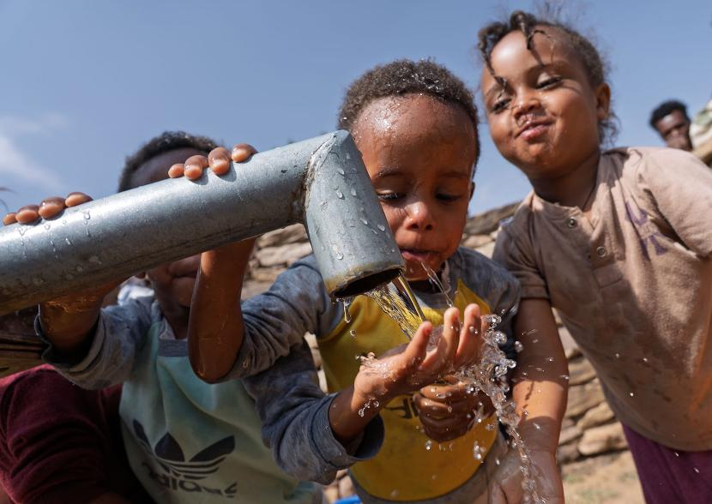
ETHIOPIA
Don’t cut aid.
Save lives!
Tell the Prime Minister to stop cutting aid and return to 0.7% immediately.
Helping the world’s poorest people access water and sanitation – and other forms of vital aid – is a matter of life and death.
Take action now.
sciaf.org.uk/aidcuts
Notes:
When Sir Keir Starmer won the UK General Election, he promised to return the aid budget to 0.7%. It could have been a lifeline for the world’s poorest people – while making the world a safer place for all.
But the Prime Minister didn’t keep his promise.
Instead, aid spending is now set to be slashed again. And it’s the world’s poorest people that will lose out: those in need of water, sanitation and hygiene in places like Ethiopia; those struggling to rebuild after war or natural disasters around the world.
The UK Government should not balance the books on the backs of the poorest. Restoring the 0.7% aid commitment is an act of solidarity from one of the richest nations in history – and an investment in a fairer, better world for all.
Don’t cut aid. Save lives!

Slide 20
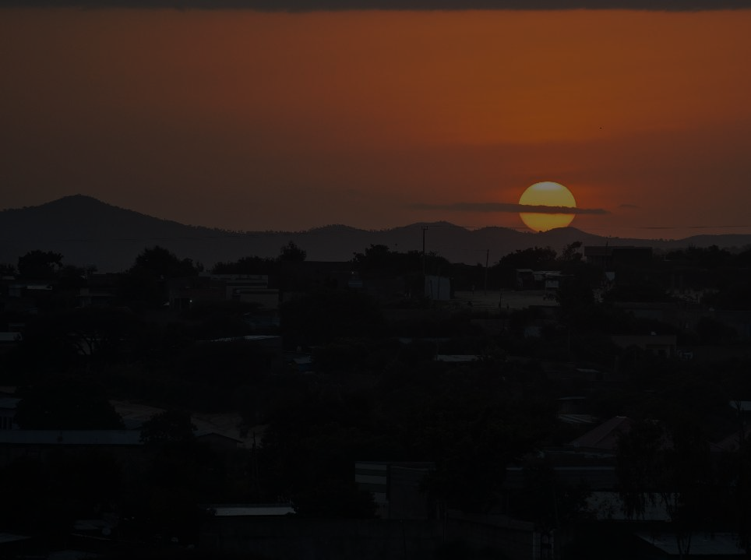
ETHIOPIA
WEE BOX Prayer
for 2026
God of Life-Giving water, we give You our praise.
We lift to You all those that seek water but do not find.
Quench their thirst and provide all that they need.
May we, the SCIAF family, continue to be a voice for those unheard;
a pillar of hope for our sisters and brothers.
We ask that You help us to play our part in building a world
where justice flows like a mighty river.
Amen

Slide 21
A JUST WORLD, FREE OF POVERTY, WHERE WE FLOURISH AND LIVE
IN HARMONY WITH EACH OTHER AND ALL CREATION.
Scottish Catholic International Aid Fund
SCIAF is the official relief and development agency of the Catholic Church in Scotland
and a proud member of the Caritas family. 196 Clyde Street, Glasgow G1 4JY.
Tel: 0141 354 5555. Scottish Charity No: SC012302. Company No: SC197327.
sciaf@sciaf.org.uk

