Slide 1
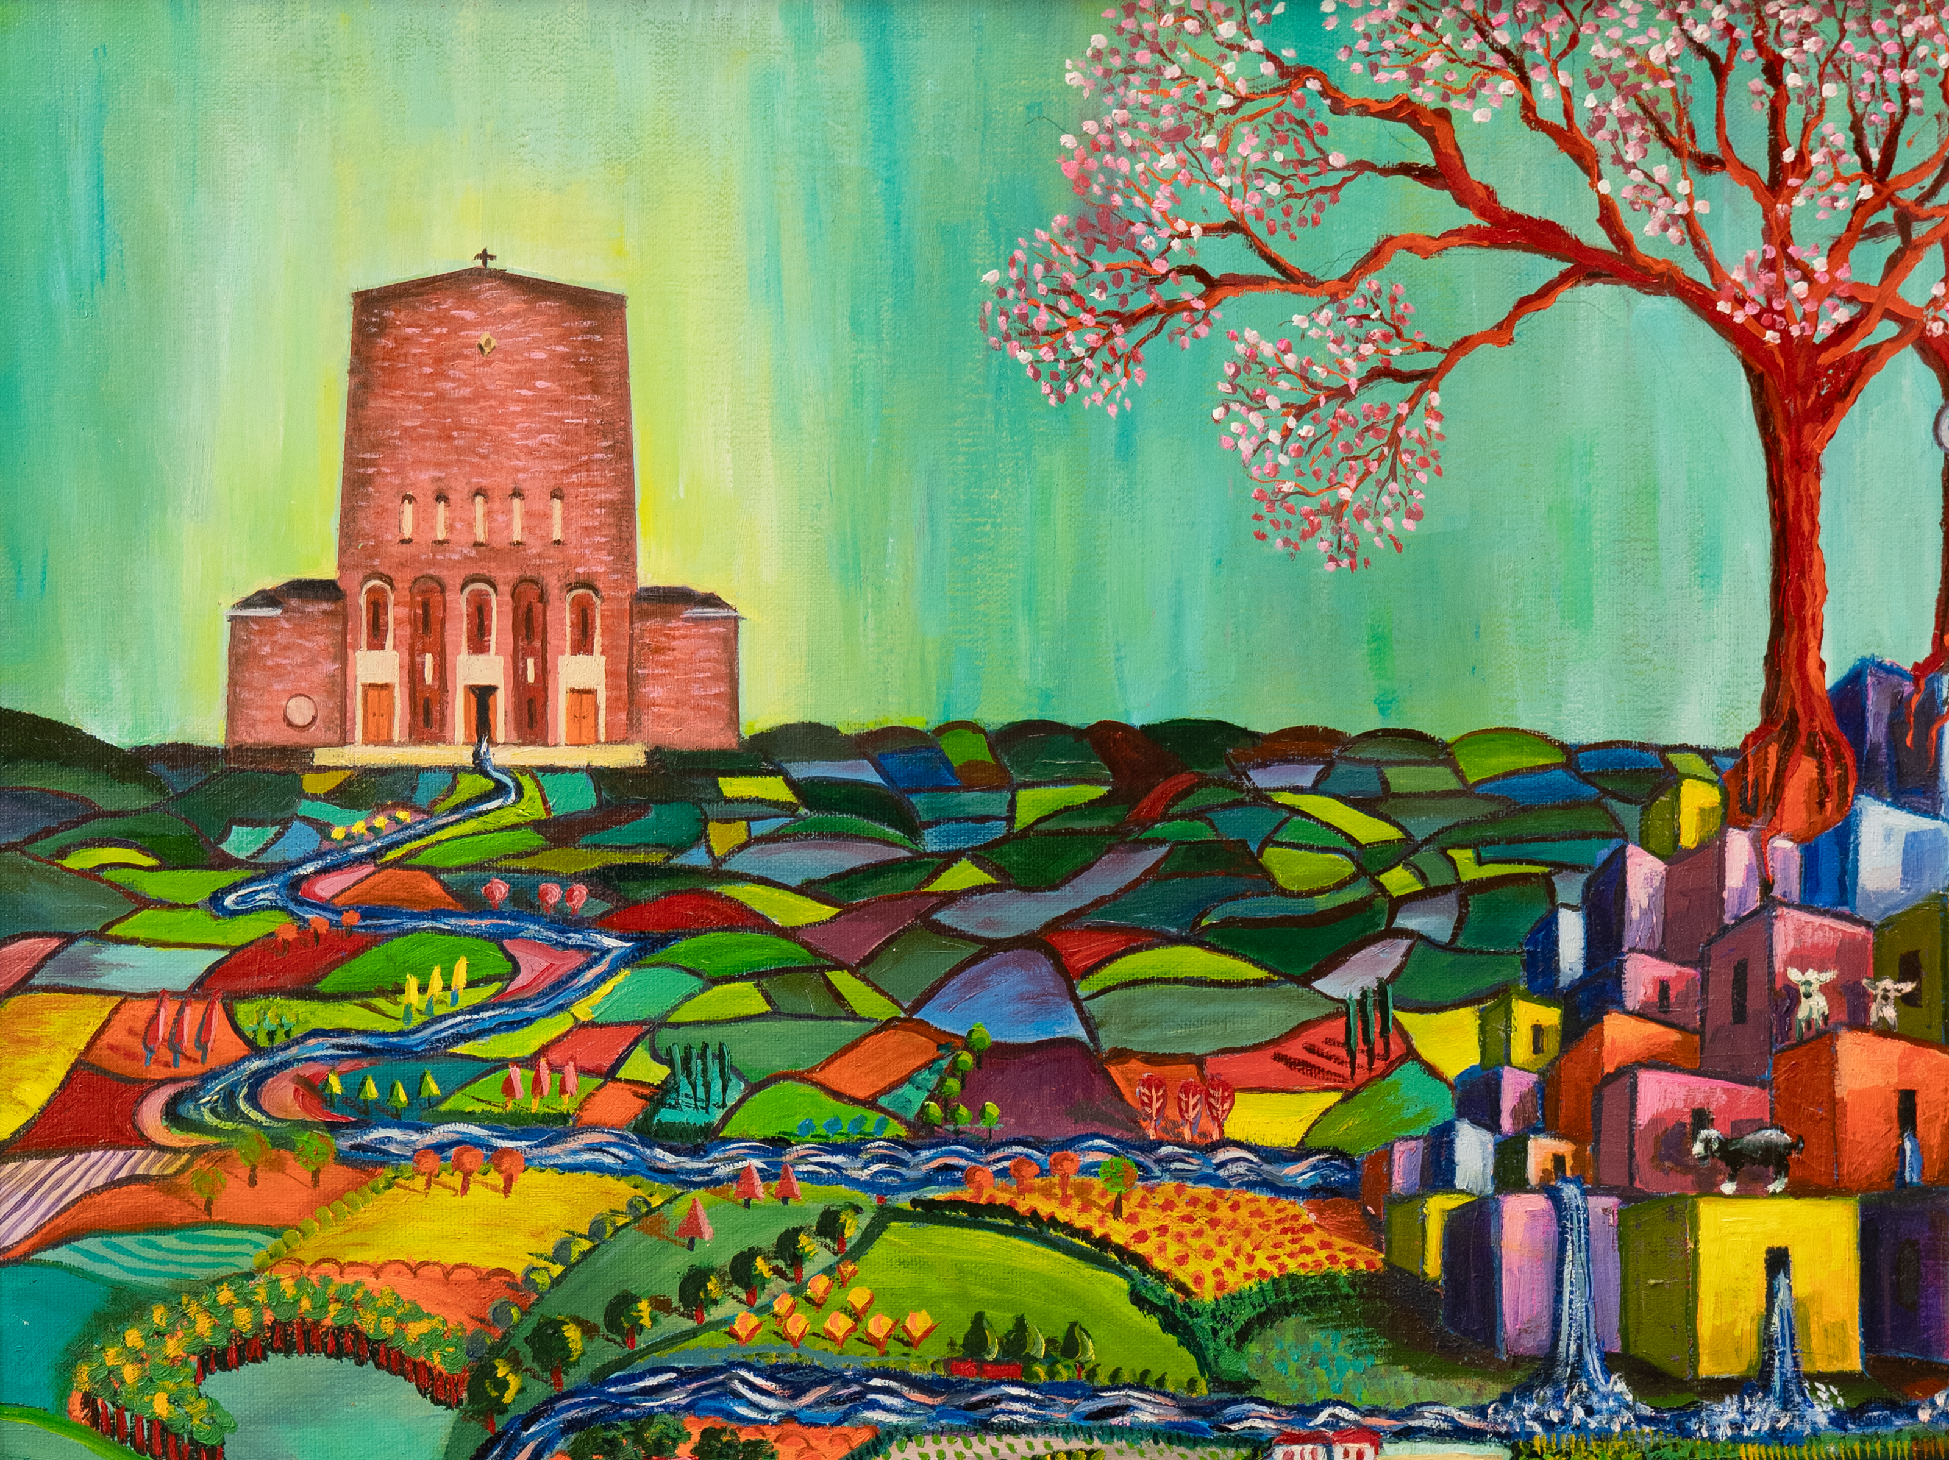

Journey St Columbkille

Slide 2
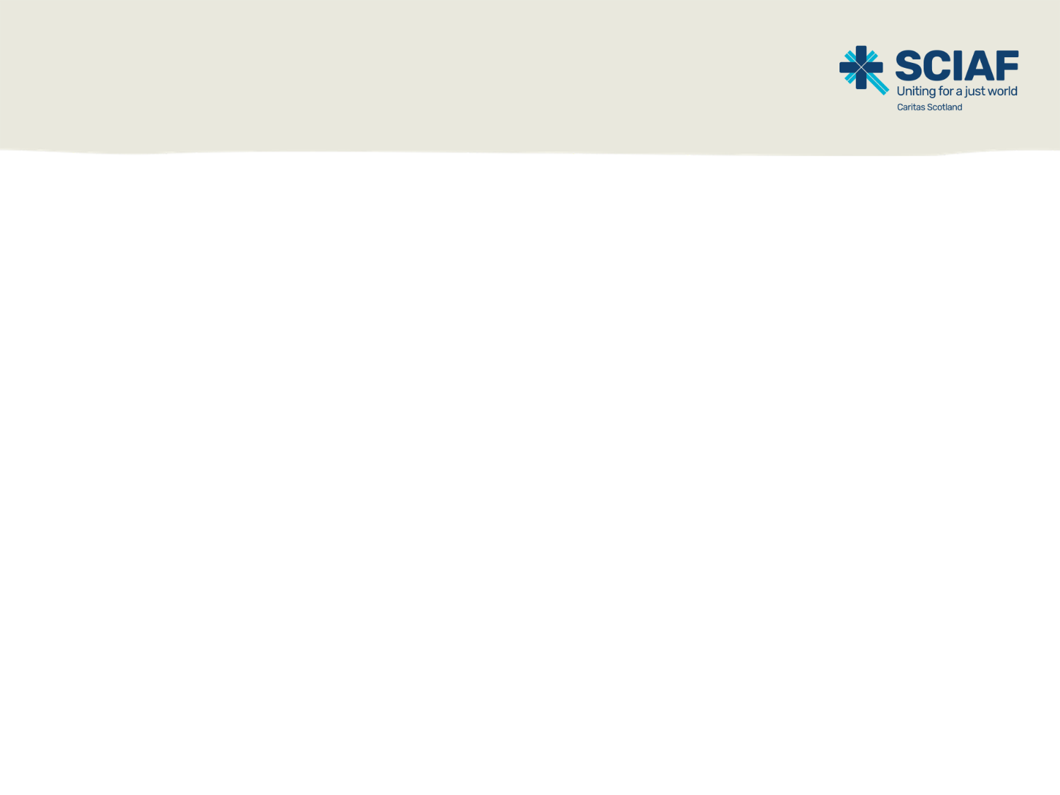
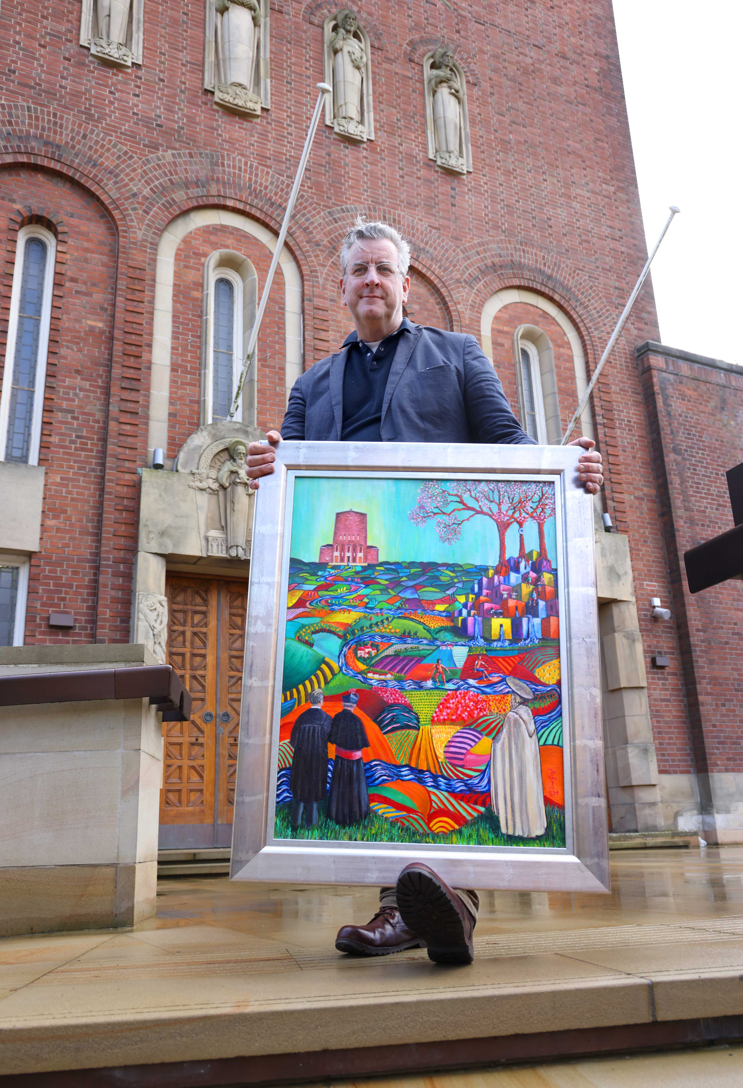
Activity 2
The history of
St Columbkille
Success Criteria
I can:
explain key facts about St Columbkille and name his feast day
describe what an illuminated letter is and why monks decorated them.
Artist Mark Armstrong outside
St Columbkille’s, Rutherglen

Slide 3
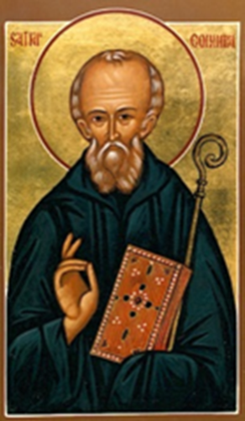

St Columbkille
Also known as St Columba
Lived in the 6th Century
Born in Ireland, he travelled to
Scotland in 563 AD
This was over 1,460 years ago.
Notes:
St. Columba was born on the 7th of December 521, in Ireland.
In 563 AD, St. Columba left Ireland and travelled to Scotland.

Slide 4
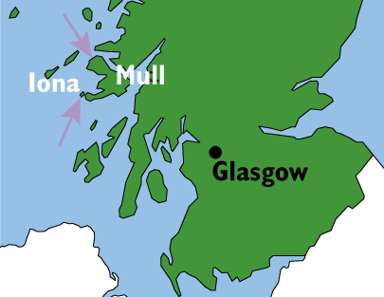
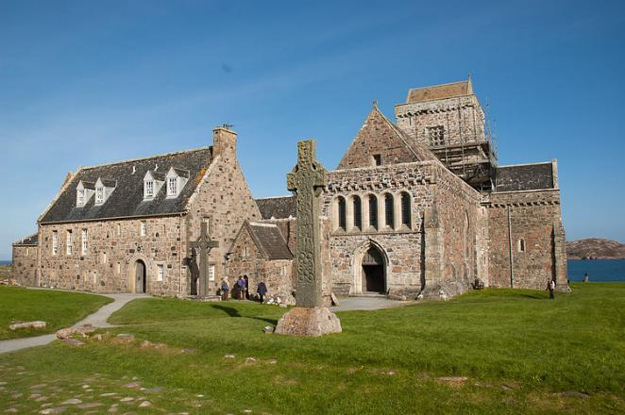
St Columbkille
Settled on the
island of Iona.
Founded a
monastery
there.
Notes:
A monastery is the building, or several buildings close together, where monks or nuns live together in a community.

Slide 5

St Columbkille
In the monastery the monks, including St Columbkille, carried out many jobs:
serving God through prayer and worship
sharing their faith with others
teaching children to read and write
building new spaces in the monastery
farming work to produce their own food
copying out books, especially Bibles by hand.

Slide 6
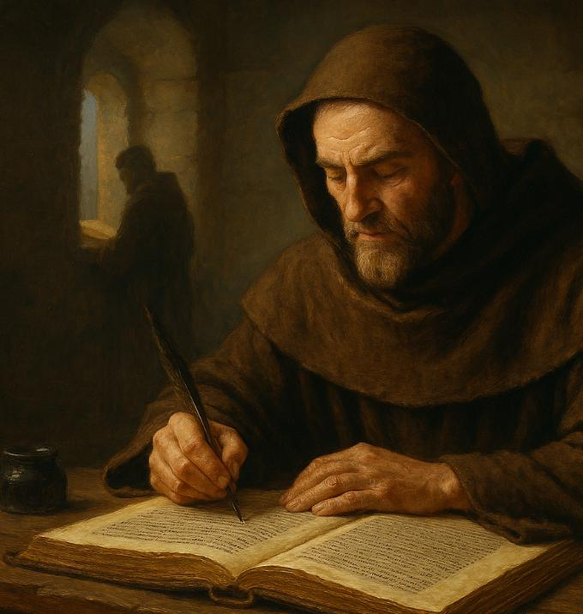
St Columbkille
At this time, all books were hand-written so copies needed to be made by hand.
St. Columba is thought to have copied out as many as 300 books!
Notes:
Because the monks were copying out The Bible and other religious books they wanted to do their best work for God

Slide 7
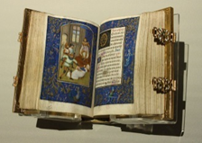
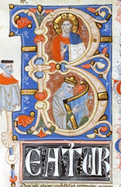
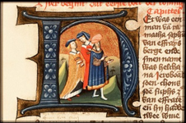
St Columbkille
Monks would illuminate (decorate) the pages with pictures.
They would use coloured inks and even silver or gold leaf to show how special the books were.

Slide 8

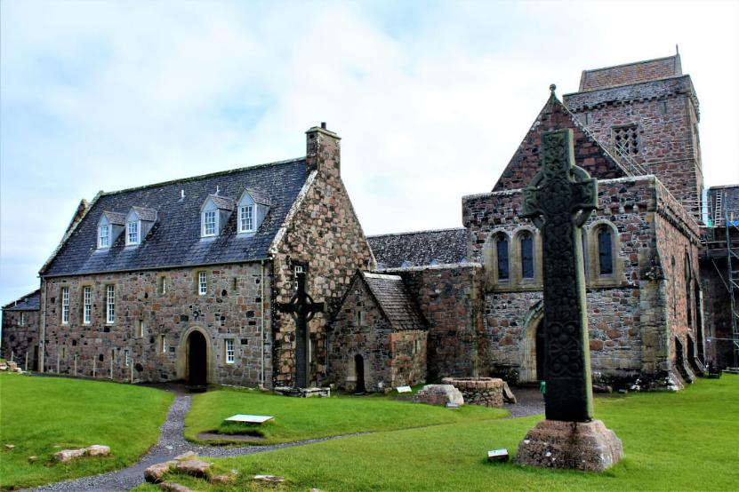
St Columbkille
St. Columba died on the 9th of June 597AD (aged 75) on Iona and was buried in the abbey that he had created.

Slide 9
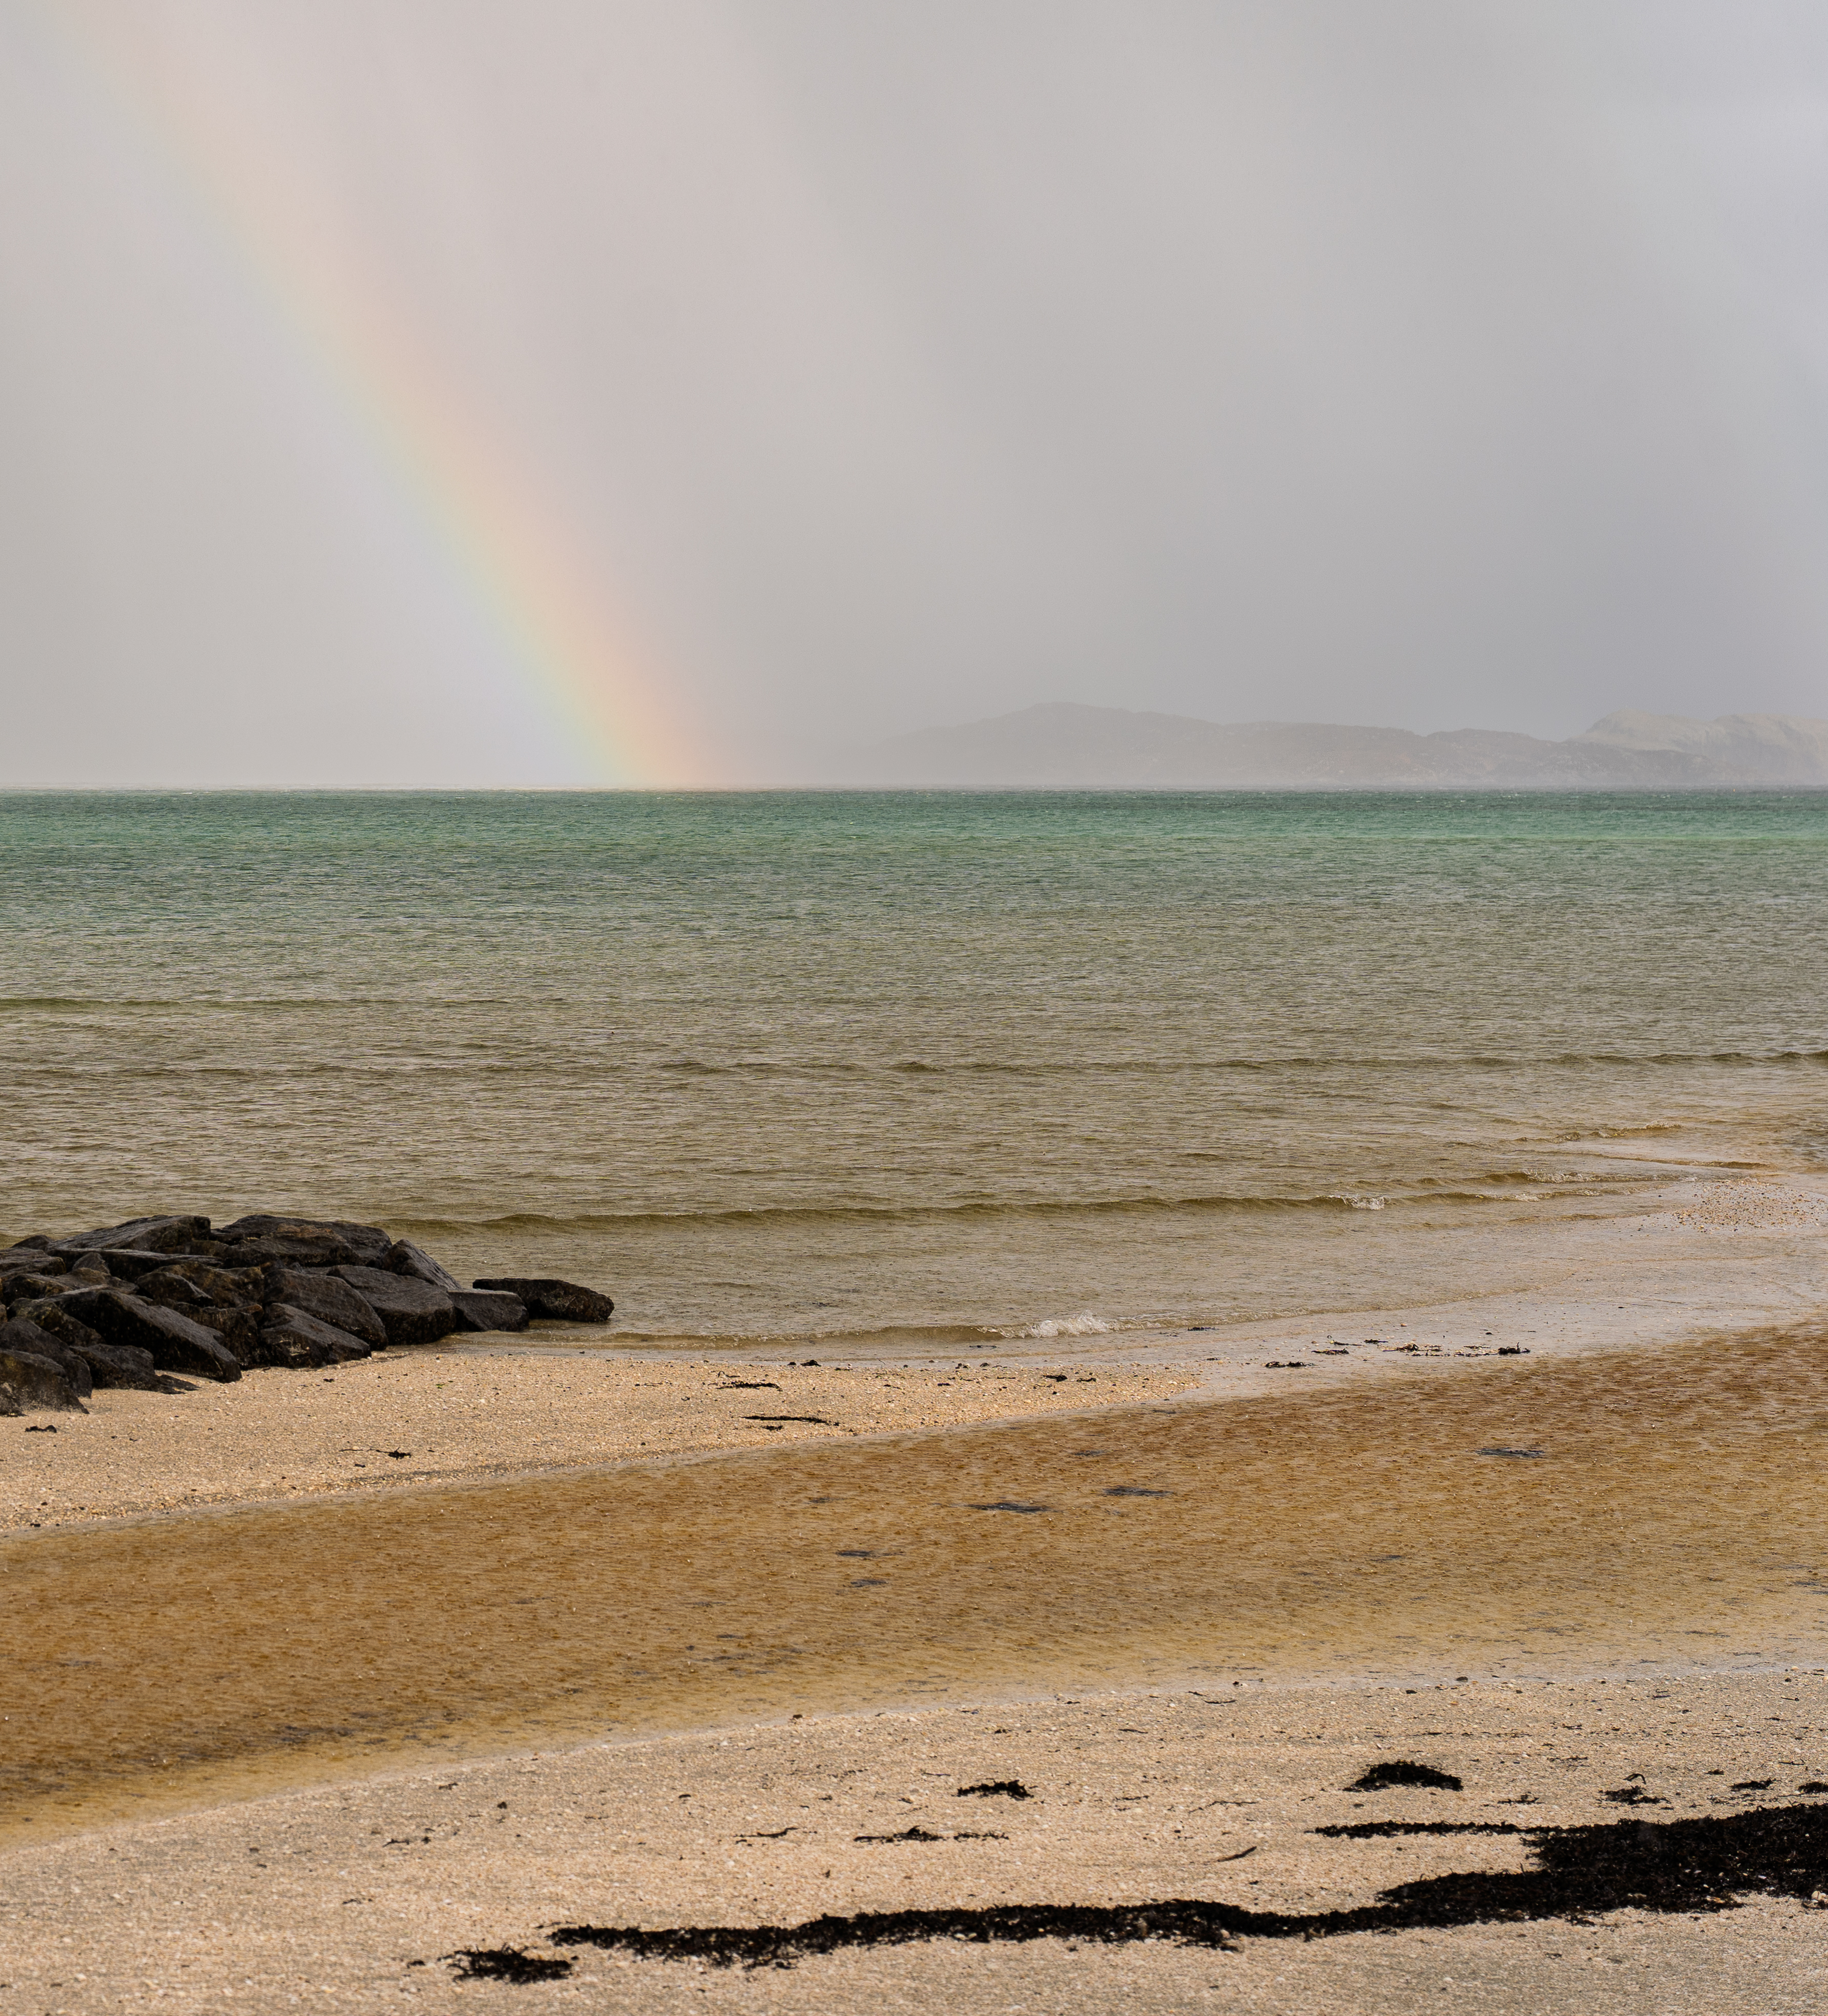
Activity 3
Gifts of the
Holy Spirit
Success Criteria
I can:
Identify the Gifts of the Holy Spirit shown in St Columba’s life
reflect on how his example can inspire us to live faithfully today.

Slide 10
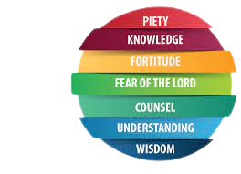
Gifts of the Holy Spirit
A Reading from the Prophet Isaiah
And the Spirit of the Lord shall rest upon Him,
the Spirit of wisdom, and of insight,
the Spirit of counsel, and of fortitude,
the Spirit of knowledge, and of piety.
And he shall be filled with the Spirit of the fear of the Lord.
Notes:
Teacher or pupil can read the Scripture quote.
It may be useful to remind pupils that when we listen to Scripture passages we are listening to the inspired Word of God (RERC 2-12a) and that we “read aloud from Sacred Scripture in such a way that I am proclaiming the Word of God” (core learning P6. 2-12a).

Slide 11

Gifts of the Holy Spirit
Some of the Gifts of the Holy Spirit are often referred to with different names:
Insight Understanding
Piety Reverence
Fear of the Lord Wonder and Awe
Fortitude Courage
Notes:
Explain to pupils that it is ok if they are not sure the full meaning of some of the Gifts. The important message from this Scripture passage is that it is the same Spirit of God that Isaiah speaks of in the Old Testament that was with the Apostles at Pentecost and is still with us today.
The thing we have to think about is, when the Holy Spirit rests upon us what is he asking us to do and how does that make us feel?

Slide 12
Gifts of the Holy Spirit
Which Gift can we see in this moment in St Columbkille's life?
FORTITUDE
The Holy Spirit gave him strength to follow God’s call even when it was difficult.

Slide 13
Gifts of the Holy Spirit
Which Gift can we see in this moment in St Columbkille's life?
St Columbkille spent many hours copying the Bible by hand to honour God’s Word.
UNDERSTANDING/
INSIGHT
He wanted people to know and understand God’s message.

Slide 14
Gifts of the Holy Spirit
Which Gift can we see in this moment in St Columbkille's life?
REVERANCE/PIETY
He showed deep love for God and helped others grow in faith.

Slide 15
Gifts of the Holy Spirit
THINK
PAIR
SHARE
How can the example of
St Columbkille help us live our faith today?
Notes:
How do people meeting me know that what I say has been inspired by the Holy Spirit?
How do my actions show God in the world to other people?
Do other people know God because of me?
Do they hear of God from what I have learned?
Do they believe in him from how I share my knowledge?
How do I show others the beauty of God in the world?
What could I do more of to share my knowledge?
How do I show my knowledge in school, at home and in the parish?

Slide 16

A just world, free of poverty, where we flourish and live
in harmony with each other and all creation.
Scottish Catholic International Aid Fund
SCIAF is the official relief and development agency of the Catholic Church in Scotland
and a proud member of the Caritas family. 196 Clyde Street, Glasgow, G1 4JY.
Tel: 0141 354 5555. Scottish Charity No: SC012302. Company No: SC197327.
sciaf@sciaf.org.uk

